Slide 1
How did I get my final prediction
My second attempt to predict the raw_visit_counts is through time series moving average model. For each place id, I calculated the average between 3 weeks and attempted to use that average to predict the future raw_visit_counts. For this method, the MAPE was 15.25 and MSPE was 1311.97.
For my next model, I turned each location categories, each individual place id, and each postal code as header for matrix with Covid19 cases shifted down for one week to account for public reaction time. I also used forward filling for the missing weeks. I attempted to split this 51731x1910 matrix randomly into 30% testing data, 70% training data and run it with ridge, lasso, decision tree, random forest, and gradient boosting methods. It took a long time for the decision tree model to calculate and the workspace couldn’t handle running such a big matrix for the random forest model. The result for the decision tree model was very promising with a testing score of 0.96. Though when I run the validation test, there was one with a score of only 0.68. For the decision tree method, the MAPE was 16.34 and the MSPE was 1508.54.
Thanks to the group aspect of this hackathon, I was able to see what other hackers did to improve the accuracy of their prediction. I got inspired by one of my groupmates to take the average between my best models to reduce the effect of outliers. After taking the average of the prediction from moving average model, decision tree model, and random forest model, the result of my prediction improved more with a MAPE of 14.58 and a MSPE of 1127.73.

Slide 2
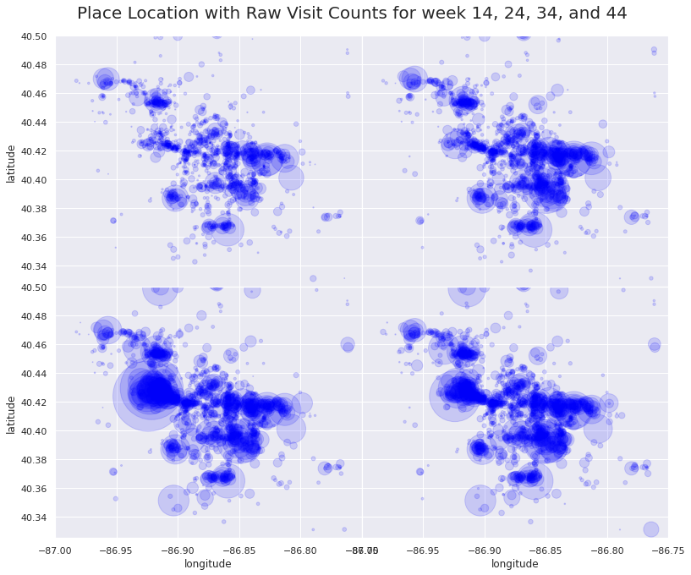

Slide 3
Policy Recommendation
I'd advise the committee to take the most precaution during 1 to 2 weeks prior to school starting this spring semester, and gradually take less precaution as the weeks go on.
Because from the data exploration phase, I found that the peak for the number of visits are caused by Purdue's fall semester start. The number of total visit counts has increased exponentially during the weeks leading to the starting of semester. After school started, the number of visits started to decrease at a constant pace.

