Slide 1

Survey Analysis for All Treatment Groups
Spring 2017

Slide 2
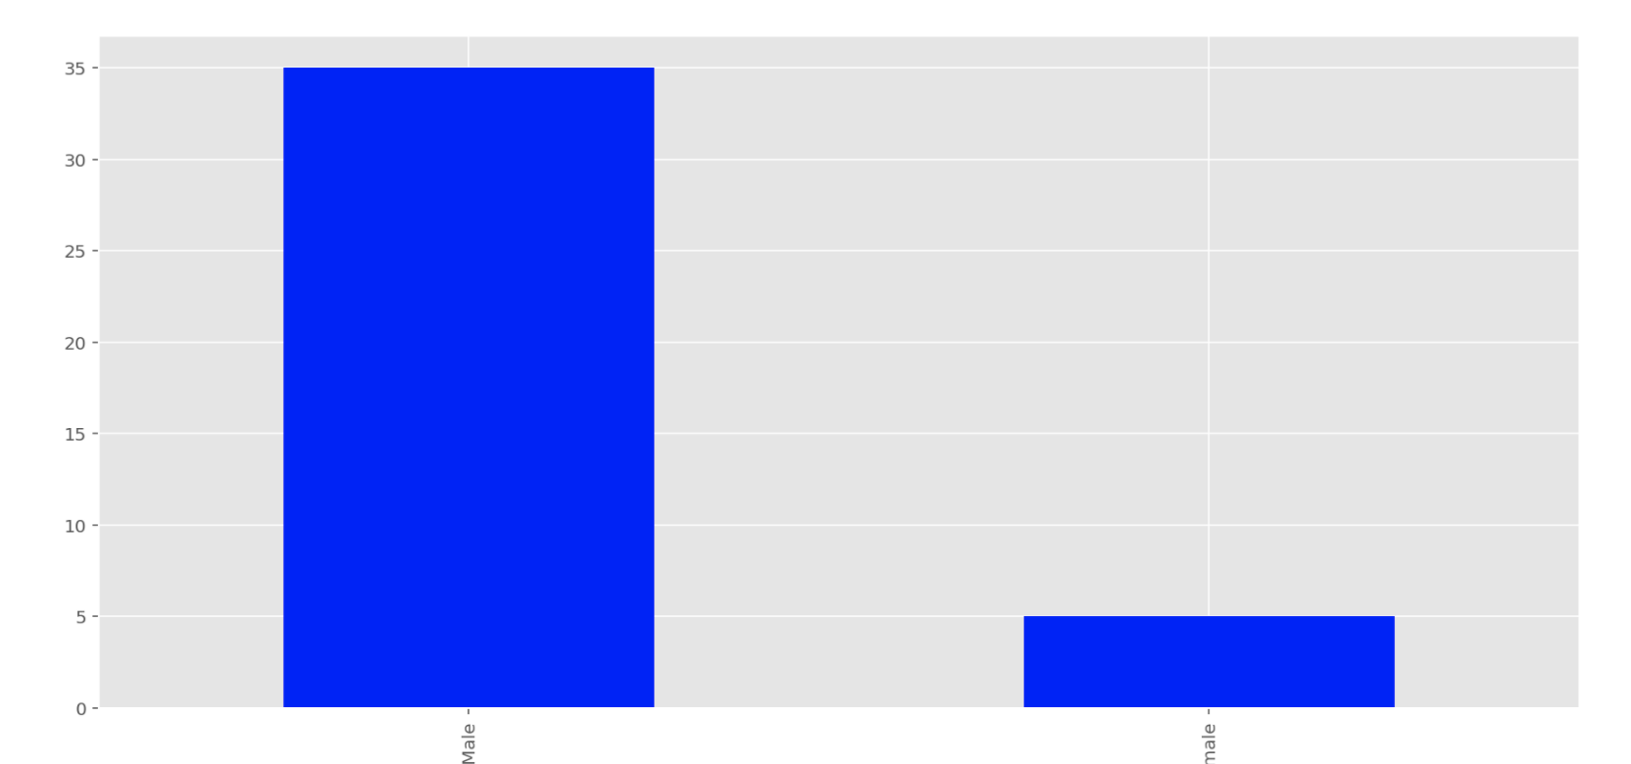
Bogota 0 No Transparency
Q17 - What is your gender?

Slide 3
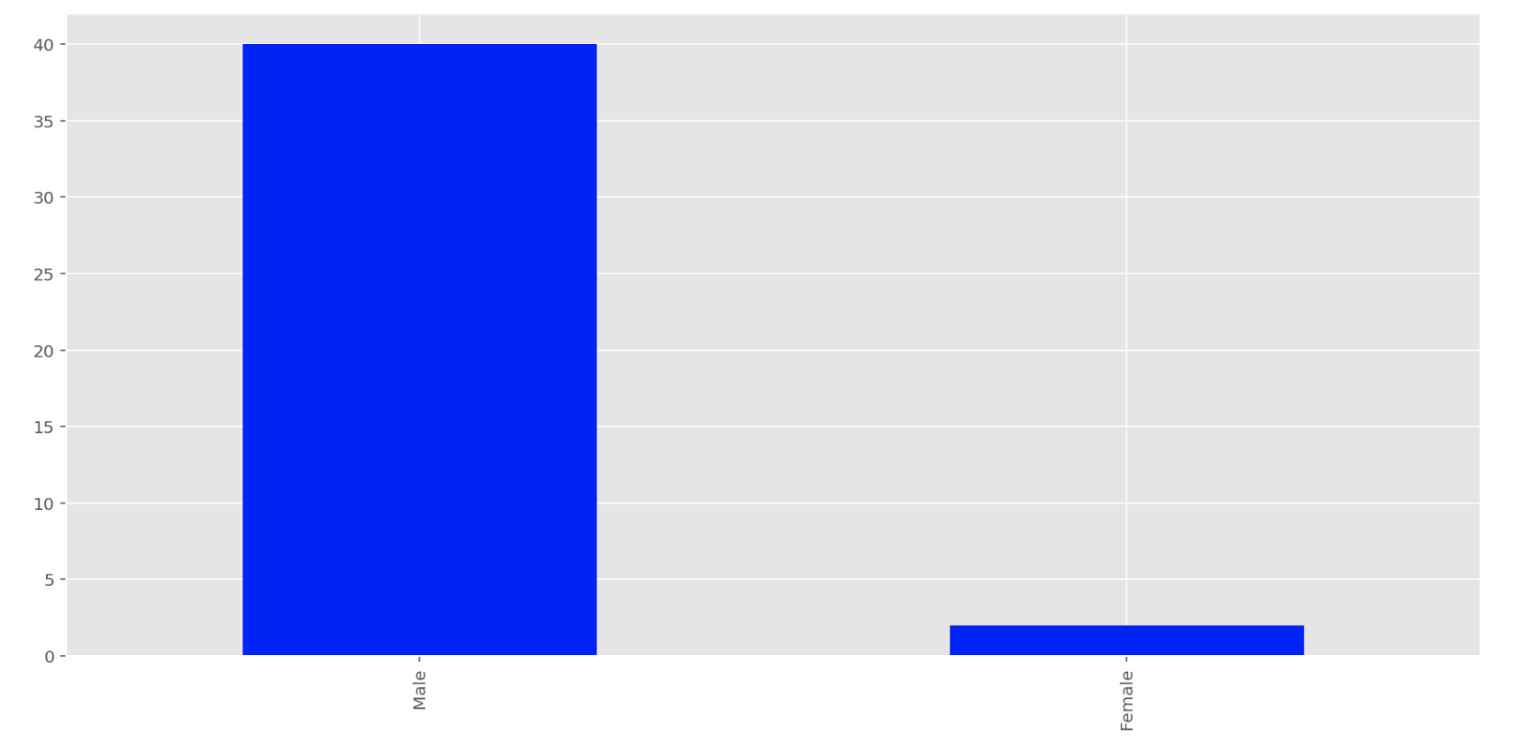
Bogota 1 Performance Transparency
Q17 - What is your gender?

Slide 4
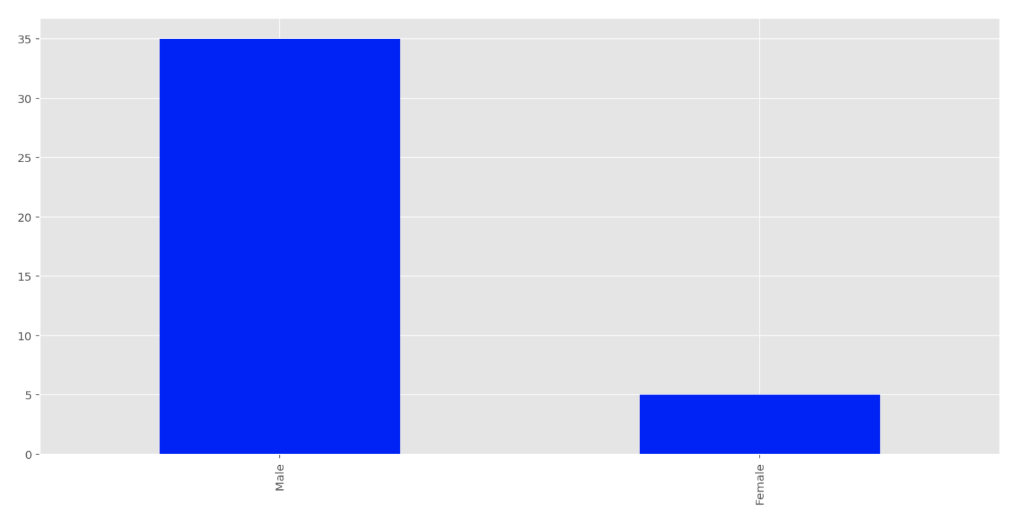
Bogota 2 Solution Transparency
Q17 - What is your gender?

Slide 5
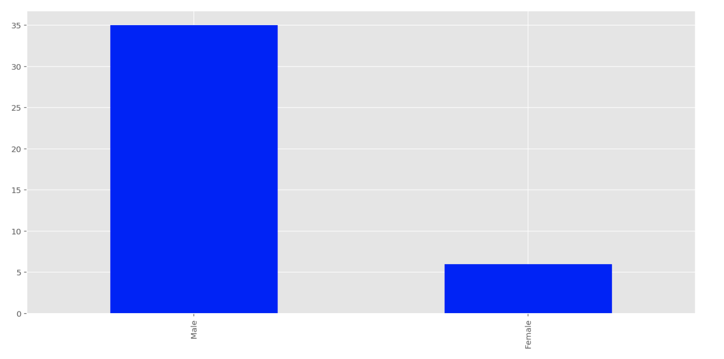
Bogota 3 Full Transparency
Q17 - What is your gender?

Slide 6
Interpretation: Q17 – What is your gender
Majority of the participants are male in all 4 treatment groups

Slide 7
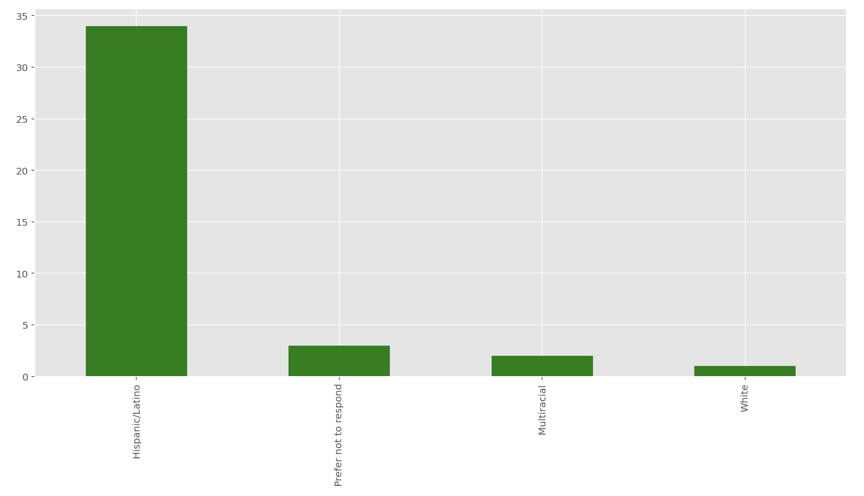
Bogota 0 No Transparency
Q18 - What is your race/ethnicity?

Slide 8
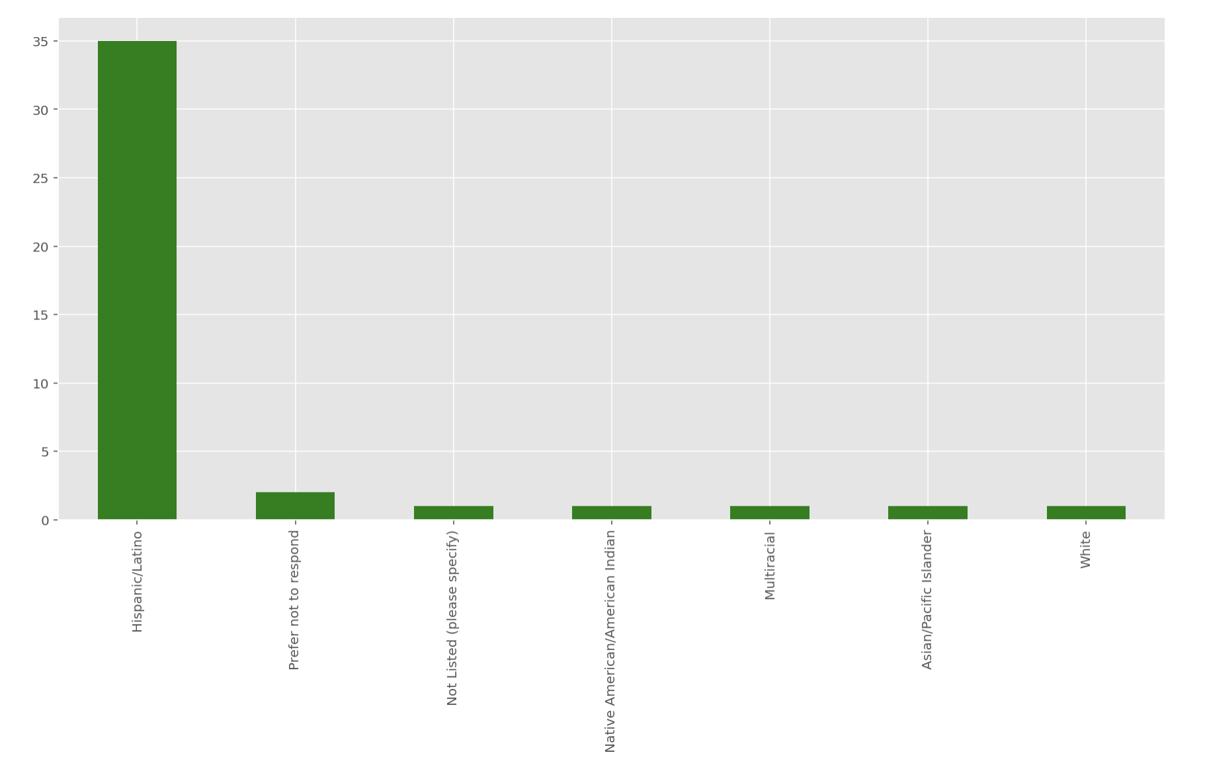
Bogota 1 Performance Transparency
Q18 - What is your race/ethnicity?

Slide 9
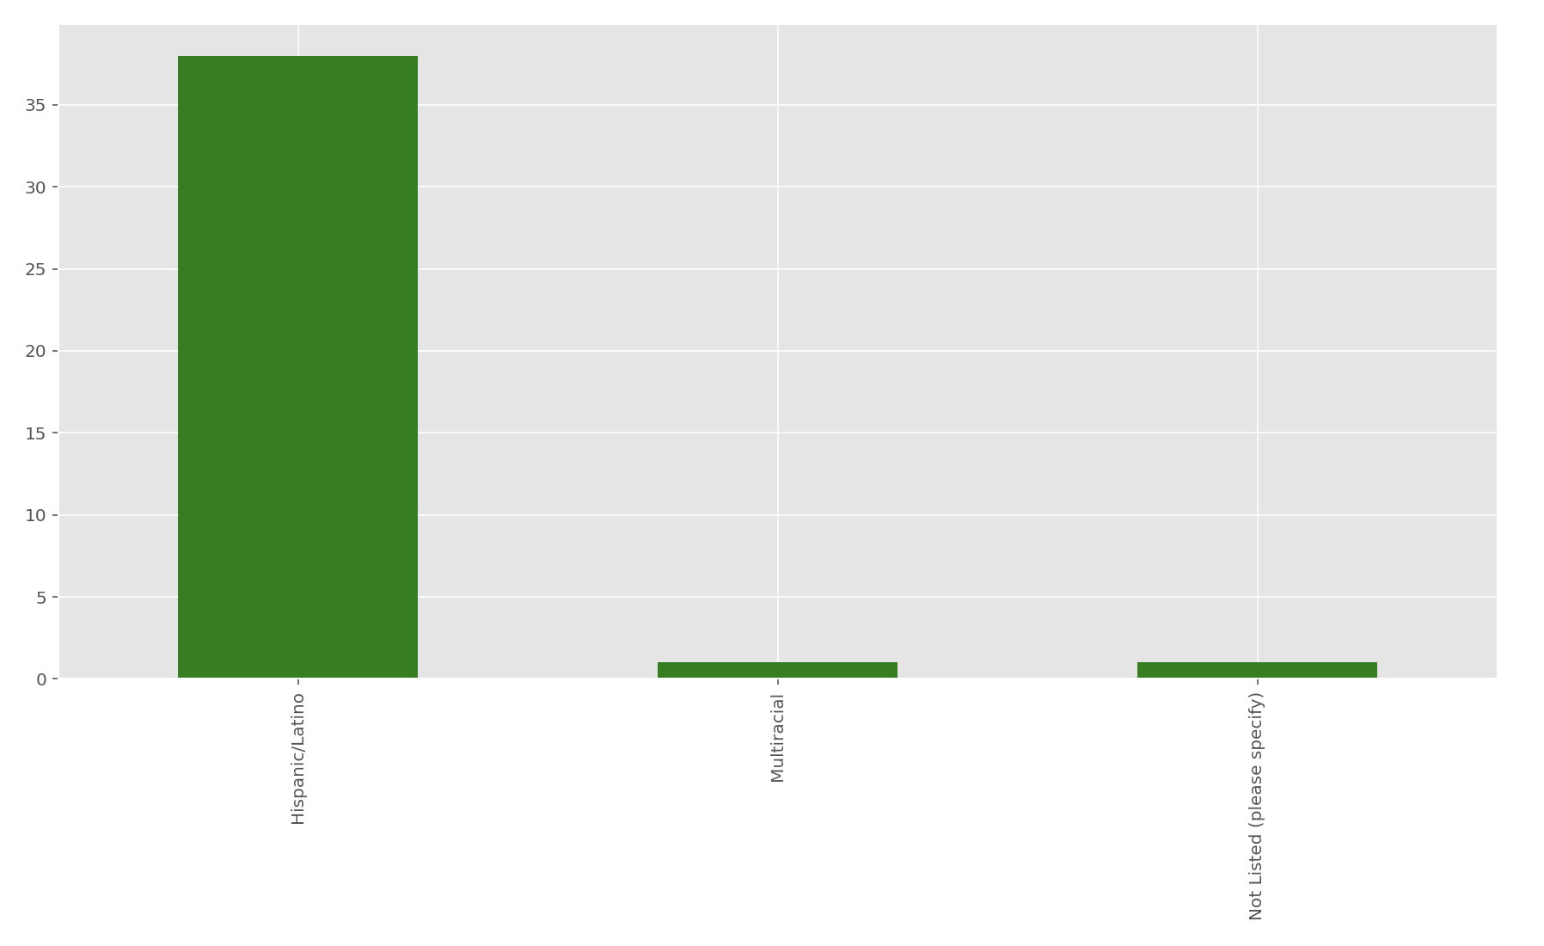
Bogota 2 Solution Transparency
Q18 - What is your race/ethnicity?

Slide 10
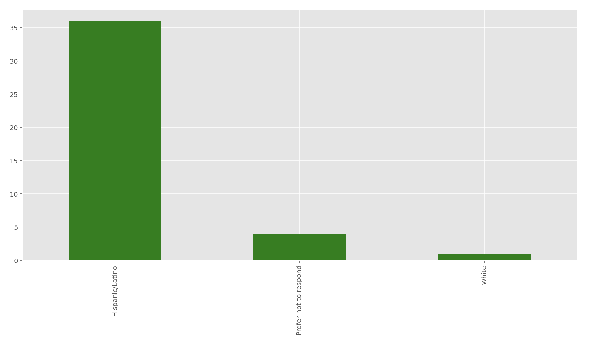
Bogota 3 Full Transparency
Q18 - What is your race/ethnicity?

Slide 11
Interpretation: Q18 - What is your race/ethnicity?
Majority of the participants are Hispanic/Latino in all 4 treatment groups

Slide 12
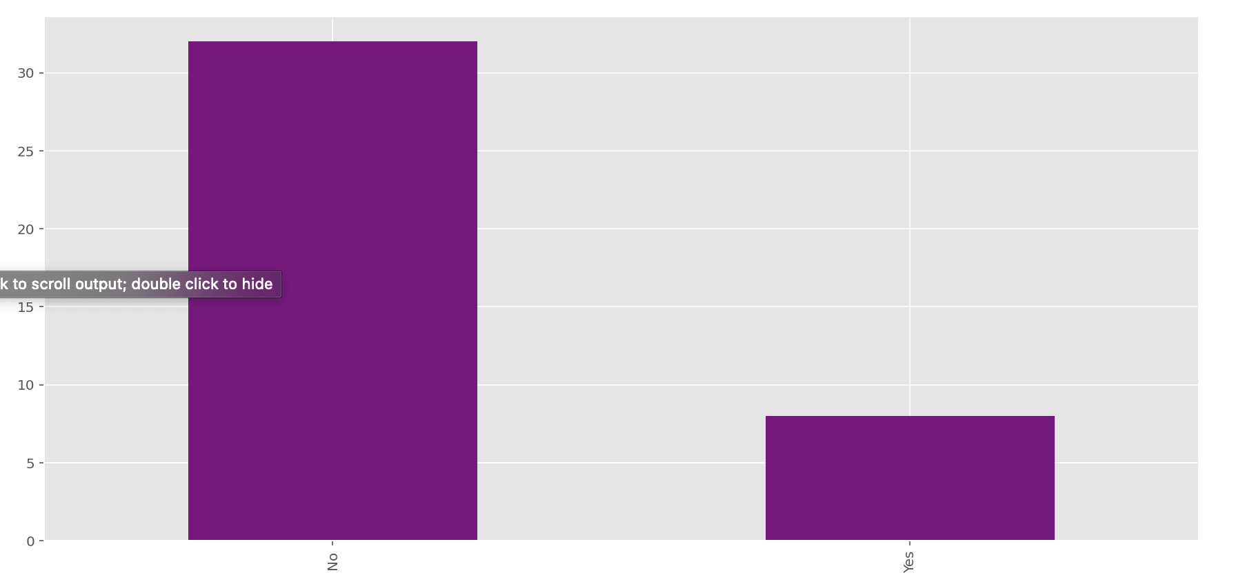
Bogota 0 No Transparency
Q9 - Have you participated in any programming competition before (e.g. Topcoder.com, local hacking events etc.)?

Slide 13
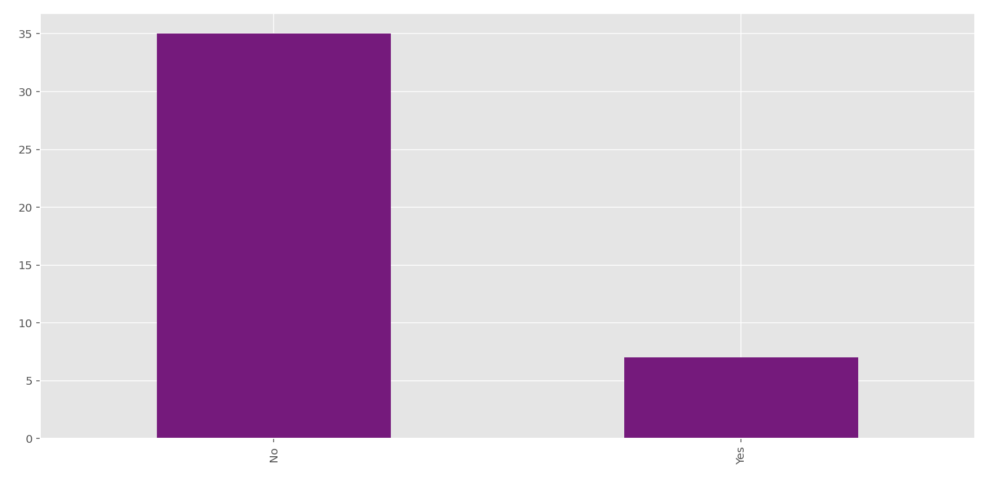
Bogota 1 Performance Transparency
Q9 - Have you participated in any programming competition before (e.g. Topcoder.com, local hacking events etc.)?

Slide 14
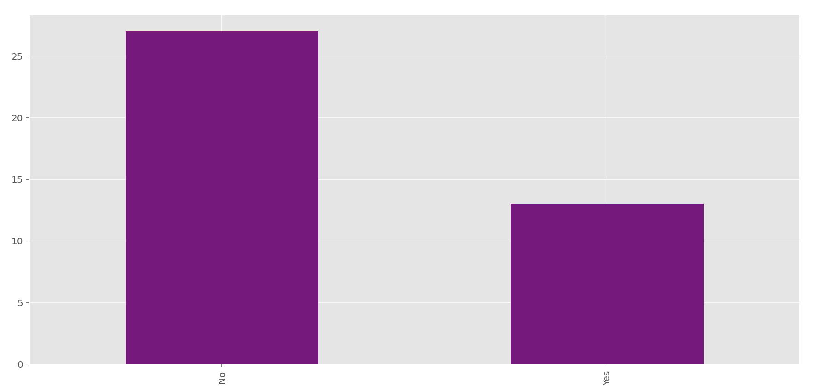
Bogota 2 Solution Transparency
Q9 - Have you participated in any programming competition before (e.g. Topcoder.com, local hacking events etc.)?

Slide 15
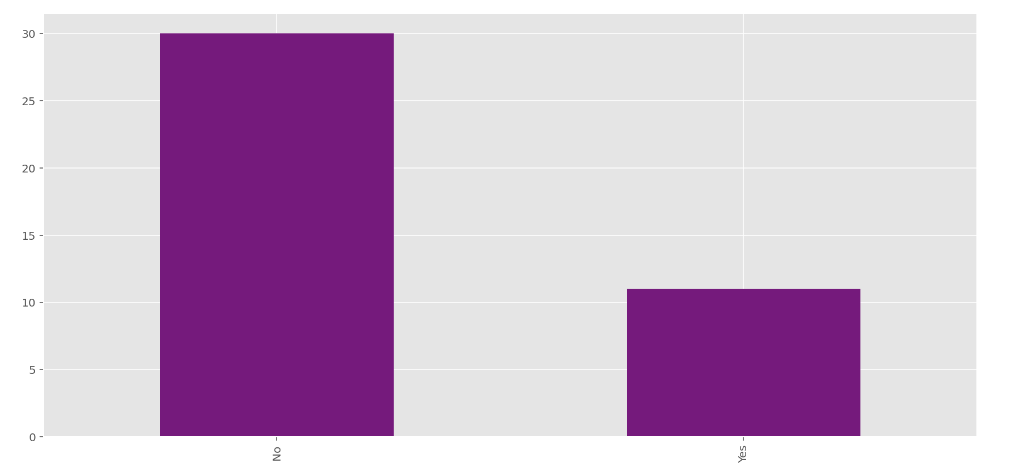
Bogota 3 Full Transparency
Q9 - Have you participated in any programming competition before (e.g. Topcoder.com, local hacking events etc.)?

Slide 16
Interpretation: Q9 - Have you participated in any programming competition before (e.g. Topcoder.com, local hacking events etc.)?
Majority of the participants have not participated in programming competition before in all 4 treatment groups

Slide 17
Bogota 3 Full Transparency
Q9 - Have you participated in any programming competition before (e.g. Topcoder.com, local hacking events etc.)?

Slide 18
Bogota 3 Full Transparency
Q9 - Have you participated in any programming competition before (e.g. Topcoder.com, local hacking events etc.)?

Slide 19
Bogota 3 Full Transparency
Q9 - Have you participated in any programming competition before (e.g. Topcoder.com, local hacking events etc.)?

Slide 20
Bogota 3 Full Transparency
Q9 - Have you participated in any programming competition before (e.g. Topcoder.com, local hacking events etc.)?

