Slide 1

Survey Analysis for All Treatment Groups
Spring 2017

Slide 2
Visual Explanation of The Mathematics Behind PCA
https://github.com/ironhacks/analysis-2017/wiki/PCA-vs-FA-Theory

Slide 3
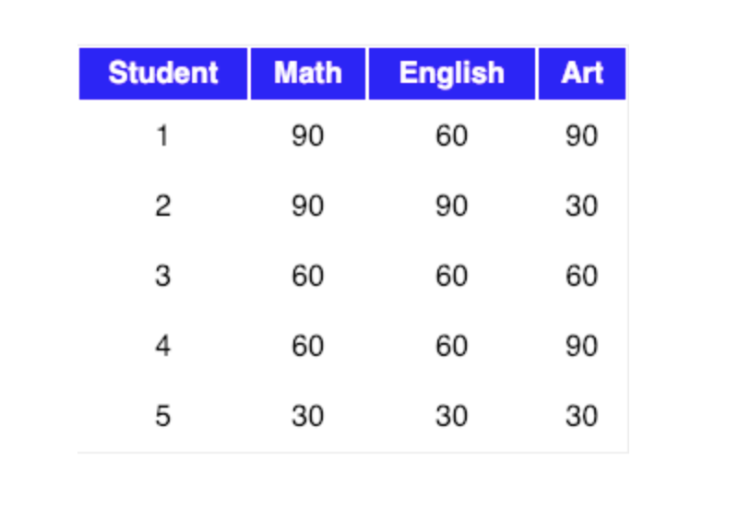
The Mathematics Behind PCA
Let our data matrix X be the score of three students:

Slide 4
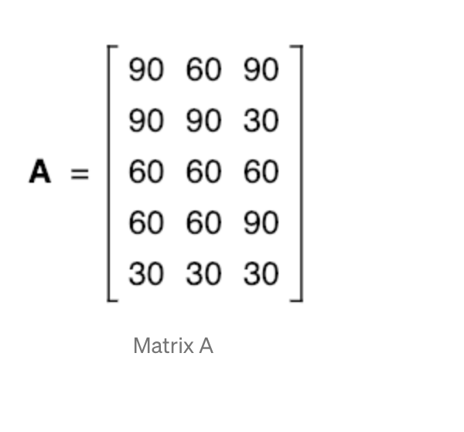
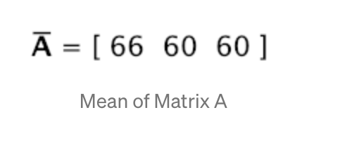
Compute the mean of every dimension of the whole dataset

Slide 5
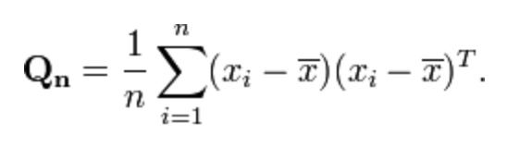
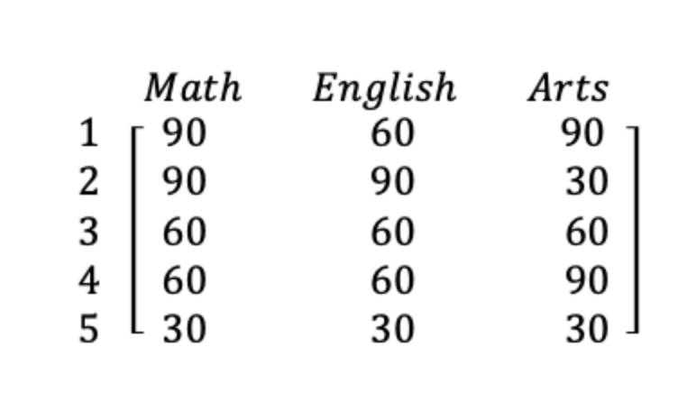
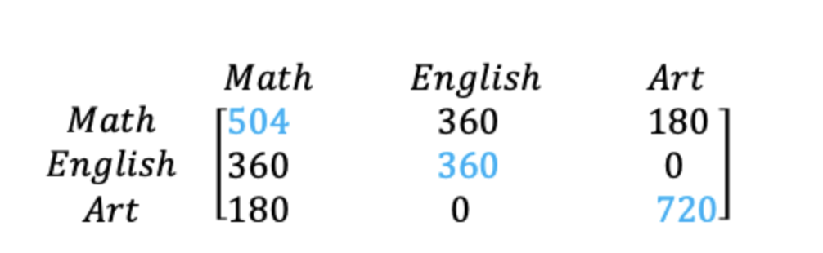
The covariance matrix of the sample can be expressed as
Original Matrix
Covariance Matrix
Notes:
Few points that can be noted here is :
Shown in Blue along the diagonal, we see the variance of scores for each test. The art test has the biggest variance (720); and the English test, the smallest (360). So we can say that art test scores have more variability than English test scores.
The covariance is displayed in black in the off-diagonal elements of the matrix A
a) The covariance between math and English is positive (360), and the covariance between math and art is positive (180). This means the scores tend to covary in a positive way. As scores on math go up, scores on art and English also tend to go up; and vice versa.
b) The covariance between English and art, however, is zero. This means there tends to be no predictable relationship between the movement of English and art scores.

Slide 6
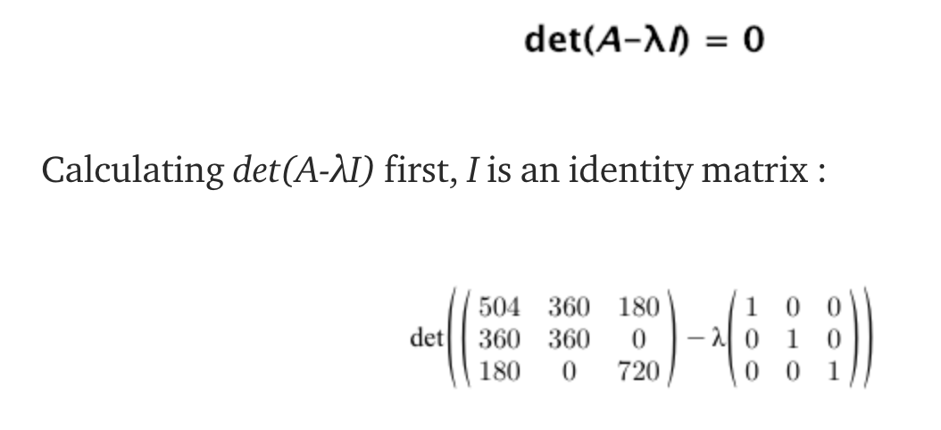
Notes:
Intuitively, an eigenvector is a vector whose direction remains unchanged when a linear transformation is applied to it.
Now, we can easily compute eigenvalue and eigenvectors from the covariance matrix that we have above.
Let A be a square matrix, ν a vector and λ a scalar that satisfies Aν = λν, then λ is called eigenvalue associated with eigenvector ν of A.
The eigenvalues of A are roots of the characteristic equation
Definition of identity matrix - a square matrix in which all the elements of the principal diagonal are ones and all other elements are zeros. The effect of multiplying a given matrix by an identity matrix is to leave the given matrix unchanged.

Slide 7
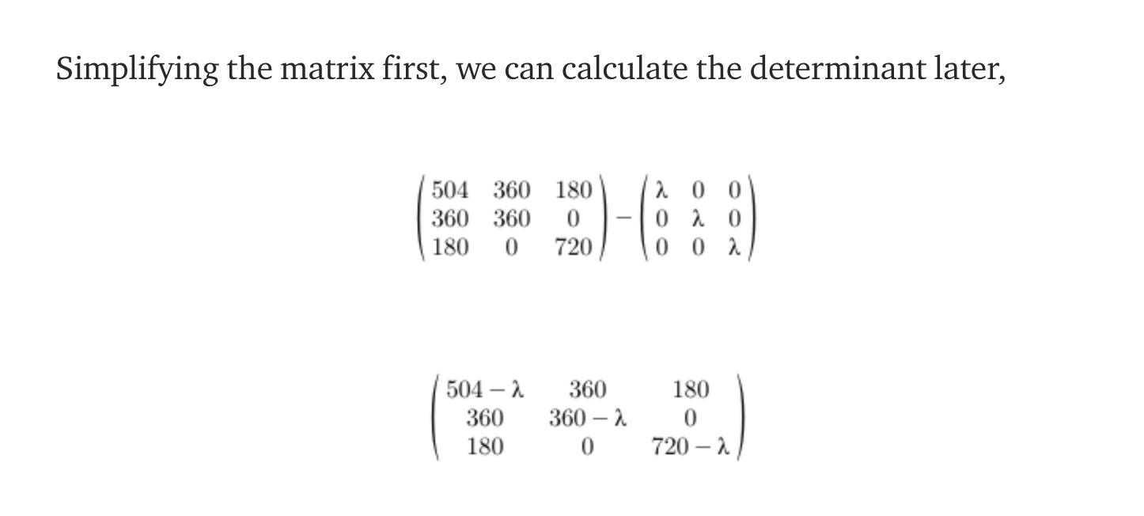
Notes:
Intuitively, an eigenvector is a vector whose direction remains unchanged when a linear transformation is applied to it.
Now, we can easily compute eigenvalue and eigenvectors from the covariance matrix that we have above.
Let A be a square matrix, ν a vector and λ a scalar that satisfies Aν = λν, then λ is called eigenvalue associated with eigenvector ν of A.
The eigenvalues of A are roots of the characteristic equation
Definition of identity matrix - a square matrix in which all the elements of the principal diagonal are ones and all other elements are zeros. The effect of multiplying a given matrix by an identity matrix is to leave the given matrix unchanged.

Slide 8

Notes:
Intuitively, an eigenvector is a vector whose direction remains unchanged when a linear transformation is applied to it.
Now, we can easily compute eigenvalue and eigenvectors from the covariance matrix that we have above.
Let A be a square matrix, ν a vector and λ a scalar that satisfies Aν = λν, then λ is called eigenvalue associated with eigenvector ν of A.
The eigenvalues of A are roots of the characteristic equation
Definition of identity matrix - a square matrix in which all the elements of the principal diagonal are ones and all other elements are zeros. The effect of multiplying a given matrix by an identity matrix is to leave the given matrix unchanged.

Slide 9
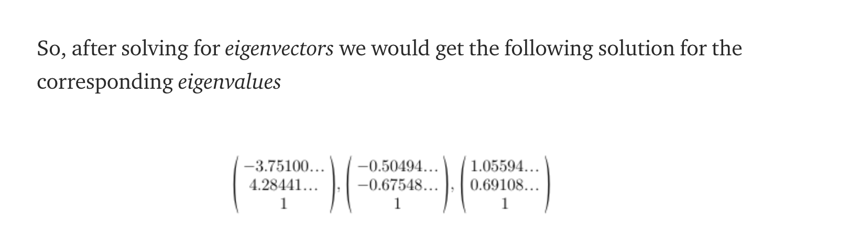
Now, we can calculate the eigenvectors corresponding to the above eigenvalues.
Notes:
Intuitively, an eigenvector is a vector whose direction remains unchanged when a linear transformation is applied to it.
Now, we can easily compute eigenvalue and eigenvectors from the covariance matrix that we have above.
Let A be a square matrix, ν a vector and λ a scalar that satisfies Aν = λν, then λ is called eigenvalue associated with eigenvector ν of A.
The eigenvalues of A are roots of the characteristic equation
Definition of identity matrix - a square matrix in which all the elements of the principal diagonal are ones and all other elements are zeros. The effect of multiplying a given matrix by an identity matrix is to leave the given matrix unchanged.

Slide 10
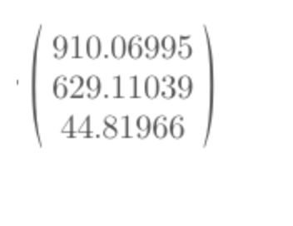
To decide which eigenvector(s) we want to drop for our lower-dimensional subspace, we have to take a look at the corresponding eigenvalues of the eigenvectors. Roughly speaking, the eigenvectors with the lowest eigenvalues bear the least information about the distribution of the data.
So, after sorting the eigenvalues in decreasing order, we have drop.
Notes:
So, in order to decide which eigenvector(s) we want to drop for our lower-dimensional subspace, we have to take a look at the corresponding eigenvalues of the eigenvectors. Roughly speaking, the eigenvectors with the lowest eigenvalues bear the least information about the distribution of the data, and those are the ones we want to drop.
The common approach is to rank the eigenvectors from highest to lowest corresponding eigenvalue and choose the top k eigenvectors.
So, after sorting the eigenvalues in decreasing order, we have

Slide 11
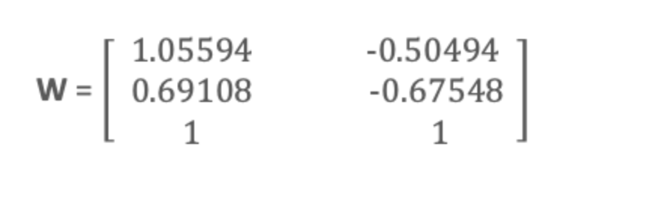
For our simple example, where we are reducing a 3-dimensional feature space to a 2-dimensional feature subspace, we are combining the two eigenvectors with the highest eigenvalues to construct our d×k dimensional eigenvector matrix W.
So, eigenvectors corresponding to two maximum eigenvalues are:
Notes:
So, in order to decide which eigenvector(s) we want to drop for our lower-dimensional subspace, we have to take a look at the corresponding eigenvalues of the eigenvectors. Roughly speaking, the eigenvectors with the lowest eigenvalues bear the least information about the distribution of the data, and those are the ones we want to drop.
The common approach is to rank the eigenvectors from highest to lowest corresponding eigenvalue and choose the top k eigenvectors.
So, after sorting the eigenvalues in decreasing order, we have

Slide 12
Transform the samples onto the new subspace
In the last step, we use the 3x2 dimensional matrix W that we just computed to transform our samples onto the new subspace via the equation y = W′ × x where W′ is the transpose of the matrix W.
So lastly, we have computed our two principal components and projected the data points onto the new subspace.
Notes:
So, in order to decide which eigenvector(s) we want to drop for our lower-dimensional subspace, we have to take a look at the corresponding eigenvalues of the eigenvectors. Roughly speaking, the eigenvectors with the lowest eigenvalues bear the least information about the distribution of the data, and those are the ones we want to drop.
The common approach is to rank the eigenvectors from highest to lowest corresponding eigenvalue and choose the top k eigenvectors.
So, after sorting the eigenvalues in decreasing order, we have

Slide 13
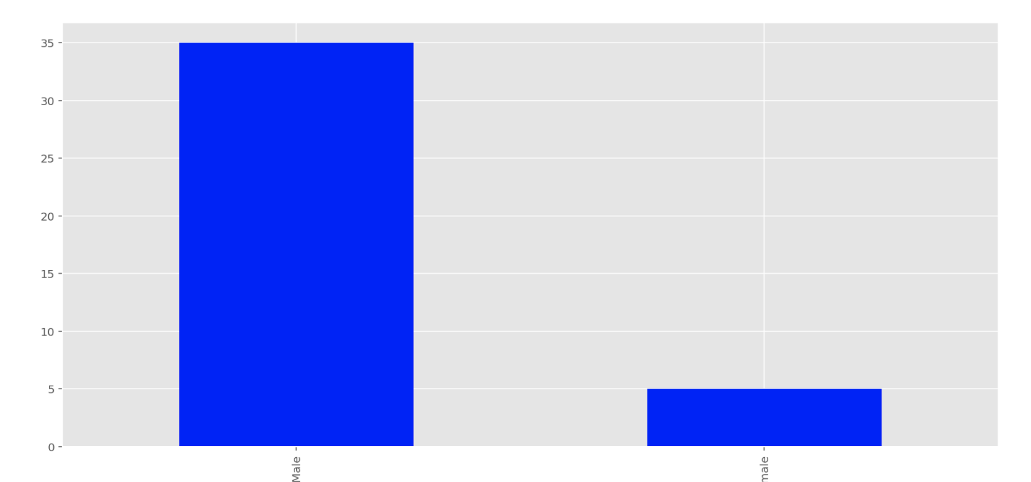
Bogota 0 No Transparency
Q17 - What is your gender?

Slide 14
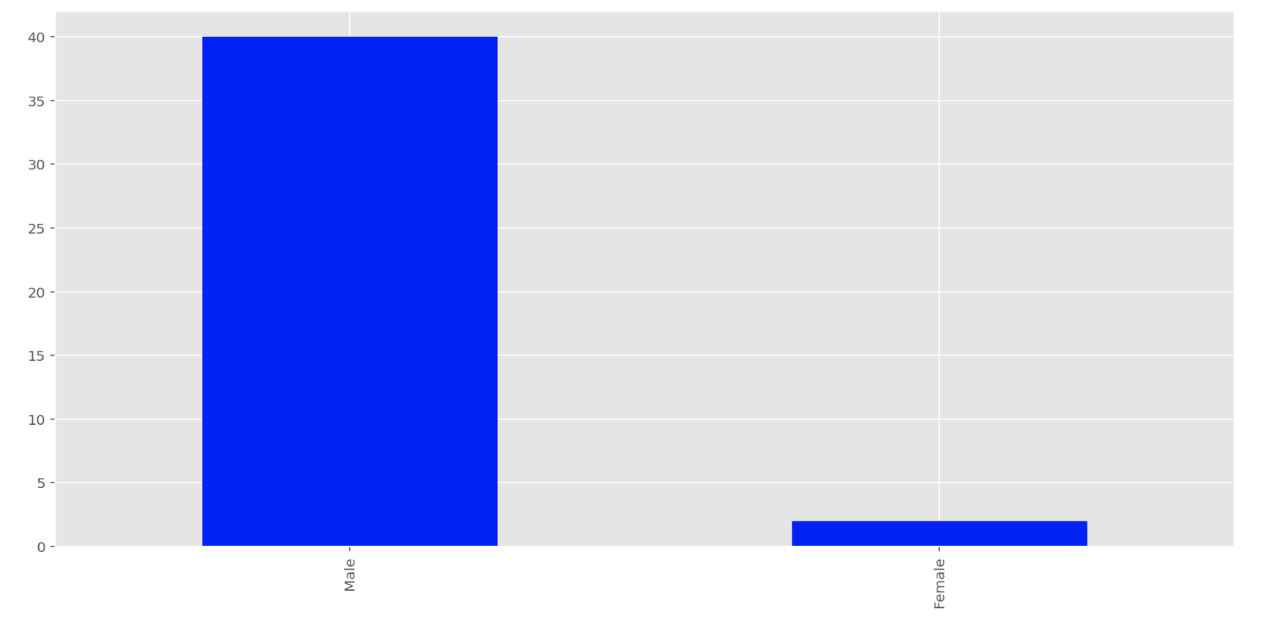
Bogota 1 Performance Transparency
Q17 - What is your gender?

Slide 15
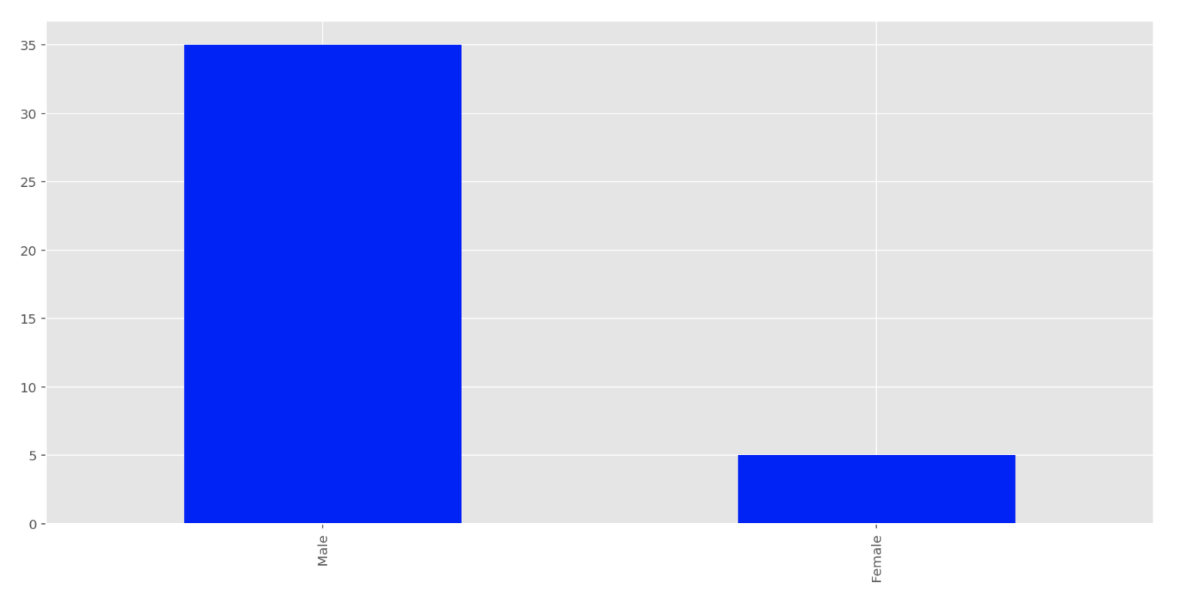
Bogota 2 Solution Transparency
Q17 - What is your gender?

Slide 16
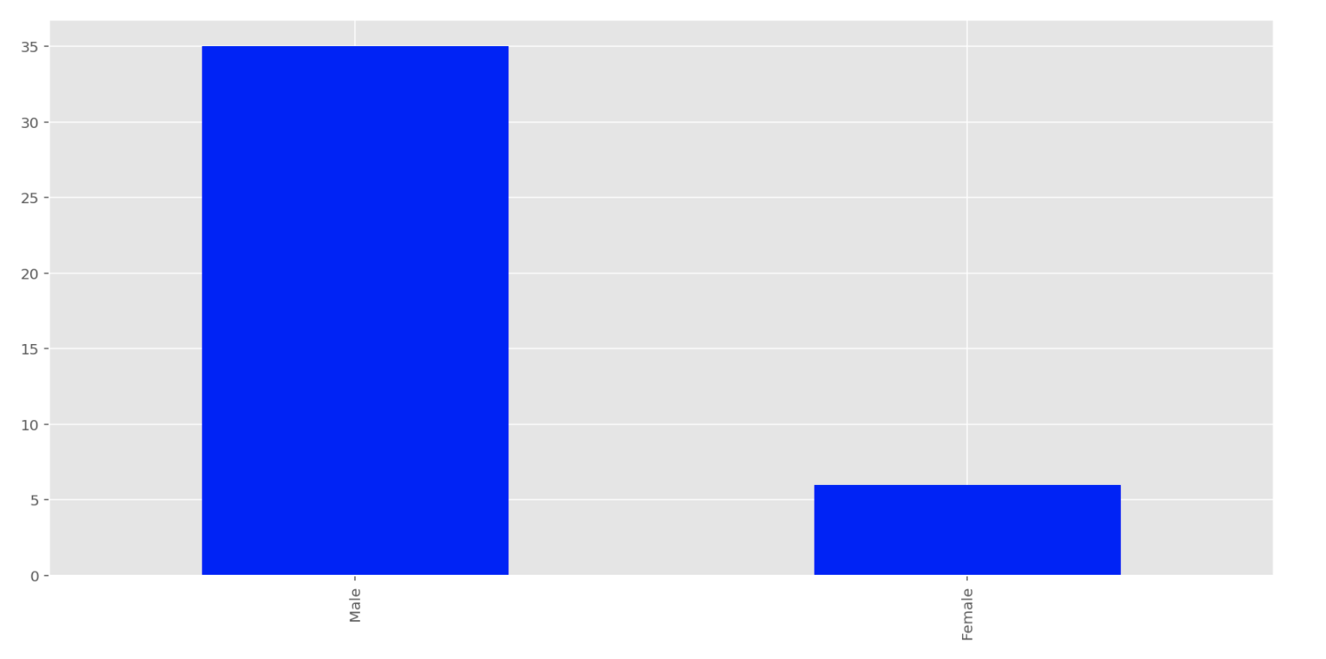
Bogota 3 Full Transparency
Q17 - What is your gender?

Slide 17
Interpretation: Q17 – What is your gender
Majority of the participants are male in all 4 treatment groups

Slide 18
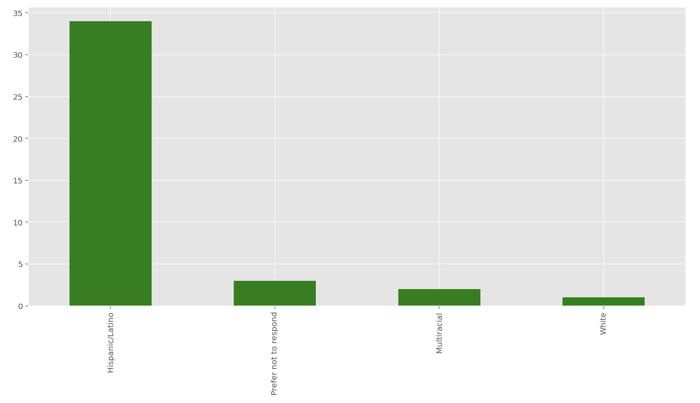
Bogota 0 No Transparency
Q18 - What is your race/ethnicity?

Slide 19
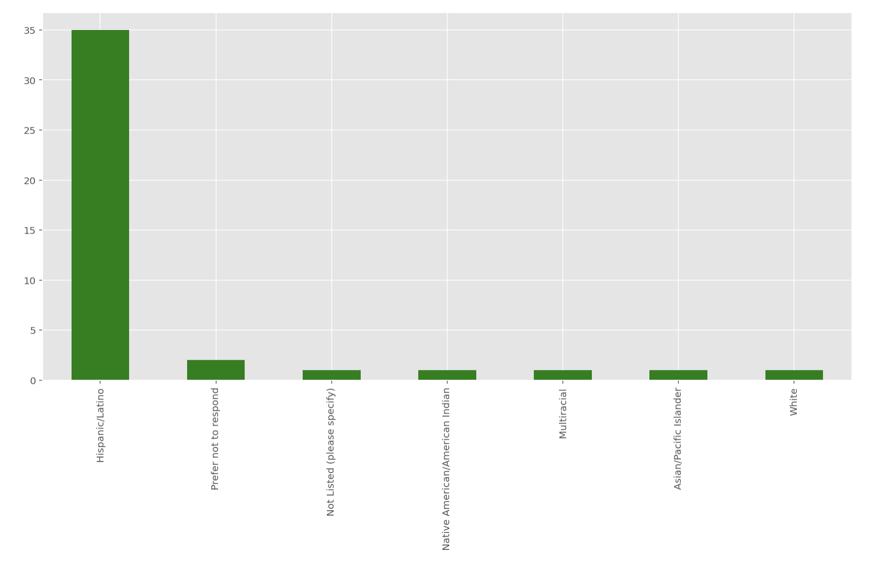
Bogota 1 Performance Transparency
Q18 - What is your race/ethnicity?

Slide 20
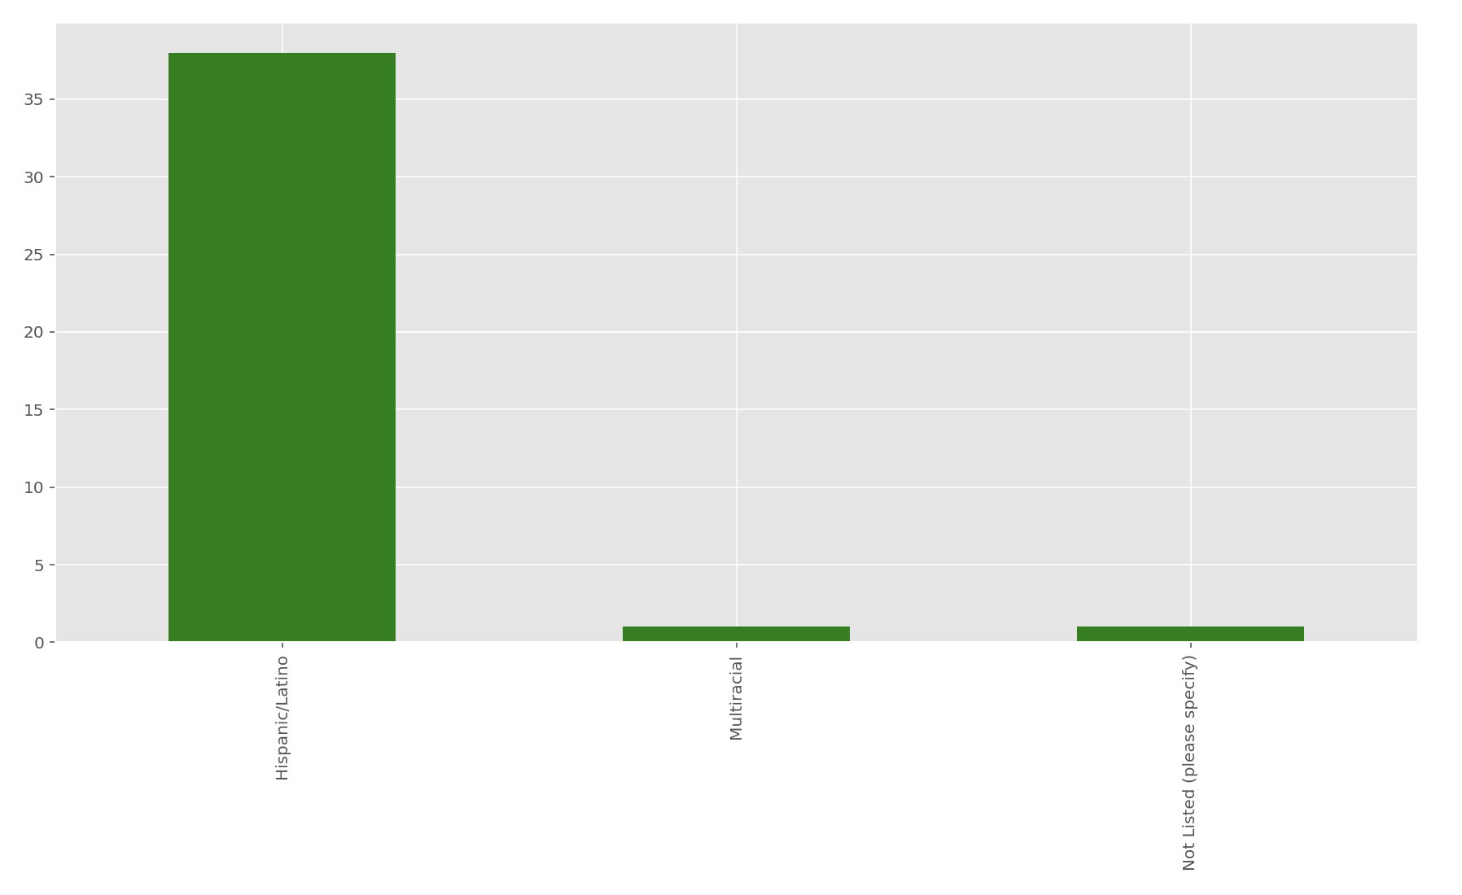
Bogota 2 Solution Transparency
Q18 - What is your race/ethnicity?

Slide 21
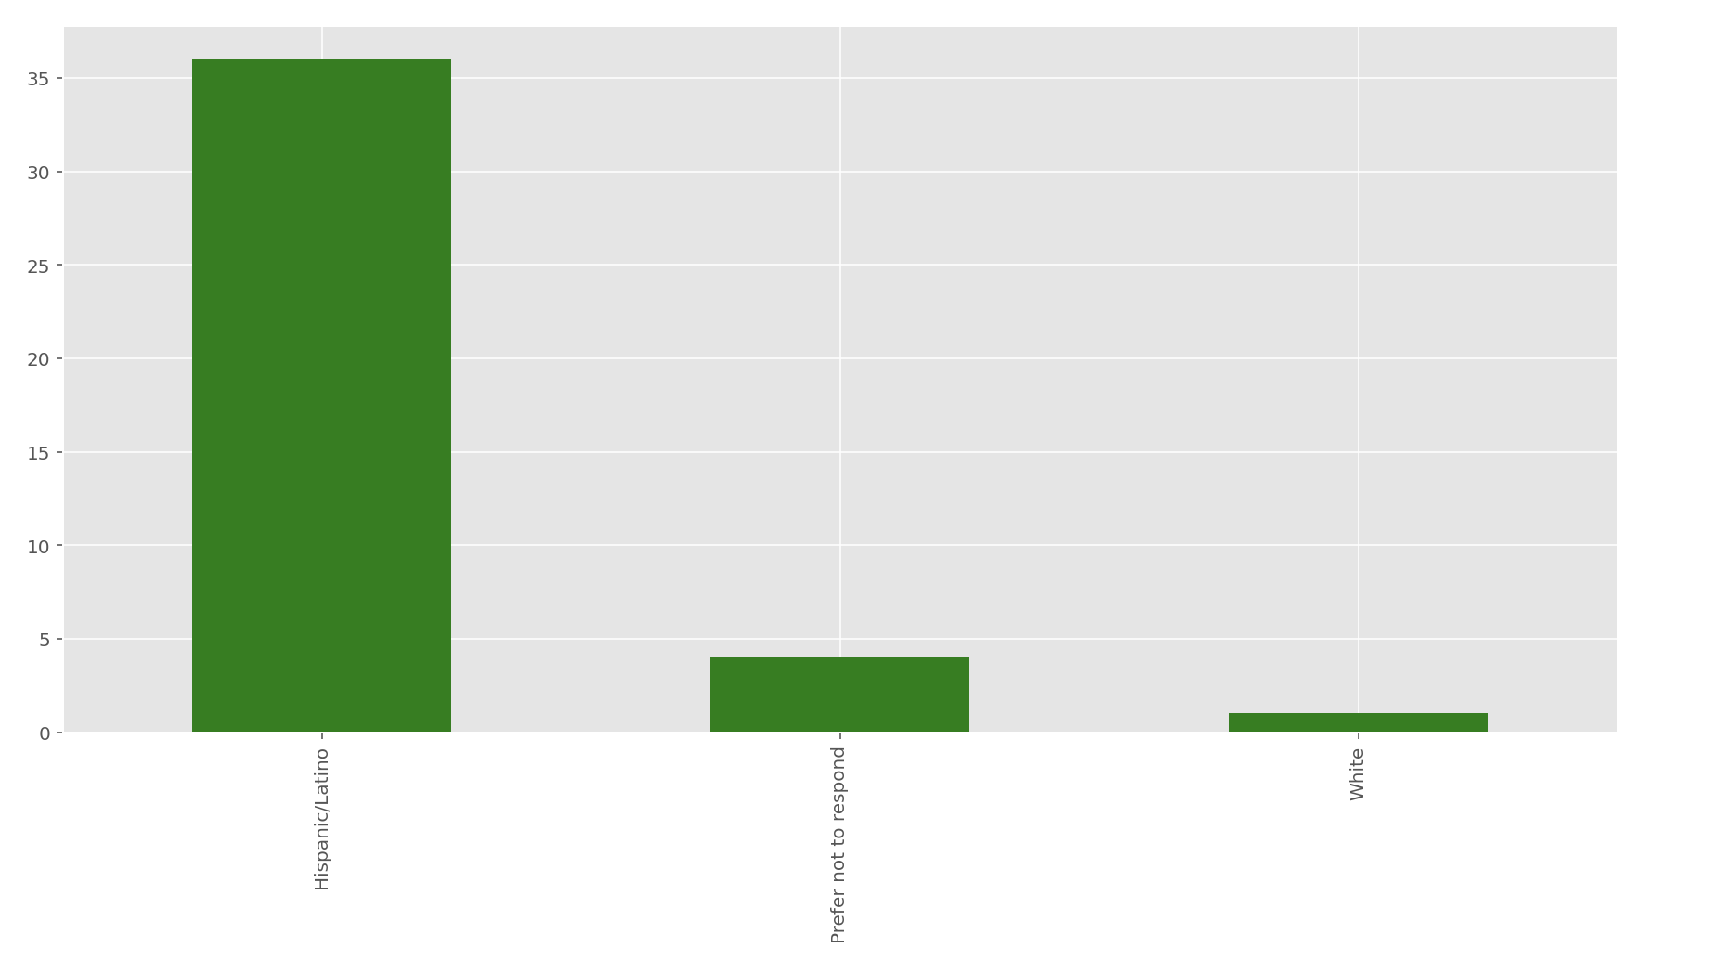
Bogota 3 Full Transparency
Q18 - What is your race/ethnicity?

Slide 22
Interpretation: Q18 - What is your race/ethnicity?
Majority of the participants are Hispanic/Latino in all 4 treatment groups

Slide 23
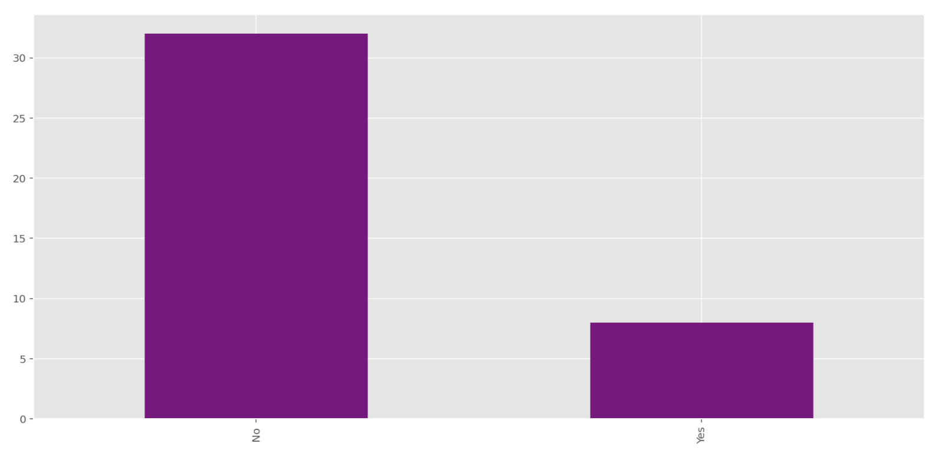
Bogota 0 No Transparency
Q9 - Have you participated in any programming competition before (e.g. Topcoder.com, local hacking events etc.)?

Slide 24
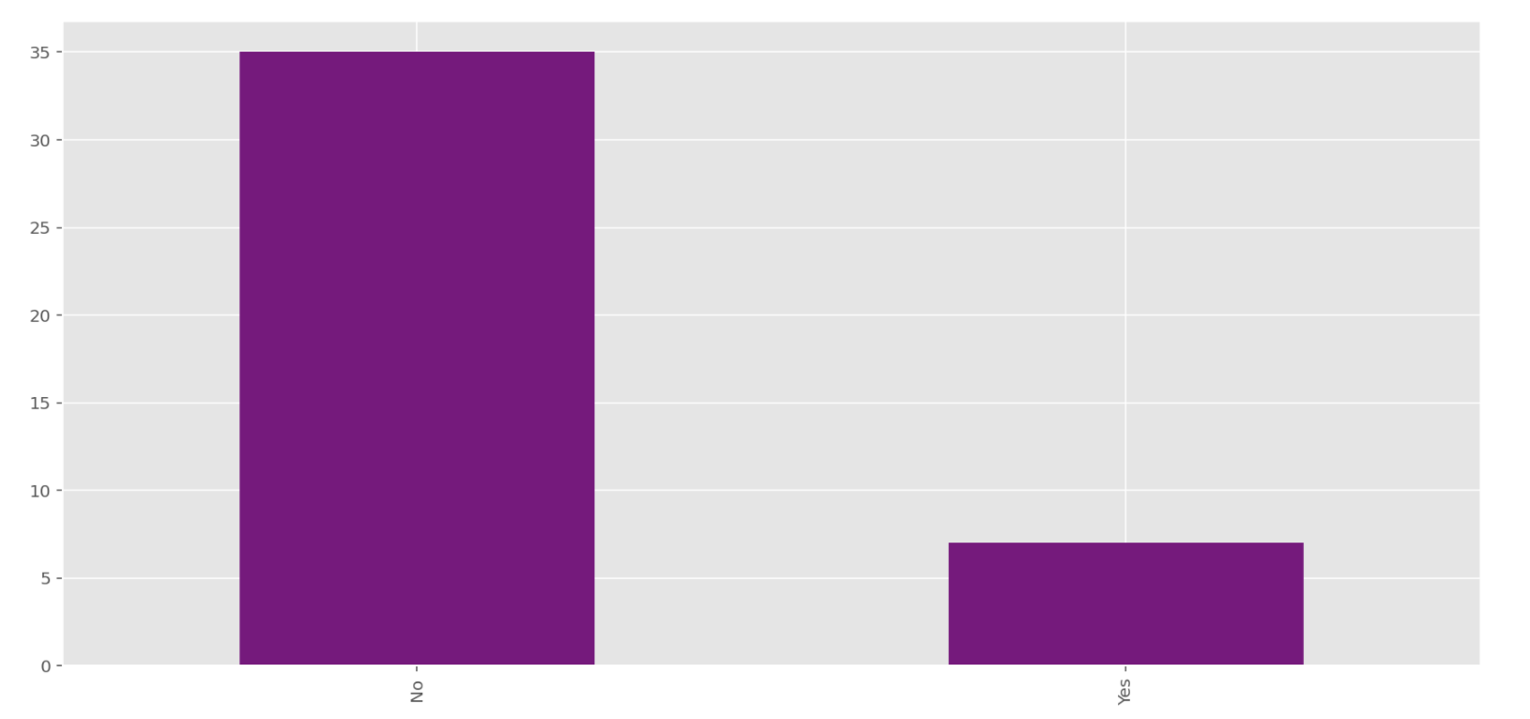
Bogota 1 Performance Transparency
Q9 - Have you participated in any programming competition before (e.g. Topcoder.com, local hacking events etc.)?

Slide 25
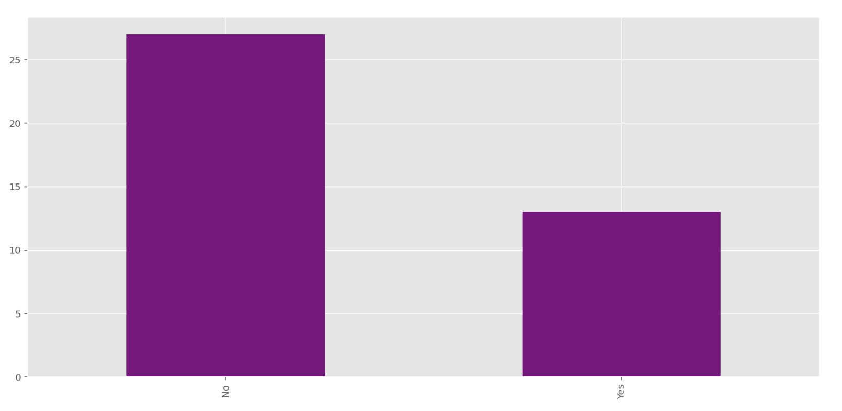
Bogota 2 Solution Transparency
Q9 - Have you participated in any programming competition before (e.g. Topcoder.com, local hacking events etc.)?

Slide 26
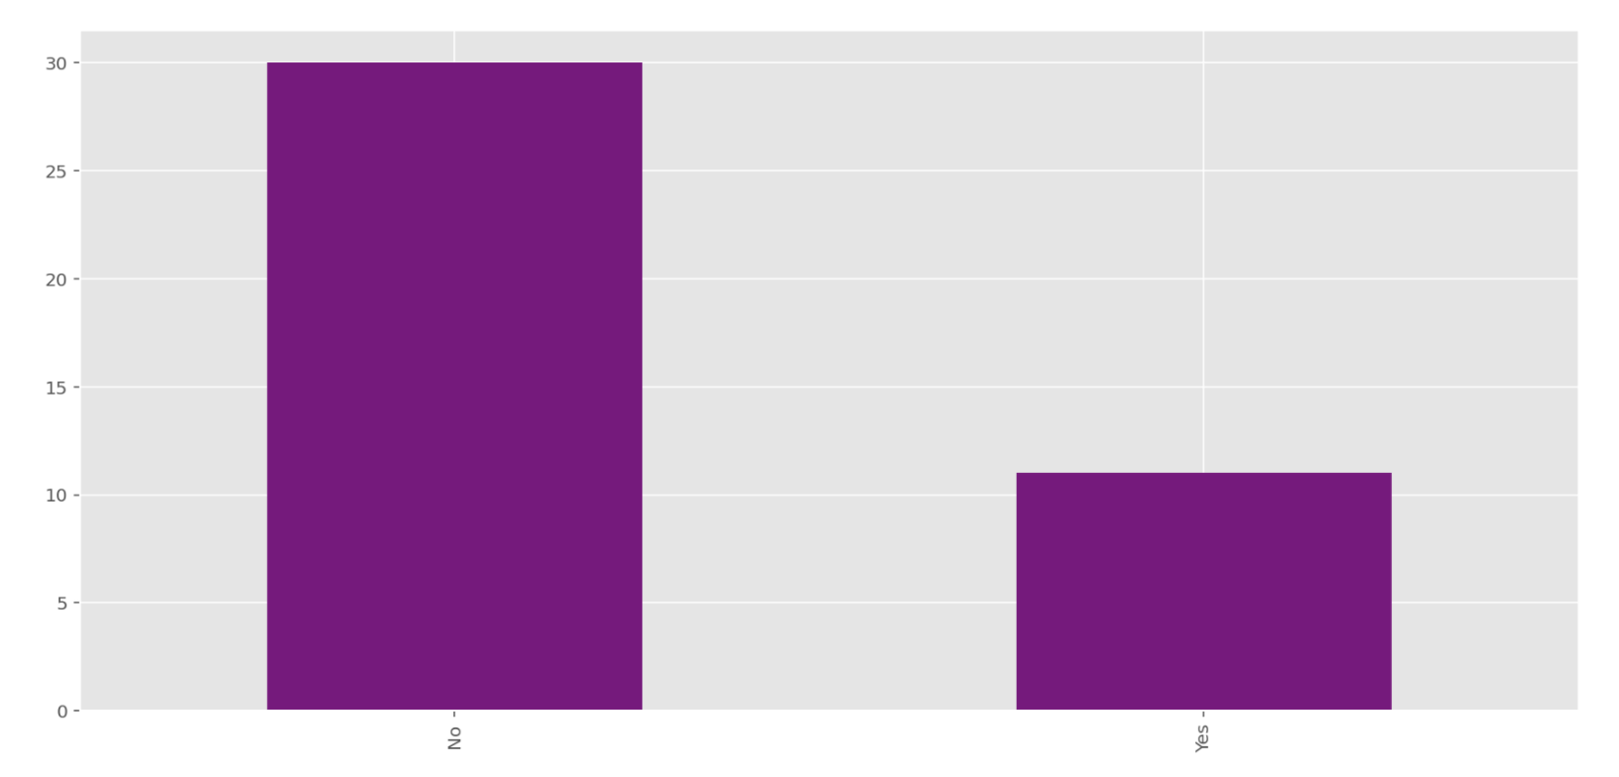
Bogota 3 Full Transparency
Q9 - Have you participated in any programming competition before (e.g. Topcoder.com, local hacking events etc.)?

Slide 27
Interpretation: Q9 - Have you participated in any programming competition before (e.g. Topcoder.com, local hacking events etc.)?
Majority of the participants have not participated in any programming competition before in all 4 groups.

Slide 28
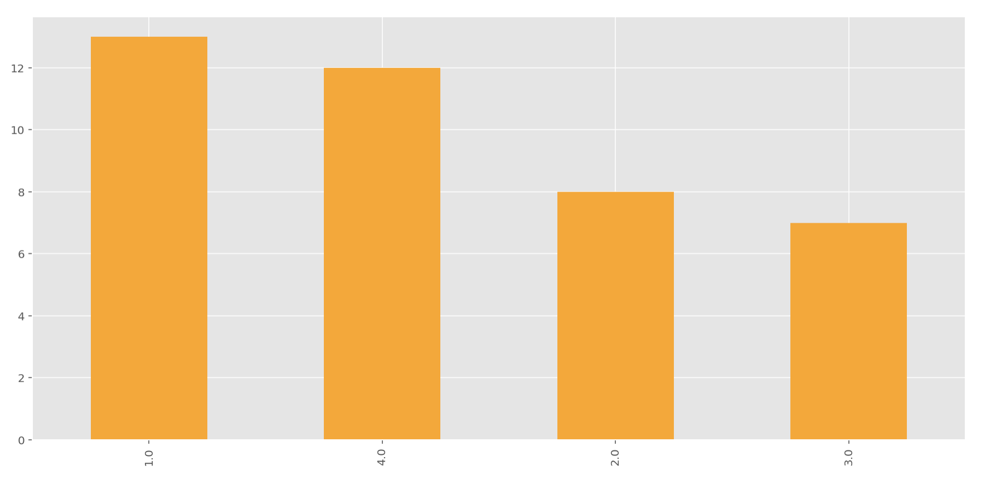
Bogota 0 No Transparency
Q24 - In which of the following classes are you enrolled?

Slide 29
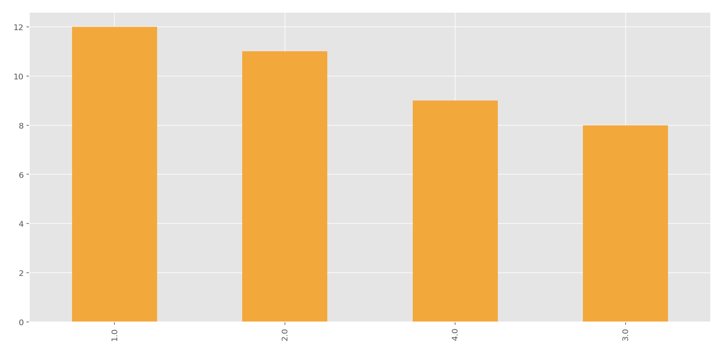
Bogota 1 Performance Transparency
Q24 - In which of the following classes are you enrolled?

Slide 30
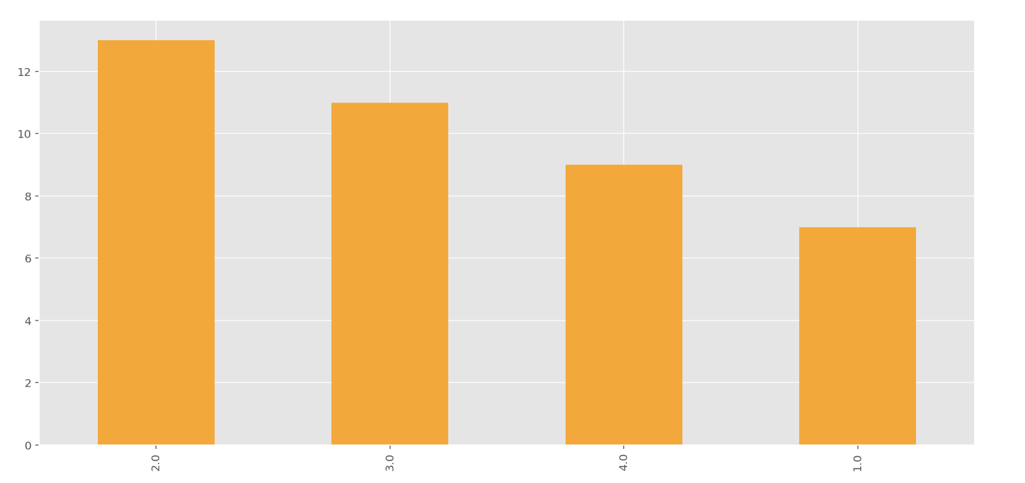
Bogota 2 Solution Transparency
Q24 - In which of the following classes are you enrolled?

Slide 31
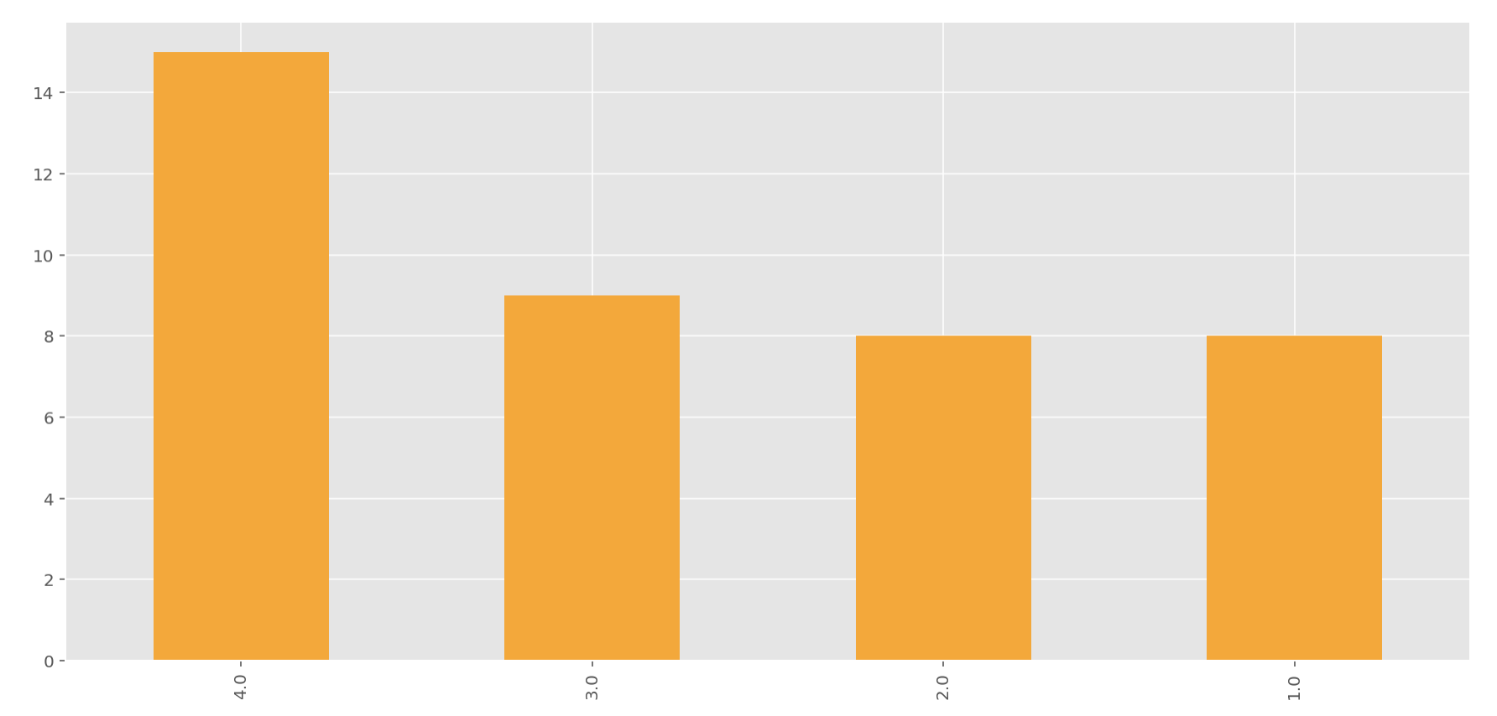
Bogota 3 Full Transparency
Q24 - In which of the following classes are you enrolled?

Slide 32
Interpretation: Q24 - In which of the following classes are you enrolled?
In all of the 4 groups, participants come from all 4 software engineering classes.

Slide 33
The Kaiser-Meyer-Olkin Measure of Sampling Adequacy is a statistic that indicates the proportion of variance in your variables that might be caused by underlying factors. High values (close to 1.0) generally indicate that a factor analysis may be useful for the data. If the value is less than 0.50, the results of the factor analysis probably won’t be very useful. Previous studies have suggested that KMO greater than 0.5 can be used for factor analysis, while KMO greater than 0.8 is very suitable for factor analysis. r
• Li, N., Huang, J., & Feng, Y. (2020). Construction and confirmatory factor analysis of the core cognitive ability index system of ship C2 system operators. PloS one, 15(8), e0237339. https://doi.org/10.1371/journal.pone.0237339
• Kaiser, H. F. (1974). An index of factorial simplicity. Psychometrika, 39(1), 31-36.

Slide 34
IDEAL VARIANCE RANGE The total value of Total Variance Explained should be between 50% and 90% for factor analysis.
Dawson, J. (2016). Analysing quantitative survey data for business and management students. Sage.

Slide 35
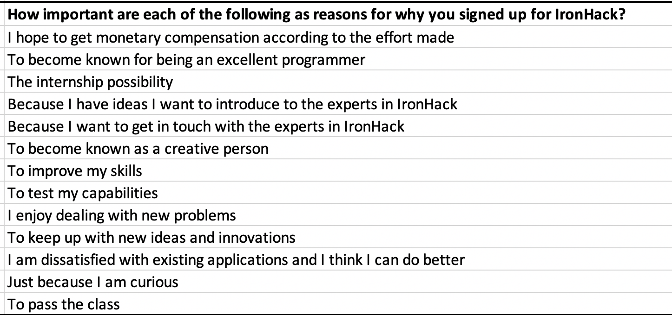
PCA Survey Q2 Motivations
How important are each of the following as reasons for why you signed up for IronHack?
Cronbach’s alpha (0.8740) (Good Consistency)
KMO ( 0.9252 ) ( adequate )
Barlett’s Test ( 5.3826e-23) ( significant )

Slide 36
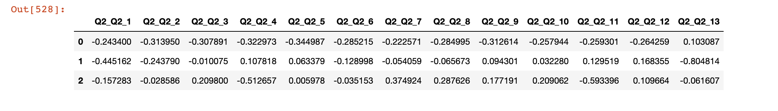
PCA Survey Q2
Three Principle Components Explained 63.65% of the Variance.
PC1 explained 45.49% of the variance - Person with high value for PC1 will have low Q4 (0.323 ) and low Q5 ( 0.345 ) and low Q2 ( 0.314 )
PC2 explained 10.15% of the variance – Person with high value for PC2 will have low Q13 ( 0.805 ) and low Q1 ( 0.445 ).
PC3 explained 8.01% of the variance – Person with high value for PC3 will have low Q4 ( 0.5127 ).

Slide 37
PCA Survey Q2
Features by importance:
[(5.839735054043034, 'Q2_Q2_13'), (4.636818964269485, 'Q2_Q2_5'), (4.538149110813588, 'Q2_Q2_2'), (4.522662372716051, 'Q2_Q2_1'), (4.387088637503117, 'Q2_Q2_4'), (4.234664206641395, 'Q2_Q2_9'), (4.119574038933979, 'Q2_Q2_3'), (3.922502790812984, 'Q2_Q2_6'), (3.840675387905758, 'Q2_Q2_8'), (3.7292214581674994, 'Q2_Q2_12'), (3.5871174171973936, 'Q2_Q2_11'), (3.458266845317514, 'Q2_Q2_10'), (3.001852776427413, 'Q2_Q2_7')]
Interpretation: Q2_Q2_5 [ Q5 ] is 'Because I want to get in touch with the experts in IronHacks’ [ 2nd important ]
Q2_Q2_13 [ Q13 ] is 'To pass the class’ [ most important ]
Q2_Q2_2 [ Q2 ] is ‘To become known for being an excellent programmer’
[ 3rd important ]
Q2_Q2_1 [ Q1 ] is ‘I hope to get monetary compensation according to the effort made’ [ 4th important ]
Q2_Q2_4 [ Q4 ] is ‘Because I have ideas I want to introduce to the experts in IronHacks’ [ 5th important ]

Slide 38
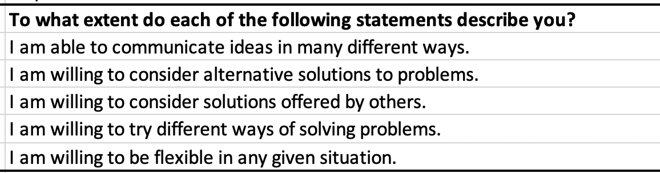
PCA Survey Q3 Openness/flexibilty
To what extent do each of the following statements describe you?
Cronbach’s alpha (0.8004) (Good Consistency)
KMO ( 0.764 ) ( adequate )
Barlett’s Test ( 1.822e-55 ) ( significant )

Slide 39
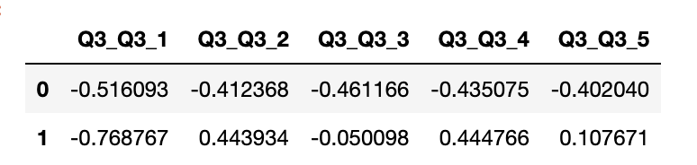
PCA Survey Q3
Two Principle Components Explained 75.11% of the Variance.
PC1 explained 55.93% of the variance - Person with High Value for PC1 will have
low Q1 ( 0.516 ) and low Q3 ( 0.461 )
PC2 explained 19.18% of the variance – Person with High Value for PC2 will have
low Q1 ( 0.7688 ) and high Q4 ( 0.4448 )

Slide 40
PCA Survey Q3
Interpretation: Q3_Q3_1 [ Q1 ] is 'I am able to communicate ideas in many different ways’ [ most important ]
Q3_Q3_3 [ Q3 ] is ‘I am willing to consider solutions offered by others’ [ 2nd important ]
Q3_Q3_4 [ Q4 ] is ‘I am willing to try different ways of solving problems’ [ 3rd important ]

Slide 41
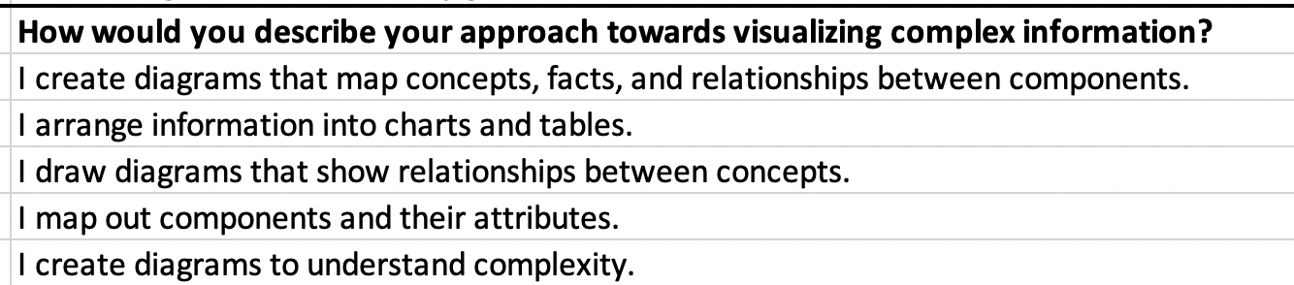
PCA Survey Q4 Skill level
How would you describe your approach towards visualizing complex information?
Cronbach’s alpha (0.8158) (Good Consistency)
KMO ( 0.8006 ) ( adequate )
Barlett’s Test ( 2.7514e-58 ) ( significant )

Slide 42
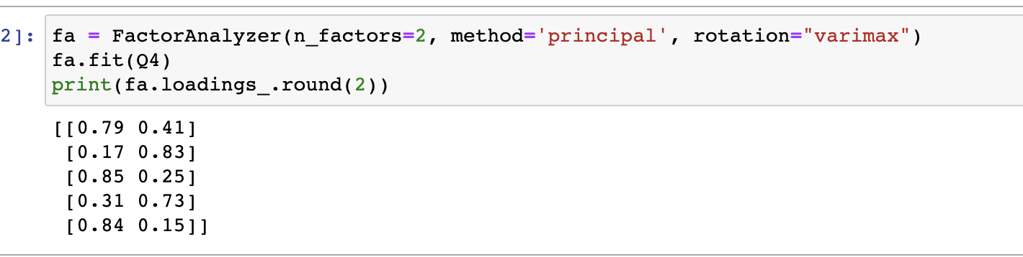
PCA Survey Q4 Skill level
PC1 – 1, 3, 5
PC2 – 2, 4
Two PCs explains 73% of the variance

Slide 43
PCA Survey Q4
Two Principle Components Explained 73.28% of the Variance.
PC1 explained 58.84% of the variance - Person with High Value for PC1 will have low Q1 (0.5567) and low Q3 (0.4819 )
PC2 explained 14.44% of the variance – Person with High Value for PC2 will have high Q5 ( 0.3725 ) and low Q4 ( 0.4244 )

Slide 44
PCA Survey Q4
Interpretation: Q4_Q4_1 [ Q1 ] is ‘I create diagrams that map concepts, facts, and relationships between components’ [ most important ]
Q4_Q4_3 [ Q3 ] is ‘I draw diagrams that show relationships between concepts’ [ 2nd important ]
Q4_Q4_5 [ Q5 ] is ‘I create diagrams to understand complexity’ [ 3rd important ]
Q4_Q4_4 [ Q4 ] is ‘I map out components and their attributes’ [ 4th important ]

Slide 45
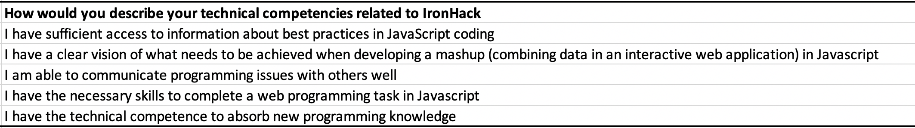
PCA Survey Q5 Individual level absorptive capacity
How would you describe your technical competencies related to IronHack?
Cronbach’s alpha (0.7834 ) ( acceptable consistency)
KMO (0.6526 ) (adequate)
Barlett’s Test (3.955e-61) (significant)

Slide 46
PCA. Survey Q5
Interpretation: Q5_Q5_4 [ Q4 ] is ‘I have the necessary skills to complete a web programming task in Javascript’ [ most important ]
Q5_Q5_2 [ Q2 ] is ‘I have a clear vision of what needs to be achieved when developing a mashup (combining data in an interactive web application) in Javascript’ [ 2nd important ]
Q5_Q5_1 [ Q1 ] is ‘I have sufficient access to information about best practices in JavaScript coding’ [ 4th important ]
Q5_Q5_3 [ Q3 ] is ‘I am able to communicate programming issues with others well’ [ 3rd important ]
Q5_Q5_5 [ Q5 ] is ‘I have the technical competence to absorb new programming knowledge’ [ 5th important ]

Slide 47
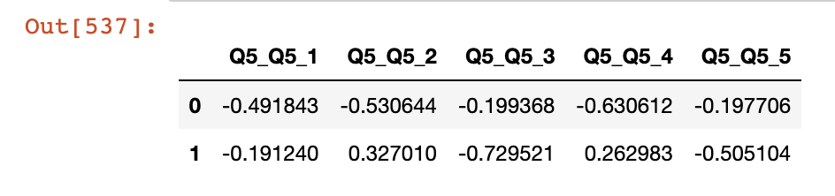
PCA Survey Q5
Two Principle Components Explained 73.28% of the Variance.
PC1 explained 58.84% of the variance - Person with High Value for PC1 will have low Q4 (0.6306) and low Q2 (0.5306 ) and low Q1 ( 0.4918 )
PC2 explained 14.44% of the variance – Person with High Value for PC2 will have low Q3 ( 0.7295) and low Q5 (0.5051)

Slide 48
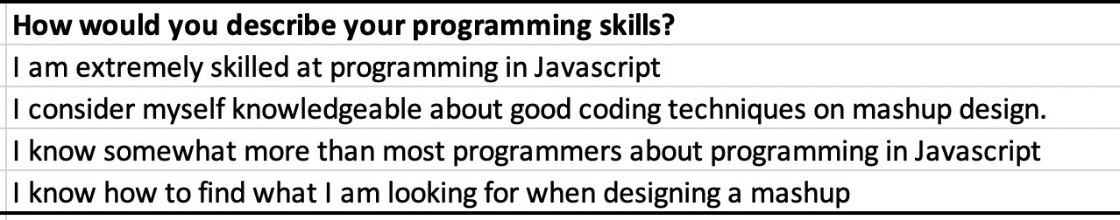
PCA Survey Q7 Individual level absorptive capacity
How would you describe your programming skills?
Cronbach’s alpha (0.8772 ) ( acceptable consistency)
KMO (0.7453 ) (adequate)
Barlett’s Test (1.323e-82) (significant)

Slide 49
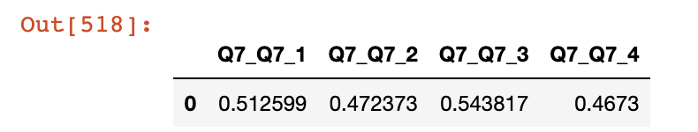
PCA Survey Q7
One Principle Components Explained 73.4% of the Variance.
PC1 explained 73.4% of the variance - Person with High Value for PC1 will have high Q1 (0.5126) and high Q3 (0.5438 ).

Slide 50
PCA Survey Q7
Interpretation:
Q7_Q7_3 [ Q3 ] is ‘I know somewhat more than most programmers about programming in Javascript’ [ most important ]
Q7_Q7_1 [ Q1 ] is ‘I am extremely skilled at programming in Javascript’ [ 2nd important ]

Slide 51
Takeaway
• Understand what the goal of analysis is and choose PCA or EFA for the data analysis
• Having done one analysis there is no need to do the other analysis.

