Slide 1

Survey Analysis for All Treatment Groups
Spring 2017

Slide 2
Visual Explanation of The Mathematics Behind PCA
https://github.com/ironhacks/analysis-2017/wiki/PCA-vs-FA-Theory

Slide 3
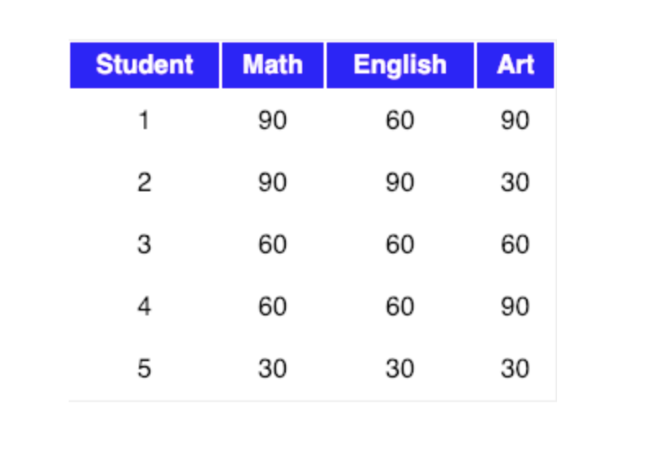
The Mathematics Behind PCA
Let our data matrix X be the score of three students:

Slide 4
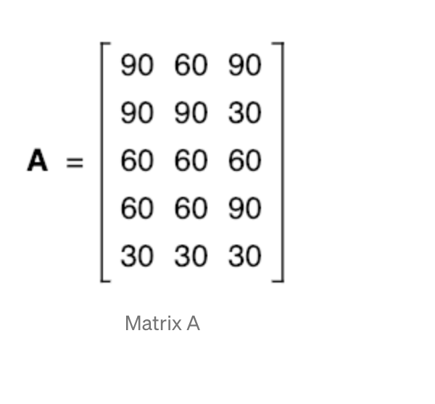
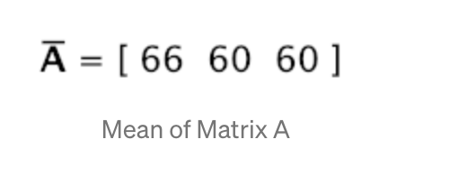
Compute the mean of every dimension of the whole dataset

Slide 5
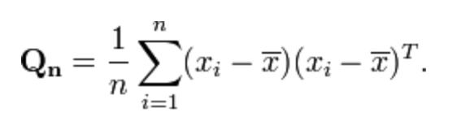
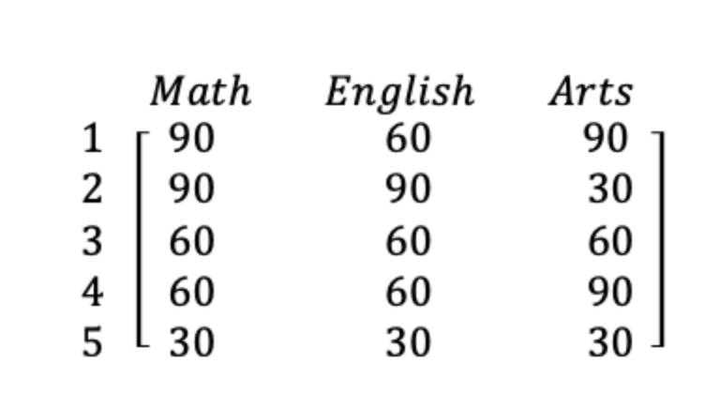
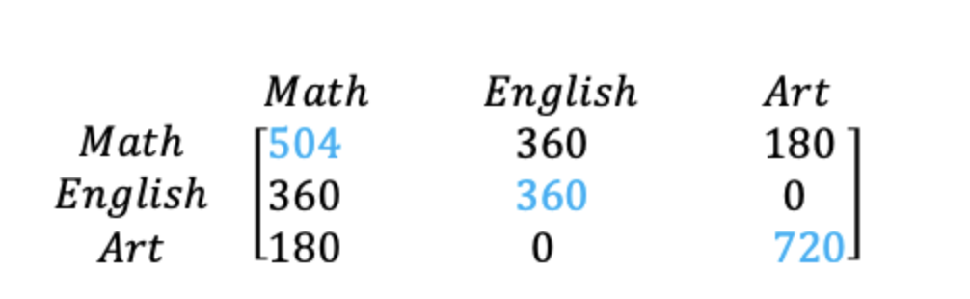
The covariance matrix of the sample can be expressed as
Original Matrix
Covariance Matrix
Notes:
Few points that can be noted here is :
Shown in Blue along the diagonal, we see the variance of scores for each test. The art test has the biggest variance (720); and the English test, the smallest (360). So we can say that art test scores have more variability than English test scores.
The covariance is displayed in black in the off-diagonal elements of the matrix A
a) The covariance between math and English is positive (360), and the covariance between math and art is positive (180). This means the scores tend to covary in a positive way. As scores on math go up, scores on art and English also tend to go up; and vice versa.
b) The covariance between English and art, however, is zero. This means there tends to be no predictable relationship between the movement of English and art scores.

Slide 6
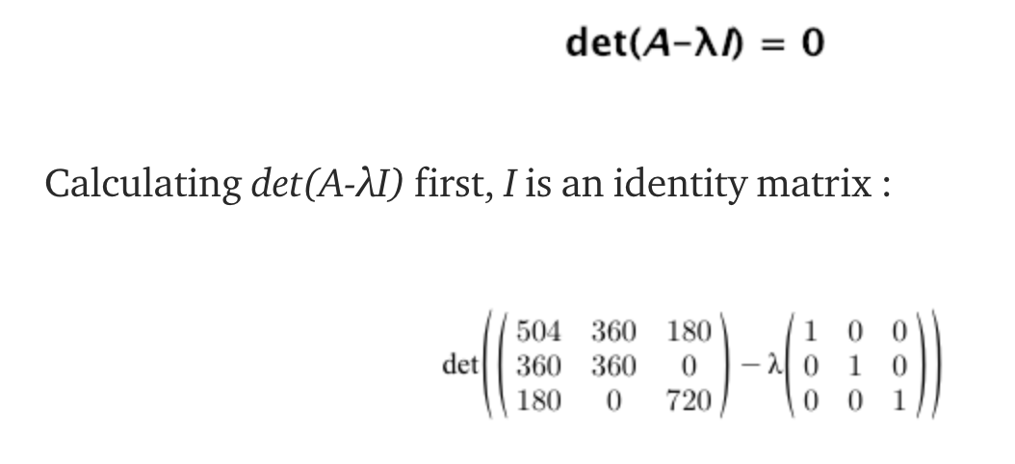
Notes:
Intuitively, an eigenvector is a vector whose direction remains unchanged when a linear transformation is applied to it.
Now, we can easily compute eigenvalue and eigenvectors from the covariance matrix that we have above.
Let A be a square matrix, ν a vector and λ a scalar that satisfies Aν = λν, then λ is called eigenvalue associated with eigenvector ν of A.
The eigenvalues of A are roots of the characteristic equation
Definition of identity matrix - a square matrix in which all the elements of the principal diagonal are ones and all other elements are zeros. The effect of multiplying a given matrix by an identity matrix is to leave the given matrix unchanged.

Slide 7
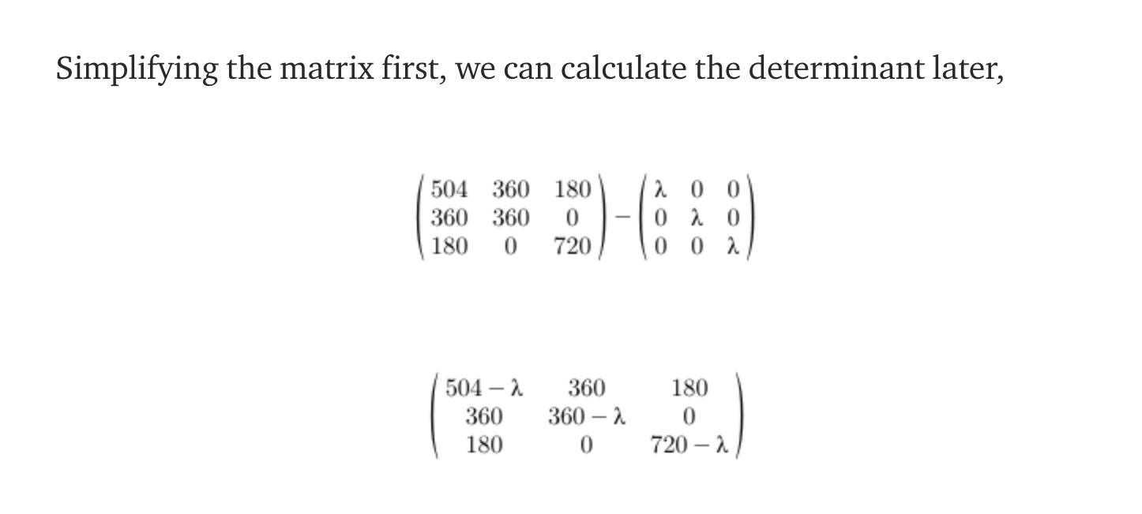
Notes:
Intuitively, an eigenvector is a vector whose direction remains unchanged when a linear transformation is applied to it.
Now, we can easily compute eigenvalue and eigenvectors from the covariance matrix that we have above.
Let A be a square matrix, ν a vector and λ a scalar that satisfies Aν = λν, then λ is called eigenvalue associated with eigenvector ν of A.
The eigenvalues of A are roots of the characteristic equation
Definition of identity matrix - a square matrix in which all the elements of the principal diagonal are ones and all other elements are zeros. The effect of multiplying a given matrix by an identity matrix is to leave the given matrix unchanged.

Slide 8

Notes:
Intuitively, an eigenvector is a vector whose direction remains unchanged when a linear transformation is applied to it.
Now, we can easily compute eigenvalue and eigenvectors from the covariance matrix that we have above.
Let A be a square matrix, ν a vector and λ a scalar that satisfies Aν = λν, then λ is called eigenvalue associated with eigenvector ν of A.
The eigenvalues of A are roots of the characteristic equation
Definition of identity matrix - a square matrix in which all the elements of the principal diagonal are ones and all other elements are zeros. The effect of multiplying a given matrix by an identity matrix is to leave the given matrix unchanged.

Slide 9
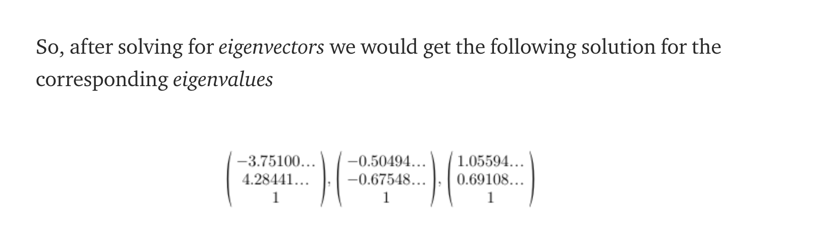
Now, we can calculate the eigenvectors corresponding to the above eigenvalues.
Notes:
Intuitively, an eigenvector is a vector whose direction remains unchanged when a linear transformation is applied to it.
Now, we can easily compute eigenvalue and eigenvectors from the covariance matrix that we have above.
Let A be a square matrix, ν a vector and λ a scalar that satisfies Aν = λν, then λ is called eigenvalue associated with eigenvector ν of A.
The eigenvalues of A are roots of the characteristic equation
Definition of identity matrix - a square matrix in which all the elements of the principal diagonal are ones and all other elements are zeros. The effect of multiplying a given matrix by an identity matrix is to leave the given matrix unchanged.

Slide 10
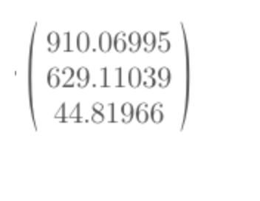
To decide which eigenvector(s) we want to drop for our lower-dimensional subspace, we have to take a look at the corresponding eigenvalues of the eigenvectors. Roughly speaking, the eigenvectors with the lowest eigenvalues bear the least information about the distribution of the data.
So, after sorting the eigenvalues in decreasing order, we have drop.
Notes:
So, in order to decide which eigenvector(s) we want to drop for our lower-dimensional subspace, we have to take a look at the corresponding eigenvalues of the eigenvectors. Roughly speaking, the eigenvectors with the lowest eigenvalues bear the least information about the distribution of the data, and those are the ones we want to drop.
The common approach is to rank the eigenvectors from highest to lowest corresponding eigenvalue and choose the top k eigenvectors.
So, after sorting the eigenvalues in decreasing order, we have

Slide 11
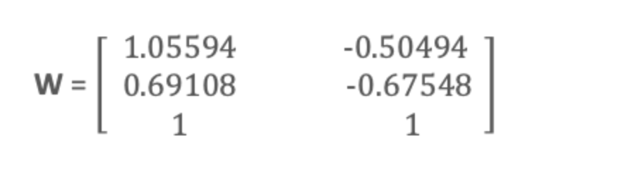
For our simple example, where we are reducing a 3-dimensional feature space to a 2-dimensional feature subspace, we are combining the two eigenvectors with the highest eigenvalues to construct our d×k dimensional eigenvector matrix W.
So, eigenvectors corresponding to two maximum eigenvalues are:
Notes:
So, in order to decide which eigenvector(s) we want to drop for our lower-dimensional subspace, we have to take a look at the corresponding eigenvalues of the eigenvectors. Roughly speaking, the eigenvectors with the lowest eigenvalues bear the least information about the distribution of the data, and those are the ones we want to drop.
The common approach is to rank the eigenvectors from highest to lowest corresponding eigenvalue and choose the top k eigenvectors.
So, after sorting the eigenvalues in decreasing order, we have

Slide 12
Transform the samples onto the new subspace
In the last step, we use the 3x2 dimensional matrix W that we just computed to transform our samples onto the new subspace via the equation y = W′ × x where W′ is the transpose of the matrix W.
So lastly, we have computed our two principal components and projected the data points onto the new subspace.
Notes:
So, in order to decide which eigenvector(s) we want to drop for our lower-dimensional subspace, we have to take a look at the corresponding eigenvalues of the eigenvectors. Roughly speaking, the eigenvectors with the lowest eigenvalues bear the least information about the distribution of the data, and those are the ones we want to drop.
The common approach is to rank the eigenvectors from highest to lowest corresponding eigenvalue and choose the top k eigenvectors.
So, after sorting the eigenvalues in decreasing order, we have

Slide 13
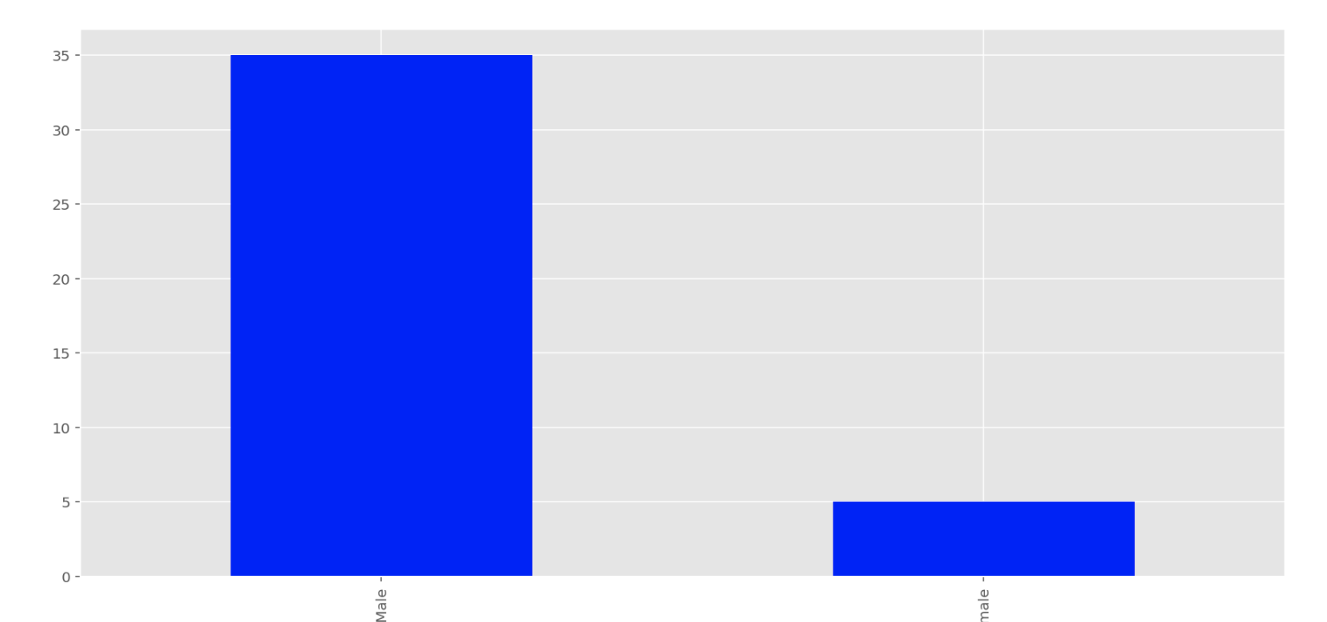
Bogota 0 No Transparency
Q17 - What is your gender?

Slide 14
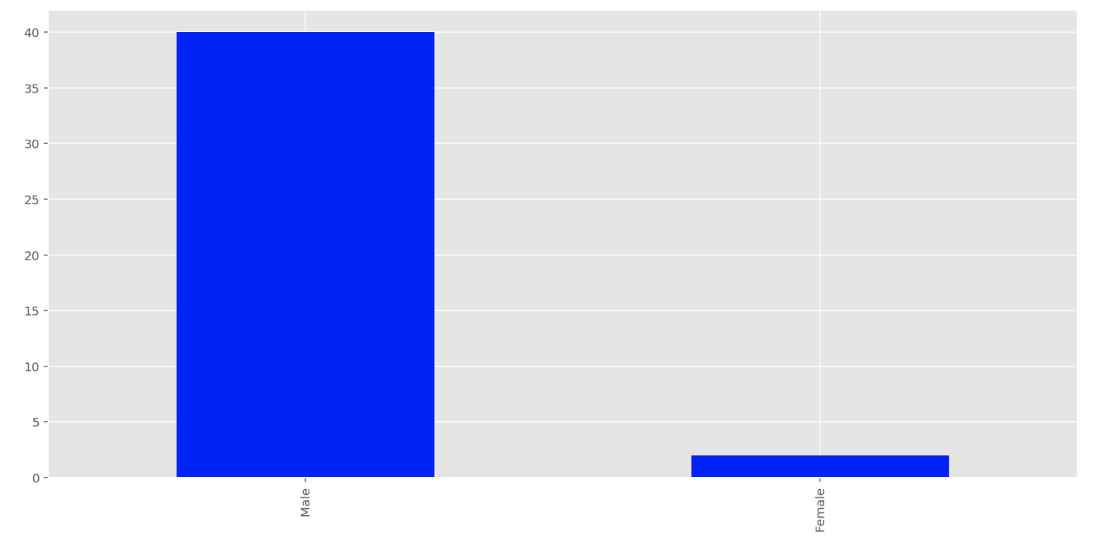
Bogota 1 Performance Transparency
Q17 - What is your gender?

Slide 15
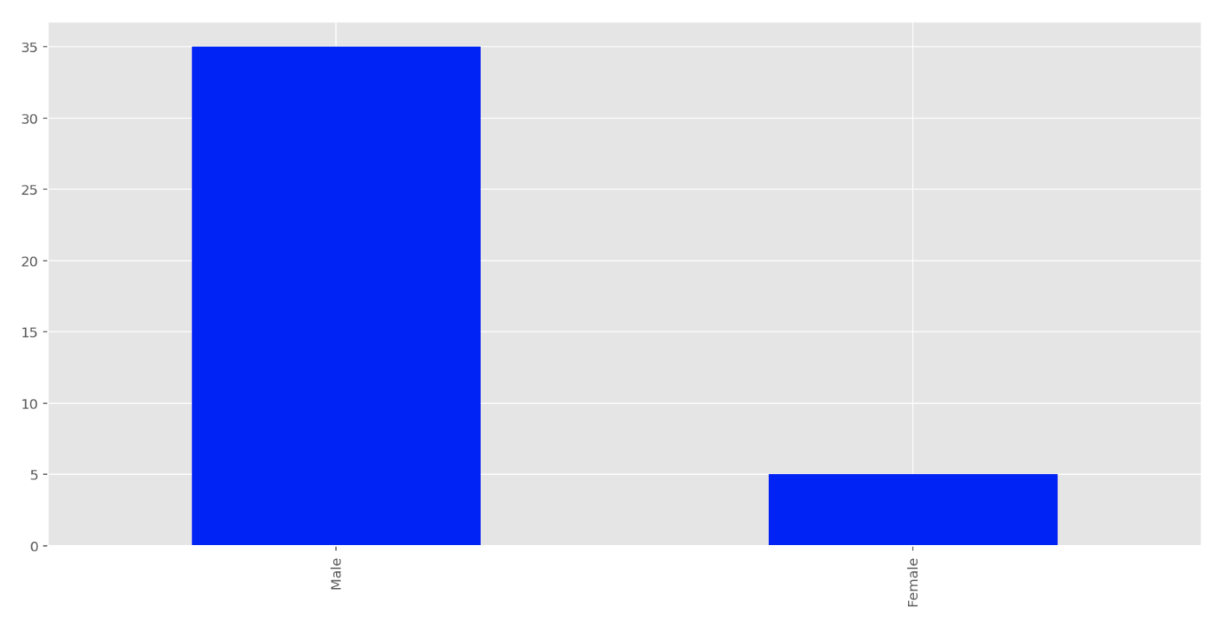
Bogota 2 Solution Transparency
Q17 - What is your gender?

Slide 16
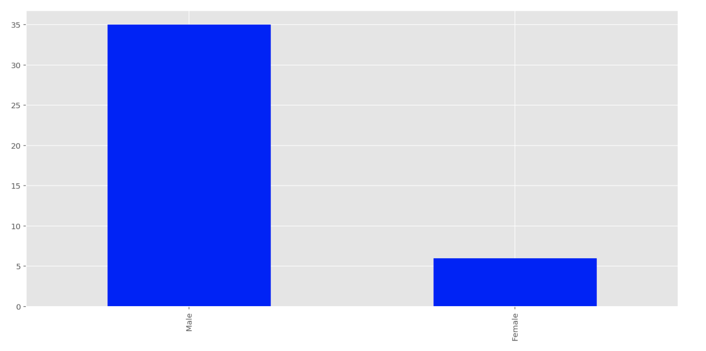
Bogota 3 Full Transparency
Q17 - What is your gender?

Slide 17
Interpretation: Q17 – What is your gender
Majority of the participants are male in all 4 treatment groups

Slide 18
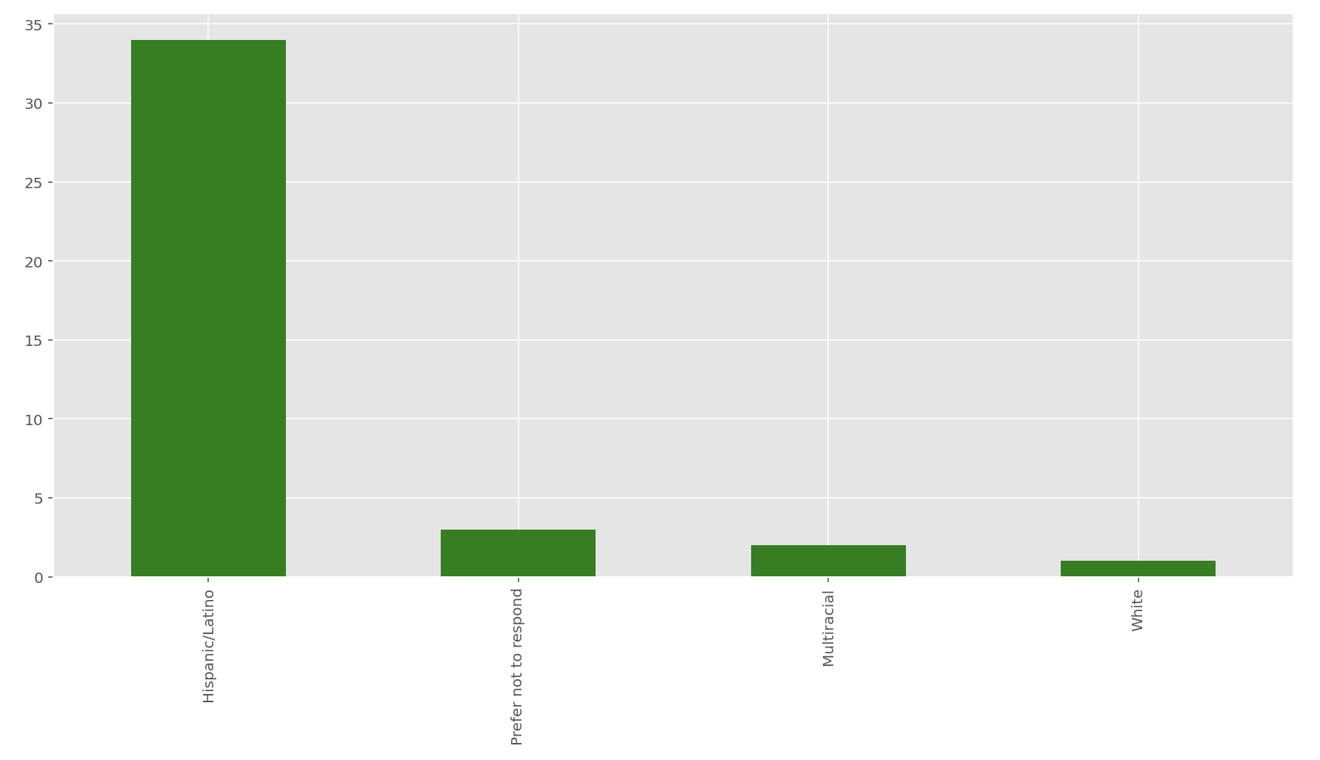
Bogota 0 No Transparency
Q18 - What is your race/ethnicity?

Slide 19
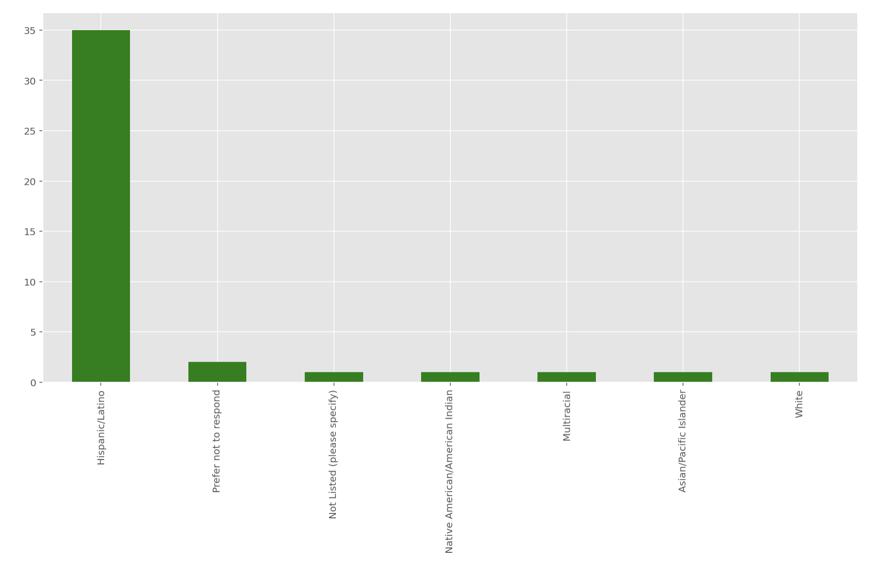
Bogota 1 Performance Transparency
Q18 - What is your race/ethnicity?

Slide 20
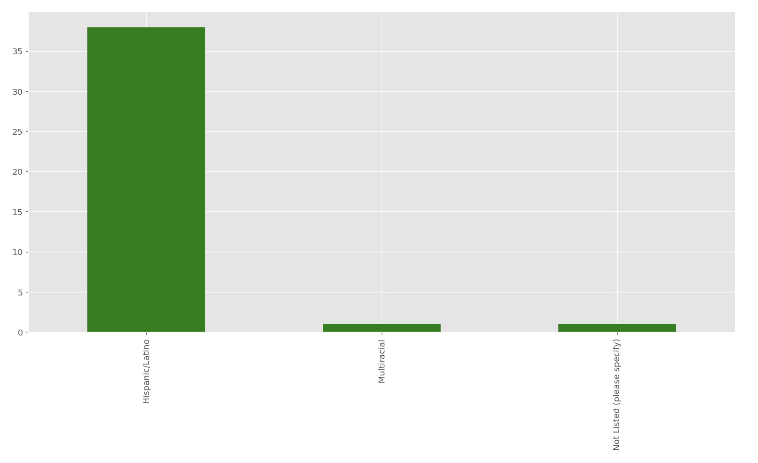
Bogota 2 Solution Transparency
Q18 - What is your race/ethnicity?

Slide 21
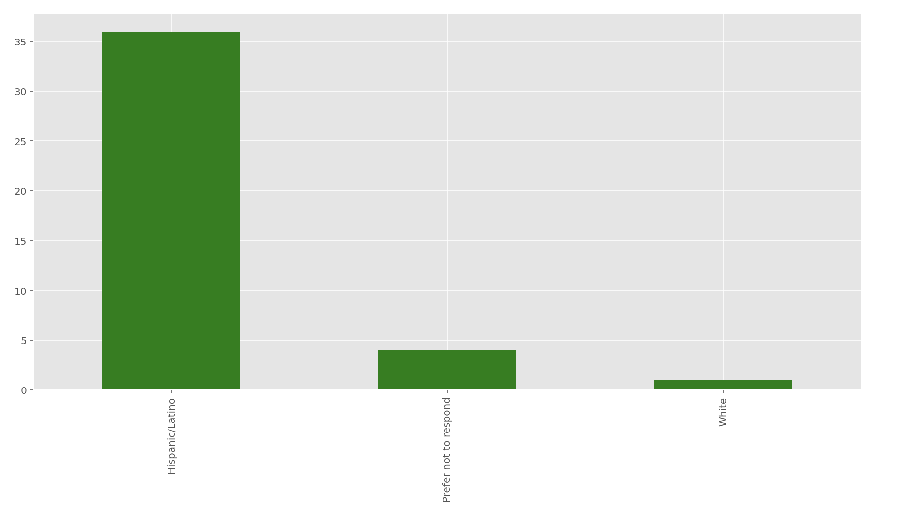
Bogota 3 Full Transparency
Q18 - What is your race/ethnicity?

Slide 22
Interpretation: Q18 - What is your race/ethnicity?
Majority of the participants are Hispanic/Latino in all 4 treatment groups

Slide 23
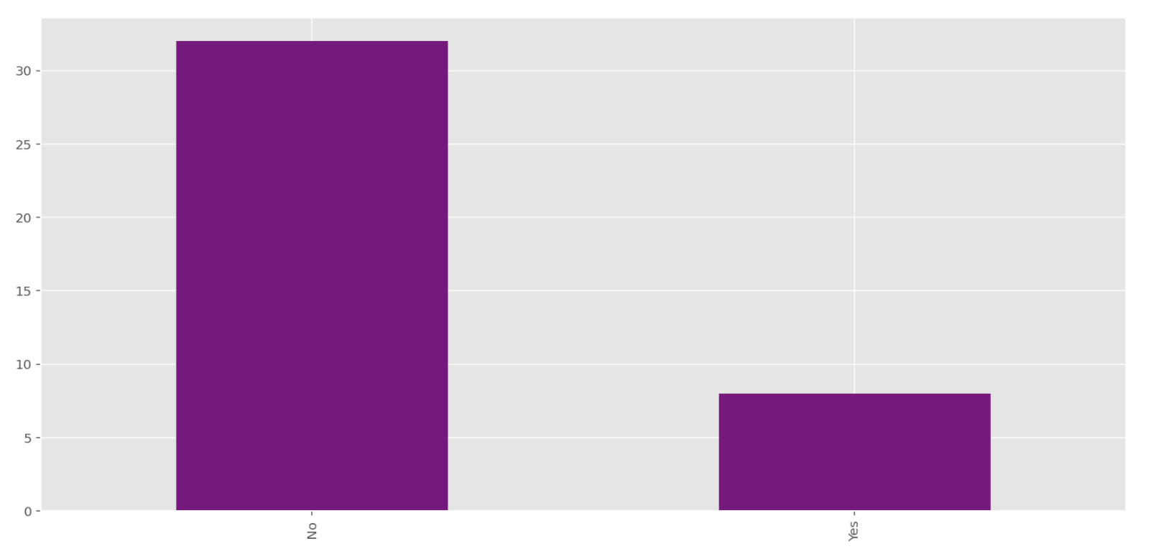
Bogota 0 No Transparency
Q9 - Have you participated in any programming competition before (e.g. Topcoder.com, local hacking events etc.)?

Slide 24
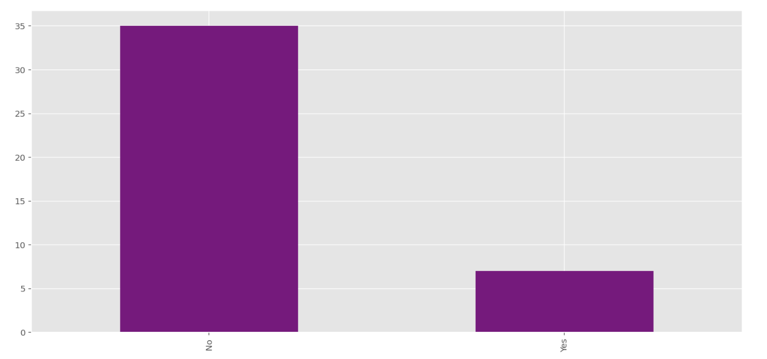
Bogota 1 Performance Transparency
Q9 - Have you participated in any programming competition before (e.g. Topcoder.com, local hacking events etc.)?

Slide 25
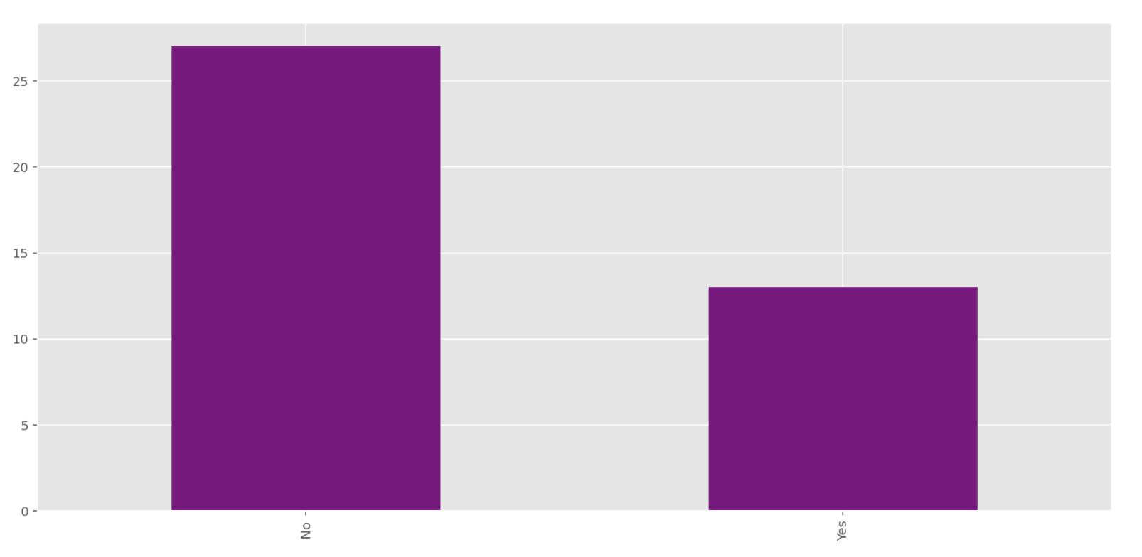
Bogota 2 Solution Transparency
Q9 - Have you participated in any programming competition before (e.g. Topcoder.com, local hacking events etc.)?

Slide 26
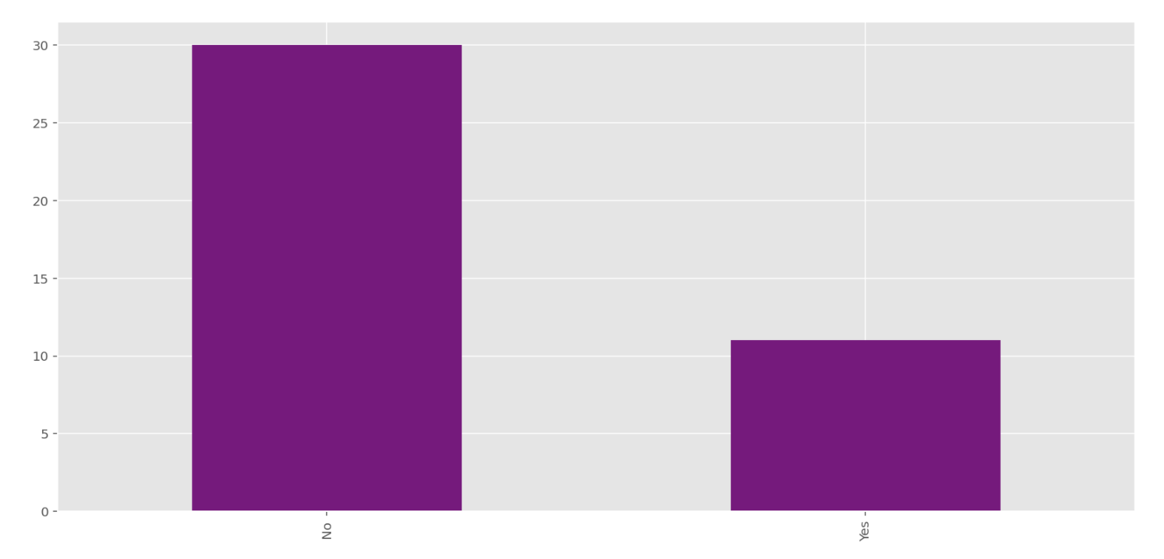
Bogota 3 Full Transparency
Q9 - Have you participated in any programming competition before (e.g. Topcoder.com, local hacking events etc.)?

Slide 27
Interpretation: Q9 - Have you participated in any programming competition before (e.g. Topcoder.com, local hacking events etc.)?
Majority of the participants have not participated in any programming competition before in all 4 groups.

Slide 28
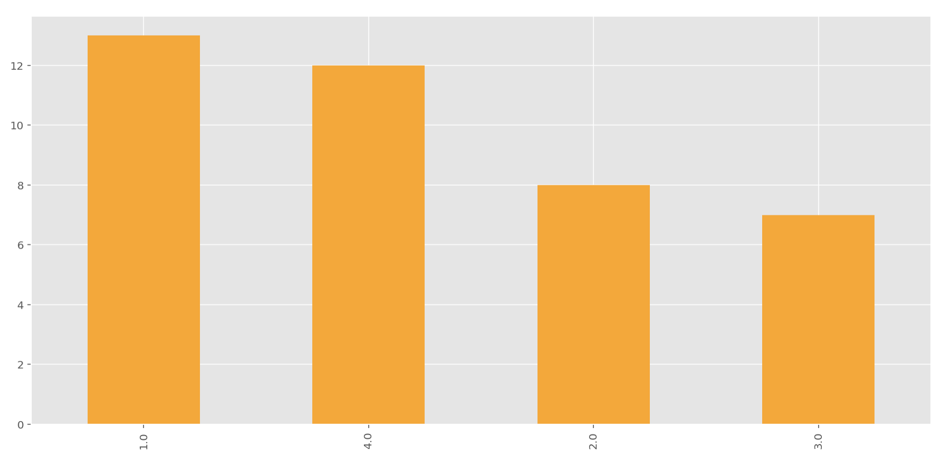
Bogota 0 No Transparency
Q24 - In which of the following classes are you enrolled?

Slide 29
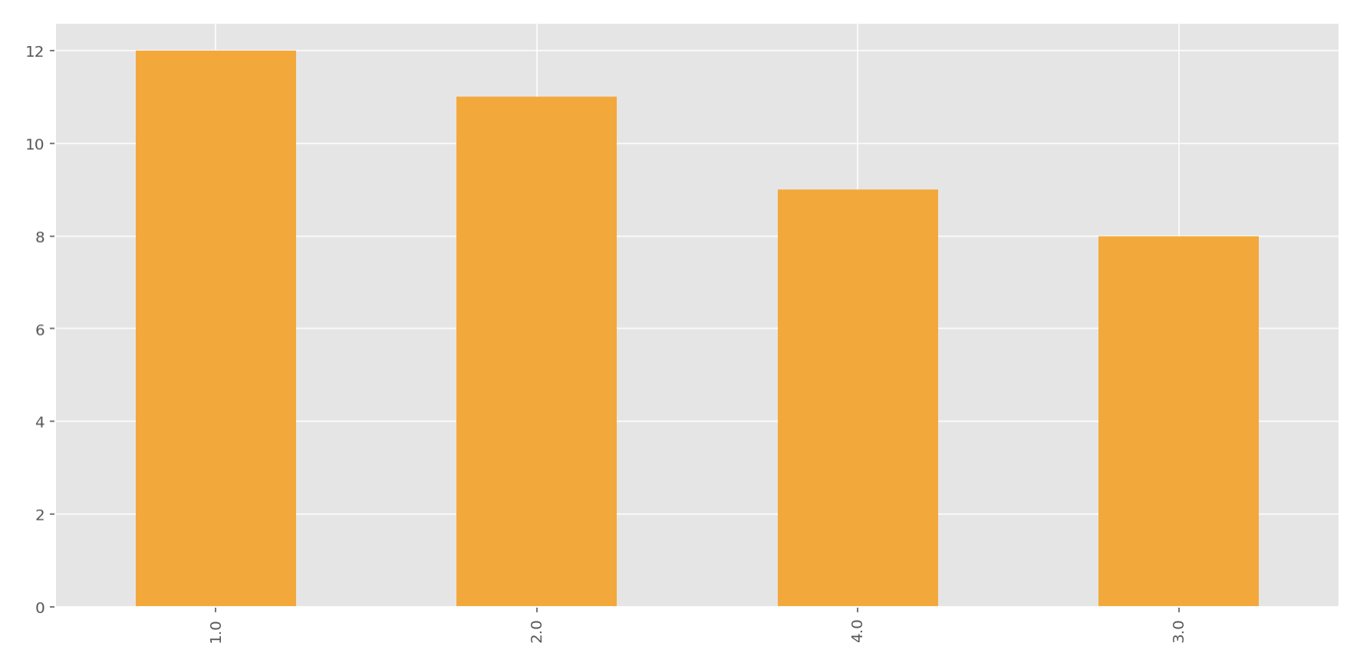
Bogota 1 Performance Transparency
Q24 - In which of the following classes are you enrolled?

Slide 30
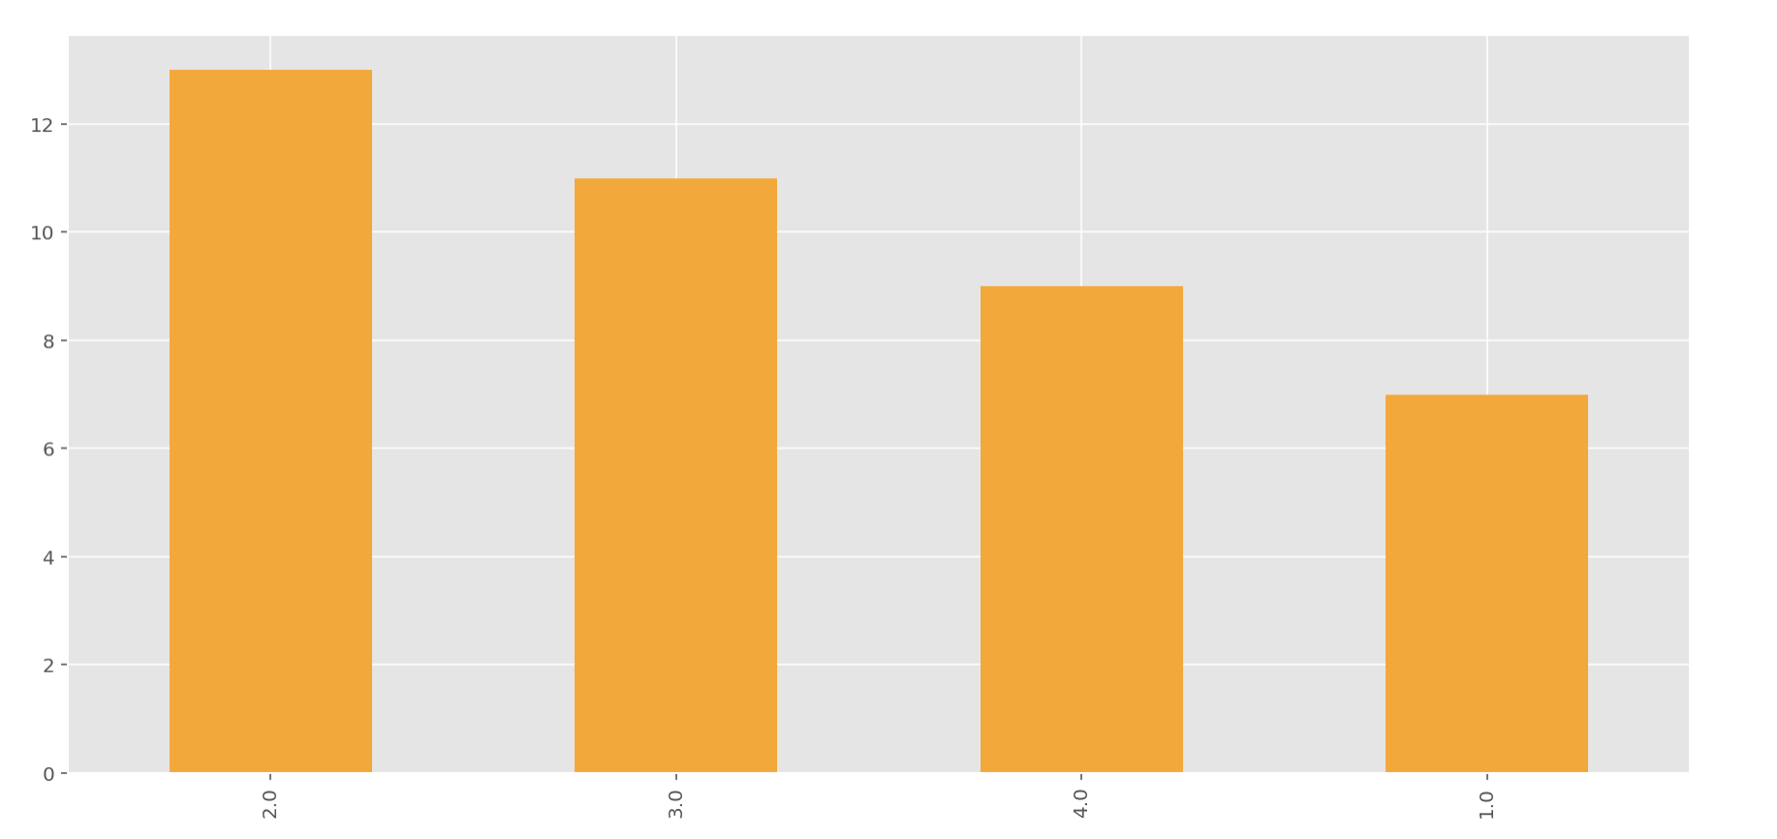
Bogota 2 Solution Transparency
Q24 - In which of the following classes are you enrolled?

Slide 31
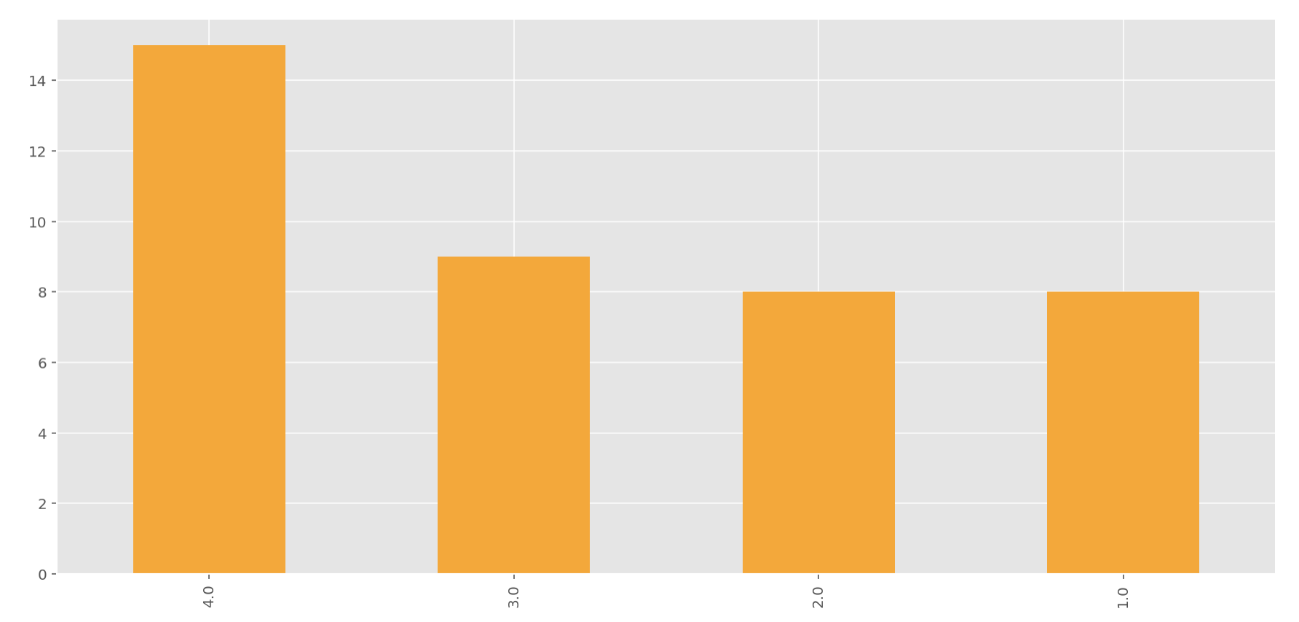
Bogota 3 Full Transparency
Q24 - In which of the following classes are you enrolled?

Slide 32
Interpretation: Q24 - In which of the following classes are you enrolled?
In all of the 4 groups, participants come from all 4 software engineering classes.

Slide 33
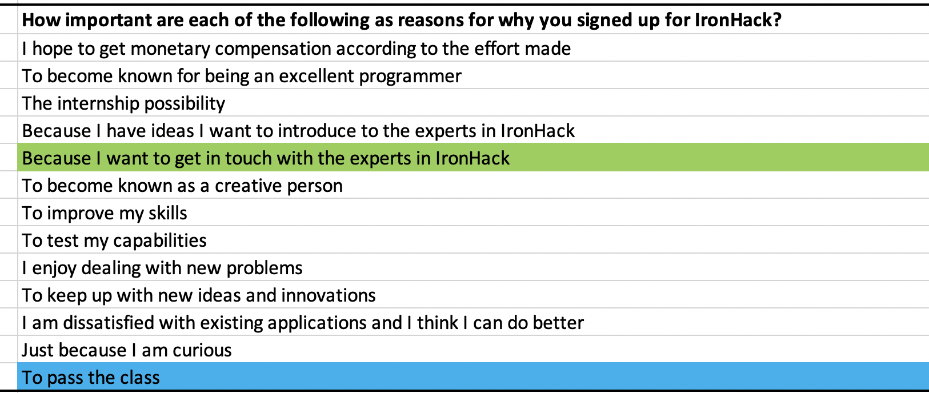
PCA Survey Q2 Motivations
How important are each of the following as reasons for why you signed up for IronHack?
Cronbach’s alpha (0.8740) (Good Consistency)
KMO 0.9252 ( 0.9252 ) ( adequate )
Barlett’s Test ( 5.3826e-23) ( significant )

Slide 34
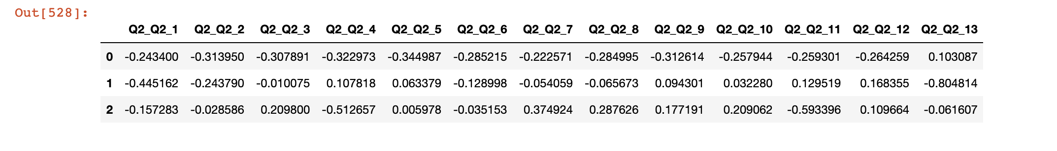
PCA Survey Q2
Three Principle Components Explained 63.65% of the Variance.
PC1 explained 45.49% of the variance - Q2 (31.4% ) and Q5 ( 34.5 % ) loads highly on PC1
PC2 explained 10.15% of the variance – Q13 ( 80.5 % ) loads highly on PC2
PC3 explained 8.01% of the variance – Q4 ( 51.27% ) loads highly on PC3

Slide 35
PCA Survey Q2
Features by importance:
[(5.839735054043034, 'Q2_Q2_13'), (4.636818964269485, 'Q2_Q2_5'), (4.538149110813588, 'Q2_Q2_2'), (4.522662372716051, 'Q2_Q2_1'), (4.387088637503117, 'Q2_Q2_4'), (4.234664206641395, 'Q2_Q2_9'), (4.119574038933979, 'Q2_Q2_3'), (3.922502790812984, 'Q2_Q2_6'), (3.840675387905758, 'Q2_Q2_8'), (3.7292214581674994, 'Q2_Q2_12'), (3.5871174171973936, 'Q2_Q2_11'), (3.458266845317514, 'Q2_Q2_10'), (3.001852776427413, 'Q2_Q2_7')]
Interpretation: Q2_Q2_5 is 'Because I want to get in touch with the experts in IronHacks’ [ 2nd important ]
Q2_Q2_13 is 'To pass the class’ [ most important ]
Q2_Q2_Q2 is ‘To become known for being an excellent programmer’ [ 3rd important ]

Slide 36
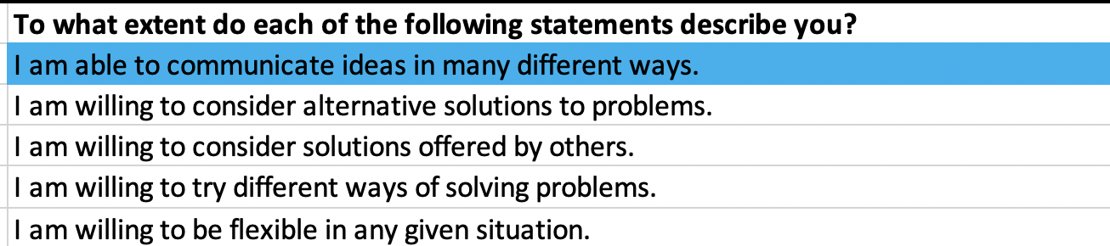
PCA Survey Q3 Openness/flexibilty
To what extent do each of the following statements describe you?
Cronbach’s alpha (0.8740) (Good Consistency)
KMO 0.9252 ( 0.9252 ) ( adequate )
Barlett’s Test ( 5.3826e-23) ( significant )

