Slide 1
Graphics Programming
(Lab1) Introduction to OpenGL
3D Vision Lab
3.20., 2020

Slide 2
Lab 1: Today’s Goal
Install OpenGL development environment.
Understand modern OpenGL rendering pipeline.
Understand shader.
Understand Vertex Array Object and Vertex Buffer Object.
Recommended to read LearnOpenGL ‘Getting started’ part, from ‘OpenGL’ to ‘Shaders’.

Slide 3



What is OpenGL?
Graphics standard API (Silicon Graphics, 1992)
Other graphics APIs
DirectX (Microsoft)
Vulkan (Kronos Group)

Slide 4
GLFW?
Creating a window is OS-specific task.
So we should implement it to use OpenGL APIs.
GLUT, SDL, SFML, GLFW are helping libraries for this task.
GLUT was widely used, but there are no updates no more.
We will use GLFW!

Slide 5
GLAD?
The location of most of OpenGL functions is not known at compile-time and needs to be queried at run-time
Retrieving those locations is OS-specific
GLAD is used for this task in C++

Slide 6
Environment Build Guide
Following installation guide is written assuming that you are using Visual Studio on Windows 10 64bit.
For Linux user, please check the original site. (https://learnopengl.com/Getting-started/Creating-a-window)
If you prefer to use other settings, it’s ok, but please install it by yourself.

Slide 7
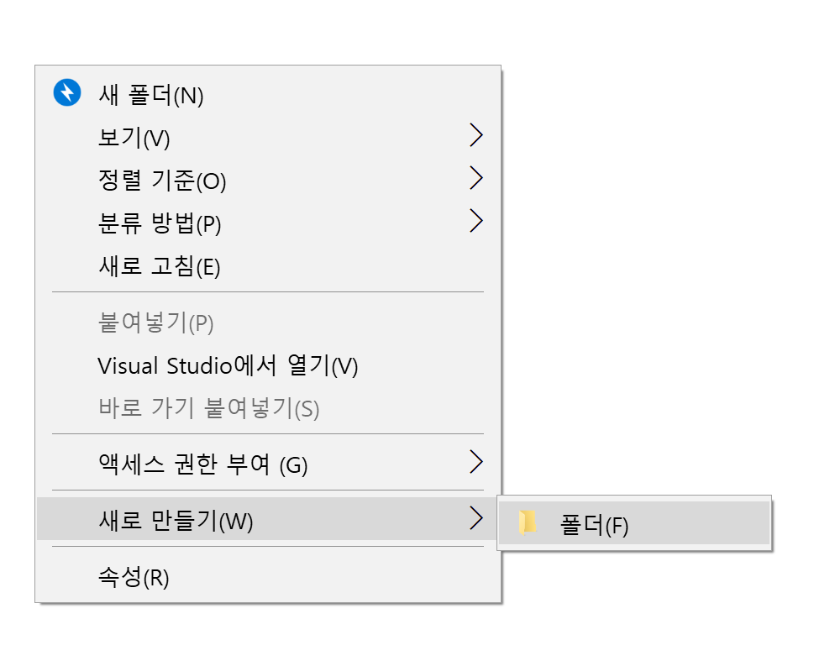
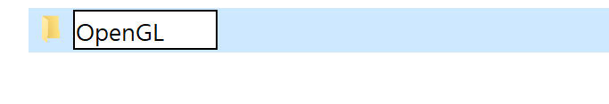
Installing GLFW & GLAD - 1
First of all, make directory(OpenGL) in C:/

Slide 8
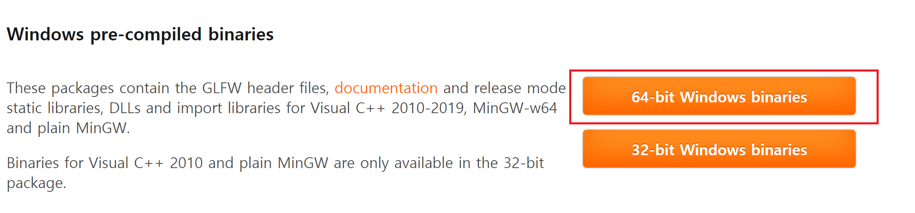
Installing GLFW & GLAD - 2
Download GLFW
Link: https://www.glfw.org/download.html

Slide 9
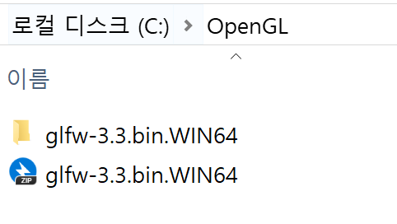
Installing GLFW & GLAD - 3
Move glfw binary zip file to C:/OpenGL directory
Unzip

Slide 10
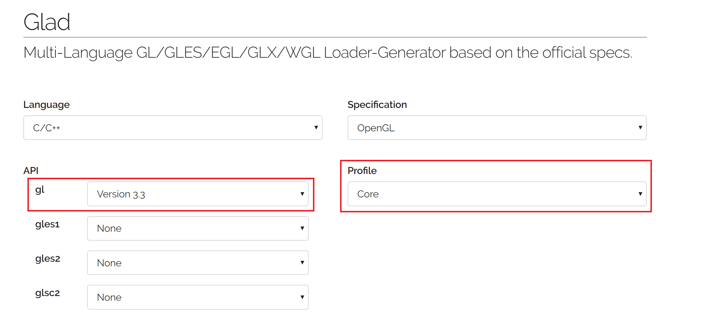
Installing GLFW & GLAD - 4
Download GLAD
Link: https://glad.dav1d.de/

Slide 11
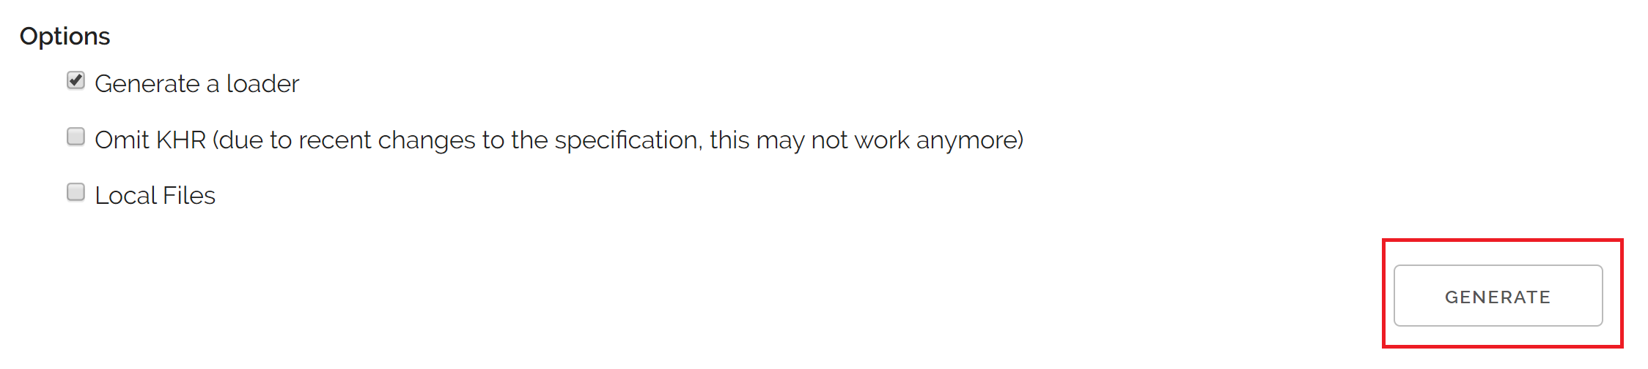
Installing GLFW & GLAD - 4
Download GLAD
Link: https://glad.dav1d.de/

Slide 12
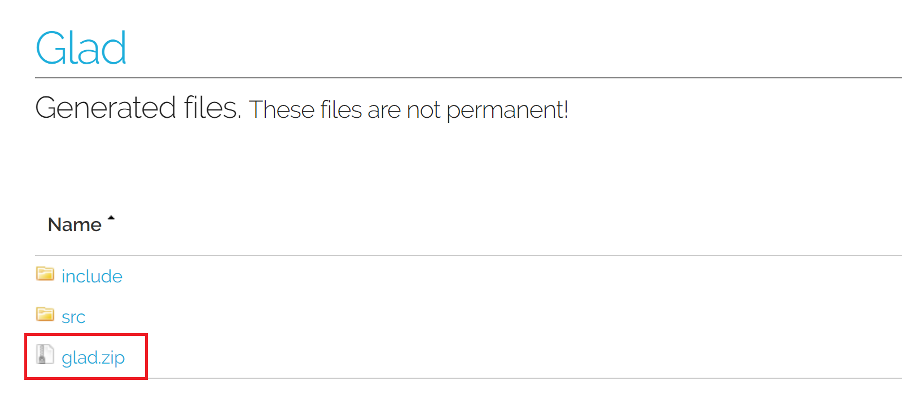
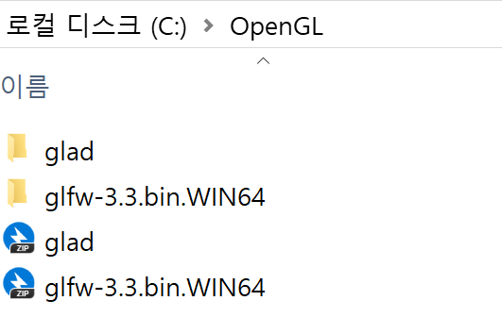
Installing GLFW & GLAD - 5
Download glad.zip & move to C:/OpenGL
Make directory(glad) and unzip glad.zip to glad directory

Slide 13
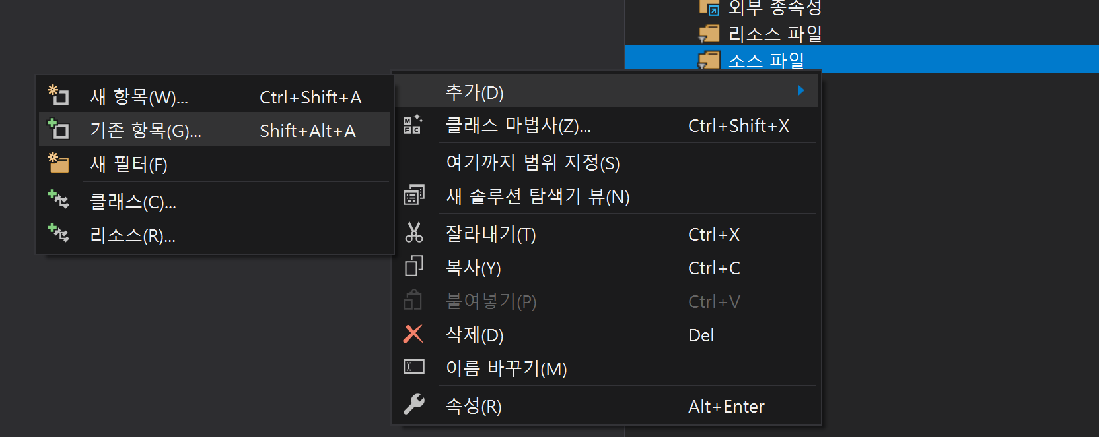
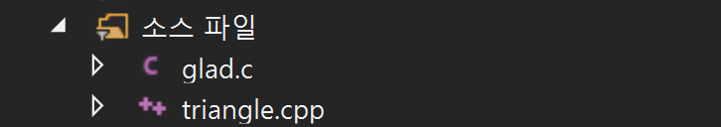
Setting up Visual Studio - 1
New project > empty project(빈 프로젝트)
Add source files
Triangle.cpp from eTL
C:/OpenGL/glad/src/glad.c

Slide 14
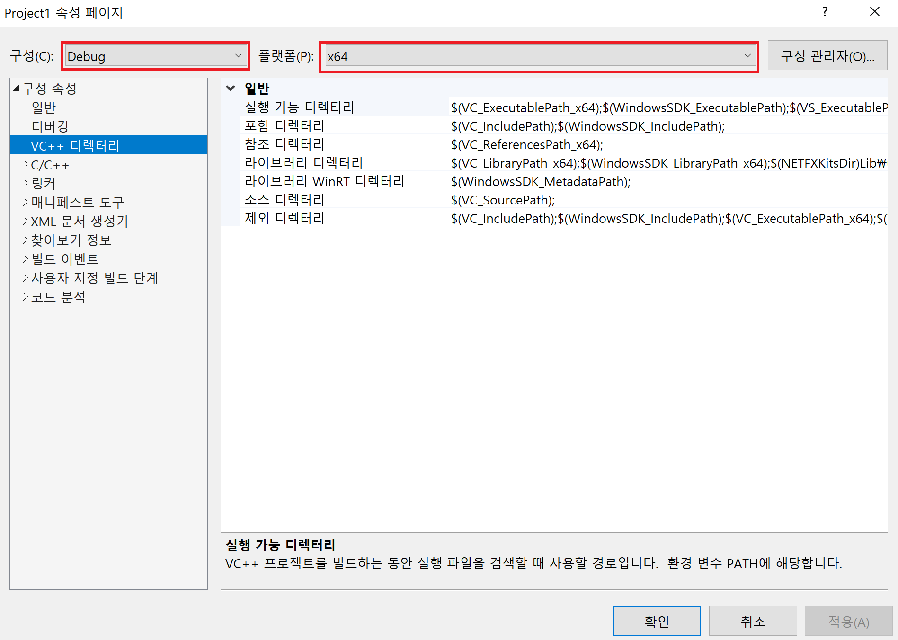
Setting up Visual Studio - 2
Project > Configuration(속성)

Slide 15
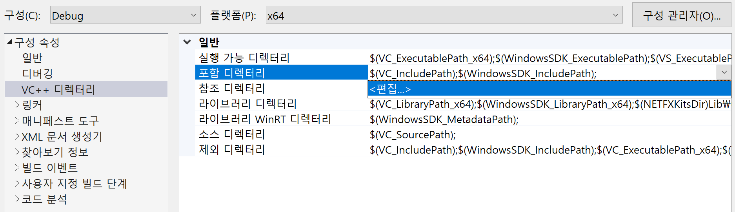
Setting up Visual Studio - 3
Add directories to include directory(포함 디렉토리)
C:\OpenGL\glad\include
C:\OpenGL\glfw-3.3.bin.WIN64\include

Slide 16
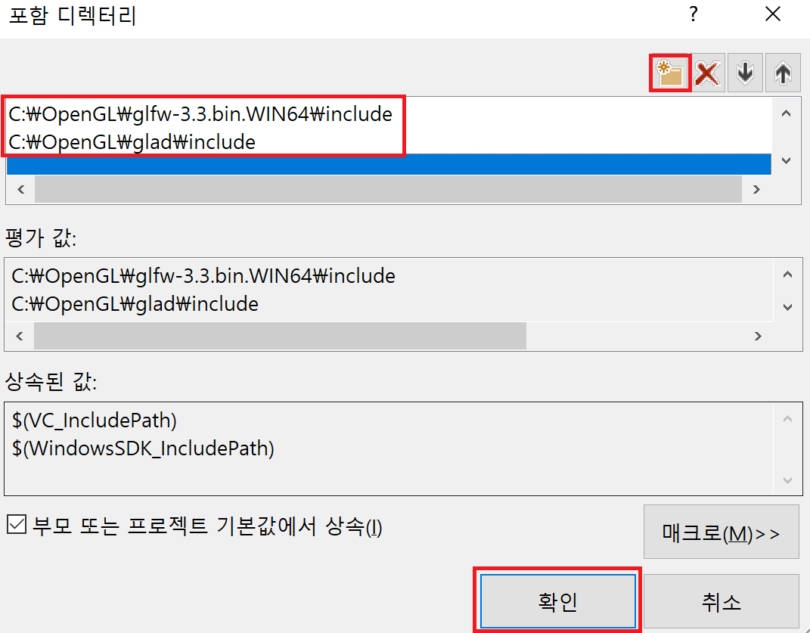
Setting up Visual Studio - 4
Add directories to include directory(포함 디렉토리)
C:\OpenGL\glad\include
C:\OpenGL\glfw-3.3.bin.WIN64\include

Slide 17
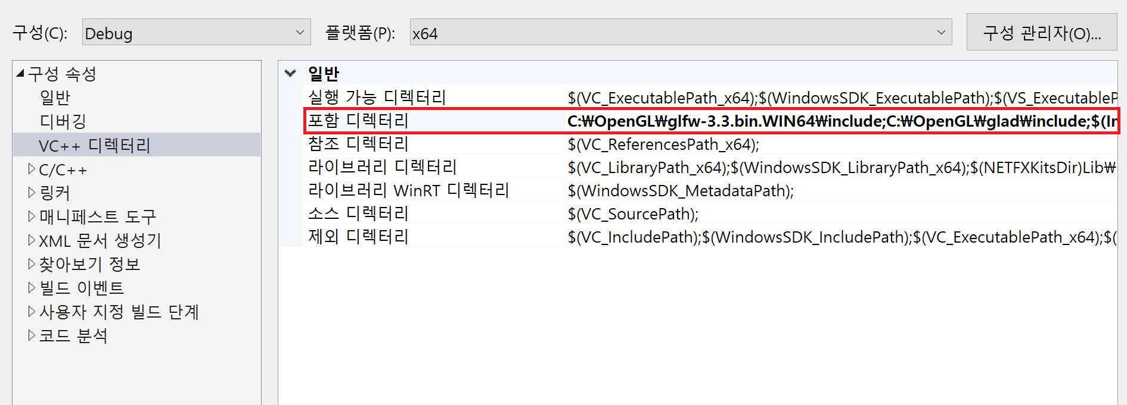
Setting up Visual Studio - 5
Add directories to include directory(포함 디렉토리)
C:\OpenGL\glad\include
C:\OpenGL\glfw-3.3.bin.WIN64\include

Slide 18
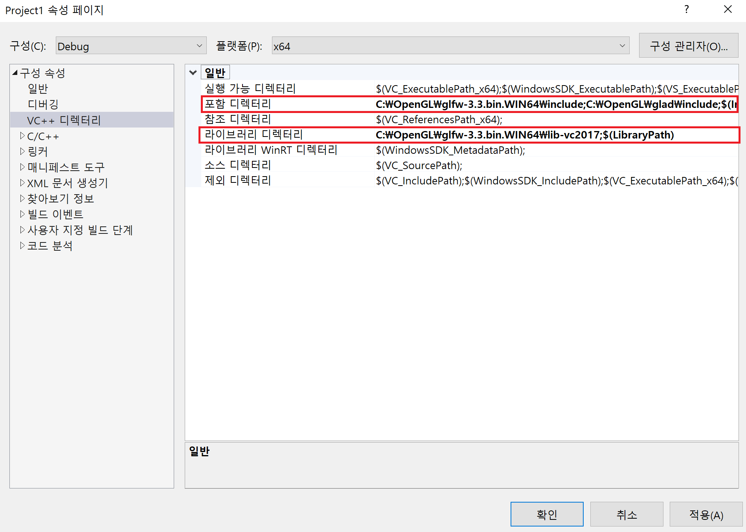
Setting up Visual Studio - 6
Add directories to library directory(포함 디렉토리)
C:\OpenGL\ glfw-3.3.bin.WIN64\lib-vc20XX (corresponding v.s. version)

Slide 19
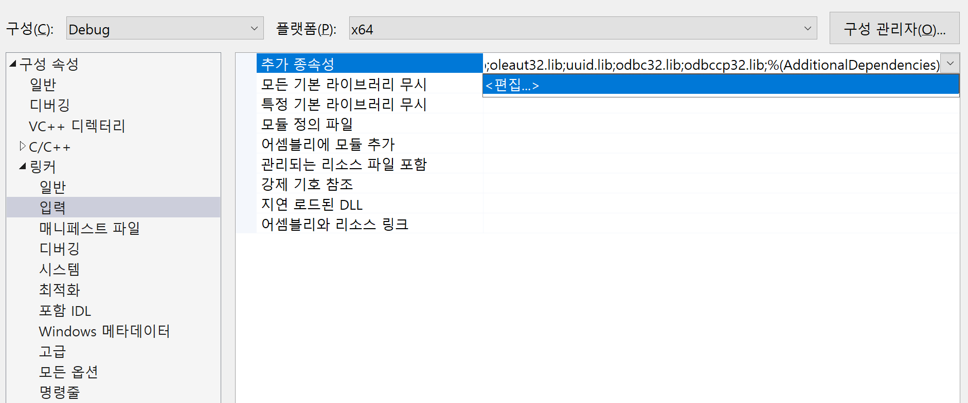
Setting up Visual Studio - 7
Linker > Input(입력) > Additional dependencies(추가 종속성)
Add libraries
glfw3.lib; opengl32.lib

Slide 20
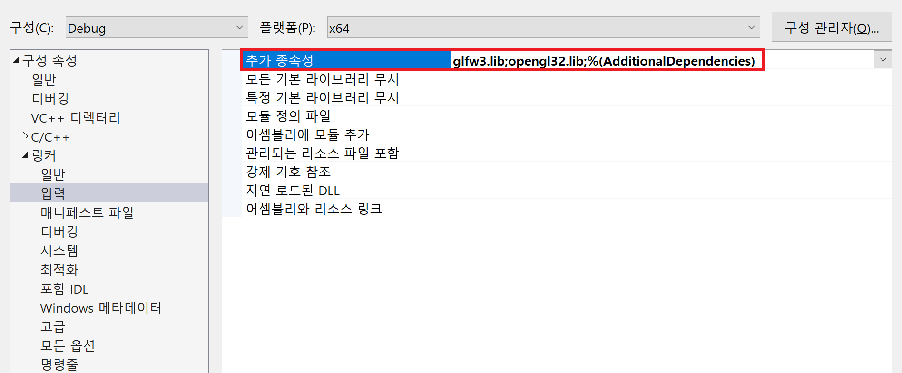
Setting up Visual Studio - 7
Linker > Input(입력) > Additional dependencies(추가 종속성)
Add libraries
glfw3.lib; opengl32.lib

Slide 21
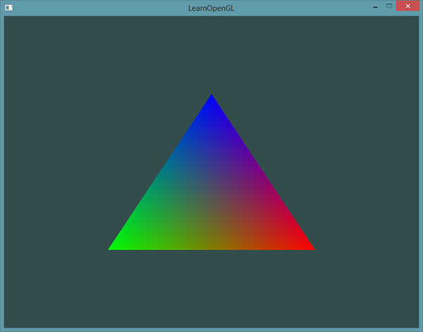
Setting up Visual Studio - 8
All settings finished.
Press ctrl+F5
Make sure that your project setting is applied to the build config.
if a triangle below is drawn when you run the skeleton code, then your setting is correct.

Slide 22
Graphics Pipeline
Shaders
enable programmers to design the rendering pipeline
GPU
We can control the shaders only
Vertex
Shader
Fragment
Shader
Rasterizer
3D data
screen
Calculate coordinates
3D → 2D
Calculate pixels

Slide 23
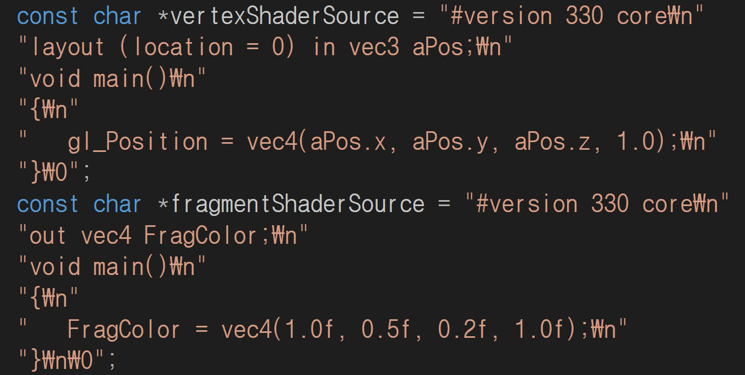
Drawing a triangle - simple shader program
Homogeneous coordinates
Red
Green
Blue
Alpha
code: https://learnopengl.com/Getting-started/Hello-Triangle

Slide 24
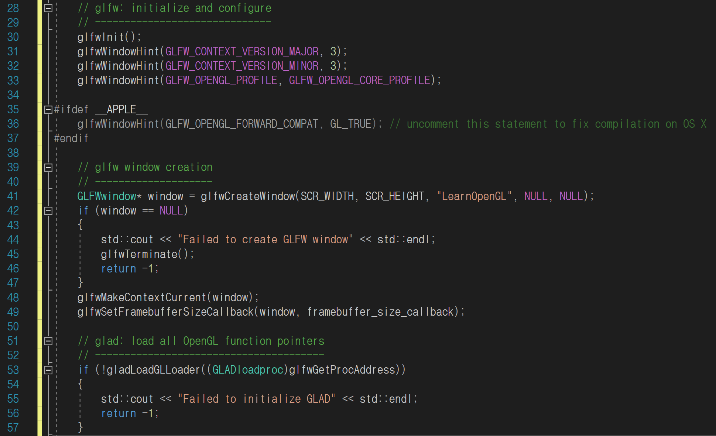
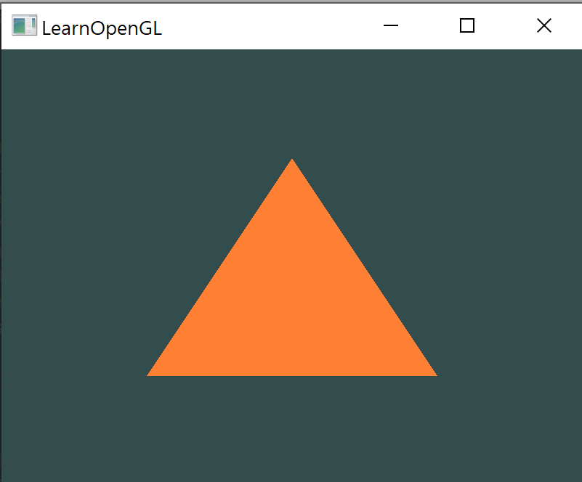
Drawing a triangle – initializing
Specify the ver. (3.3, core)
*Homogeneous coordinates
Red
Green
Blue
Alpha
called each time the window is resized
code: https://learnopengl.com/Getting-started/Hello-Triangle

Slide 25
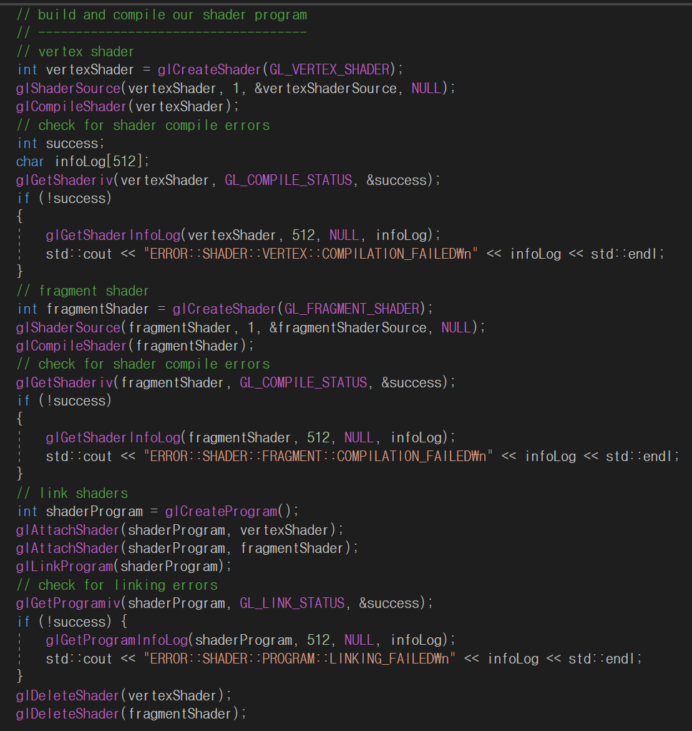
Drawing a triangle – build shader program
Compiling a
vertex shader
Compiling a
fragment shader
Linking shaders

Slide 26
Drawing a triangle – VAO & VBO
3D data
vertex coordinates, colors, normal vectors, texture coordinates…
difficult to handle
VAO(Vertex Array Object) & VBO(Vertex Buffer Object)
make handling 3d data easy
VAO includes vertex attribute pointers
VBO includes real data

Slide 27
Drawing a triangle – VAO & VBO
VAO
VBO 1 (Coordinates)
x1 y1 z1
x2 y2 z2
x3 y3 z3
Attribute Pointer 0
Attribute Pointer 1
VBO 2 (Colors)
Attribute Pointer 2
r1 g1 b1
r2 g2 b2
r3 g3 b3
VBO 3 (Normal Vectors of each vertices)
…
nx1 ny2 nz3
nx2 ny2 nz2
nx3 ny3 nz3
…
Attribute Pointer 15

Slide 28
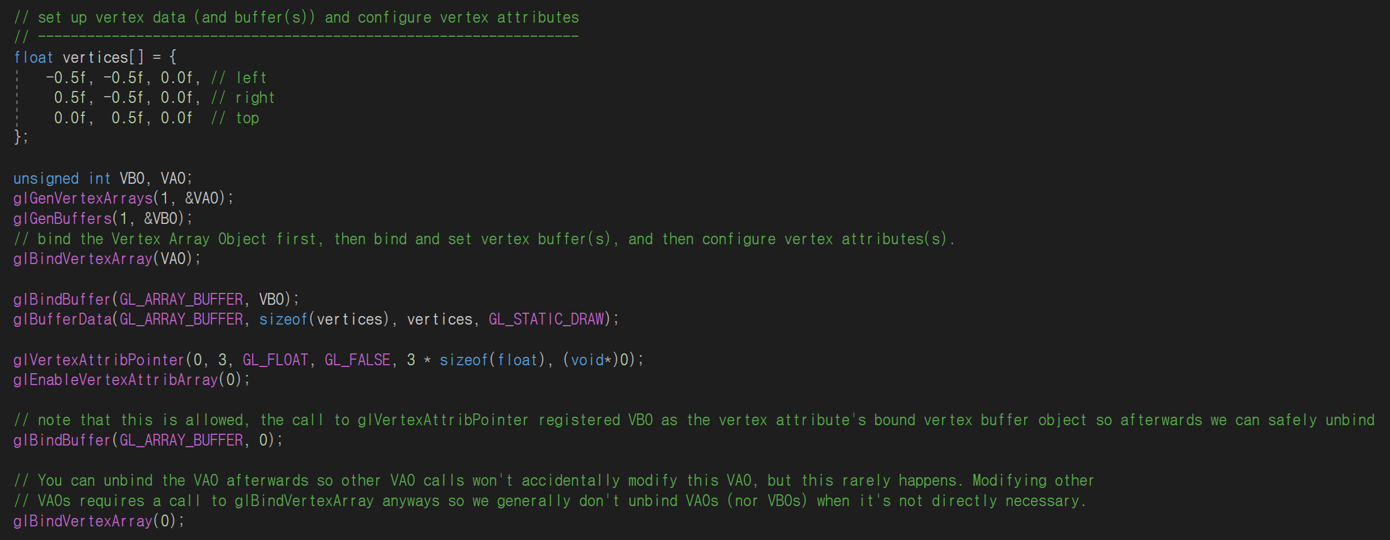
Drawing a triangle – VAO & VBO
Generate a VAO and a VBO
Bind the VAO
Bind and copy data in the VBO
Set the vertex attribute pointers and enable it
Unbind the VBO
Unbind the VAO
code: https://learnopengl.com/Getting-started/Hello-Triangle

Slide 29
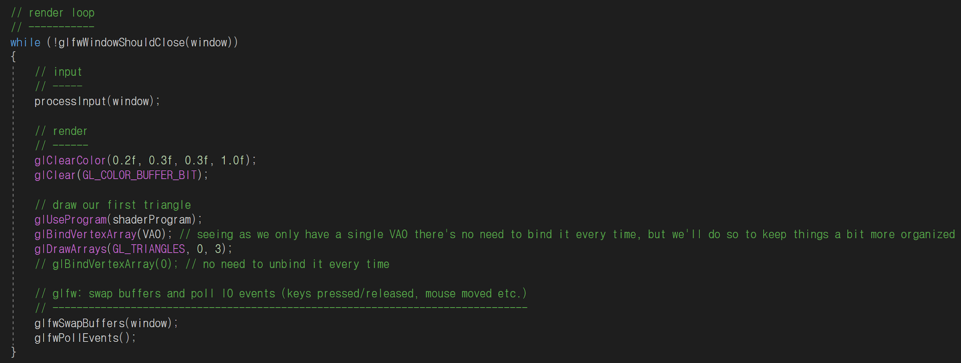
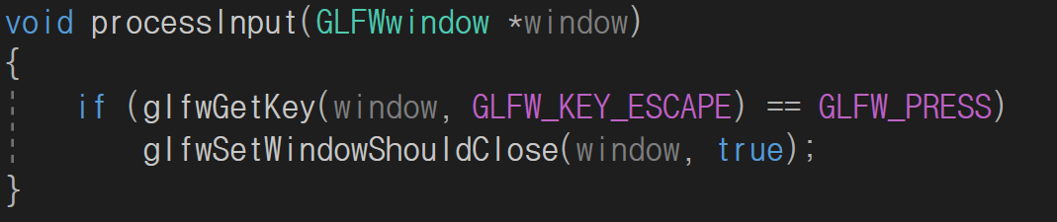
Drawing a triangle – rendering loop
Infinite loop
Make background
Draw a triangle using shaders
code: https://learnopengl.com/Getting-started/Hello-Triangle

Slide 30
More on Shaders
Little programs that rest on the GPU
Written in the C-like language GLSL
GPU
We can control the shaders only
Vertex
Shader
Fragment
Shader
Rasterizer
3D data
screen
Calculate coordinates
3D → 2D
Calculate pixels

Slide 31
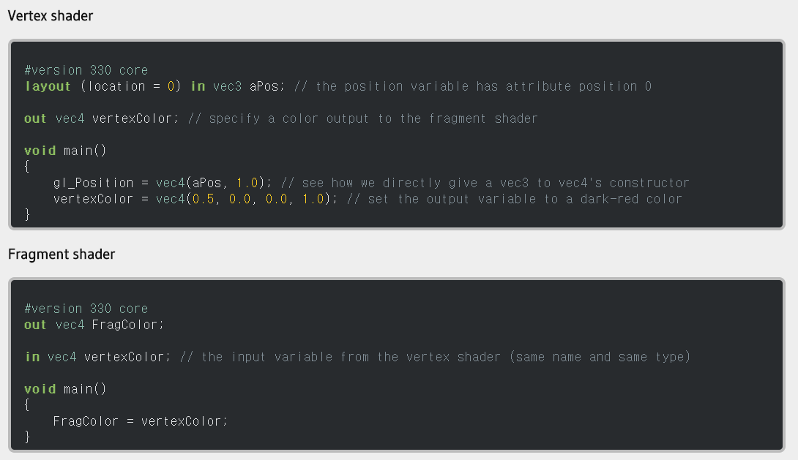
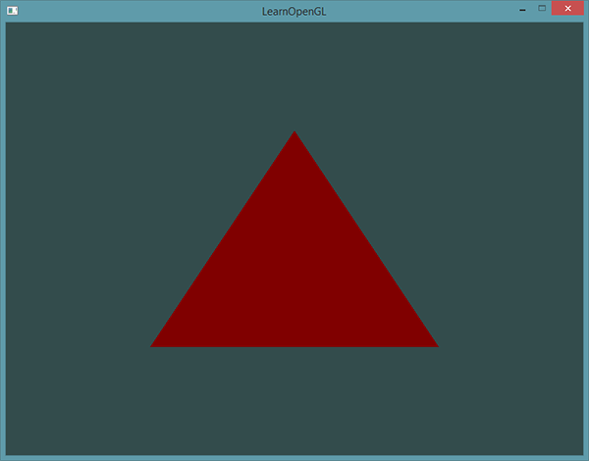
Vertex Shader & Fragment Shader
Output
code: https://learnopengl.com/Getting-started/Shaders

Slide 32
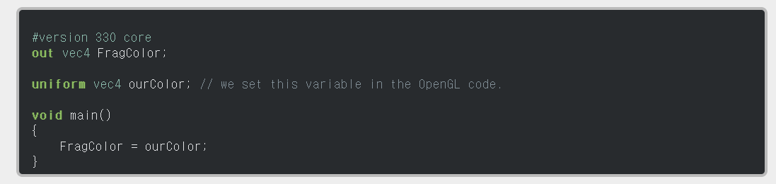

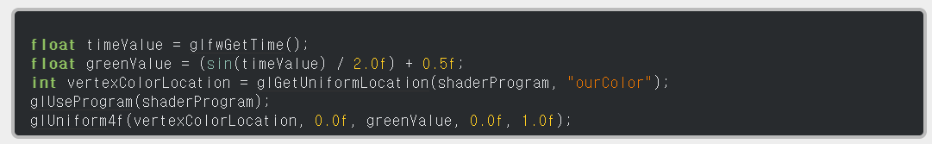
Uniform Variable
Pass data from our application on the CPU to the shaders on the GPU
Declare ‘ourColor’ uniform variable
Output
(Triangle color changes as time passes)
Fragment Shader
Upload ‘ourColor’ uniform variable
main.cpp
code: https://learnopengl.com/Getting-started/Shaders

Slide 33
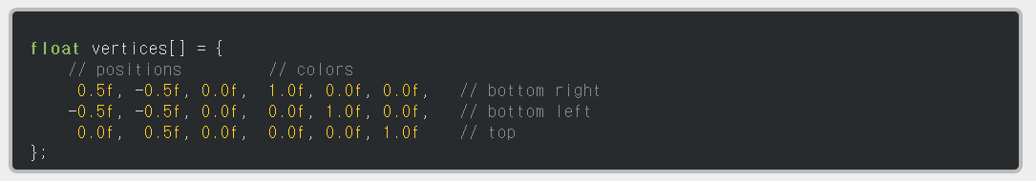
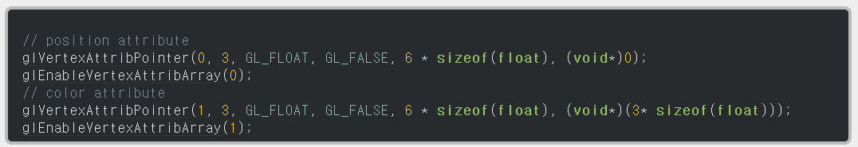
More Attributes
Data with position and colors
Declare ‘ourColor’ uniform variable
Set attrib pointer
Upload ‘ourColor’ uniform variable
Vertex shader with more input
code: https://learnopengl.com/Getting-started/Shaders

Slide 34
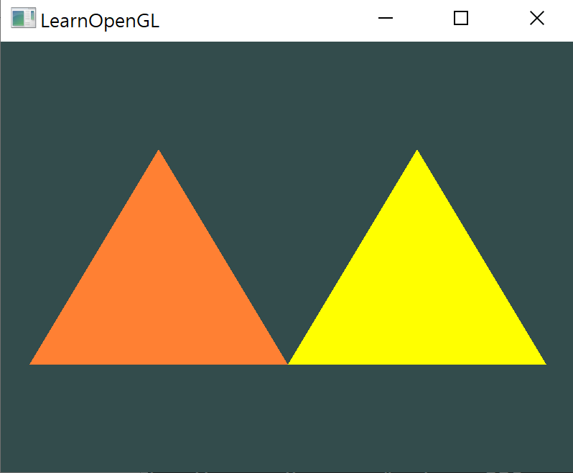
Today’s Goal
We give LearnOpenGL code as a skeleton code. First try to run it.
Your goal: Draw two triangles with different colors.
You can use multiple VAO/VBOs, or use uniform variable.
Positions of vertices and colors are not specified. Draw what you want!
Example:
Instead of LearnOpenGL, write your Student ID and Name here!!!!
e.g) 2020-12345 Hong Gil Dong
Submit only screenshot like left on ETL until 3/20 11:59PM. It will be graded by on/off policy.

