Slide 1
(SARDAR)
Surveillance with Artificial Intelligence & Remote Control based on Deep Learning Advanced Robot

Slide 2
INTRODUCTION
SARDAR is like having a super-smart robot keeping an eye on things for you! This cool system uses really smart computer programs and special sensors to watch and understand what's going on around it. But here's the really cool part: it doesn't just watch, it learns and gets better at spotting any problems or dangers. Plus, you can control it from far away! That means you can keep an eye on important places or things without having to be right there. There's more! This robot is not just smart; it's equipped with cool features like spotting intruders, grabbing things with its robotic arm, detecting metals, and even sensing temperature, humidity, and location using GPS. It's like having a superhero guardian that can do it all, making surveillance smarter, safer, and more effective than ever before. Welcome to a new era of security, where intelligence and control converge seamlessly to safeguard what matters most.

Slide 3
THEORY
The theory behind SARDAR is the combination of algorithms, advanced sensors, and remote control capabilities to enhance surveillance efficacy and responsiveness. At its core, artificial intelligence (AI) serves as the backbone of the system, enabling the robot to process vast amounts of data in real-time and make intelligent decisions based on patterns. Deep learning algorithms empower the robot to learn from experience, continuously refining its ability to recognize and respond to diverse scenarios with increasing accuracy. The utilization of advanced sensors provides the robot with a comprehensive understanding of its environment, enabling it to detect subtle changes and potential threats more effectively. Through webserver based remote control interfaces, operators can navigate the robot, adjust its behavior, and respond to emerging threats in real-time, enhancing overall surveillance efficiency and responsiveness.
By combining AI-driven intelligence, advanced sensor technology, and remote control capabilities, SARDAR represents a comprehensive approach to modern surveillance, offering enhanced security, flexibility, and peace of mind in diverse environments and scenarios.

Slide 4
COMPONENTS
Raspberry pi 4
Ultrasonic Sensor (HC-SR04)
Metal Detector
DHT 11
MPU-9250 (9-Axis Accelerometer)
L298N Motor Driver
ESP 32
DC Motor
Chassis Frame
Web Camera
Robotic Arm
Servo
NEO-6M GPS

Slide 5
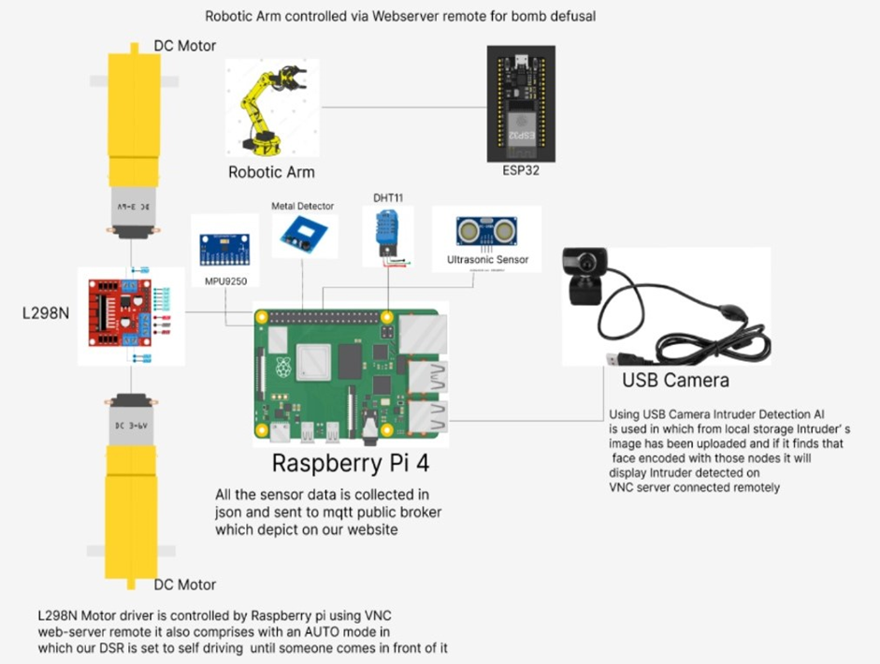
Block diagram

Slide 6
Working PRINCIPLE
SARDAR Overview: It's a smart system supported by AI and remote control for surveillance.
Deep Learning Algorithms: These algorithms analyze real-time data and recognize objects or anomalies accurately.
Sensor Integration: Includes various sensors like metal detectors, temperature, humidity, and ultrasonic sensors for comprehensive environmental monitoring.
AI Decision-Making: Enables instant decision-making based on threat detection or anomaly identification.
Integration with Advanced Robots: Creates a blend of intelligent surveillance and responsive robotics.
Remote Control: Allows operators to navigate the robot for on-site investigations, patrolling, and responses derived from AI insights.
Adaptability: Enhanced adaptability addresses complex security challenges across diverse domains, from public safety to industrial monitoring.

Slide 7
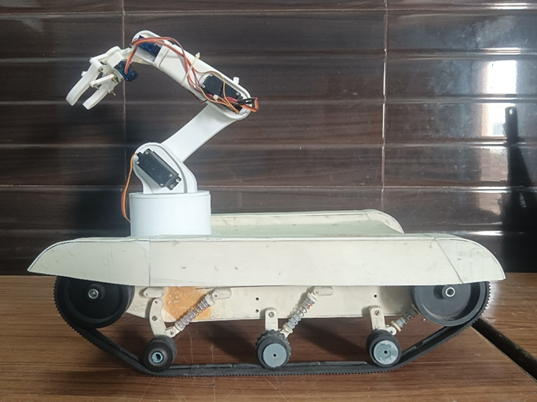
Final project

Slide 8
result
The project "Surveillance with Artificial Intelligence & Remote Control based on Deep Learning Advanced Robot" successfully created a innovative surveillance system. By utilizing AI and deep learning algorithms, it achieved precise object detection and tracking. Remote control functionalities allowed for flexible operation, while real-time analysis ensured immediate threat detection. Emphasizing user-friendly interfaces and ethical considerations, the project sets a benchmark for responsible deployment of AI in security. Its outcomes signify a significant leap forward in enhancing surveillance efficacy and operational adaptability, promising a safer and more technologically advanced future.

Slide 9
ADVANTAGES
Remote Operation: Control from a secure location.
Versatility: Customizable for specific mission needs.
Cost Efficiency: Reduces the need for continuous human presence.
Quick Deployment: Rapid response to emergencies.
Security: Secure communication.
Enhanced Stealth: Operates discreetly.

Slide 10
Limitations
Data Privacy Concerns: AI systems require vast amounts of data for training, raising concerns about the privacy of individuals captured in surveillance footage.
High Initial Costs: Need advanced AI technologies, robotic platforms, and remote-control interfaces, exorbitant for smaller organizations or communities.
Dependency on Connectivity: Remote control functionalities depend on stable and high-bandwidth connectivity. In areas with poor network it is completely unreliable.
Energy Consumption: Running a fancy robot with smart AI can drain a lot of power, making it need frequent charging or careful energy management.

Slide 11
Applications
Public Safety and Law Enforcement: Putting smart cameras and robots in public places helps police know what's happening, making things safer for everyone.
Counter-Terrorism Operations: SARDAR helps keep people safe by checking dangerous places for bombs or other threats without risking human lives.
Border Surveillance: SARDAR patrols borders, helping guards by watching for trouble and investigating anything suspicious from afar.
Search and Rescue: These robots can be deployed in disaster stricken are such as earthquake site and building collapsed area.
Environmental Monitoring: Tracking wildlife, detecting illegal activities, and monitoring pollution levels.

Slide 12
CONCLUSION
The implementation of an advanced surveillance robot, integrating AI, deep learning, and a suite of sophisticated sensors, has yielded significant enhancements in security and monitoring capabilities. This system includes intruder detection, a robotic arm, license plate recognition, metal detection, environmental sensors, and GPS, all of which have been rigorously tested to ensure high functionality and effectiveness. The intruder detection system, demonstrated high accuracy in identifying unauthorized individuals. The robotic arm extended the robot's utility by performing tasks. Metal detection added a critical security layer by identifying concealed metallic objects. Environmental sensors provided valuable data on temperature and humidity, contributing to operational efficiency. GPS ensured precise location tracking and efficient navigation over large areas. Despite challenges such as high initial costs, data privacy concerns, and potential operational constraints in harsh conditions, the project's promising results underscore the significant potential of AI-driven robotic surveillance systems to transform security practices and enhance operational efficiency across various domains.

