Slide 1
Space and Time Trade-Offs (chapter-7)
Team – I Presentation (Solvi Magnusson, Ishan Anand, Rishi Tej Talluri)
Reference : Introduction to Design and Analysis of Algorithms, 3rd Edition by Anany Levitin
Note: All of the slides have been prepared according to the syllabus mentioned and no other topic has been covered except than that for the chapter.

Slide 2
Introduction
A space-time or time-memory tradeoff is a way of solving a problem or calculation in less time by using more storage space(or memory), or by solving a problem in very little space by spending a long time. Most computers have a large amount of space, but not infinite space.
Space and time trade-offs in algorithm design are a well-known issue for both theoreticians and practitioners of computing.
In somewhat more general terms, the idea of using space and time trade-offs is to preprocess the problem’s input, in whole or in part, and store the additional information obtained to accelerate solving the problem afterward.

Slide 3
Input enhancement in Space and Time Trade-Off
The approach used for processing this technique is approach input enhancement which is a standard term, used for preprocessing and preconditioning.
These terms can also be applied to methods that use the idea of preprocessing but do not use extra space
The following algorithms based on it are:
counting methods for sorting
Boyer-Moore algorithm for string matching

Slide 4
Techniques for Space and Time Trade-off
type of technique that exploits space-for-time trade-offs simply uses extra space to facilitate faster and/or more flexible access to the data. We call this approach pre-structuring.
Unlike the input-enhancement variety, it deals with access structuring. We illustrate this approach by:
Hashing
Indexing with B-trees
Dynamic Programming in Space-Time Trade Off
This strategy is based on recording solutions to overlapping sub-problems of a given problem in a table from which a solution to the problem in question is then obtained.

Slide 5
Sorting by Counting (comparison-counting sort )
The idea of Sorting by Counting is to count for each element of a list to be sorted and the total number of elements smaller than this element and record the results in a table.
These numbers will indicate the positions of the elements in the sorted list: e.g., if the count is 10 for some element, it should be in the 11th position (with index 10, if we start counting with 0) in the sorted array.

Slide 6
Comparison-Counting sort Algorithm
ComparisonCountingSort(A[0..n − 1])
//Sorts an array by comparison counting
//Input: An array A[0..n − 1] of orderable elements
//Output: Array S[0..n − 1] of A’s elements sorted in non-decreasing order
for i ← 0 to n − 1 do Count[i] ← 0
for i ← 0 to n − 2 do
for j ← i + 1 to n − 1 do
if A[i] < A[j ]
else
for i ← 0 to
return S

Slide 7
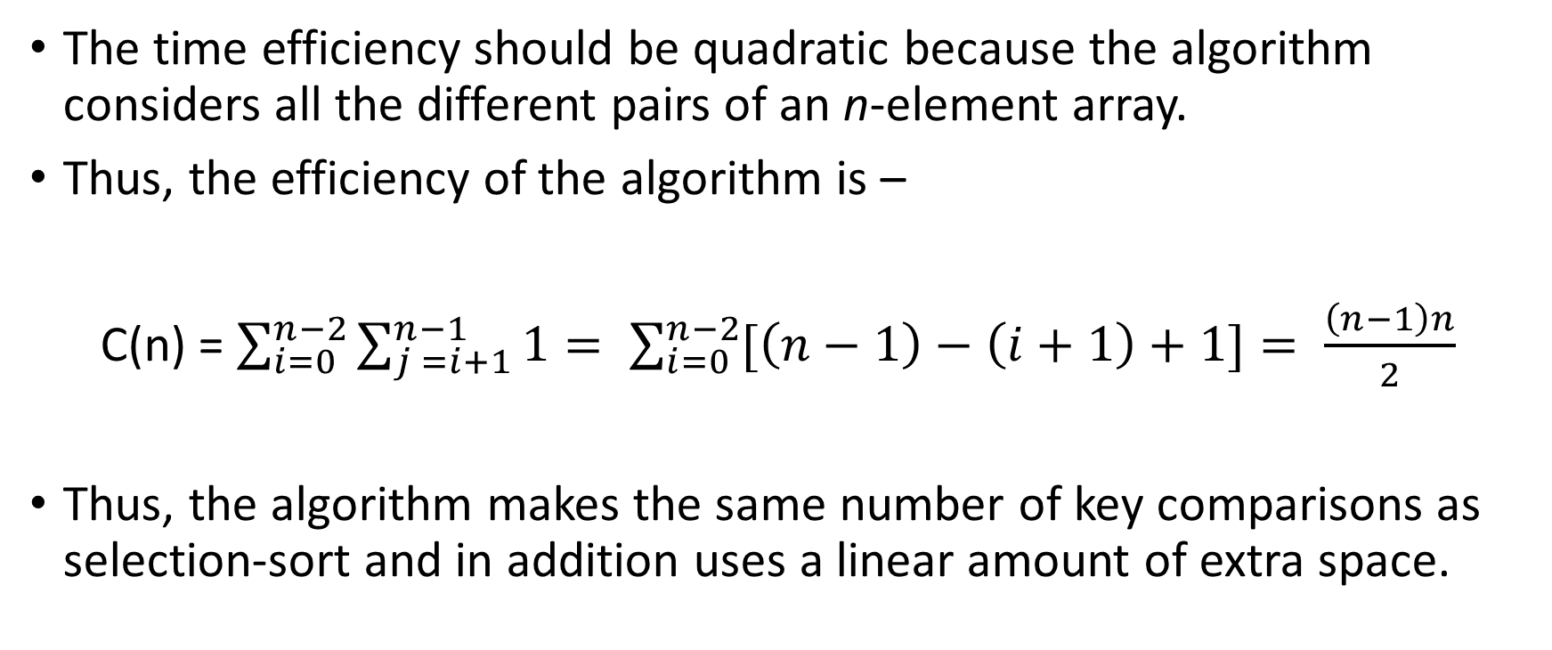
Time Efficiency of Comparison-Counting sort Algorithm
The time efficiency should be quadratic because the algorithm considers all the different pairs of an n-element array.
Thus, the efficiency of the algorithm is –
C(n) = $\sum_{i=0}^{n−2}{\sum_{j =i+1}^{n−1}{1= \sum_{i=0}^{n−2}{[\left(n−1\right)−\left(i+1\right)+1]= \frac{\left(n−1\right)n}{2} }}}$
Thus, the algorithm makes the same number of key comparisons as selection-sort and in addition uses a linear amount of extra space.

Slide 8
Distribution Sort
If we consider a more realistic situation of sorting a list of items with some other information associated with their keys so that we cannot over-write the list’s elements, then we can copy elements into a new array to hold the sorted list.
This method itself is known as distribution counting.

Slide 9
Distribution Sort Algorithm
DistributionCountingSort(A[0..n − 1], l, u)
//Sorts an array of integers from limited range by distribution counting
//Input: An array A[0..n − 1] of integers between l and u (l ≤ u)
//Output: Array S[0..n − 1] sorted in non-decreasing order
for j ← 0 to u − l do D[j ] ← 0 //initialize frequencies for i ← 0 to n − 1 do D[A[i] − l] ← D[A[i] − l] + 1 //compute frequencies
for j ← 1 to u − l do D[j ] ← D[j − 1] + D[j ]
for i ← n − 1 downto 0 do
j ← A[i] − l
S[D[j ] − 1] ← A[i]
D[j ] ← D[j ] − 1
return S

Slide 10
Input Enhancement in String Matching
It String Matching works by finding an occurrence of a given string of m characters called the pattern in a longer string of n characters called the text.
It simply matches corresponding pairs of characters in the pattern and the text left to right and, if a mismatch occurs, shifts the pattern one position to the right for the next trial.
Since the maximum number of such trials is n − m + 1 and, in the worst case, m comparisons need to be made on each of them, so:
worst-case efficiency of the brute-force algorithm is in the O(nm) class
average-case efficiency of the brute-force algorithm is in the O(n + m) class

Slide 11
Input Enhancement in String Matching Contd.
Several string searching algorithms are based on the input enhancement idea of preprocessing the pattern are:
Knuth-Morris-Pratt (KMP) algorithm preprocesses pattern left to right to get useful information for later searching
Boyer -Moore algorithm preprocesses pattern right to left and store information into two tables
Horspool’s algorithm simplifies the Boyer-Moore algorithm by using just one table

Slide 12
Horspool’s Algorithm
In addition to being simpler than Boyer-Moore algorithm, Horspool’s algorithm is not necessarily less efficient than the Boyer-Moore algorithm on random strings.
The working of the Algorithm is as follows:
Starting with the last R of the pattern and moving right to left, we compare the corresponding pairs of characters in the pattern and the text.
If all the pattern’s characters match successfully, a matching substring is found. Then the search can be either stopped altogether or continued if another occurrence of the same pattern is desired.
If a mismatch occurs, we need to shift the pattern to the right.

Slide 13
Horspool’s Algorithm Case Study
Consider the following example of the pattern BARBER, the following four possibilities can occur that are:
Case 1 – If there are no characters in the pattern – we can safely shift the pattern by its entire length
Case 2 – If there are occurrences of character characters in the pattern but it is not the last one there
Case 3 – If characters happens to be the last character in the pattern but there are no characters among its other m − 1 characters
Case 4 – If characters happens to be the last character in the pattern and there are other characters among its first m − 1 characters

Slide 14
Horspool’s Algorithm Shift Table Algorithm
ShiftTable(P [0..m − 1])
//Fills the shift table used by Horspool’s and Boyer-Moore algorithms //Input: Pattern P [0..m − 1] and an alphabet of possible characters //Output: Table[0..size − 1] indexed by the alphabet’s characters and filled with shift sizes computed by formula
for i ← 0 to size − 1 do Table[i] ← m
for j ← 0 to m − 2 do Table[P [j ]] ← m − 1 − j
return Table

Slide 15
Horspool’s algorithm pseudocode
HorspoolMatching(P [0..m − 1], T [0..n − 1])
//Implements Horspool’s algorithm for string matching
//Input: Pattern P [0..m − 1] and text T [0..n − 1]
//Output: The index of the left end of the first matching substring or −1 if there are no matches
ShiftTable(P [0..m − 1])
i ← m − 1
while i ≤ n − 1 do
k ← 0
while k ≤ m − 1 and P [m − 1 − k] = T [i − k] do
k ← k + 1
if k = m
return i − m + 1
else i ← i + Table[T [i]]
return −1

Slide 16
Boyer-Moore Algorithm Introduction
If the first comparison of the rightmost character in the pattern with the corresponding character c in the text fails, the algorithm does exactly the same thing as Horspool’s algorithm.
The two algorithms act differently, however, after some positive number k (0 < k < m) of the pattern’s characters are matched successfully before a mismatch is encountered.
Boyer-Moore algorithm determines the shift size by consid-ering two quantities:
Text’s character c that caused a mismatch with its counterpart in the pattern(bad-symbol shift).
A successful match of the last k > 0 characters of the pattern.

Slide 17
Boyer-Moore Algorithm
Step 1 For a given pattern and the alphabet used in both the pattern and the text, construct the bad-symbol shift table as described earlier.
Step 2 Using the pattern, construct the good-suffix shift table as described earlier.
Step 3 Align the pattern against the beginning of the text.
Step 4 Repeat the following step until either a matching substring is found or the pattern reaches beyond the last character of the text. Starting with the last character in the pattern, compare the corresponding characters in the pattern and the text until either all m character pairs are matched (then stop) or a mismatching pair is encountered after k ≥ 0 character pairs are matched successfully. In the latter case, retrieve the entry t₁(c) from the c’s column of the bad-symbol table where c is the text’s mismatched character. If k > 0, also retrieve the corresponding d₂ entry from the good-suffix table. Shift the pattern to the right by the number of positions computed by the formula
d = max {d₁, d₂} where d₁ = max{t₁(c) - k, 1}.

Slide 18
Hashing
Hashing is based on the idea of distributing keys among a one-dimensional array H [0..m − 1] called a hash table.
The distribution is done by computing, for each of the keys, the value of some predefined function h called the hash function.
This function assigns an integer between 0 and m − 1, called the hash address, to a key.

Slide 19
Hashing Contd.
In general, a hash function needs to satisfy somewhat conflicting requirements:
A hash table’s size should not be excessively large compared to the number of keys, but it should be sufficient to not jeopardize the implementation’s time efficiency.
A hash function needs to distribute keys among the cells of the hash table as evenly as possible.
hash function has to be easy to compute.
Obviously, if we choose a hash table’s size m to be smaller than the number of keys n, we will get collisions—a phenomenon of two (or more) keys being hashed into the same cell of the hash table

Slide 20
Open Hashing (Separate Chaining)
In open hashing, keys are stored in linked lists attached to cells of a hash table.
Each list contains all the keys hashed to its cell.
Consider, as an example, the following list of words:
A, FOOL, AND, HIS, MONEY, ARE, SOON, PARTED.
As a hash function, we will use the simple function for strings mentioned above, i.e., we will add the positions of a word’s letters in the alphabet and compute the sum’s remainder after division by 13.

Slide 21
Open Hashing (Separate Chaining) Efficiency
In general, the efficiency of searching depends on the lengths of the linked lists, which, in turn, depend on the dictionary and table sizes, as well as the quality of the hash function.
If the hash function distributes n keys among m cells of the hash table about evenly, each list will be about n/m keys long.
The ratio α = n/m, called the load factor of the hash table, plays a crucial role in the efficiency of hashing.
In particular, the average number of pointers (chain links) inspected in successful searches, S, and unsuccessful searches, U, turns out to be –
S ≈ 1 + α/2 and U = α

Slide 22
Closed Hashing (Open Addressing)
In closed hashing, all keys are stored in the hash table itself without the use of linked lists.
Different strategies can be employed for collision resolution.
The simplest one—called linear probing—checks the cell following the one where the collision occurs.
If that cell is empty, the new key is installed there; if the next cell is already occupied, the availability of that cell’s immediate successor is checked, and so on.

Slide 23
Closed Hashing (Open Addressing) Contd.
It is worthwhile to compare the main properties of hashing with balanced search trees—its principal competitor for implementing dictionaries.
Asymptotic time efficiency With hashing, searching, insertion, and deletion can be implemented to take (1) time on the average but (n) time in the very unlikely worst case. For balanced search trees, the average time efficiencies are (log n) for both the average and worst cases.
Ordering preservation Unlike balanced search trees, hashing does not assume existence of key ordering and usually does not preserve it. This makes hashing less suitable for applications that need to iterate over the keys in or-der or require range queries such as counting the number of keys between some lower and upper bounds.

