Slide 1
DYNAMIC PROGRAMMING
(Chapter – 8)
Team – I Presentation (Solvi Magnusson, Ishan Anand, Rishi Tej Talluri)
Reference : Introduction to Design and Analysis of Algorithms, 3rd Edition by Anany Levitin
Note: All of the slides have been prepared according to the syllabus mentioned and no other topic has been covered except than that for the chapter.

Slide 2
Introduction
Dynamic programming is a technique for solving problems with overlapping sub-problems.
Typically, these sub-problems arise from a recurrence relating a given problem’s solution to solutions of its smaller sub-problems.
Rather than solving overlapping sub-problems again and again, dynamic programming suggests solving each of the smaller sub-problems only once and recording the results in a table from which a solution to the original problem can then be obtained.

Slide 3
Dynamic Programming Example
Ex: The Fibonacci numbers are the elements of the sequence
0, 1, 1, 2, 3, 5, 8, 13, 21, 34, . . . ,
which can be defined by the simple recurrence
F (n) = F (n − 1) + F (n − 2) for n > 1
and two initial conditions
F (0) = 0,F (1) = 1

Slide 4
Principle of Optimality
Since a majority of dynamic programming applications deal with optimization problems, there is a need to mention a general principle that underlines such applications.
Richard Bellman called it the principle of optimality.
In terms some-what different from its original formulation, it says that an optimal solution to any instance of an optimization problem is composed of optimal solutions to its sub-instances.
Although its applicability to a particular problem needs to be checked, of course, such a check is usually not a principal difficulty in developing a dynamic programming algorithm.

Slide 5
Coin-row problem
There is a row of n coins whose values are some positive integers c₁, c₂, . . . , c_{n}, not necessarily distinct. The goal is to pick up the maximum amount of money subject to the constraint that no two coins adjacent in the initial row can be picked up.
The solution to this problem can be describes as follows:
    Let F (n) be the maximum amount that can be picked up from the row of n coins. To derive a recurrence for F (n), we partition all the allowed coin selections into two groups:
    Those that include the last coin and those without it
    The largest amount we can get from the first group is equal to c_{n} + F (n − 2)—the value of the nth coin plus the maximum amount we can pick up from the first n − 2 coins.
    The maximum amount we can get from the second group is equal to F (n − 1) by the definition of F (n). Thus, we have the following recurrence subject to the obvious initial conditions:
    F (n) = max{c_{n} + F (n − 2), F (n − 1)} for n > 1,
    F (0) = 0,F (1) = c₁.
    We can compute F (n) by filling the one-row table left to right.

Slide 6
Coin-row problem Algorithm
ALGORITHM CoinRow(C[1..n])
//Applies formula (8.3) bottom up to find the maximum amount of money //that can be picked up from a coin row without picking two adjacent coins //Input: Array C[1..n] of positive integers indicating the coin values //Output: The maximum amount of money that can be picked up
F [0] ← 0; F [1] ← C[1]
for i ← 2 to n do
F [i] ← max(C[i] + F [i − 2], F [i − 1])
return F [n]

Slide 7
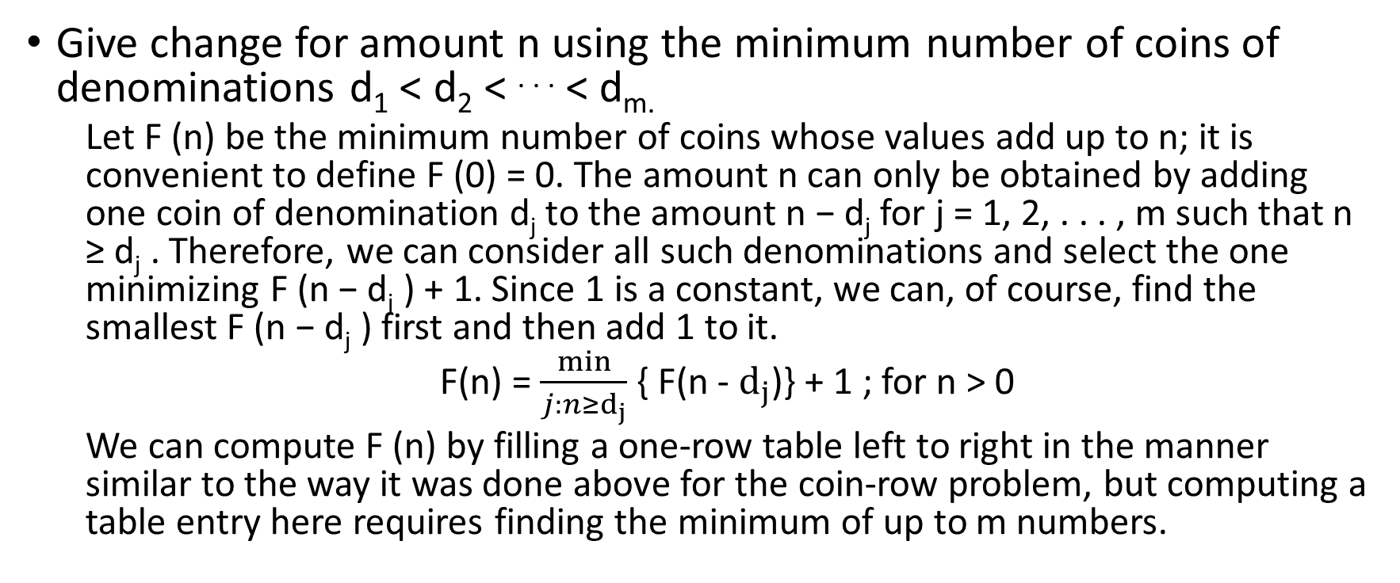
Change-making problem
Give change for amount n using the minimum number of coins of denominations d₁ < d₂ < . . . < d_{m.}
  Let F (n) be the minimum number of coins whose values add up to n; it is convenient to define F (0) = 0. The amount n can only be obtained by adding one coin of denomination d_{j} to the amount n − d_{j} for j = 1, 2, . . . , m such that n ≥ d_{j} . Therefore, we can consider all such denominations and select the one minimizing F (n − d_{j} ) + 1. Since 1 is a constant, we can, of course, find the smallest F (n − d_{j} ) first and then add 1 to it.
  F(n) = $\frac{min}{j:n≥d_{j}}$ { F(n - $d_{j}$)} + 1 ; for n > 0
  We can compute F (n) by filling a one-row table left to right in the manner similar to the way it was done above for the coin-row problem, but computing a table entry here requires finding the minimum of up to m numbers.

Slide 8
Change-making problem Algorithm
ALGORITHM ChangeMaking(D[1..m], n)
//Applies dynamic programming to find the minimum number of coins //of denominations d₁ < d₂ < . . . < d_{m} where d₁ = 1 that add up to a //given amount n
//Input: Positive integer n and array D[1..m] of increasing positive
integers indicating the coin denominations where D[1] = 1 //Output: The minimum number of coins that add up to n
F [0] ← 0
for i ← 1 to n do
temp ← ∞; j ← 1
while j ≤ m and i ≥ D[j ] do
temp ← min(F [i − D[j ]], t emp)
← j + 1
F [i] ← t emp + 1
return F [n]

Slide 9
Coin-collecting problem
Several coins are placed in cells of an n × m board, no more than one coin per cell. A robot, located in the upper left cell of the board, needs to collect as many of the coins as possible and bring them to the bottom right cell. On each step, the robot can move either one cell to the right or one cell down from its current location. When the robot visits a cell with a coin, it always picks up that coin. Find the maximum number of coins the robot can collect and a path it needs to follow to do this.

Slide 10
Coin-collecting problem Contd.
Let F (i, j ) be the largest number of coins the robot can collect and bring to the cell (i, j ) in the ith row and jth column of the board. It can reach this cell either from the adjacent cell (i − 1, j ) above it or from the adjacent cell (i, j − 1) to the left of it. The largest numbers of coins that can be brought to these cells are F (i − 1, j ) and F (i, j − 1), respectively.
Of course, there are no adjacent cells above the cells in the first row, and there are no adjacent cells to the left of the cells in the first column. For those cells, we assume that F (i − 1, j ) and F (i, j − 1) are equal to 0 for their nonexistent neighbors. Therefore, the largest number of coins the robot can bring to cell (i, j ) is the maximum of these two numbers plus one possible coin at cell (i, j ) itself. In other words, we have the following formula for F (i, j ):
F (i, j ) = max{F (i − 1, j ), F (i, j − 1)} + c_{ij} for 1 ≤ i ≤ n, 1 ≤ j ≤ m
F (0, j ) = 0 for 1 ≤ j ≤ m and F (i, 0) = 0 for 1 ≤ i ≤ n
  where c_{ij} = 1 if there is a coin in cell (i, j ), and c_{ij} = 0 otherwise.

Slide 11
Coin-collecting problem Algorithm
ALGORITHM RobotCoinCollection(C[1..n, 1..m])
//Applies dynamic programming to compute the largest number of //coins a robot can collect on an n × m board by starting at (1, 1) //and moving right and down from upper left to down right corner //Input: Matrix C[1..n, 1..m] whose elements are equal to 1 and 0 //for cells with and without a coin, respectively
//Output: Largest number of coins the robot can bring to cell (n, m) F [1, 1] ← C[1, 1]; for j ← 2 to m do F [1, j ] ← F [1, j − 1] + C[1, j ] for i ← 2 to n do
F [i, 1] ← F [i − 1, 1] + C[i, 1]
for j ← 2 to m do
F [i, j ] ← max(F [i − 1, j ], F [i, j − 1]) + C[i, j ] return F [n, m]

Slide 12
The Knapsack Problem
knapsack problem:
  given n items of known weights w₁, ... , w_{n} and values v₁, ... , v_{n} and a knapsack of capacity W , find the most valuable subset of the items that fit into the knapsack.
To design a dynamic programming algorithm, we need to derive a recurrence relation that expresses a solution to an instance of the knapsack problem in terms of solutions to its smaller sub-instances.

Slide 13
The Knapsack Problem Example
Example of solving an instance of the knapsack problem by the dynamic programming algorithm.
Let us consider the instance given by the following data:
ITEM | WEIGHT | VALUE
1 | 2 | $12
2 | 1 | $10
3 | 3 | $20
4 | 2 | $15
CapacityW=5

Slide 14
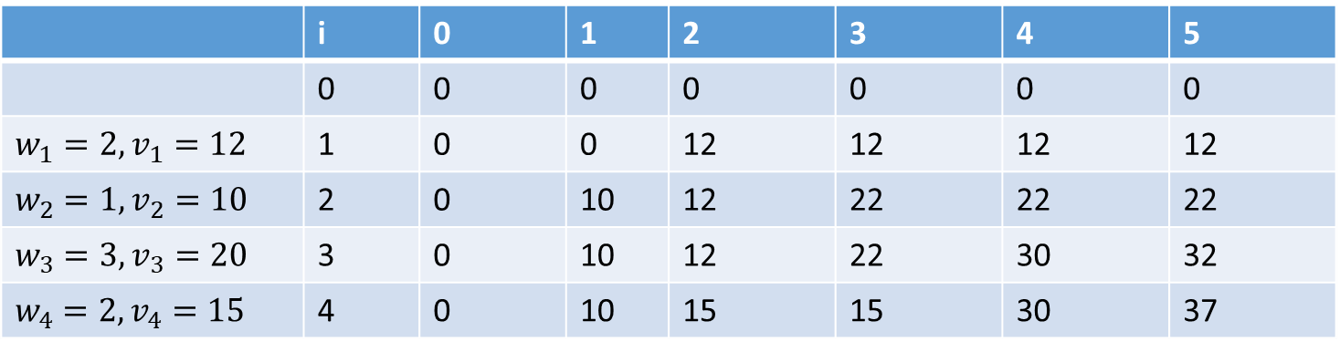
The Knapsack Problem Example Contd.
Thus, the maximal value is F (4, 5) = $37. We can find the composition of an optimal subset by back-tracing the computations of this entry in the table. Since F (4, 5) > F (3, 5), item 4 has to be included in an optimal solution along with an optimal subset for filling 5 − 2 = 3 remaining units of the knapsack capacity. The value of the latter is F (3, 3). Since F (3, 3) = F (2, 3), item 3 need not be in an optimal subset. Since F (2, 3) > F (1, 3), item 2 is a part of an optimal selection, which leaves element F (1, 3 − 1) to specify its remaining composition. Similarly, since F (1, 2) > F (0, 2), item 1 is the final part of the optimal solution {item 1, item 2, item 4}.
 | i | 0 | 1 | 2 | 3 | 4 | 5
 | 0 | 0 | 0 | 0 | 0 | 0 | 0
$$w_{1}=2,v_{1}=12$$ | 1 | 0 | 0 | 12 | 12 | 12 | 12
$w_{2}$ $=1,v_{2}=10$ | 2 | 0 | 10 | 12 | 22 | 22 | 22
$w_{3}$ $=3,v_{3}=20$ | 3 | 0 | 10 | 12 | 22 | 30 | 32
$w_{4}$ $=2,v_{4}=15$ | 4 | 0 | 10 | 15 | 15 | 30 | 37

Slide 15
The Knapsack Problem Example Contd.
The time efficiency and space efficiency of this algorithm are both in (nW ). The time needed to find the composition of an optimal solution is in O(n). You are asked to prove these assertions in the exercises.

Slide 16
Memory Functions
The direct top-down approach to finding a solution to such a recurrence leads to an algorithm that solves common sub-problems more than once and hence is very inefficient.
The classic dynamic programming approach, on the other hand, works bottom up: it fills a table with solutions to all smaller sub-problems, but each of them is solved only once.
An unsatisfying aspect of this approach is that solutions to some of these smaller sub-problems are often not necessary for getting a solution to the problem given. Since this drawback is not present in the top-down approach, it is natural to try to combine the strengths of the top-down and bottom-up approaches.
The goal is to get a method that solves only subproblems that are necessary and does so only once. Such a method exists; it is based on using memory functions.

Slide 17
Knapsack Algorithm Pseudocode
ALGORITHM MFKnapsack(i, j )
//Implements the memory function method for the knapsack problem //Input: A nonnegative integer i indicating the number of the first
items being considered and a nonnegative integer j indicating
the knapsack capacity
//Output: The value of an optimal feasible subset of the first i items
//Note: Uses as global variables input arrays W eight s[1..n], V alues[1..n], //and table F [0..n, 0..W ] whose entries are initialized with −1’s except for //row 0 and column 0 initialized with 0’s
if F [i, j ] < 0
if j < Weights[i]
value ← MFKnapsack(i − 1, j )
else
value ← max(MFKnapsack(i − 1, j ),
Values[i] + MFKnapsack(i − 1, j − Weights[i]))
F [i, j ] ← value
return F [i, j ]

Slide 18
Optimal Binary Search Trees
If probabilities of searching for elements of a set are known—e.g., from accumulated data about past searches—it is natural to pose a question about an optimal binary search tree for which the average number of comparisons in a search is the smallest possible.
As an example, consider four keys A, B, C, and D to be searched for with probabilities 0.1, 0.2, 0.4, and 0.3, respectively. The average number of comparisons in a successful search in the first of these trees is 0.1 . 1 + 0.2 . 2 + 0.4 .3 + 0.3 . 4 = 2.9, and for the second one it is 0.1 . 2 + 0.2 . 1 + 0.4 . 2 + 0.3 . 3 = 2.1.
Neither of these two trees is, in fact, optimal.

Slide 19
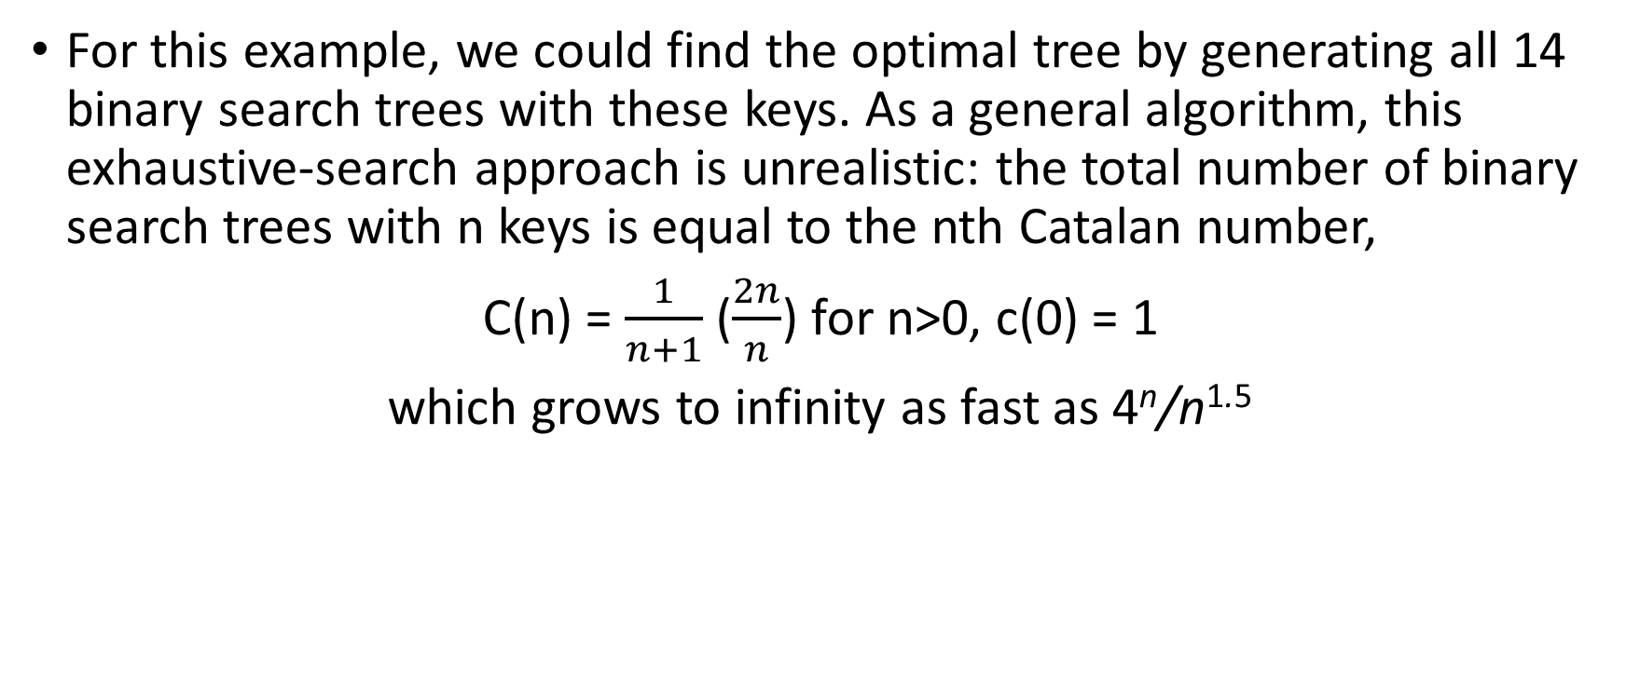
Optimal Binary Search Trees Contd.
For this example, we could find the optimal tree by generating all 14 binary search trees with these keys. As a general algorithm, this exhaustive-search approach is unrealistic: the total number of binary search trees with n keys is equal to the nth Catalan number,
C(n) = $\frac{1}{n+1}$ ($\frac{2n}{n}$) for n>0, c(0) = 1
which grows to infinity as fast as 4^{n}/n^{1.5}

Slide 20
Optimal Binary Search Trees Algorithm
ALGORITHM OptimalBST(P [1..n])
//Finds an optimal binary search tree by dynamic programming
//Input: An array P [1..n] of search probabilities for a sorted list of n keys
//Output: Average number of comparisons in successful searches in the
optimal BST and table R of subtrees’ roots in the optimal BST
for i ← 1 to n do
C[i, i − 1] ← 0 C[i, i] ← P [i] R[i, i] ← i
C[n + 1, n] ← 0
for d ← 1 to n − 1 do //diagonal count
for i ← 1 to n − d do
← i + d minval ← ∞ for k ← i to j do
if C[i, k − 1] + C[k + 1, j ] < minval
minval ← C[i, k − 1] + C[k + 1, j ]; kmin ← k R[i, j ] ← kmin
sum ← P [i]; for s ← i + 1 to j do sum ← sum + P [s] C[i, j ] ← minval + sum
return C[1, n], R

Slide 21
Warshall’s Algorithm
DEFINITION The transitive closure of a directed graph with n vertices can be defined as the n × n boolean matrix T = {t_{ij} }, in which the element in the ith row and the j th column is 1 if there exists a nontrivial path (i.e., directed path of a positive length) from the ith vertex to the j th vertex; otherwise, t_{ij} is 0.
Since this method traverses the same digraph several times, we should hope that a better algorithm can be found. Indeed, such an algorithm exists. It is called Warshall’s algorithm.
Warshall’s algorithm constructs the transitive closure through a series of n × n boolean matrices:
R⁽⁰⁾, . . . , R^{(k−1)}, R^{(k)}, . . . R^{(n)}.

Slide 22
Warshall’s Algorithm Pseudocode
ALGORITHM Warshall(A[1..n, 1..n])
//Implements Warshall’s algorithm for computing the transitive closure //Input: The adjacency matrix A of a digraph with n vertices //Output: The transitive closure of the digraph
R⁽⁰⁾ ← A
for k ← 1 to n do
for i ← 1 to n do
for j ← 1 to n do
R^{(k)}[i, j ] ← R^{(k−1)}[i, j ] or (R^{(k−1)}[i, k] and R^{(k−1)}[k, j ])
return R^{(n)}

Slide 23
Floyd’s Algorithm for the All-Pairs Shortest-Paths Problem
Given a weighted connected graph (undirected or directed), the all-pairs shortest-paths problem asks to find the distances—i.e., the lengths of the shortest paths— from each vertex to all other vertices.
It is convenient to record the lengths of shortest paths in an n × n matrix D called the distance matrix: the element d_{ij} in the ith row and the j th column of this matrix indicates the length of the shortest path from the ith vertex to the j th vertex.
We can generate the distance matrix with an algorithm that is very similar to Warshall’s algorithm. It is called Floyd’s algorithm.

Slide 24
Floyd’s Algorithm for the All-Pairs Shortest-Paths Problem Contd.
Floyd’s algorithm computes the distance matrix of a weighted graph with n vertices through a series of n × n matrices:
D⁽⁰⁾, ... , D^{(k−1)}, D^{(k)}, ... , D^{(n)}
Each of these matrices contains the lengths of shortest paths with certain constraints on the paths considered for the matrix in question.
the element d_{ij}^{(k)} in the ith row and the j th column of matrix D^{(k)} (i, j = 1, 2, . . . , n, k = 0, 1, . . . , n) is equal to the length of the shortest path among all paths from the ith vertex to the j th vertex with each intermediate vertex, if any, numbered not higher than k.

Slide 25
Floyd’s Algorithm Pseudocode
ALGORITHM loyd(W [1..n, 1..n])
//Implements Floyd’s algorithm for the all-pairs shortest-paths problem //Input: The weight matrix W of a graph with no negative-length cycle //Output: The distance matrix of the shortest paths’ lengths
D ← W //is not necessary if W can be overwritten for k ← 1 to n do
for i ← 1 to n do
for j ← 1 to n do
D[i, j ] ← min{D[i, j ], D[i, k] + D[k, j ]}
return D

