Slide 2
Assign score across multiple dimensions (helpfulness, correctness, coherence, complexity and verbosity) using Nvidia-nemotron-4-340B reward model
Category: Closed-Ended QA dataset
Prompt GPT-4o to generate multiple questions for each sub-topic
Topic
Sub-topics Generation
Questions Generation
Response Generation
Scoring
Filtering and Saving data
Prompt GPT-4o to generate multiple sub-topics
Prompt GPT-4o to generate responses for each question
Filtering Criterion:
Score > Threshold

Slide 3
Category: Closed-Ended DPO dataset
Assign alignment score using Nvidia-nemotron-4-340B reward model for each response and rejected response
Response Generation
Prompt GPT-4o to generate multiple questions for each sub-topic
Chosen Response
Topic
Sub-topics Generation
Questions Generation
Scoring
Filtering and Saving data
Rejected Response
Prompt GPT-4o to generate multiple sub-topics
Filtering Criterion:
1. Chosen response score > threshold
2. Rejected response score < threshold
Prompt GPT-4o to generate chosen and rejected response for each question

Slide 4
Category: Process Synthesis, PFDs and PIDs Description Dataset
(SynDiP dataset)
Industrial Synthesis Generation
PFD Generation
PID Generation
Scoring
GPT-4o
GPT-4o
GPT-4o
Nvidia-Nemotron-340B-reward model
GPT-4o
GPT-4o
GPT-4o
Chemical
SynDiP Dataset
Claude-3-Haiku
Claude-3-Haiku
Claude-3-Haiku
Assign score using Nvidia-nemotron-4-340B reward model and filter low-quality outputs
Proposers
Aggregators
Reward Model

Slide 5
Category: Logical, Contextual Reasoning, Common-sense and Factual knowledge
(LogiCore dataset)
Question Generation
Answer Generation
Scoring
GPT-4o
GPT-4o
Nvidia-Nemotron-340B-reward model
Reasoning, knowledge, and comprehension (LogiCore)
datasets
Chemical-PFD-PID Q&A dataset
Claude-3-Haiku
Claude-3-Haiku
Assign score using Nvidia-nemotron-4-340B reward model and filter low-quality outputs

Slide 6




Assign alignment score using Nvidia-nemotron-4-340B reward model
Parse Documents to extract text
Prompt GPT-4o to generate multiple questions for each chunk
Reward Model-as-a-judge
Questions Generation
Response Generation
Local-RAIT Synthetic dataset
Machine Evaluation (LLM-as-a-Judge)
PDF
Text Chunks
Prompt GPT-4o to generate answers for
each question
Question:___
Context:______________
Answer:_____
Likert Scale Survey

Slide 7


Assign alignment score using Nvidia-nemotron-4-340B reward model
Parse Documents to extract text
Group Chunks
Prompt GPT-4o to generate multiple questions for each chunk
Reward Model-as-a-judge
Questions Generation
Response Generation
Global-RAIT Synthetic dataset
Machine Evaluation (LLM-as-a-Judge)
Prompt GPT-4o to generate answers for
each question
PDFs
Question:___
Context:______________
Answer:_____
Likert Scale Survey
Text Chunks

Slide 8

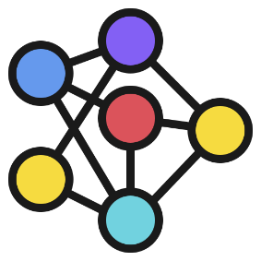

Vector-base indexing of property graph in enterprise graph store
Agentic Web RAG
Scoring
Extract Knowledge Graph Triples
Parse Documents
Nvidia-Nemotron-340B-reward model
Chemical
Industrial Synthesis Generation
Claude-3-Haiku
PFD Generation
PID Generation
LLM-as-a-judge
Text Chunks
Property Graph
Graph database

Slide 9

Closed-Ended QA dataset
SynDiP Dataset
LogiCore dataset
General purpose SLMs
Instruction-Tuning
Instruction-Tuning
Instruction-Tuning
DPO dataset
Local-RAIT dataset
Global-RAIT dataset
General purpose SLMs
Instruction-Tuning
Instruction-Tuning
Instruction-Tuning
General purpose SLMs
General purpose SLMs
General purpose SLMs
General purpose SLMs
Fine-Tuned Model

Slide 10




(a)
Instruction-tuned SLM
General Purpose Pre-trained SLM
DPO
Width and Depth pruning
Reinforcement Fine-tuned SLM (GRPO)
(b)
Meta-Agent
Critique-Agent
SLM-as-a-judge
Instruction-tuned/ Policy Optimized SLM
KV Caching paged attention
Initial
Response
Look-ahead Decoding
Flash attention
Test Time Scaling
Output
Guardrails
User Question
Reward Model-as-a-judge
Memory database
Graph database
Feedback
Human-as-a-judge

Slide 11
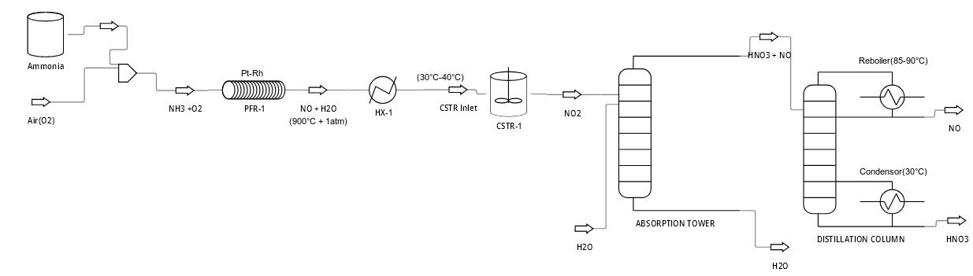
F-1
T-1
P-1
CV-1
T-4
T-5
CV-3
T-2
T-3
T-6
CV-2
P-4
P-5
F-2
P-2
F-3
P-3
T-7
F-4
F-5
CV-4

Slide 12
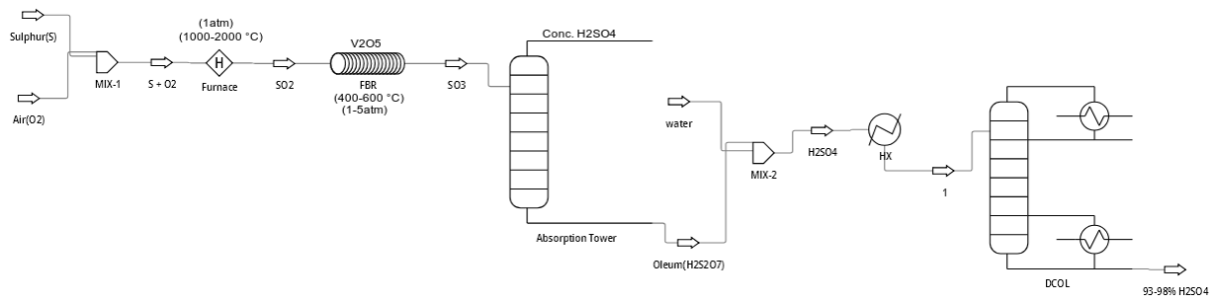
CV-1
F-1
T-9
T-2
T-4
T-1
P-3
F-3
F-4
CV-5
T-8
T-6
F-6
L-1
P-1
P-2
T-3
P-4
F-2
CV-3
CV-4
CV-2
P-5
F-5
F-7
L-2
T-5
T-7
CV-6

