Slide 1
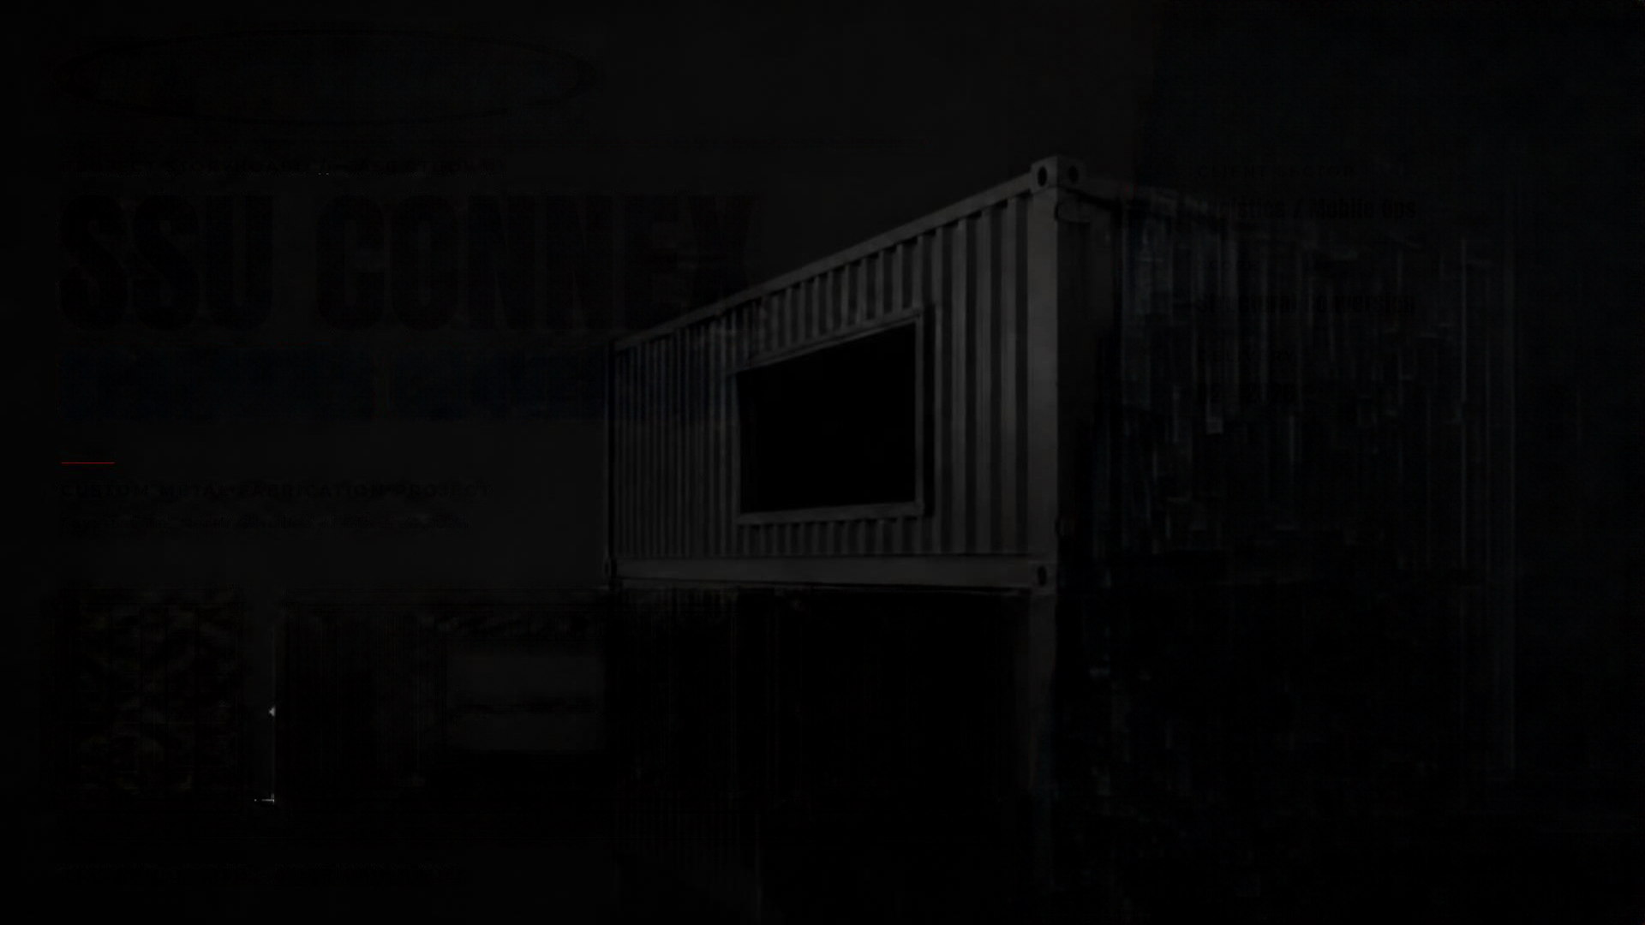
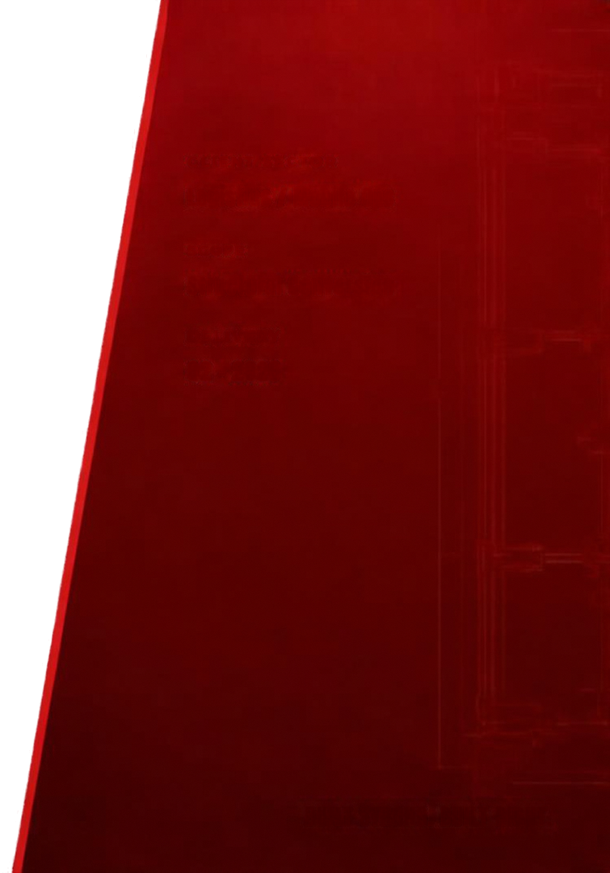

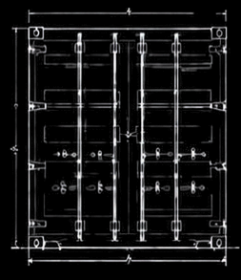
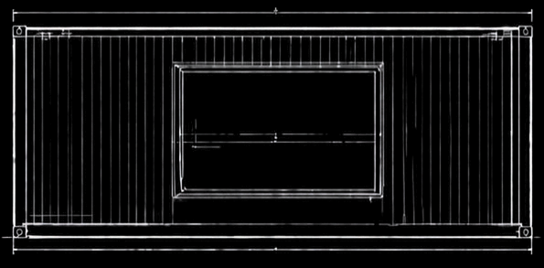
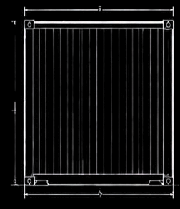
INC.
PROJECT STORYBOARD // CASE STUDY 01
CLIENT SECTOR
SSU CONNEX
Logistics / Mobile Ops
SCOPE
Structural Conversion
CONTAINER CONVERSION
DELIVERY
Q2 - 2026
CUSTOM METAL FABRICATION PROJECT
Fayetteville, North Carolina • Delivered 2026
VETERAN OWNED • AMERICAN MADE
BUILT STRONG. BUILT RIGHT.

Slide 2
METAL WORX
CUSTOM METAL FABRICATION
PROJECT STORYBOARD // 001
PROJECT
NAME
HERE
+ INSERT PROJECT HERO IMAGE
CUSTOMER / LOCATION
PROJECT TYPE
Customer or Location
Fabrication Category
DELIVERY QUARTER
QX / YEAR
CUSTOM METAL. BUILT TO LAST.
VETERAN OWNED · AMERICAN MADE · BUILT STRONG. FINISHED RIGHT.
METAL WORX, INC. // BUILT STRONG. BUILT RIGHT.
PROJECT NAME
01 / 18

Slide 3
METAL WORX
CUSTOM METAL FABRICATION
+
INSERT SUMMARY IMAGE
01 // OVERVIEW
PROJECT EXECUTIVE SUMMARY
01
02
03
04
PROJECT OBJECTIVE
CUSTOMER NEED
METAL WORX SOLUTION
CURRENT STATUS
Concise statement of the fabrication objective and delivery target for this engagement.
Operational, structural, or functional need driving the request from the customer.
Engineered fabrication and installation approach delivering the required outcome.
Phase in progress, percent complete, and next scheduled milestone or review.
MAJOR MILESTONES
PROJECT SIZE
SCOPE TYPE
MATERIALS
CLIENT SECTOR
· Design approval
· Materials received
· Fabrication complete
· Installation & sign-off
—
—
—
—
METAL WORX, INC. // BUILT STRONG. BUILT RIGHT.
PROJECT NAME
02 / 18

Slide 4
METAL WORX
CUSTOM METAL FABRICATION
02 // BASELINE
ORIGINAL CONDITION
PROJECT BACKGROUND
Context, prior use, and reason the customer engaged Metal Worx.
ORIGINAL CONDITION
Observed condition, wear points, and any structural or functional issues.
+
CUSTOMER REQUIREMENTS
ORIGINAL CONDITION PHOTO
What the customer requires from the finished fabrication and installation.
PLANNED TRANSFORMATION
High-level overview of the intended change and outcome.
CAPTION // Insert descriptive caption for original condition photograph.
METAL WORX, INC. // BUILT STRONG. BUILT RIGHT.
PROJECT NAME
03 / 18

Slide 5
METAL WORX
CUSTOM METAL FABRICATION
03 // DEFINITION
SCOPE AND OBJECTIVES
PROJECT SCOPE
MAJOR DELIVERABLES
· Overall scope statement
· Boundaries and exclusions
· Approval authority
· Primary fabricated assemblies
· Sub-components and hardware
· Documentation package
MATERIALS & FABRICATION
INSTALLATION
· Steel grade / plate spec
· Welding process and standard
· Finish and coatings
· Site readiness requirements
· Rigging and equipment
· Crew and schedule
DESIRED OUTCOMES / TECHNICAL NOTES
Concise placeholder for measurable outcomes, load specifications, tolerances, or acceptance criteria.
METAL WORX, INC. // BUILT STRONG. BUILT RIGHT.
PROJECT NAME
04 / 18

Slide 6
METAL WORX
CUSTOM METAL FABRICATION
04 // SCHEDULE
PROJECT TIMELINE
+
+
+
+
+
+
+
+
PHOTO 1
PHOTO 2
PHOTO 3
PHOTO 4
PHOTO 5
PHOTO 6
PHOTO 7
PHOTO 8
01
02
03
04
05
06
07
08
ARRIVAL
INSPECTION
DESIGN
FABRICATION
TEST FIT
FINISH
INSTALLATION
COMPLETION
QX · WK 00
QX · WK 00
QX · WK 00
QX · WK 00
QX · WK 00
QX · WK 00
QX · WK 00
QX · WK 00
CURRENT PHASE // FABRICATION IN PROGRESS · 38% COMPLETE
METAL WORX, INC. // BUILT STRONG. BUILT RIGHT.
PROJECT NAME
05 / 18

Slide 7
METAL WORX
CUSTOM METAL FABRICATION
SECTION DIVIDER // PHASE
PHASE
01
+
INSERT PHASE PHOTO HERE
PHASE NAME HERE
Short description placeholder summarizing the scope, deliverables, and intent of this phase.
PROGRESS · 35%
METAL WORX, INC. // BUILT STRONG. BUILT RIGHT.
PROJECT NAME
06 / 18

Slide 8
METAL WORX
CUSTOM METAL FABRICATION
PHASE 0X // MILESTONE
QX · YEAR
+
HERO PHOTO
CONCISE TITLE PLACEHOLDER
Milestone statement placeholder describing the significance of this image.
CAPTION // Professional caption placeholder describing scene, materials, or crew activity.
METAL WORX, INC. // BUILT STRONG. BUILT RIGHT.
PROJECT NAME
07 / 18

Slide 9
METAL WORX
CUSTOM METAL FABRICATION
PHASE 0X // DOCUMENTATION
TWO-PHOTO EDITORIAL
+
SECONDARY IMAGE
+
PRIMARY IMAGE
CAPTION 02 // Short caption for secondary image.
TECHNICAL DETAIL
Placeholder for fabrication or installation details — process, spec, tolerance, or finish notes.
CAPTION 01 // Short caption placeholder for primary image.
METAL WORX, INC. // BUILT STRONG. BUILT RIGHT.
PROJECT NAME
08 / 18

Slide 10
METAL WORX
CUSTOM METAL FABRICATION
PHASE 0X // PROGRESS
THREE-PHOTO PROGRESS
+
SUPPORTING PHOTO 1
+
MAIN PROGRESS PHOTO
+
SUPPORTING PHOTO 2
01
WHAT WAS COMPLETED
02
WHY IT MATTERED
03
NEXT STEP
Placeholder summary of completed work in this progress update.
Placeholder for significance and value of this milestone.
Placeholder for the upcoming task or next scheduled activity.
METAL WORX, INC. // BUILT STRONG. BUILT RIGHT.
PROJECT NAME
09 / 18

Slide 11
METAL WORX
CUSTOM METAL FABRICATION
PHASE 0X // FIELD JOURNAL
CONSTRUCTION JOURNAL
+
+
PHOTO 2
PHOTO 3
+
PHOTO 1
+
PHOTO 4
CREW NOTES // FIELD OBSERVATIONS
· Field challenge placeholder
· Crew and equipment note
· Safety observation
· Materials handling note
+
+
PHOTO 5
PHOTO 6
METAL WORX, INC. // BUILT STRONG. BUILT RIGHT.
PROJECT NAME
10 / 18

Slide 12
METAL WORX
CUSTOM METAL FABRICATION
TRANSFORMATION // COMPARISON
BEFORE / AFTER
BEFORE
AFTER
+
+
BEFORE
AFTER
METAL WORX, INC. // BUILT STRONG. BUILT RIGHT.
TRANSFORMATION SUMMARY
PROJECT NAME
11 / 18
KEY IMPROVEMENTS
Placeholder describing the transformation and scope of change delivered.
· Structural improvement
· Finish and durability
· Fit, function, and safety

Slide 13
METAL WORX
CUSTOM METAL FABRICATION
PROBLEM // RESPONSE
CHALLENGE AND SOLUTION
CHALLENGE
METAL WORX SOLUTION
Placeholder describing the fabrication or installation challenge — constraints, risks, or complexity to resolve.
Placeholder describing the engineered response, materials, process, and delivered outcome.
+
+
CHALLENGE CONTEXT
SOLUTION / RESULT
METAL WORX, INC. // BUILT STRONG. BUILT RIGHT.
PROJECT NAME
12 / 18
RESULT // Placeholder result statement — measurable outcome, delivery, or acceptance.

Slide 14
METAL WORX
CUSTOM METAL FABRICATION
CRAFTSMANSHIP // CLOSE-UP
FABRICATION DETAIL
+
SUPPORT DETAIL 1
+
DETAIL CLOSE-UP
+
SUPPORT DETAIL 2
MATERIAL
PROCESS
FINISH
METAL WORX, INC. // BUILT STRONG. BUILT RIGHT.
PROJECT NAME
13 / 18
Placeholder for material spec, grade, and thickness.
Placeholder for welding process, joint prep, and standard.
Placeholder for coating, tolerance, or acceptance criteria.

Slide 15
METAL WORX
CUSTOM METAL FABRICATION
PROGRESS // CHECKLIST
MILESTONE SUMMARY
✓
01
Milestone 1 achievement statement placeholder — concise result description.
+
✓
02
Milestone 2 achievement statement placeholder — concise result description.
+
1
2
✓
03
Milestone 3 achievement statement placeholder — concise result description.
+
✓
04
Milestone 4 achievement statement placeholder — concise result description.
+
3
4
✓
05
Milestone 5 achievement statement placeholder — concise result description.
+
✓
06
Milestone 6 achievement statement placeholder — concise result description.
+
5
6
✓
07
Milestone 7 achievement statement placeholder — concise result description.
+
✓
08
Milestone 8 achievement statement placeholder — concise result description.
+
7
8
METAL WORX, INC. // BUILT STRONG. BUILT RIGHT.
PROJECT NAME
14 / 18

Slide 16
METAL WORX
CUSTOM METAL FABRICATION
PHASE 0X // SITE
INSTALLATION FIELDWORK
+
+
SITE CONDITIONS
EQUIPMENT
+
CREW AT WORK
+
INSTALLATION DETAIL
CAPTION // Crew activity, safety, and installation note placeholder.
METAL WORX, INC. // BUILT STRONG. BUILT RIGHT.
PROJECT NAME
15 / 18
INSTALLATION NOTES & FIELD ACCOMPLISHMENTS
· Placeholder for site prep and staging notes
· Placeholder for lift plans and rigging observations
· Placeholder for safety measures and PPE requirements
· Placeholder for field accomplishments and daily progress

Slide 17
METAL WORX
CUSTOM METAL FABRICATION
+
COMPLETED PROJECT PHOTO
COMPLETED // PROJECT REVEAL
PROJECT TITLE PLACEHOLDER
COMPLETED // QX · YEAR
Brief outcome statement placeholder — craftsmanship, quality, and delivery.
METAL WORX, INC. // BUILT STRONG. BUILT RIGHT.
PROJECT NAME
16 / 18

Slide 18
METAL WORX
CUSTOM METAL FABRICATION
OUTCOME // CUSTOMER VALUE
RESULTS AND PROJECT IMPACT
WHAT METAL WORX DELIVERED
Placeholder describing the delivered fabrication and installation scope.
CRAFTSMANSHIP HIGHLIGHTS
Placeholder for materials, welding, finish, and quality highlights.
+
COMPLETED PROJECT
CUSTOMER BENEFITS
Placeholder for operational value, durability, and outcome for the customer.
CUSTOM METAL.
BUILT TO LAST.
METAL WORX, INC. // BUILT STRONG. BUILT RIGHT.
PROJECT NAME
17 / 18
VETERAN OWNED · AMERICAN MADE · BUILT STRONG. FINISHED RIGHT.

Slide 19
METAL WORX
PROJECT NAME PLACEHOLDER
CUSTOM METAL FABRICATION
CONTACT
PHONE
000.000.0000
PROJECT STORYBOARD // CLOSING
EMAIL
info@company.com
BUILT STRONG.
BUILT RIGHT.
WEB
www.metalworxinc.com
LOCATION
Fayetteville, North Carolina
CUSTOM METAL. BUILT TO LAST.
VETERAN OWNED · AMERICAN MADE · BUILT STRONG. FINISHED RIGHT.
METAL WORX, INC. // BUILT STRONG. BUILT RIGHT.
PROJECT NAME
18 / 18

