Slide 1
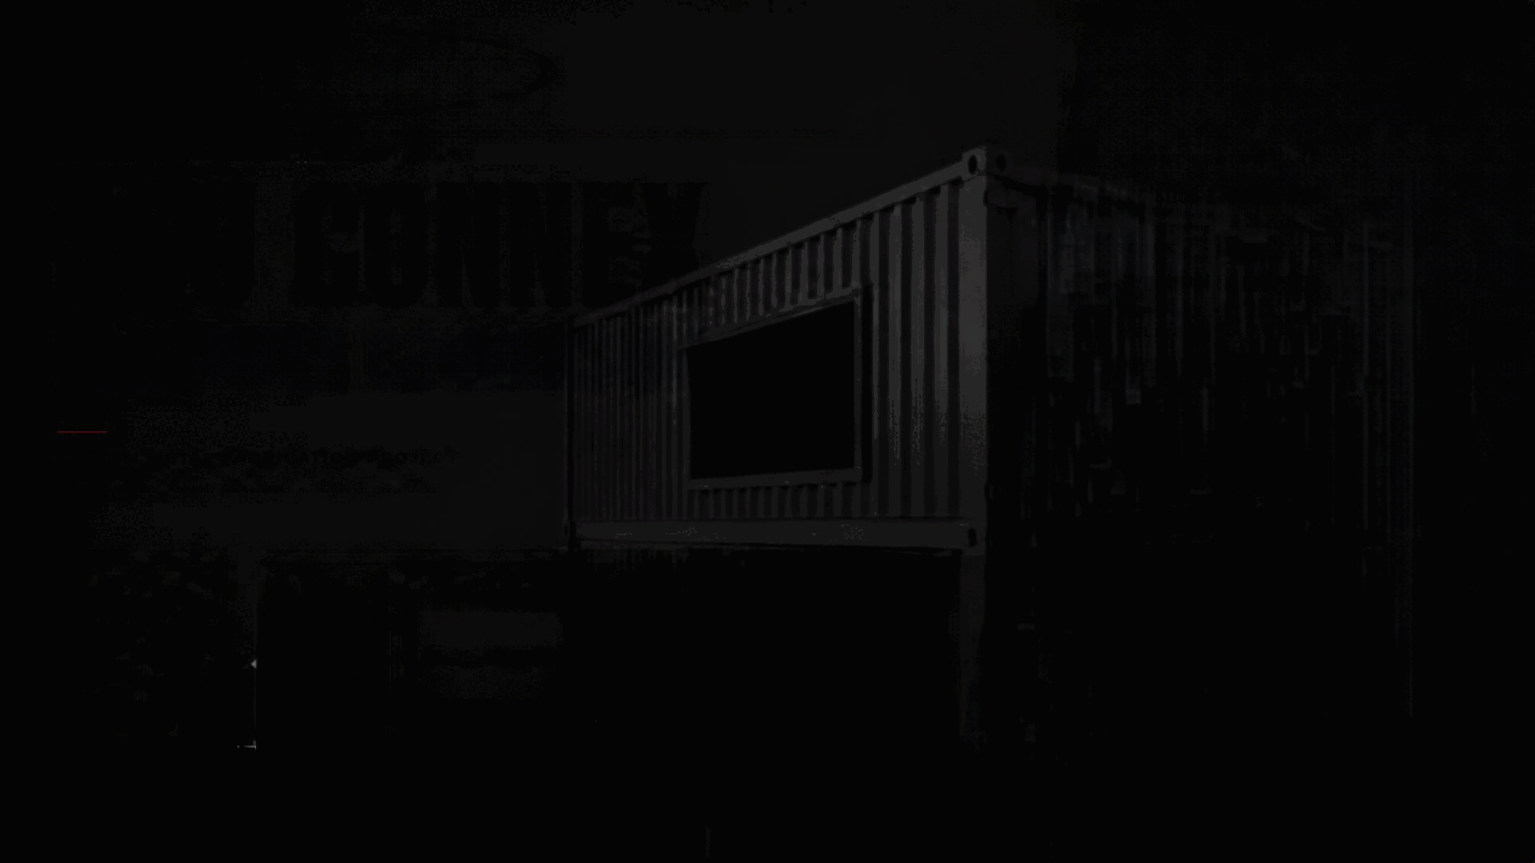

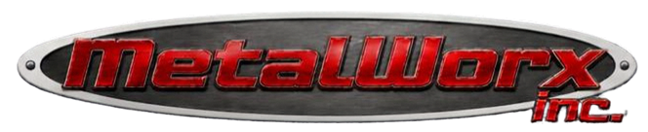
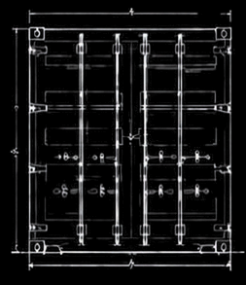
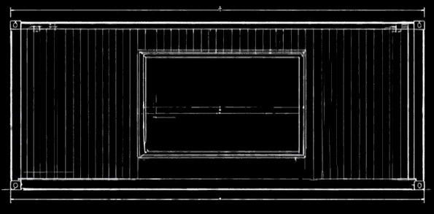
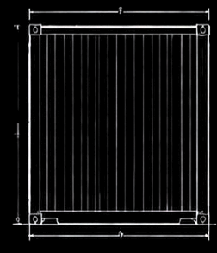
INC.
PROJECT STORYBOARD // CASE STUDY 01
CLIENT SECTOR
SSU CONNEX
Logistics / Mobile Ops
SCOPE
Structural Conversion
CONTAINER CONVERSION
DELIVERY
Q2 - 2026
CUSTOM METAL FABRICATION PROJECT
Fayetteville, North Carolina • Delivered 2026
VETERAN OWNED • AMERICAN MADE
BUILT STRONG. BUILT RIGHT.

Slide 2
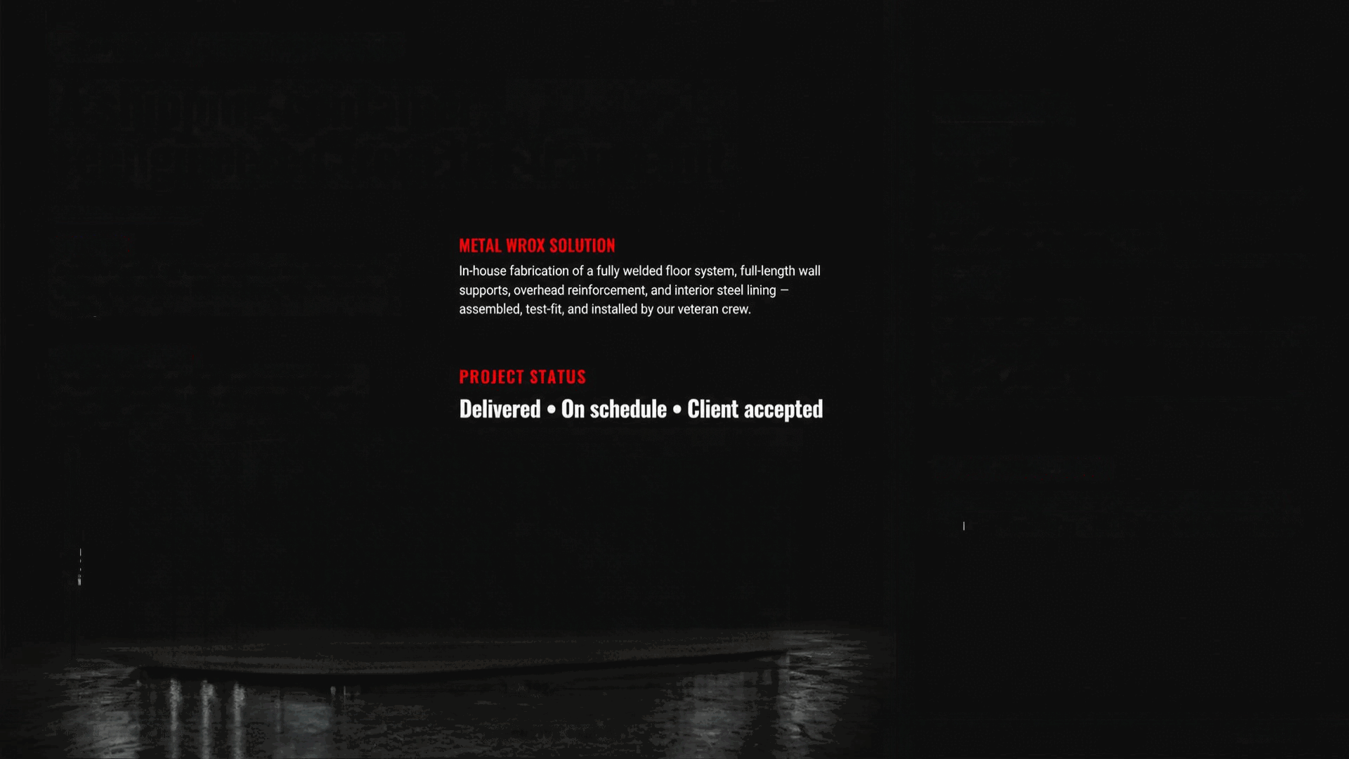


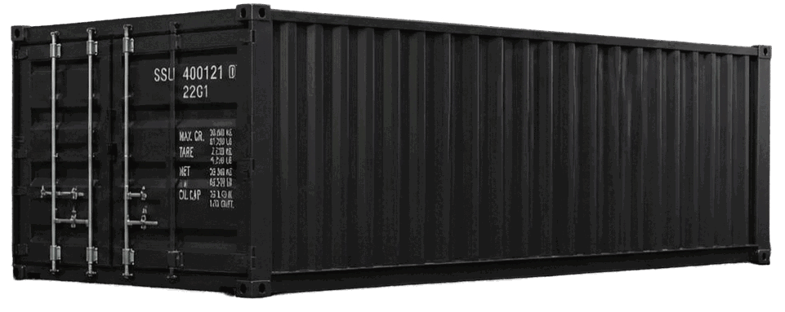







SECTION 01
EXECUTIVE SUMMARY
A shipping container, reengineered from the frame out.
PROJECT FACTS
CONTAINER
20-ft SSU Connex
SCOPE
OBJECTIVE
METAL WROX SOLUTION
Floor • Walls • Overhead • Liner
Convert a standard SSU Connex container into a mission-ready structural enclosure with reinforced floor walls, and overhead framing.
In-house fabrication of a fully welded floor system, full-length wall supports, overhead reinforcement, and interior steel lining • assembled, test-fit, and installed by our veteran crew.
MATERIAL
A36 structural steel
CUSTOMER NEED
CLIENT SECTOR
A durable, transportable steel structure engineered for repeat deployment and heavy interior loading • beyond factory tolerances.
PROJECT STATUS
Logistics / Mobile Ops
Delivered • On schedule • Client accepted
MAJOR MILESTONES
Arrival
Fabricate
Test Fit
Install
Deliver
2,592
12.192
METAL WROX, INC.
EXECUTIVE SUMARY
02 / 18

Slide 3

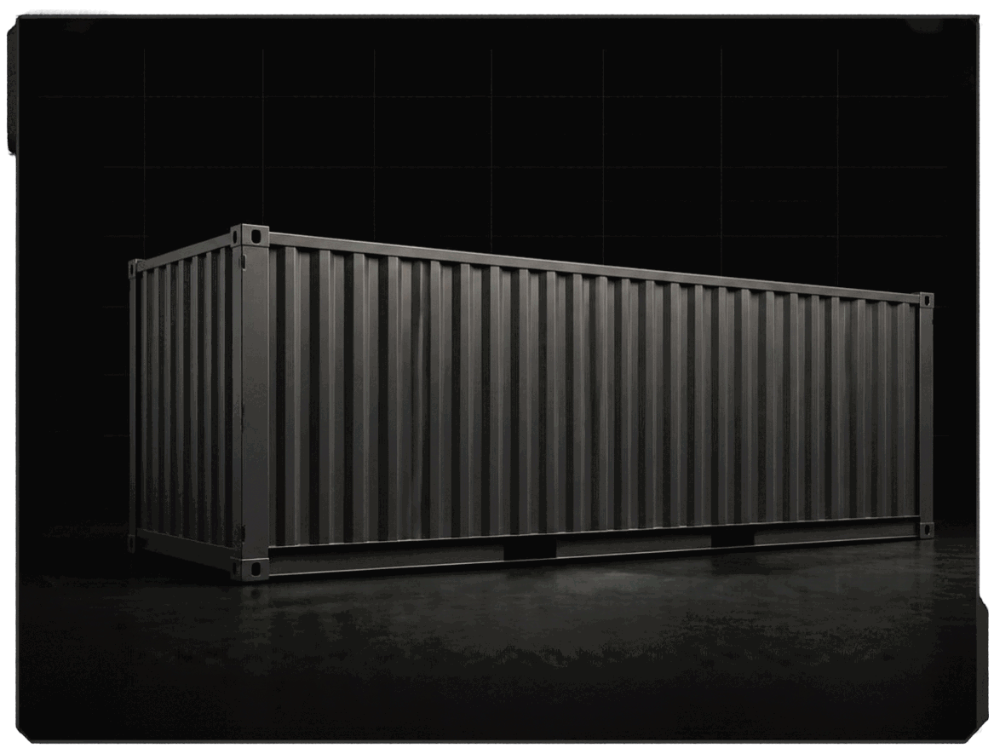


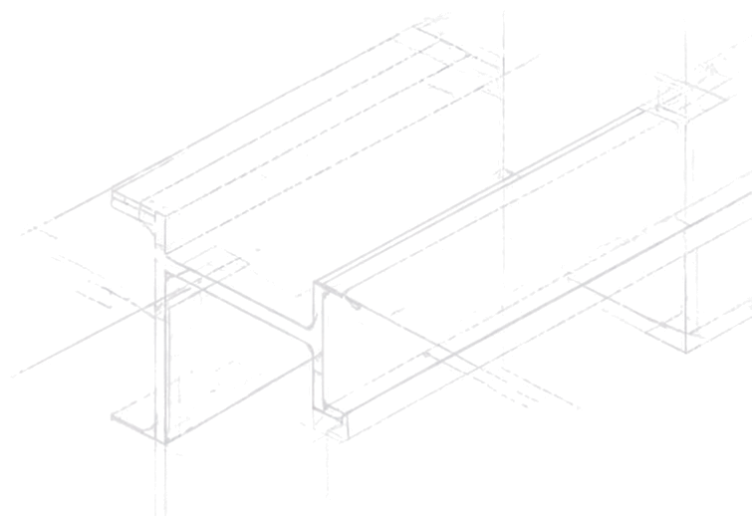
PHASE 01 - 10.14.2026
Connex Arrival and Initial Inspection
The SSCU Connex arrived at our Lafayetteville shop in factory-standard configuration — corrugated steel skin, plywood decking, minimal internal framing. Our inspection documented weld seams, deck condition, and dimensional tolerances against the customer’s build package.
Field notes flagged the standard floor as under-rated for the intended payload, and the sidewall ribs as insufficient anchor points. The transformation plan calls for a purpose-built structural system fabricated from A36 steel, welded in place and finished to marine-grade standards.
CAPTION
Container as received — original condition documented in a full 360° walkaround.
METAL WORX, INC.
ORIGINAL CONDITION
03 / 18

Slide 4

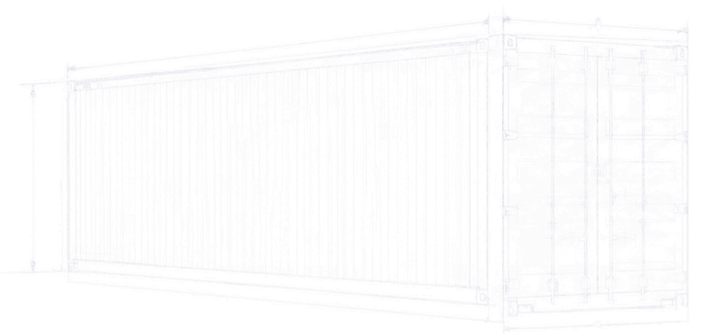

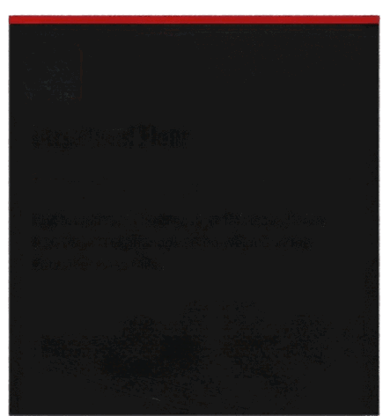
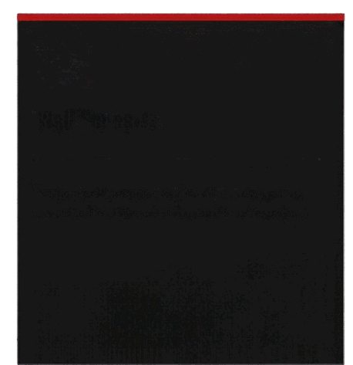
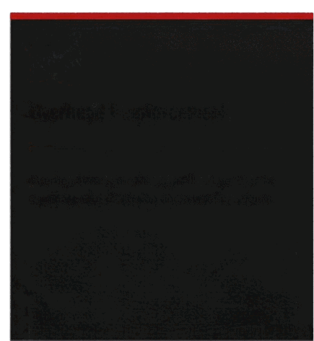
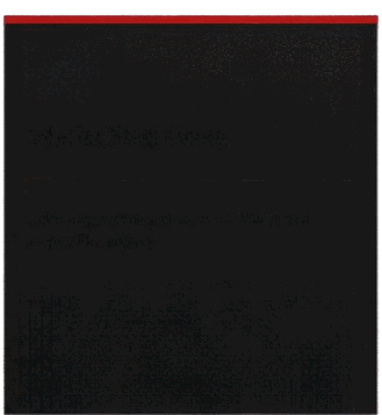


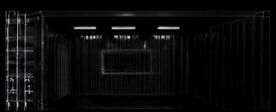
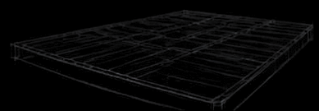
SECTION 02 . SCOPE & OBJECTIVES
Deliverables engineered to structural intent.
Four fabrication packages define the conversion. Each is drawn, cut, and welded in-house beforeall.
01
02
03
04
Structural Floor
Wall Supports
Overhead Reinforcement
Interior Steel Lining
Full-length steel floor system fabricated from A36 plate and channel, seam-welded to the container base rails.
Vertical wall supports tied into the corner posts, tensioned and gusseted for point-load resistance.
Overhead cross-members and load headers to eliminate roof deflection under interior rigging.
Full-perimeter lining plate, welded flush and prepped for coating.
METAL WORX, INC.
SCOPE & OBJECTIVES
04 / 18

Slide 5

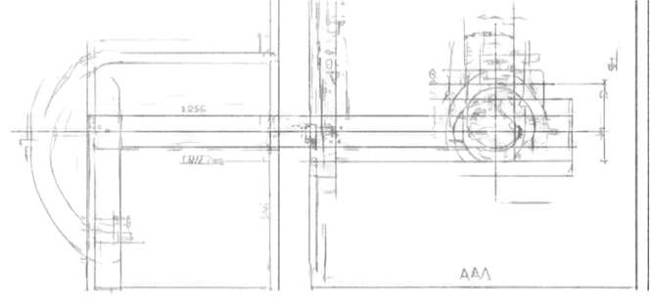
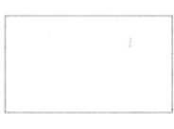
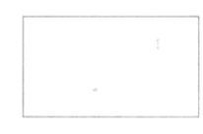
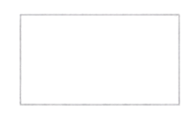
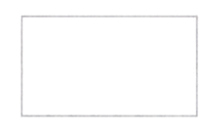
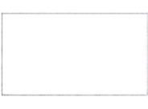
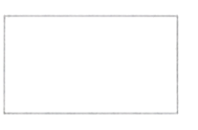
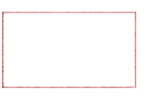
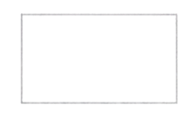
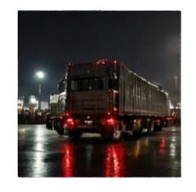
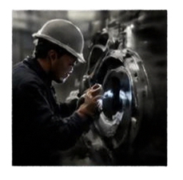
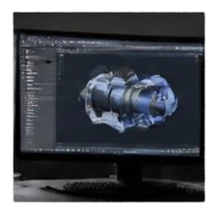
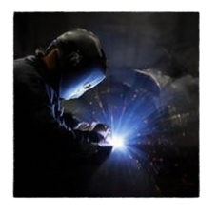
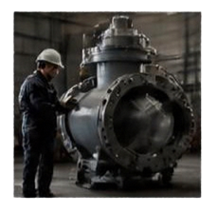
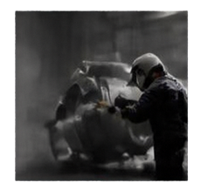
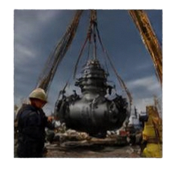
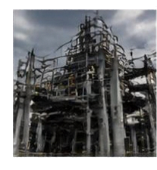












SECTION 03 • PROJECT TIMELINE
From arrival to installation.
COMPLETE
COMPLETE
COMPLETE
COMPLETE
COMPLETE
COMPLETE
IN PROGRESS
PLANNED
Arrival
Inspection
Design
Fabrication
Test Fit
Finish
Installation
Completion
01
ARRIVAL
02
INSPECTION
03
DESIGN
04
FABRICATION
05
TEST FIT
06
FINISH
07
INSTALLATION
08
COMPLETION
Q1 • Stage 1
Q1 • Stage 2
Q2 • Stage 3
Q2 • Stage 4
Q3 • Stage 5
Q3 • Stage 6
Q4 • Stage 7
Q4 • Stage 8
CURRENT PHASE • COMPLETED • •
METAL WROX, INC.
PROJECT TIMELINE
05 / 18

Slide 6
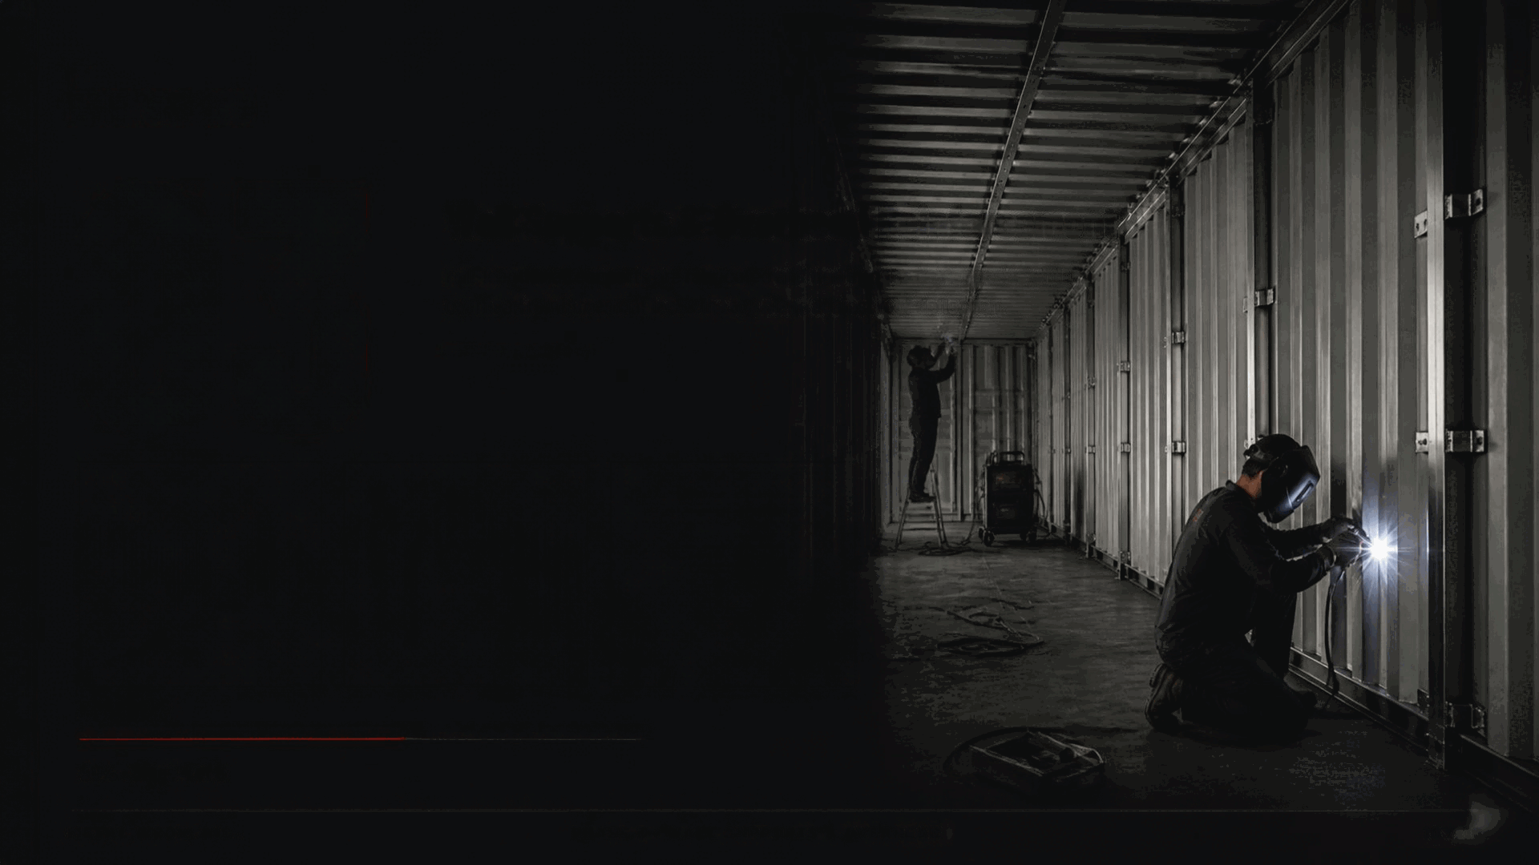

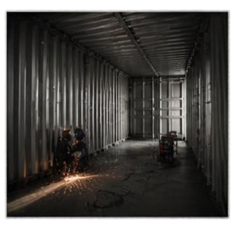
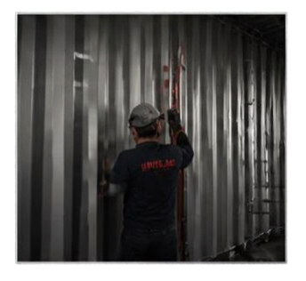
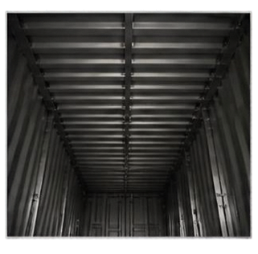
PHASE 03
03
Wall Supports & Overhead Reinforcement
Full-length wall supports are fabricated and tied into the corner posts, while overhead reinforcement locks the top plane against roof deflection.
PROGRESS
50% • Stage 4 of 8
METAL WROX, INC.
PHASE 3 • WALL SUPPORTS & OVERHEAD
10 / 18

Slide 7



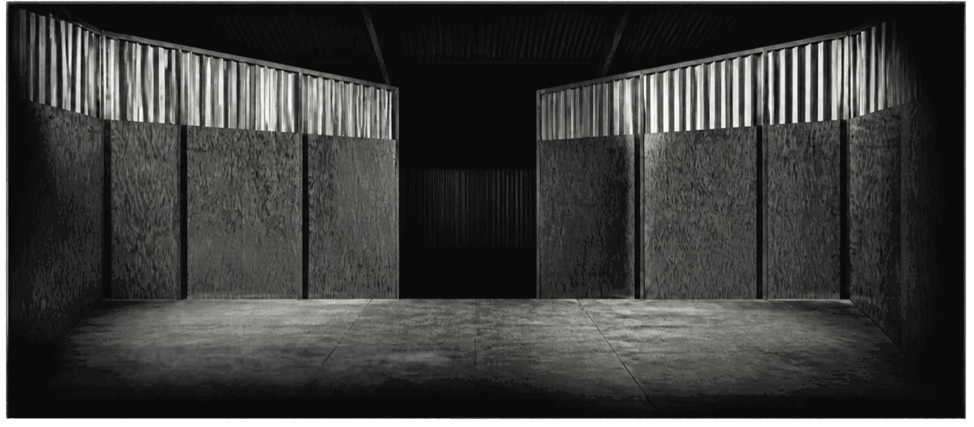

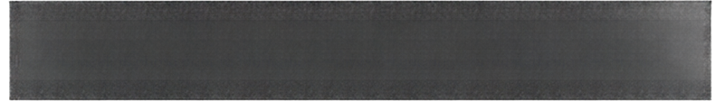

PHASE 01 • 10.16.2026
Documenting the Original Interior
CAPTION
Interior baseline photo prior to fabrication — plywood decking, corrugated skin, factory ribs.
METAL WORX, INC.
ORIGINAL INTERIOR
07 / 18

Slide 8

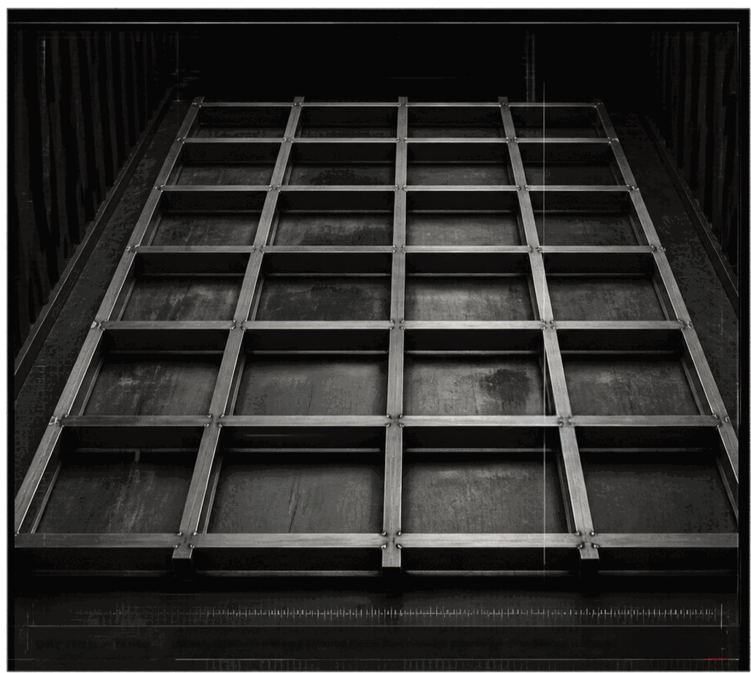


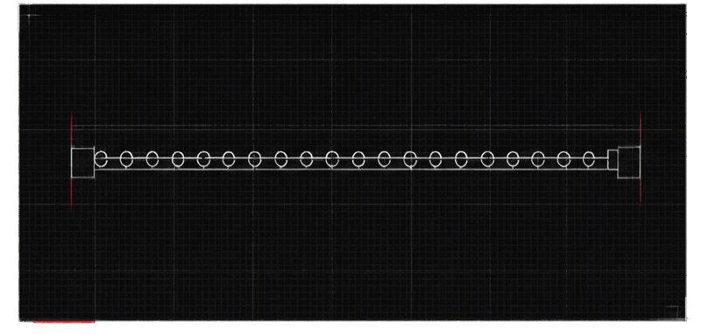

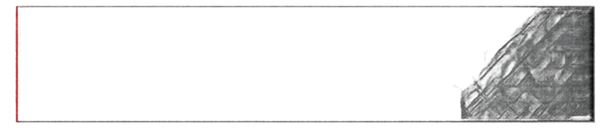
PHASE 02 • STRUCTURAL FOUNDATION
DETAIL
MIG weld • root pass, A38 plate to base rail.
Building the structural foundation.
The floor system starts here. A38 channel and plate are cut, squared, and tack-fit inside the container before final passes (back the frame to the base rail).
Steel: A38 channel + plate
Process: MIG (GMAW), C45 ER7D5-G
Prep: Squared to •11")16" •
Paste: Foot + fill + cap • inspection Visual • dye pericrane
CAPTION • MAIN
Structural framing fit and squared inside the container prior to full-penetration welding.
METAL WORX, INC.
PHASE 2 • STRUCTURAL FOUNDATION
08 / 18

Slide 9

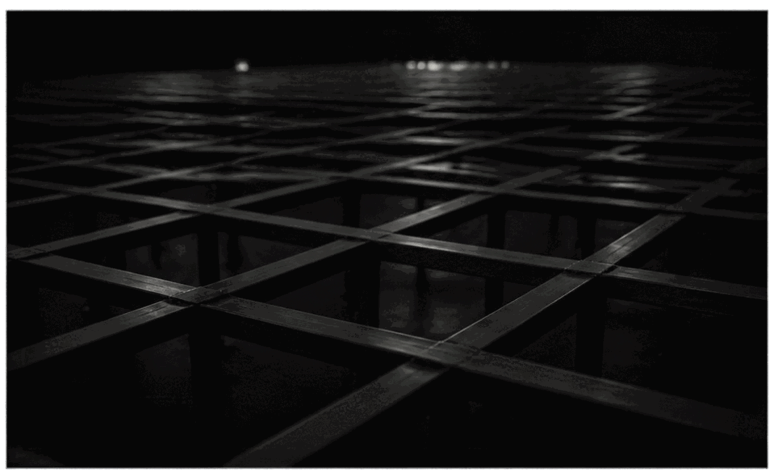
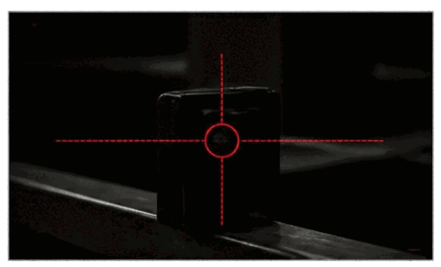


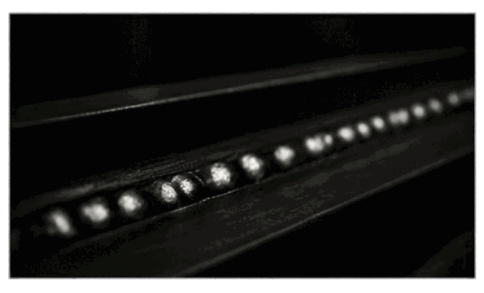




PHASE 02 • FLOOR SYSTEM
Steel Floor System — Installed & Squared.
02 • Alignment check, x1/16 •
POSITIONING - SQUARE - WED
01 • Positioning the fabricated floor system.
The floor system anchors every subsequent build stage. With the frame squared and locked, wall supports and overhead reinforcement can be indexed off a true datum • cutting install variance from the outlet.
03 • Weld pass on floor rail.
METAL WORX, INC.
STEEL FLOOR SYSTEM
09 / 18

Slide 10


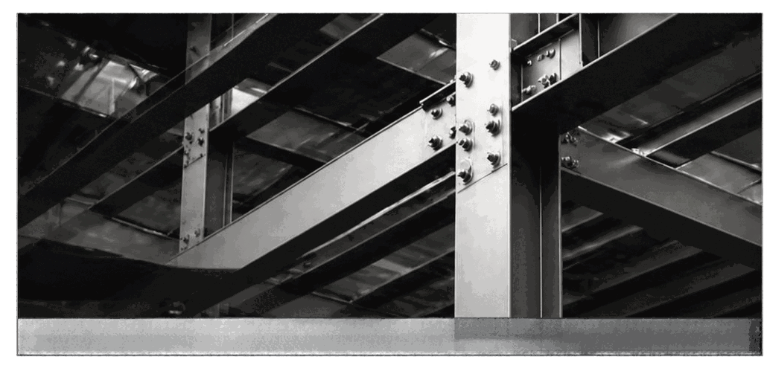


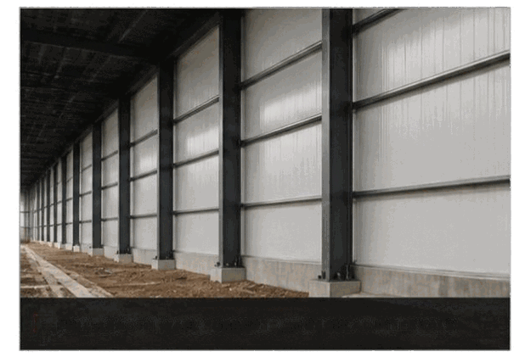
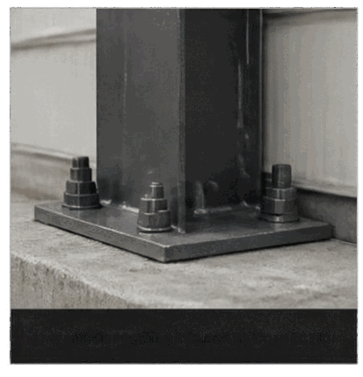



PHASE 03
03
OVERHEAD REINFORCEMENT TIED INTO CORNER POSTS
Wall Supports & Overhead Reinforcement
Full-length wall supports are fabricated and tied into the corner posts, while overhead reinforcement locks the top plane against roof deflection.
PROGRESS
50% • Stage 4 of 8
FULL-LENGTH WALL SUPPORTS AT REGULAR INTERVALS
WALL SUPPORT BASE PLATE CONNECTION
METAL WORX, INC.
PHASE 3 — WALL SUPPORTS & OVERHEAD
10 / 18

Slide 11
PHASE 03 · FIELD JOURNAL
Installing Full-Length Wall Supports.
2
3
02 Alignment check with laser plumb and torpedo level.
03 Root pass, vertical up — E71T-1 flux core, downhand fill.
1
4
5
01 Full-length support tacked plumb along the sidewall — corner posts referenced.
04 Crew hand-off between weld positions.
05 Support run complete, ready for gusset plates.
FIELD CHALLENGES & SOLUTIONS
CHALLENGE
SOLUTION
SAFETY
Corner posts out of plumb by ~3/8" over full height, biasing every support run.
Fabricated adjustable gusset plates to shim each support at the top and bottom rail.
Hot-work permit, forced-air ventilation, and dual fire watch throughout all vertical positions.
METAL WORX, INC.
WALL SUPPORTS
11 / 18

Slide 12
PHASE 03 · OVERHEAD REINFORCEMENT
Reinforcing the Upper Structure.
BEFORE
AFTER
Deflection observed under load; roof plane unrestrained between corner posts.
Cross-header and paired stiffeners tied into wall supports — plane locked, deflection eliminated.
TRANSFORMATION SUMMARY
Overhead deflection: 3/8" → 0. Load rating: doubled. Interior rigging: sanctioned for full spec.
METAL WORX, INC.
UPPER STRUCTURE
12 / 18

Slide 13
PHASE 04 · INTERIOR STEEL LINING
Skinning the interior in welded plate.
CHALLENGE
METAL WORX SOLUTION
Uneven substrate.
Furring, plate, seam-weld.
Original ribbed skin creates a discontinuous mounting surface — full-perimeter lining plate must span factory undulations without oil-canning or losing weld access to the corner posts.
Fabricated furring strips index off the wall supports to build a true plane. 14-ga plate is fitted, stitch-welded, then continuous-seamed and ground flush — a monolithic interior ready for coating.
CRAFTSMANSHIP CALLOUT · Continuous seam · zero oil-can · coating-ready
METAL WORX, INC.
PHASE 4 — INTERIOR STEEL LINING
13 / 18

Slide 14
TECHNICAL · FABRICATION DETAILS
Where the welds do the talking.
A
Fillet weld — 1/4" leg, all-around
Floor system bracket · A36 plate
B
Bracket — A36, 1/4" plate, laser-cut
Welded bracket assembly — floor rail to vertical stiffener, gusseted, 1/4" fillet all-around.
Wall reinforcement · paired stiffener + header
METAL WORX, INC.
FABRICATION DETAILS
14 / 18

Slide 15
SECTION 05 · MILESTONE SUMMARY
Every stage · checked and closed.
01
✓
02
✓
03
✓
04
✓
Arrival and inspection
Structural foundation fabricated
Wall supports installed
Overhead reinforcement finished
05
✓
06
✓
07
✓
08
✓
Interior lining completed
Test fitting and alignment
Installation finalized
Project completed
METAL WORX, INC.
MILESTONE SUMMARY
15 / 18

Slide 16
SECTION 06 · INSTALLATION FIELDWORK
Boots on the ground.
On-site, on-spec.
CREW
5-person install team, all trades on-site.
EQUIPMENT
Rough-terrain forklift · MIG rig · plasma cutter.
SAFETY
Fire watch · hot-work permit · PPE tier 3.
SITE CONDITIONS
Concrete pad, 42° F, mild wind — heat blankets deployed.
CHALLENGE OVERCOME
Field-verified corner variance; on-site shims fabricated in ≈ 40 minutes.
ON-SITE INSTALL
METAL WORX, INC.
INSTALLATION FIELDWORK
16 / 18

Slide 17
PROJECT COMPLETE · Q2 · 2026
SSU Connex — Delivered.
Custom Metal Fabrication · Fayetteville, NC
MW
Built to endure — the finished conversion passed client acceptance on the first walkthrough. Reinforced, sealed, and coating-ready.

Slide 18
MW
METAL WORX
RESULTS · DELIVERED
INCORPORATED
Custom Metal.
Built to Last.
DELIVERY
On time · On spec · Zero rework
CRAFTSMANSHIP
Full-penetration welds · square to ±1/16"
IMPACT
Load rating doubled · client re-order authorized
MW
VETERAN OWNED
AMERICAN MADE
BUILT STRONG. FINISHED RIGHT.
METAL WORX, INC. · Fayetteville, NC · metalworxnc.com · (910) 000-0000

