Slide 1
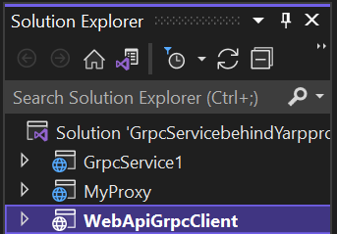
Project Structure
Webapi and Grpc Hosted in ASP.NET Core
A proxy Server for Hiding the apis .
In this case it is a proxy for grpcservice1
Web api and Grpc client .
The client will call only myproxy not Grpc Service

Slide 2
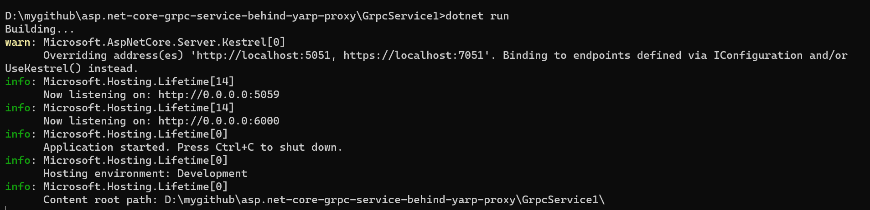
Steps to run
Step-1

Slide 3
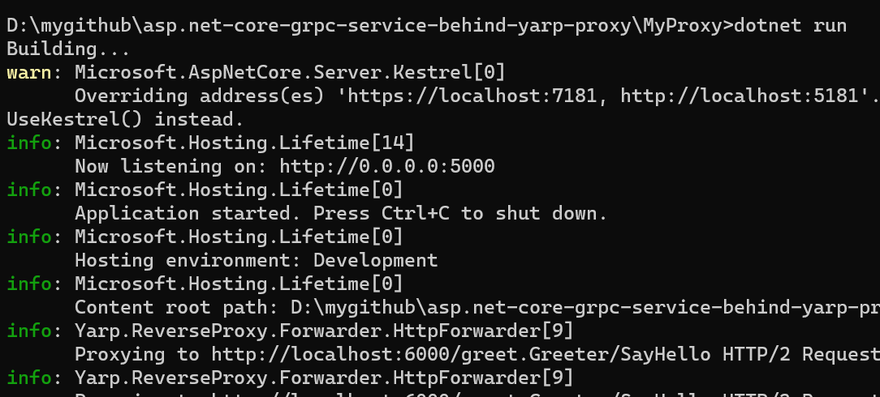
Step-2

Slide 4
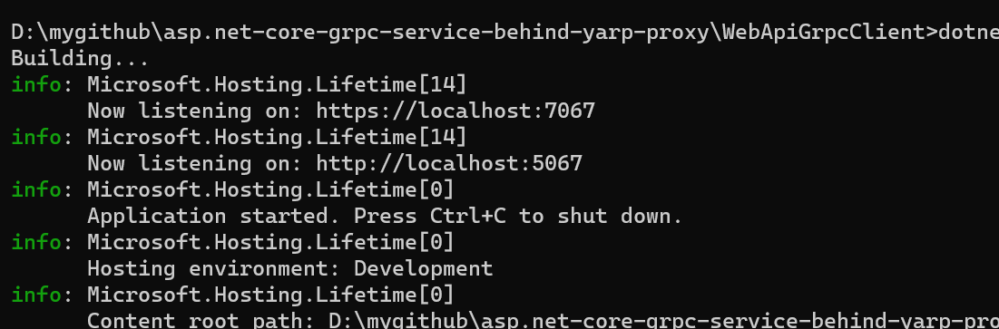
Step-3

Slide 5
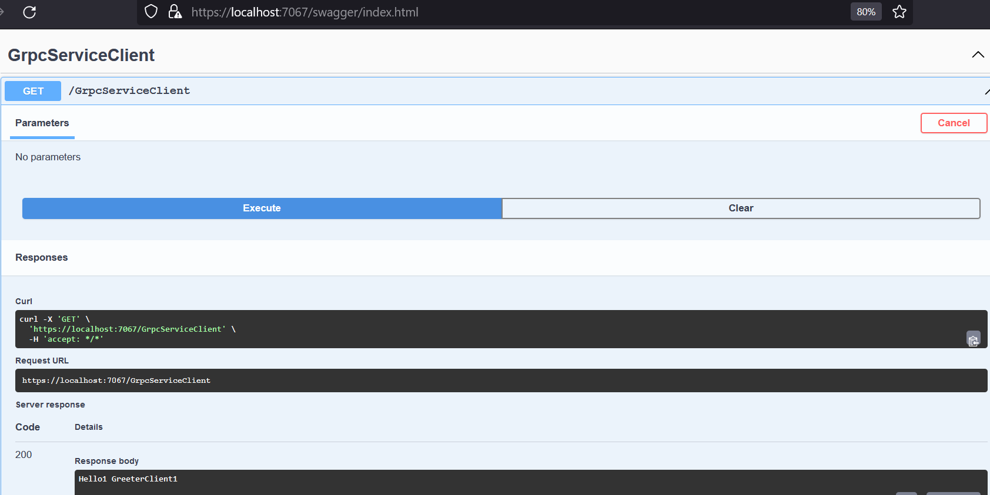
Step-4

