Slide 1
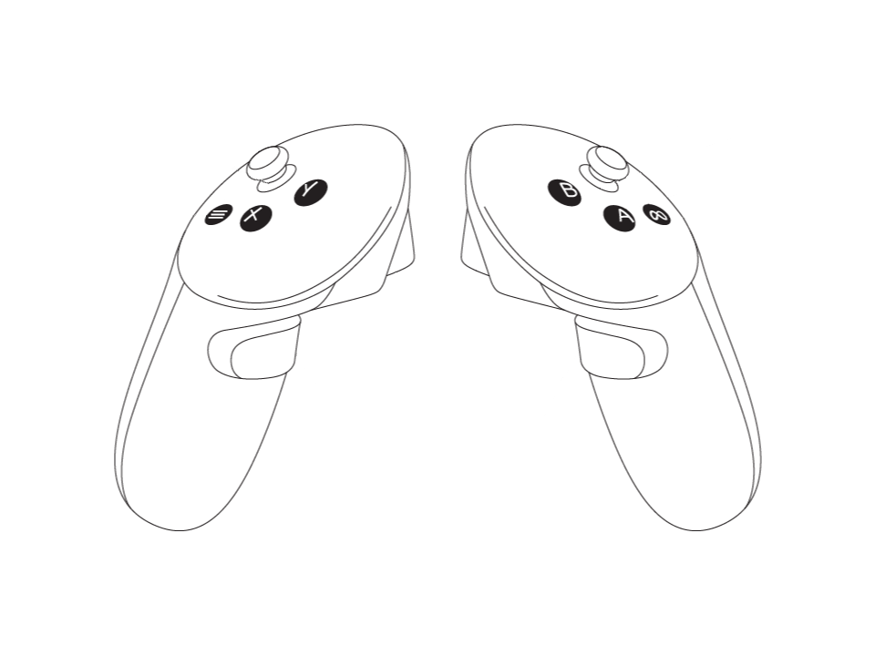
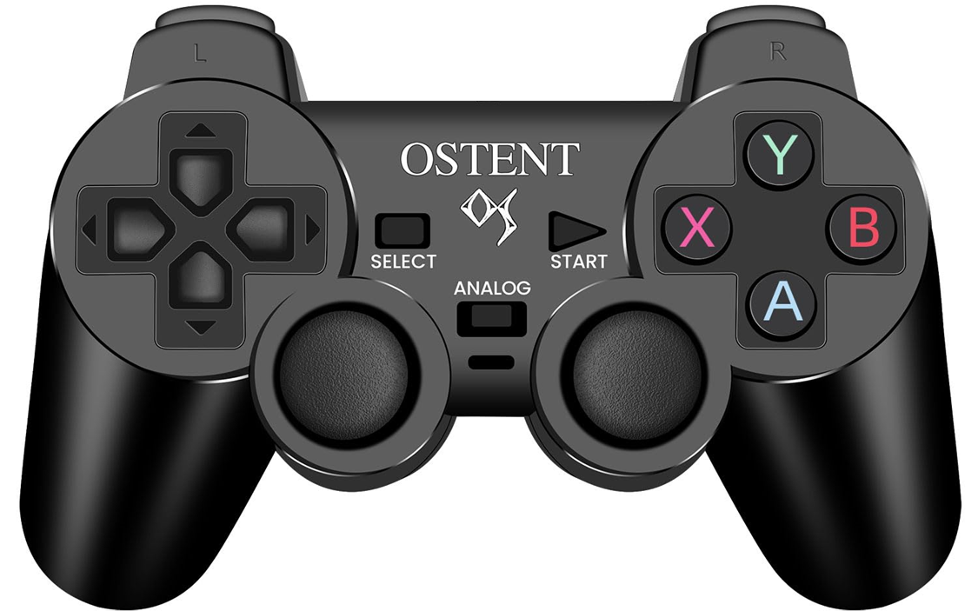
Map from VR controllers to PS2 controller
Reserved by the App. Opens the App menu
Reserved by the VR. Opens the VR menu
Sends the “start” signal to the robot and also opens the debugging panel
CLICK
CLICK
R1
L1
L2
R2
MOVE
MOVE
Not mapped in the VR controllers!

