Slide 1
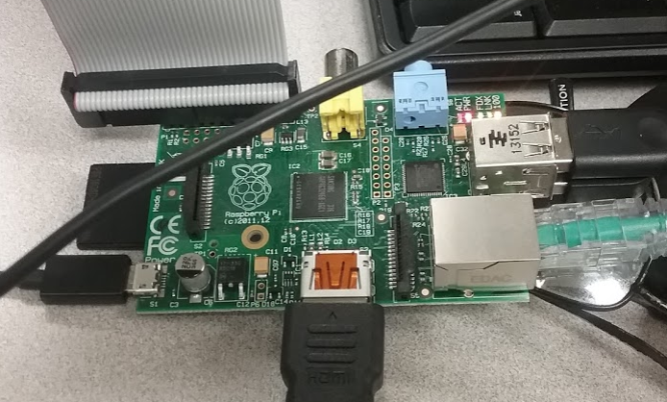

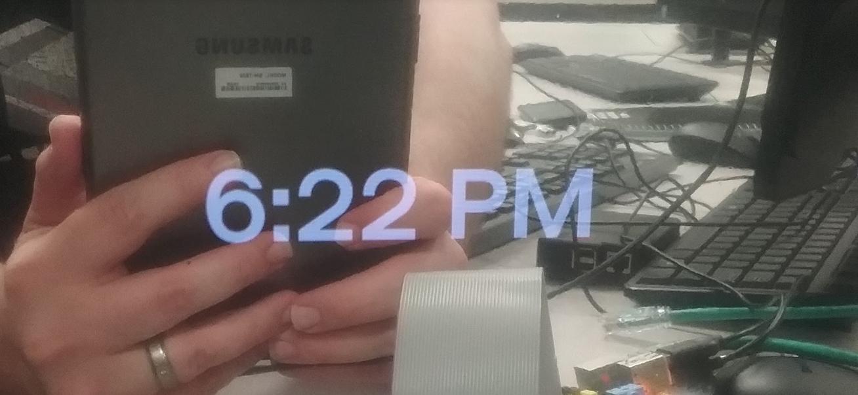
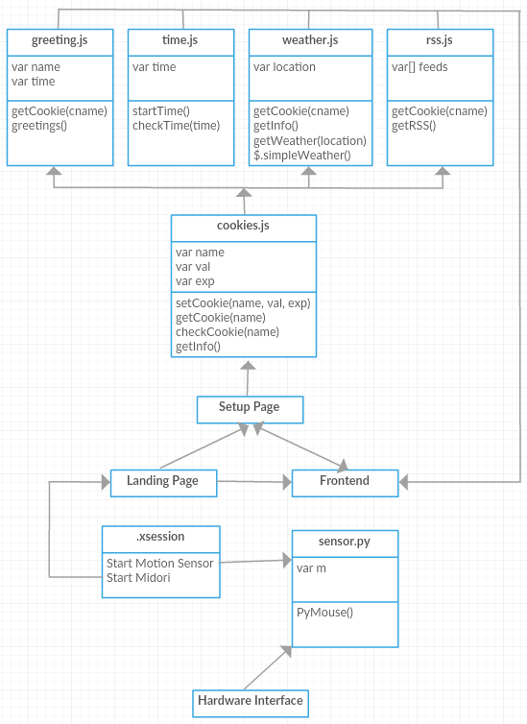
Pudding: A Smart Mirror For The Masses Charles Alan Macon Jordan Sanders Hunter Russ Computer Science – University of North Texas – Spring 2016
Introduction
Pudding is an interactive mirror that allows the user to view the time, the weather, and news headlines – all while still acting as a mirror. The display was designed to require as little user setup as possible, while still creating an awe-inspiring experience. This was meant to create an experience that would be convenient to the user, without creating any unnecessary clutter in their home.
The core idea of Pudding was the creation of an additive system that enhances things that most people already have without the need for advanced technical skills to set them up. For instance, in its current incarnation, the Pudding software is behind a mirror, and displays information through the mirror so that the user can still use the mirror as an actual mirror.
Technical Information
To make the Pudding as cost effective and as easy to deploy as possible, we opted to modify a standard, HDMI capable computer monitor with a Raspberry Pi 1 Model B running a modified version of the latest Raspbian Linux operating system. Upon boot, the Pudding loads the Midori browser in kiosk mode and automatically navigates to a page that is locally hosted on a LAMP server. The LAMP server allows Pudding to run JavaScript and save information about the user as needed. The software is written in a combination of HTML, CSS3, JavaScript, PHP, Python, and Shell languages.
Upon plugging in the Pudding, the Raspberry Pi automatically boots and searches for either a wired internet connection or an open wireless internet connection. Upon securing an internet connection, the Pudding loads a configuration page so that they user may enter their name, location, preferred RSS feeds, and other such information.
While the browser is running in the foreground, there is also a Python script running in the background that is monitoring input from a motion sensor that has been attached to the Raspberry Pi using a breadboard. When the motion sensor detects motion, it subtly moves the mouse cursor to disable (or delay) the Raspbian screensaver. This enables the device to automatically “sleep” when there is nobody in front of the display, but “wake up” when somebody is.
Problems Throughout
Over the course of the semester, we ran into several snags while trying to create Pudding. These included, but were certainly not limited to:
We developed the software on at least three different models of the Raspberry Pi which led to compatibility issues when it came time to test.
The Raspberry Pi does not have an internal clock and, as such, will not save the time when the system powers down. This had to be solved using a software solution.
The Raspberry Pi 1 Model B is too slow for some of the “fancier” features, such as animated weather backgrounds, and the scope had to be changed.
The “input paradox”: We tried to create a system that should (ideally) only be controlled via a mobile application over Wi-Fi. Unfortunately, one cannot login to a wireless network (to control the system), unless one has already manually logged into the network.
Class Diagram
The Hardware
A Raspberry Pi 1 Model B with breadboard attachment (not shown)
Lessons Learned
Always make sure your storage medium is properly formatted and ejected. This could have saved us so much time and trouble.
In that same vein, always make sure your storage medium is the appropriate size. Even though the operating system recommends a certain size SD card, get a bigger one.
Measure twice, cut once.
When developing a user interface, never assume that you know the resolution of the display beforehand.
Future Plans
We plan to continue developing the Pudding after the conclusion of the semester. There are several features that we would like to add, and have already created the framework for several of these:
Animated backgrounds that display depending on current weather conditions. These have already been created, but the current hardware is unable to display these without slowing the system down to an unacceptable level.
Amazon Alexa integration. This would allow the user to control the system via voice commands. This system also allows access to any media that is available via Amazon Prime (music, movies, etc.)
Weather information via Geolocation – determined by IP address. This feature is entirely possible, but the browser that we are currently working with (Midori) doesn’t currently support it. We would have to figure out a different method of doing this, or we would have to find a browser that includes this feature.

