Slide 1

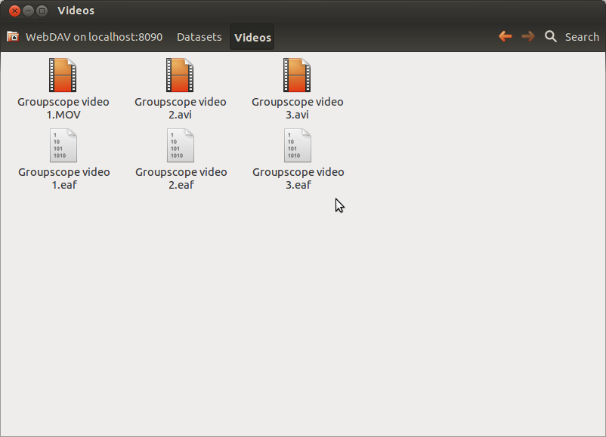
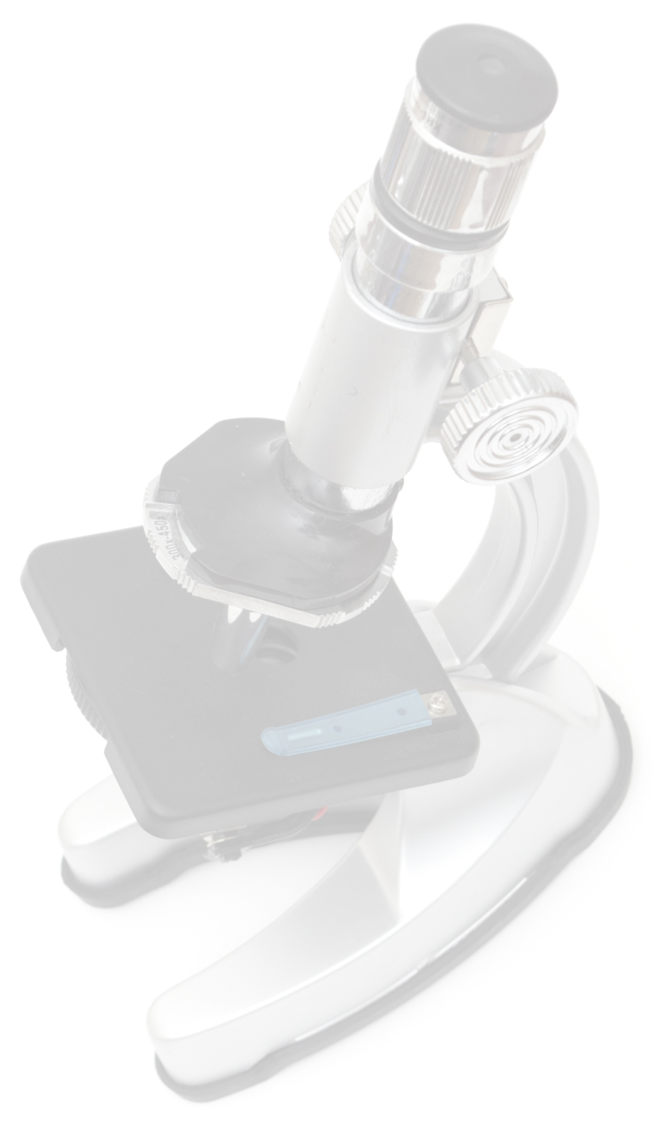
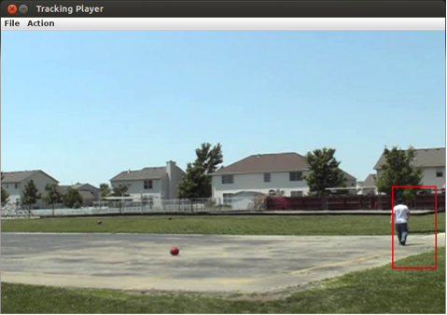
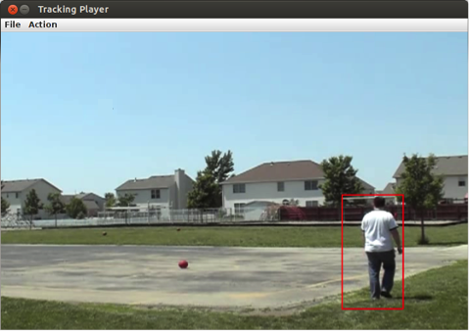

Groupscope:
A Microscope for Large Dynamic Groups Research
Sandeep Puthanveetil Satheesan, Marshall Scott Poole, Rob Kooper, Kenton McHenry
National Center for Supercomputing Applications, University of Illinois at Urbana-Champaign, Urbana, IL, USA {sandeeps, mchenry}@illinois.edu
Abstract
Social Science research on large dynamic groups of people involves many challenges of which a prominent one is working with large amounts of video and audio data. Lack of automation has resulted in a methodological gap on how research is conducted in this area. For example direct observation and annotation becomes a tedious and manual task as the size of the group and the duration of interaction increases. We propose to leverage an extensible and scalable content aware data repository called Medici to incorporate content based analysis tools from computer vision as well as manual annotations tools to provide a more practical solution for storing, managing, processing, and analyzing data for researchers enabling them to make firsthand observations and verification of theories.
Large Dynamic Groups (LDGs)
People interacting in dynamic subgroups in indoor or outdoor spaces
8 ≤ group size ≤ 200 (approx.)
Critical to functioning of modern-day society
Disaster and emergency response
Medical care
Product design
Military operations
NCSA Medici
Gaps in LDGs’ Research
WebDAV
Less theory and research on LDGs
Usually treated as large small groups
Currently used methodologies:
Ethnography
Participant observation
Analysis of transactional records
Survey based network analysis
Almost NO direct observation
E.g. disaster simulation by 40 emergency responders for 6 hours (20 cameras and 40 microphones) = 120 hours video + 240 hours audio ≈ 800 GB
Difficulty in managing, visualizing and analyzing large amounts of data without software tools
Integration with ELAN
Use Cases
Tool for annotation and transcription
WebDAV as platform for integration
Provides a more intuitive interface
Easier management of data and annotation files
Improving efficiency of multi-team interaction
Proposing and verifying theories on LDGs
Studying acts of aggression and bullying in classrooms and playground
Additional challenges due to noise and long distance person tracking
Conclusion
A scalable content aware data repository based solution for conducting research LDGs and analyzing data
A microscope to study the world of LDGs
Could lead to pioneering changes in Social Science research
NCSA Medici
Scalable content aware data repository
Heterogeneous data
RESTful services
Data storage layer abstraction
Scaling based on study requirements
Extractors
Previewers
Person Detection and Tracking
Identification of communication links
Using Kinect depth data for indoor scenarios
Tracking people from a distance
“Tracking People by Learning their Appearances”, Ramanan et al (2007)
“Detecting interaction links in a collaborating group using manually annotated data”, Mathur et al (2012)
Acknowledgement
This work at NCSA/UIUC has been supported by the National Science Foundation under grant BCS-0941268.
For more information, please visit http://isda.ncsa.illinois.edu

