Slide 1
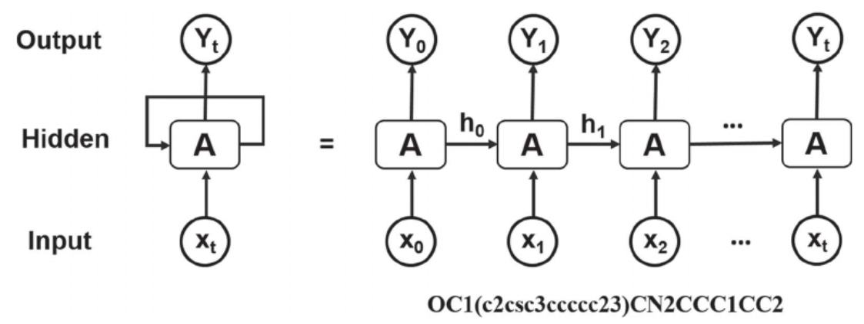
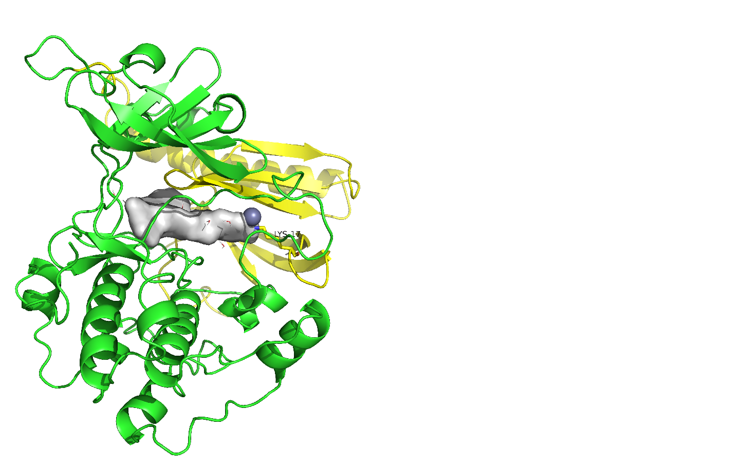
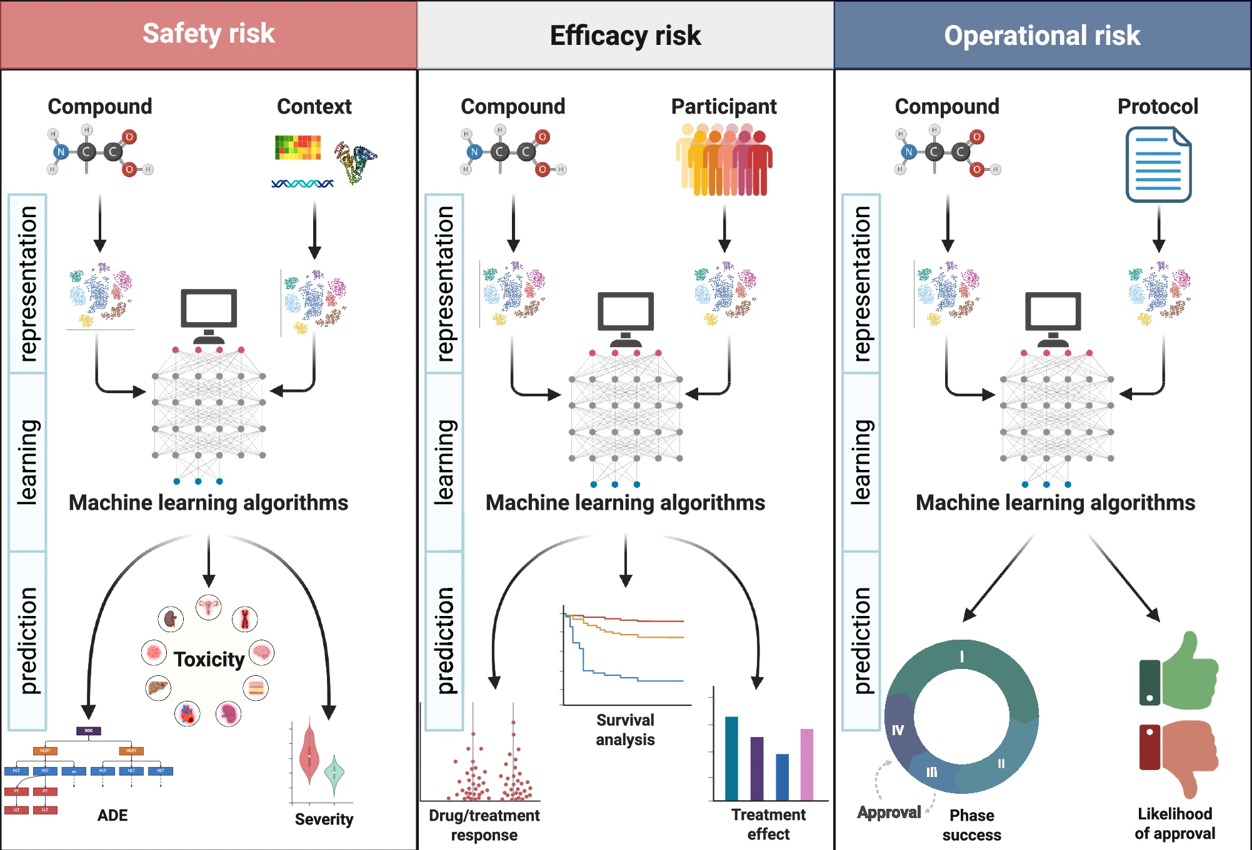
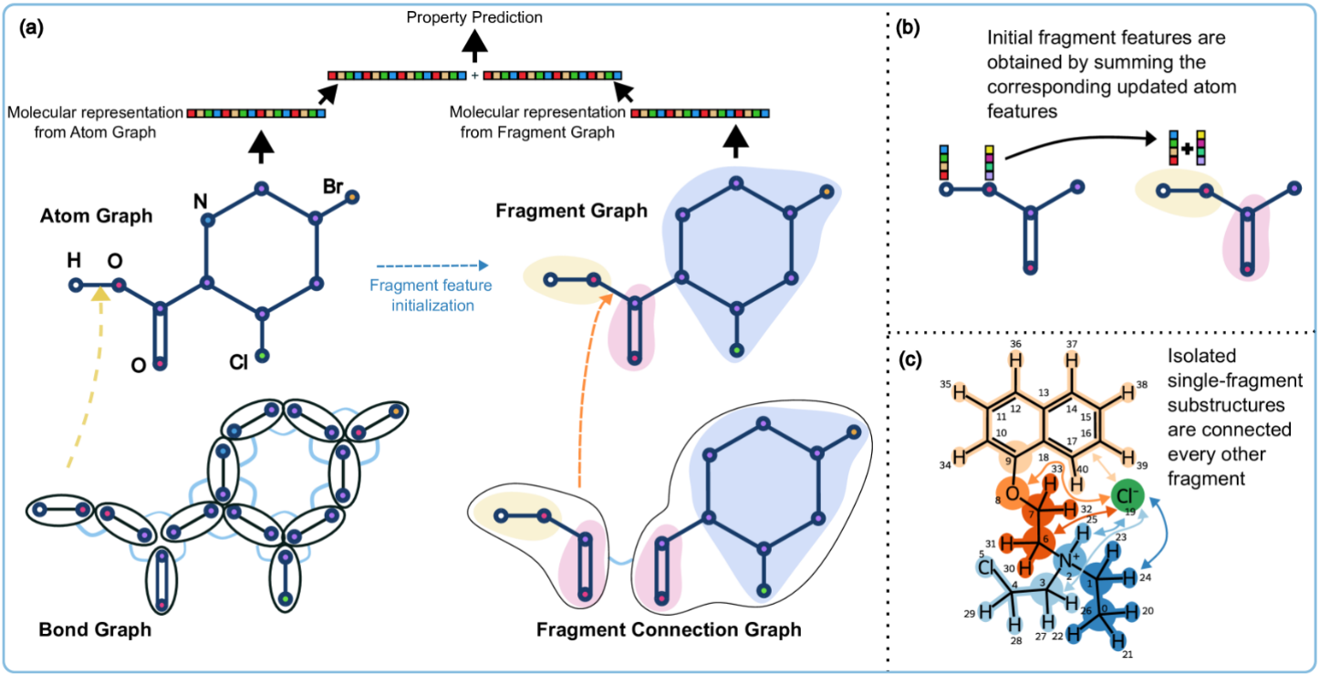
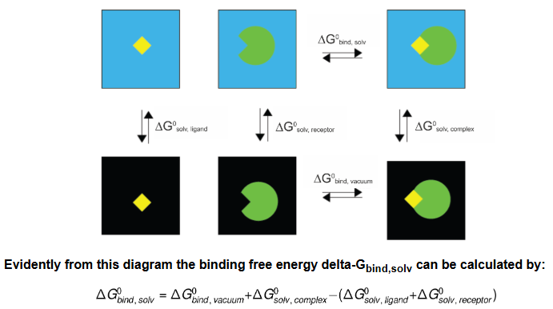
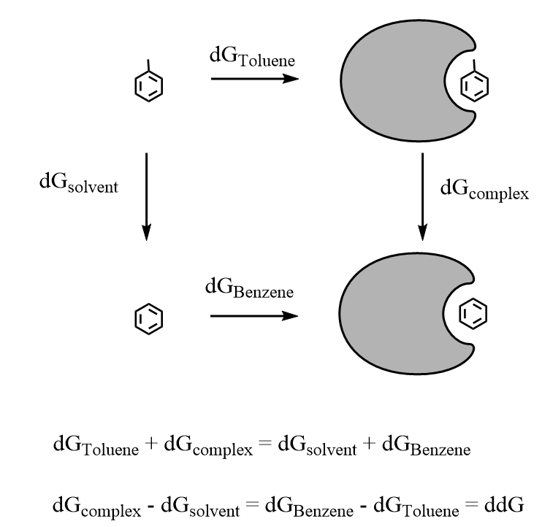
expert opinions patent/literature data
Reinforcement Learning
Generator 1
Reinforcement Learning
Scoring 1
Evaluation
Feedback
WET
ChemBL
PubMed
Zinc
Molecule optimization*
De nove design
Scaffold design
Linker design
…
RCSB PDB*
IFD, C-dock, Rosetta
Physics*:
MM-GB/PBSA
FEP
…
ML*:
Hyperpramter-Optuna
GNN-Chemprop
Diffusion-Boltz2
…
“Data from Biology Lab”
RNN*
VAE
GAN
Transformers
…
AL¹
Transfer Learning
synthesizability model
“Stage1”
Molecules
Rank
Real world
Reinforcement Learning
Generator 2
Reinforcement Learning
Scoring 2
Evaluation
Feedback
WET
“Generator 2 inherits all the features of Generator 1”
Blood–brain barrier
Bioavailability
Half Life
Clearance
Solubility
hERG
…
“Data from Biology Lab”
“Data from other Labs”
Compared with all clinical compounds
ML:
Hyperpramter-Optuna
GNN-Chemprop
…
“Stage2”
Molecules
Rank
Real world
“Stage Clinic*”
1: active learning, combining ML and sate-of-the-art simulation.

