Slide 1
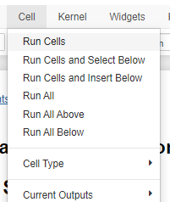


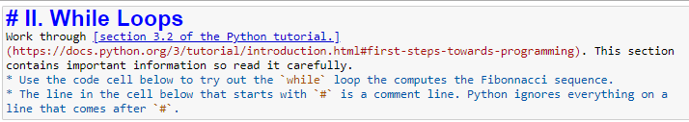
Jupyter Notebook Tips
There are four ways to run code in a notebook cell. Place the cursor in the cell you want to run, then…
Press the Run button in the toolbar
Press CTRL + ENTER
Press CTRL + SHIFT (almost the same as CTRL + ENTER, but the next cell down will become the selected cell)
Select Run Cells from the Cell menu.
Infinite loops happen sometimes. If you run a cell and …
you don’t see any output and …
This asterisk never goes away …
… you are in an infinite loop.
Don’t panic.
Don’t open your house’s main circuit breaker to make it stop (won’t work if you are on a laptop)
Just hit the stop button!
Notebooks have two kinds of cells. You can see and change the type with the cell-type dropdown box.
You can run Python in Code cells
Markdown cells contain text and images.
Sometimes the cell type gets changed accidentally. No worries, just change it back.
Markdown cells look like this if you double-click on them. Just run the Markdown cell (e.g., CTRL + ENTER) to re-render the text

