Slide 1

Python for Scouting and Data Analysis
Session 04
Modules, Packages, and Imports
Issaquah Robotics Society
FRC 1318
Stacy Irwin
June 2018

Slide 2
Session 4 Overview
Topics
Organizing code into modules
Using code in other modules
Using and creating packages
PYTHONPATH environment variable

Slide 3
Session 4 Reading List
Reading Assignment
IRS Scouting System Code on Github
https://github.com/irs1318dev/irsScouting2017
Browse through the Python code for FRC 1318’s scouting system. (Python code is in the Server folder.)
Pay attention to how code is organized into different folders and files
Also pay attention to import statements
Python Tutorial
https://docs.python.org/3/tutorial/index.html
Section 6 (all of it)
Atom Text Editor
https://flight-manual.atom.io/getting-started/sections/atom-basics/
Atom Basics section, especially portion on working with files and directories

Slide 4
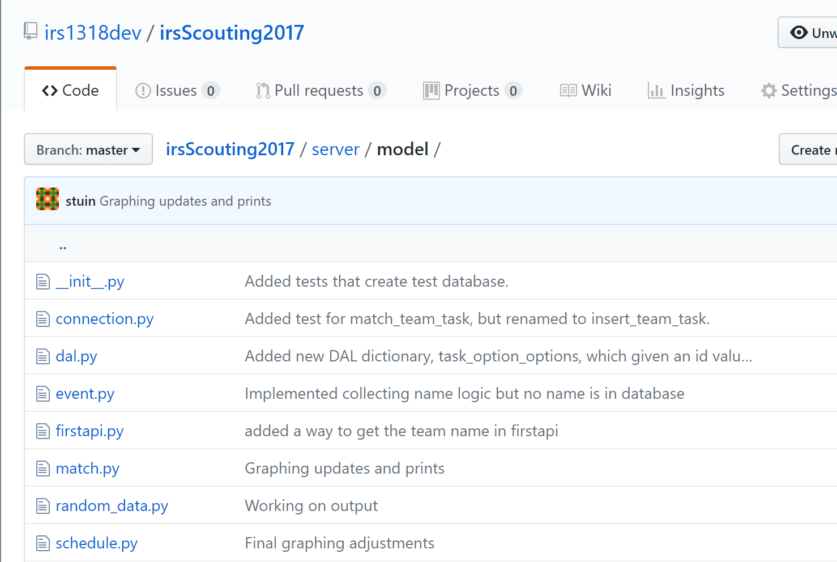
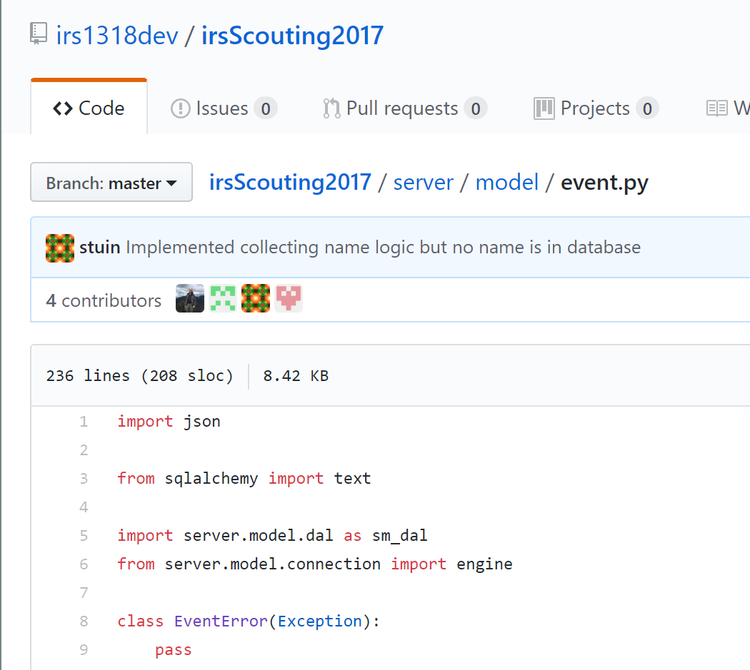
Github
Github is basically an online cloud drive for code
The IRS uses Github to store and share code for the robot and scouting system
Look at the event.py file in the server/model folder.
Import statements allow a Python module to run code from a different module (i.e., file)
Each Python file is called a module

Slide 5
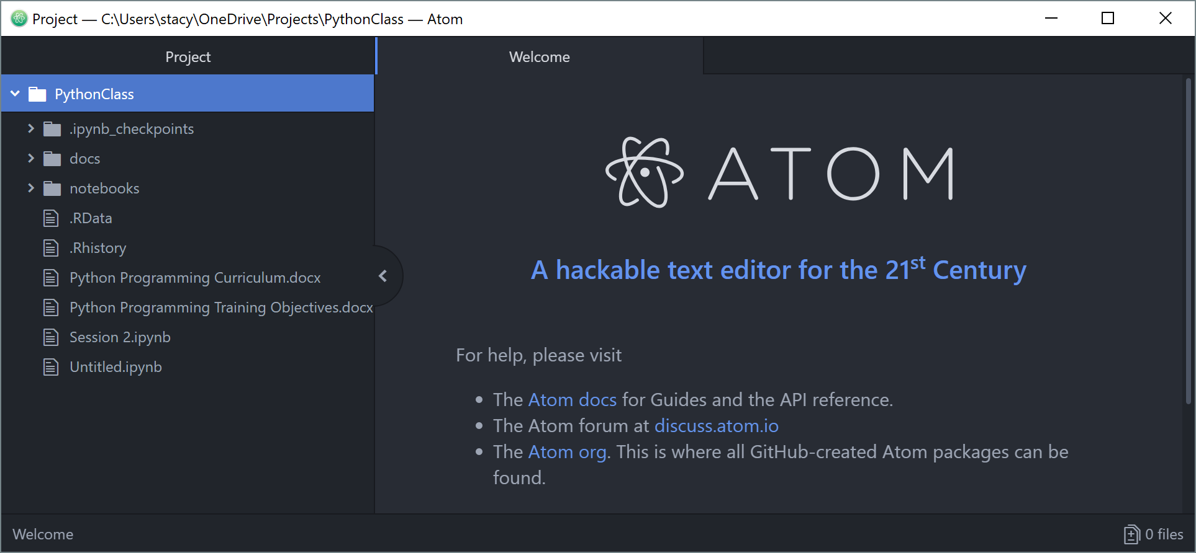
Atom Text Editor
For the next few sessions we will write code in a programmer’s text editor called Atom.
Has good syntax highlighting (i.e., uses colors to make your code easier to read)
Free, but still being maintained (bug fixes are available)
Download and install Atom from https://atom.io/.
Set up a project
From the welcome guide screen, select Open a Project.
Select the folder that contains the files for the Python class.
Atom displays contents of project file
Press ALT key to toggle menu on and off
To open new file:
Right click
Select New File
Type name of file

Slide 6
Exercises 4-1
Open your Jupyter notebook that contains the functions you wrote in session 3.
Copy those functions into a file in atom.
Save the file. Name it mymod.py.
Create another Python file in atom. Name it import_test.py
Make sure import_test.py and mymod.py are in the same folder
import_test.py should call a function in mymod.py and print the results
Test the import_test.py file by calling it from the command line (Windows PowerShell)
Add some more functions to mymod.py
First, save the matchresults_turing_2018.json to the same folder as the python modules
Write a function that reads the JSON file and returns the contents stored in a variable (see example code in session 02).
Write a function that takes a team number and the JSON variable from 3.b as arguments and returns a list of all matches in which the team played
Write another function that extracts data of your choice from the match results
Write import statements and run all functions from import_test.py
Write an import statement that changes the name of the function in import_test.py
Write an import statement that imports all functions from mymod.py

Slide 7
Exercises 4-2
So far we’ve imported modules that are in the same folder. Let’s figure out how to import modules from other folders:
Move mymod.py to a different folder (a folder that does not contain import_test.py)
Convert the folder with mymod.py into a package by creating an __init__.py file
Update the PYTHONPATH environment variable to include the folder containing mymod.py.
Run import_test.py from the command line and verify the import statements work

Slide 8
Questions 4-1
What is the difference between the following two statements:
import json
from json import *
Suppose I need to import mod_a and mod_b. Both modules have a do_stuff() function. List three different ways we can import both do_stuff() functions so they don’t conflict with each other.
How does one create a multi-level package, such as server.model package in the IRS scouting system?
What happens if the __init__.py module contains Python code, such as a print() statement?

Slide 9
Terms You Should Know
Token
Operator
Expression
Statement
Variable
Type
Function
Module
Package

Slide 10
Minimize the Cost, Maximize the Value!

