Slide 1

Python for Scouting and Data Analysis
Session 01
Getting Started
Issaquah Robotics Society
FRC 1318
Stacy Irwin
June 2018

Slide 2
Python Overview
One of the most popular computer programming languages, along with Java, C, and C++
First released in 1991
Open source and free to use
Designed for readability
Supports many different styles of programming, such as functional and object-oriented
Python is an interpreted language
Interpreted means program code is not compiled
Instead, text files with program code are read and executed by another program called the Python interpreter
Benefits of interpreted language
Programs can be run on any operating system (e.g., Linux, Windows, Mac, etc.)
Simpler development cycle since no compilation is required
Disadvantages
Computer must have interpreter installed to be able to run program
Programs do not execute as fast as compiled languages
Has nothing to do with snakes, named after a British comedy troupe
Sources:
https://en.wikipedia.org/wiki/Python_(programming_language)
https://www.python.org/
https://en.wikipedia.org/wiki/Monty_Python

Slide 3
Why the IRS Uses Python
Many excellent, free packages available in Python for data analysis, data access and retrieval, graphing, statistics, etc.
Relatively easy to learn (compared to C or Java)
Python programming is a valuable skill for all STEM majors (not just computer science). Python is an excellent tool for:
Statistical analysis via numpy and scipy packages
Symbolic mathematics via Sympy package
Writing technical reports via Jupyter Notebooks
And much more...
Slow speed due to being interpreted is not an issue - Python is plenty fast enough for our purposes
IRS uses the CPython implementation
Most common implementation
Written in C and can be extended with modules written in C or C++
The IRS uses Python 3
Python 2 will no longer be supported as of 1 January 2020

Slide 4
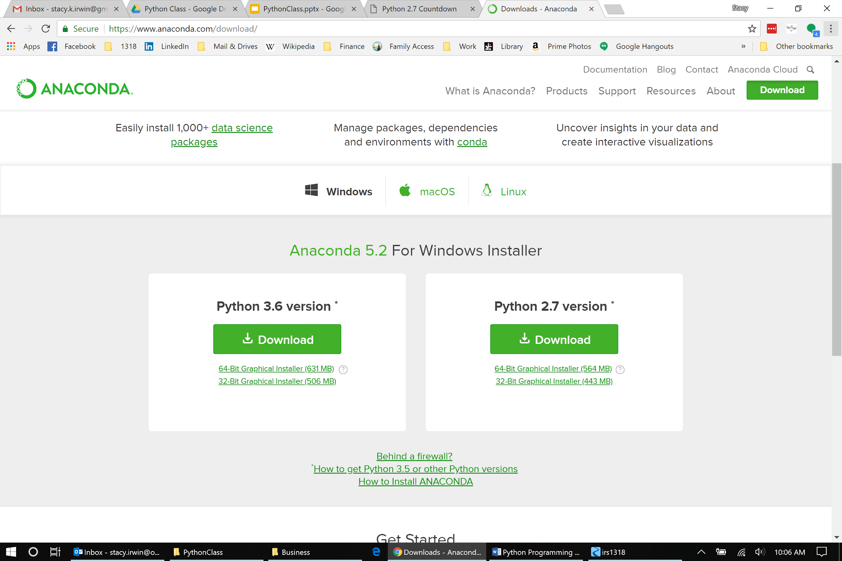
Installing Python on Windows 10
Before Installation
Make sure there are no spaces in your user folder on Windows (spaces can cause problems down the road)
Example (BAD): C:\Users\Stacy Irwin\
Example (GOOD): C:\Users\stacy
Install on a different account if your user account name contains a space
Uninstall all other versions of Python
Go to Add or Remove Programs
Search list of installed programs and uninstall anything with Python in the program name
Restart computer after uninstall
Many ways to install Python. The IRS uses the Anaconda3 version of CPython
Easy to install and includes almost all packages that the IRS uses for FRC scouting
Install from https://www.anaconda.com/download/
Install Python 3.6 version or newer
Installation Options:
Select “Install for this user only”
Does not require administrator login
All files will be installed to “C:\Users\{username}\Anaconda3
Accept all other default settings

Slide 5
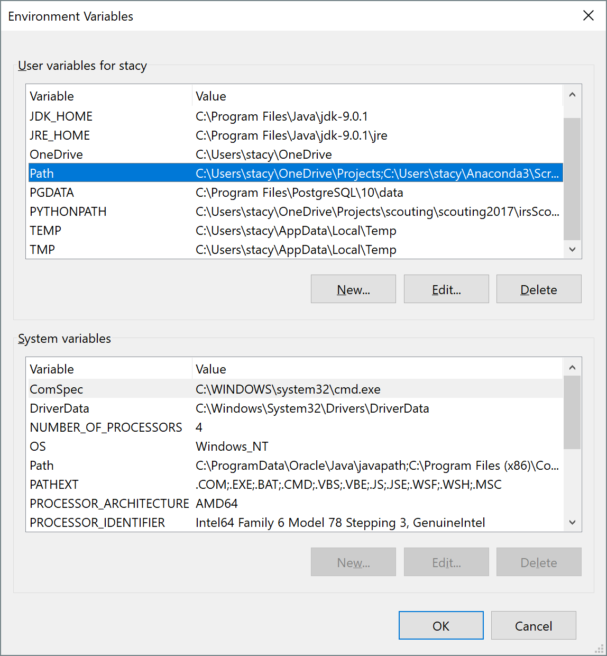
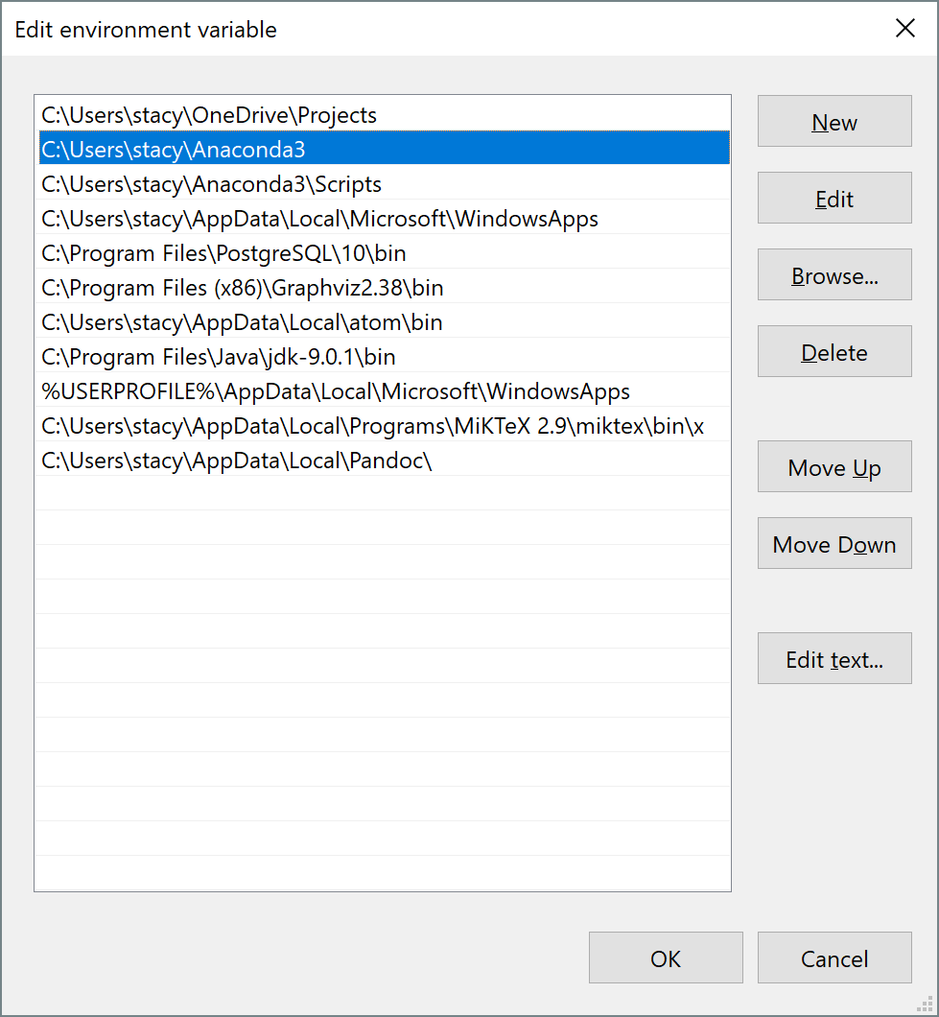
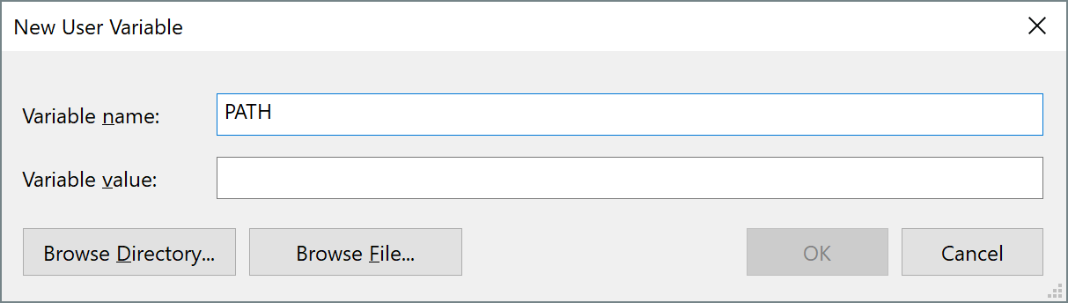
Configuration
Type env in the taskbar search box and select Edit the Environment variables for your account from search results.
Select the Path environment variable from upper list of environment variables and click Edit, or ...
If no Path variable listed, click New and add a Path variable
Path variable should include absolute paths to Anaconda3 and Anaconda3/Scripts folders
Separate folder paths with semicolons
Examples
C:\Users\{username}\Anaconda3
C:\Users\{username}\Anaconda3\Scripts
Save changes by clicking OK on all open dialogs
Dialog for adding new PATH variable (step #3)

Slide 6
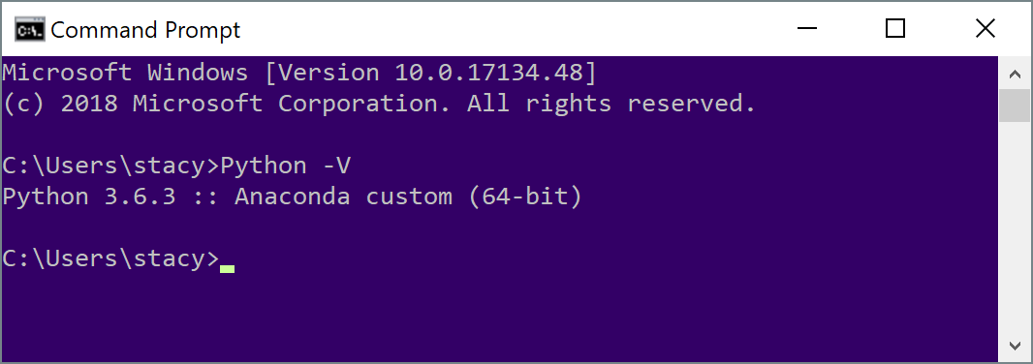
Verification
Type CMD in Windows search box
Select Command Prompt from search results
Type Python -V at command prompt. Should see something like this:
If you see something like ‘Python’ is not recognized …, then check your PATH variable

Slide 7
Session 1 Reading List
Reading Assignment
Python Tutorial
https://docs.python.org/3/tutorial/index.html
Sections 1 and 2
Windows Command Prompt
https://www.computerhope.com/issues/chusedos.htm
Windows Environment Variables
https://windowsreport.com/edit-windows-path-environment-variable

Slide 8
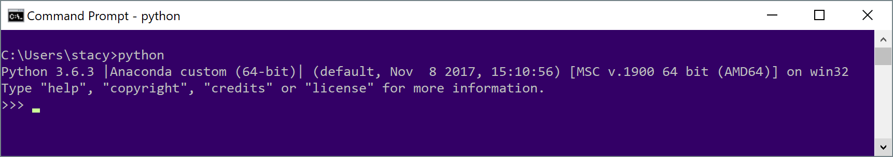
Session 1 Exercises - Python
Use the Python interpreter within the command window to complete the exercises on this slide
Type python at the command prompt to start the interpreter
Type quit()to close the interpreter and return to the windows prompt
Calculate the average finals score for the winners of each division at the Houston world championships (see https://www.thebluealliance.com/)
Calculate 13 to the 18th power
What is the remainder of 13 to the 18th power divided by 1318?

Slide 9
Useful Command Prompt Commands
help (Help)
help lists the built-in commands that are available at the command prompt.
help cd displays detailed documentation for the change directory command.
dir (Directory)
dir lists all subdirectories and files within the current directory.
dir *.txt lists all of the files ending in ".txt" within the current directory.
cd (Change directory)
cd Pictures changes the directory location to the pictures subdirectory within the current command prompt location.
cd .. moves to the parent directory of the current command prompt location.
cd C:/Program Files moves to the C:/Program Files folder, regardless of the current directory location.
md (Make Directory)
md new_folder creates a subdirectory named new_folder within the current directory.
rd (Remove Directory)
rd /S subfolder deletes the subdirectory subfolder, including erasing all files and subdirectories within subfolder.
del (Delete File)
del old_file.py deletes old_file.py in the current folder.
del *.txt* deletes all files ending in .txt in the current folder. Note the use of '*' as a wildcard.
copy (Copy File)
copy s*.* C:\Users\Stacy\Documents copies all files that start with 's' to the documents folder.
move (Move File)
move *s.docx C:\Users\Stacy\Documents moves all Microsoft Word files that end in 's' to the documents folder.
set (Displays and Sets Environment Variables)
set displays all environment variables
set {var_name} displays the environment variable var_name
cls (Clear Screen)
cls clears all text from the command window.
exit (Exit)
exit exits the command window.

Slide 10
Session 1 Exercises - Command Line
Create a folder using the command line
Using the command line, print the value of the PATH environment variable from the command line
Using only the command line, navigate from you Python project file to the root folder (C:/) and list the contents.

Slide 11
Minimize the Cost, Maximize the Value!

