Slide 1

Python for Scouting and Data Analysis
Session 02
Data Types and Control Statements
Issaquah Robotics Society
FRC 1318
Stacy Irwin
June 2018

Slide 2
Session 2 Overview
Topics
Control statements, such as for loops and if statements
Data structures, including dictionaries and lists
Calling built-in functions
Using the Python Standard Library
Writing Code in Jupyter Notebooks
Allows you to write and run Python code within a web browser

Slide 3
Session 2 Reading List
Reading Assignment
Python Tutorial
https://docs.python.org/3/tutorial/index.html
Sections 3, 4.1 - 4.5, 7.2
Jupyter Notebooks
https://jupyter-notebook.readthedocs.io/en/stable/examples/Notebook/Notebook%20Basics.html
Notebook Basics section
JavaScript Object Notation (JSON)
http://www.json.org/
https://en.wikipedia.org/wiki/JSON

Slide 4
Session 2 Preparations
Create a folder in which to save the code you write
Make sure there are no spaces in the folder name or in the names of the parent folders
Download the following files from https://drive.google.com/open?id=1eAV6gEo4Z9B0qSD6UNGf6Zdt1UBHp6uI
sched_turing_2018.json
rank_turing_2018.json
Save them to the file you created on the previous slide

Slide 5
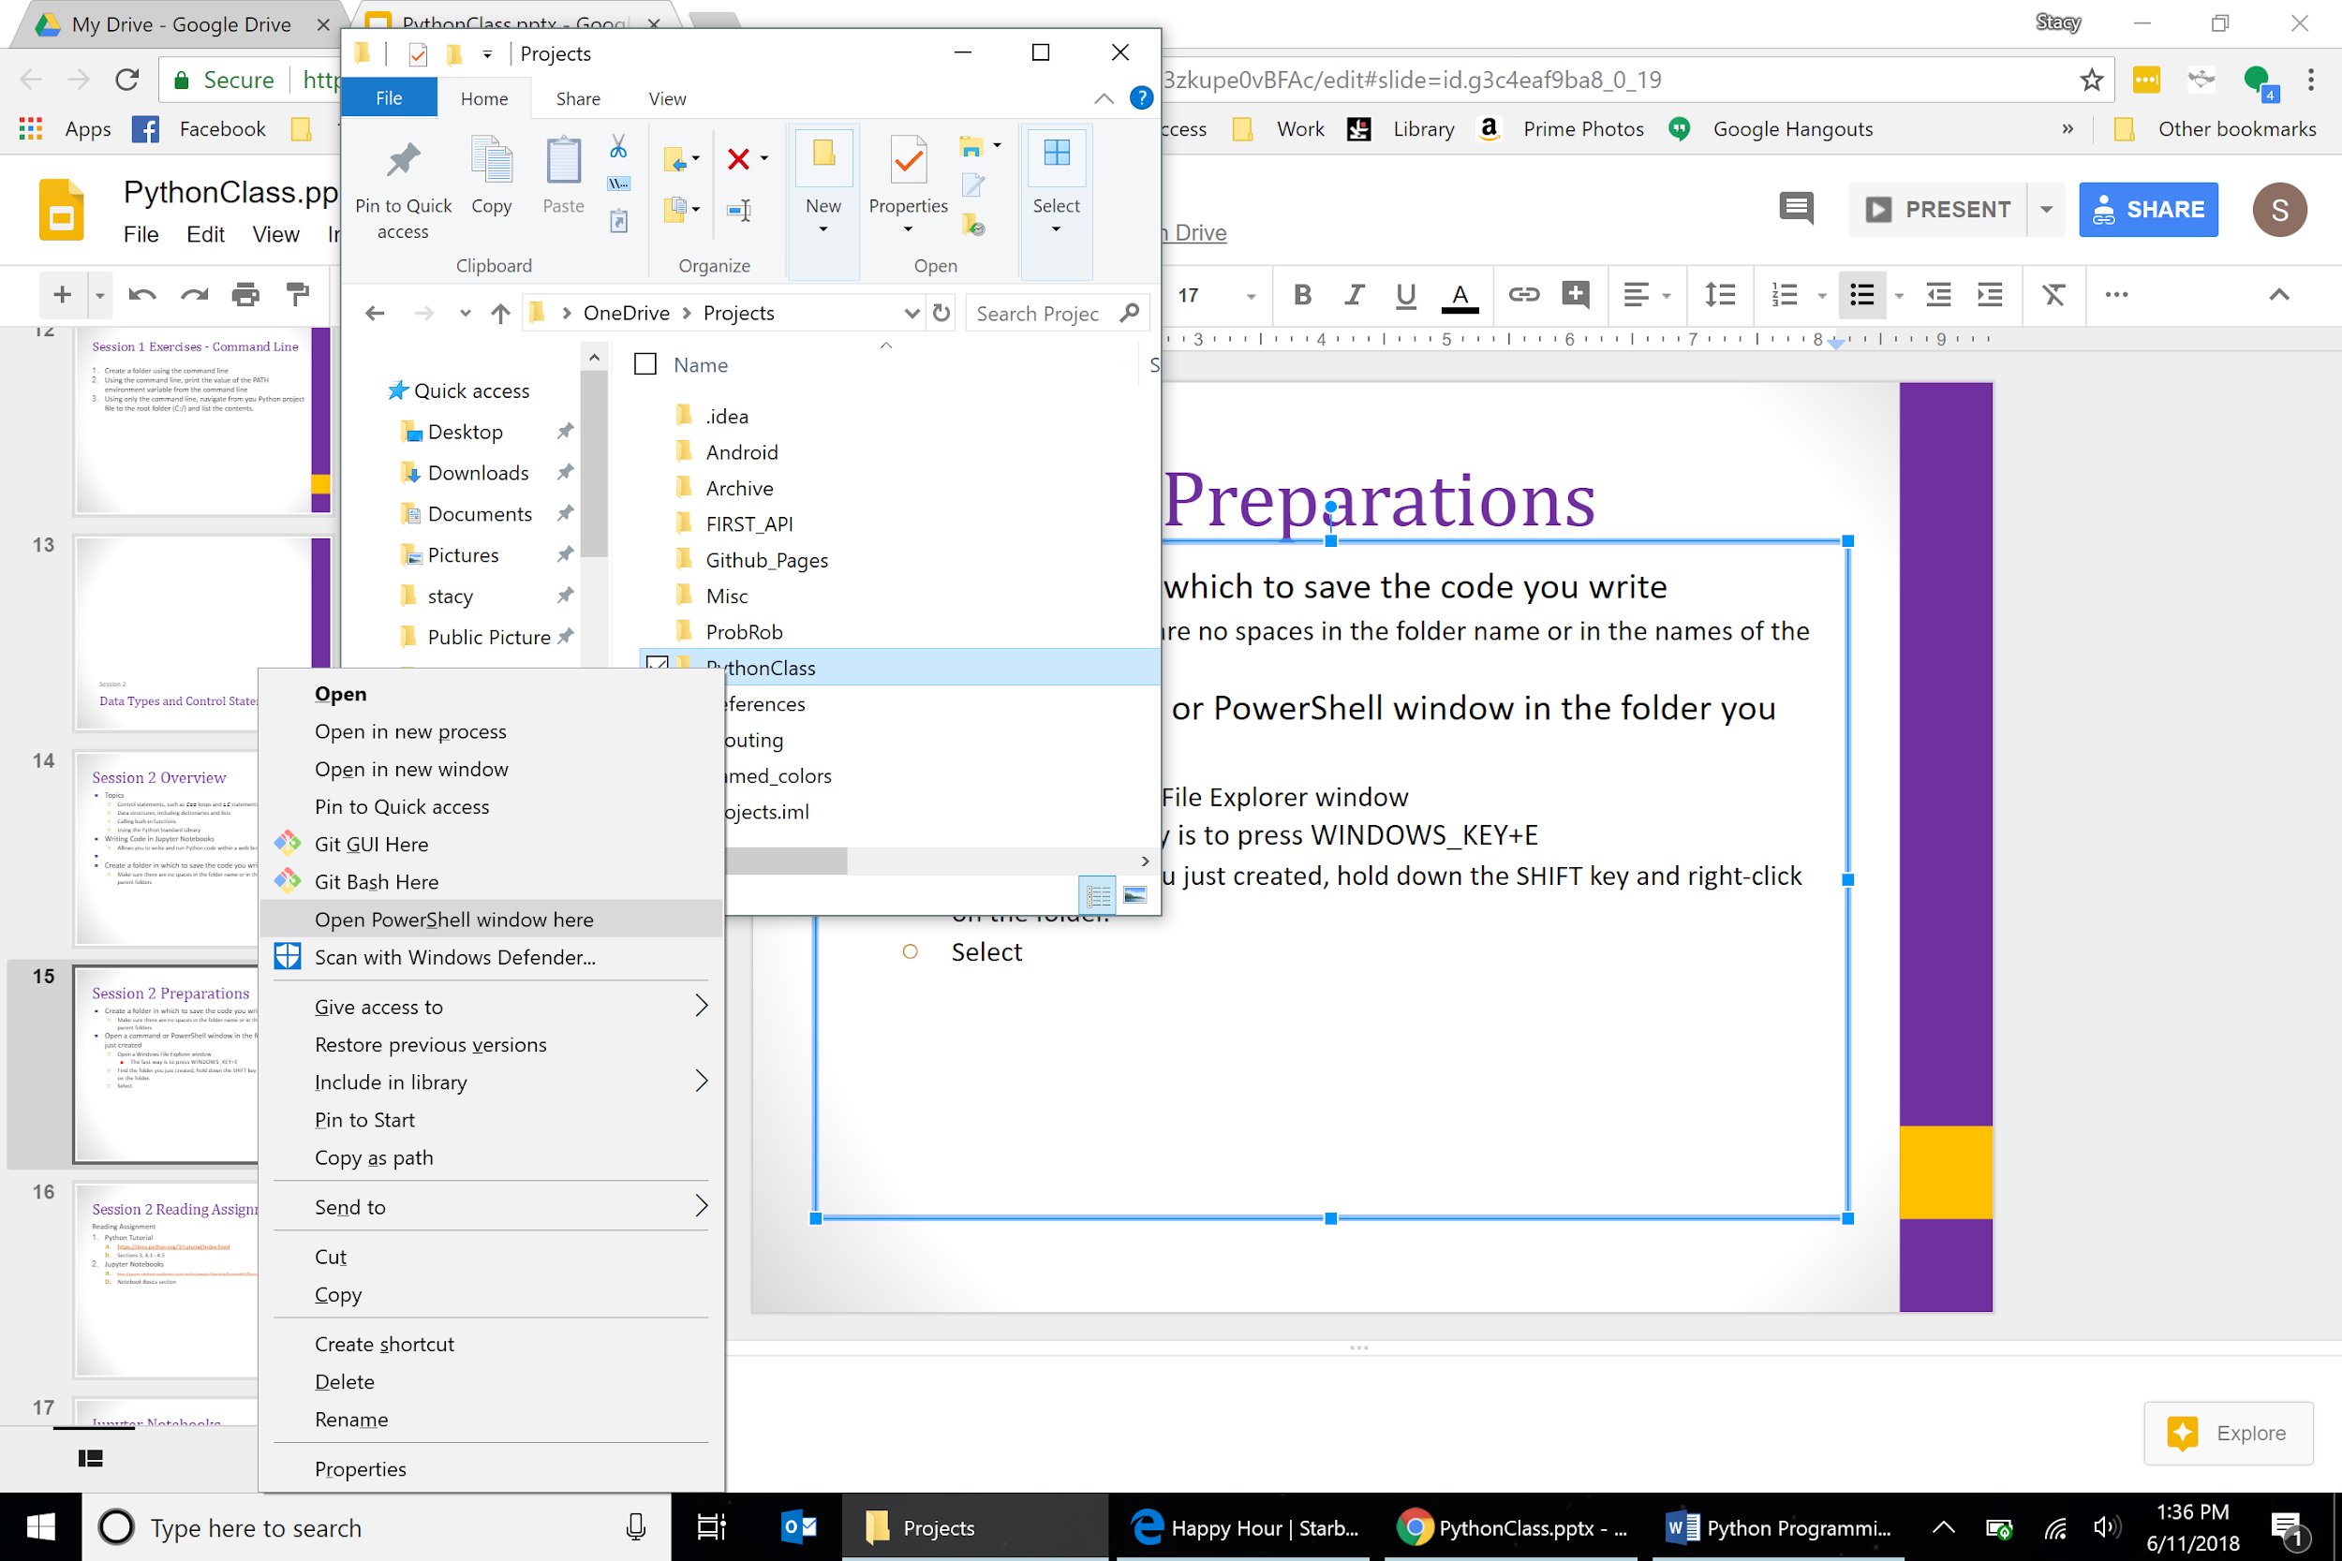
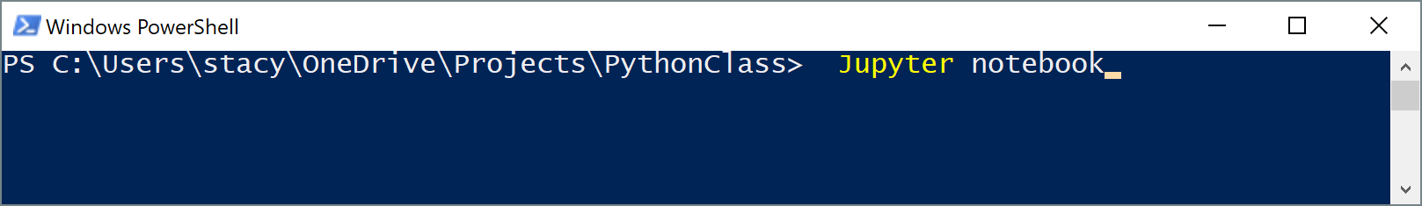
More Preparations
Open a PowerShell window in the folder you just created
Open a Windows File Explorer window
The fast way is to press WINDOWS_KEY+E
Find the folder you just created, hold down the SHIFT key and right-click on the folder.
Select Open PowerShell window here
At the PowerShell prompt:
Type jupyter notebook
Hit ENTER
Your browser should open after a few seconds
Check your path variable if you get a “... is not recognized…” error
Must contain …\Anaconda3\Scripts folder

Slide 6
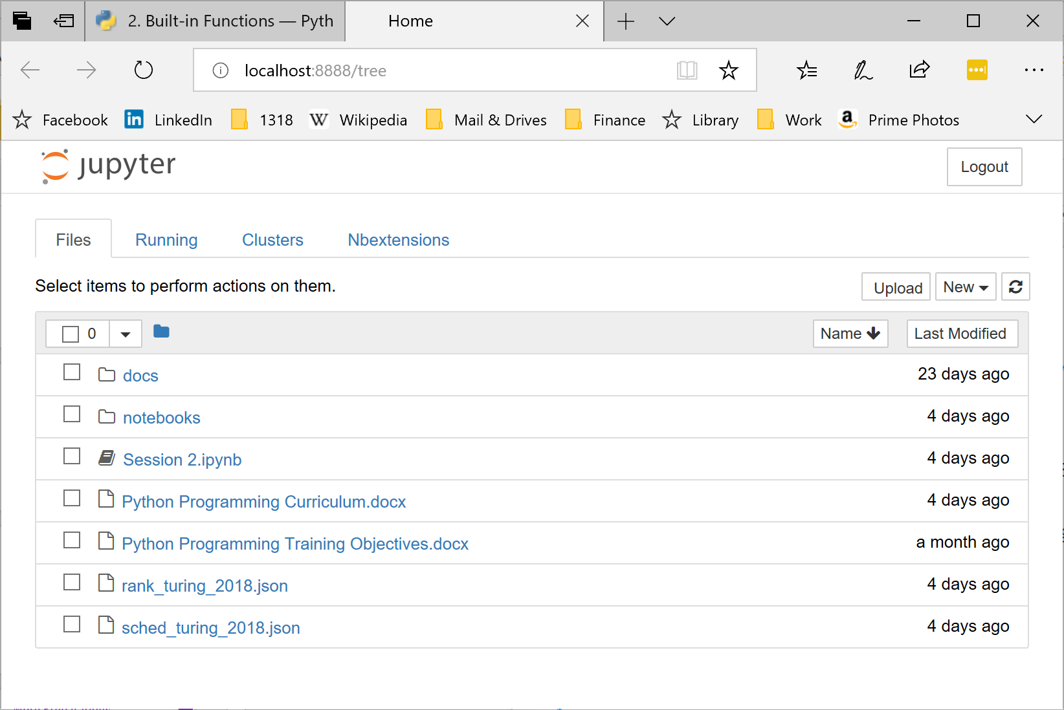
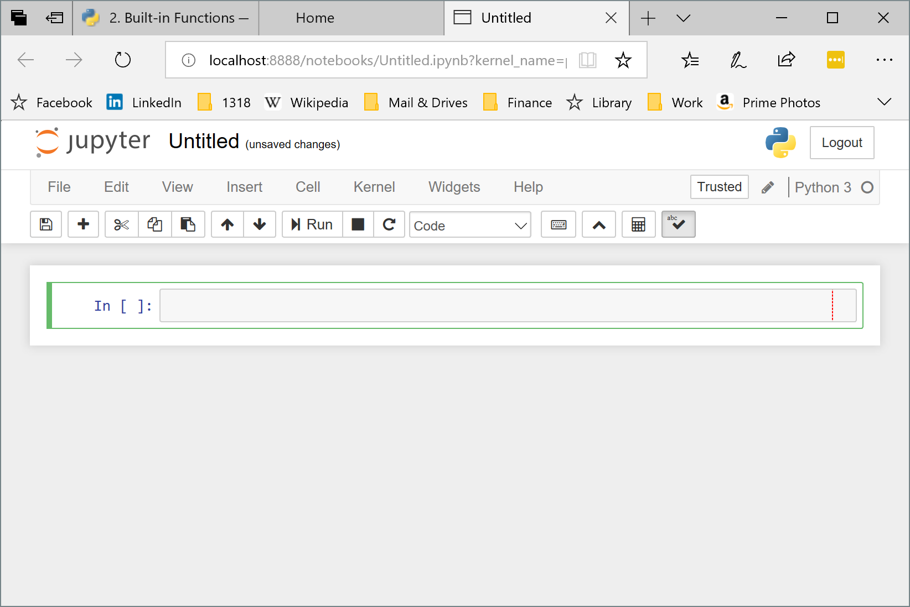
Jupyter Notebooks
In the browser, click New and then Python 3 to create a new notebook with Python 3 code
Type your Python code in the code block (grey box) and hit SHIFT+ENTER to execute the code
The notebook will display the value of the expression on the last line of the code block
Use the notebook to complete this session’s exercises
Refer to the reading assignment to learn how to add cells, delete cells, reorder cells, give the notebook a title, etc.
Click File->Close and Halt when done

Slide 7
JavaScript Object Notation
(JSON)
{"Rankings": [ { "rank": 1, "teamNumber": 2557, "sortOrder1": 3.10, "sortOrder2": 820.00, "sortOrder3": 358.00, "sortOrder4": 2368.00, "sortOrder5": 290.00, "sortOrder6": 0.00, "wins": 7, "losses": 3, "ties": 0, "qualAverage": 379.80, "dq": 0, "matchesPlayed": 10 }, { "rank": 2, "teamNumber": 1806, "sortOrder1": 3.10, "sortOrder2": 745.00, "sortOrder3": 417.00, "sortOrder4": 2676.00, "sortOrder5": 330.00, "sortOrder6": 0.00, "wins": 9, "losses": 1, "ties": 0, "qualAverage": 414.60, "dq": 0, "matchesPlayed": 10}
}
Structured text format used for data exchange on the internet
The IRS scouting system uses JSON to obtain match schedules from the FIRST API and The Blue Alliance
In the session two exercises, we’ll use control statements to extract data from JSON text files
Example JSON from rank_turing_2018.json file

Slide 8
Session 2 Exercises
Use a for loop to calculate the factorial of 1318
Use a while loop to calculate the factorial of 1318
Create a list containing all integers between 0 and 1318 that are multiples of 13 or 18.
Loop through the JSON rankings to find the team with the highest score in sortOrder3

Slide 9
Working with JSON
Insert and run this code at the beginning of your Jupyter notebook to read the JSON file:
import json
rank_file = open("rank_turing_2018.json")
rank_data = json.load(rank_file)
rank_file.close()
rank_data
Use the rank_data variable for the exercises on the next slide

Slide 10
Session 2 Exercises
Analyze the JSON schedule to find all matches with a specific team
Analyze the JSON schedule to find a match where two specified teams play each other
Read the online documentation for the json.load(), open(), and close() functions (for close(), refer to section 16.2 (io) of the Python Standard Library documentation)

Slide 11
Minimize the Cost, Maximize the Value!

