Slide 1
Wordpress and CiviCRM Installation on Ubuntu 22.04
Objectives:
Wordpress and the plugin CiviCRM are installed on your PC rather than a public website.
To be able to utilise the demonstration CRM data in order to learn Wordpress / CiviCRM.
Note: Text in dark blue colour should be cut and pasted to perform this installation.
Ian Stewart - 2023-05-21

Slide 2
Wordpress Installation and CiviCRM Plugin
Based on https://ubuntu.com/tutorials/install-and-configure-wordpress
Install on 22.04 Ubuntu Mate Desktop PC.
Download Wordpress
Pre-requisites include Apache2 mysql, php.
Website build off /srv/www/wordpress/ directory
Configuring apache2
Configuring mysql database
Configuring wp-config.php
Configuring Wordpress
Download CiviCRM and International Language support
Configuring mysql
Install CiviCRM plugin for Wordpress.

Slide 3
Install Dependencies. Apache2, Mysql, Php.
$ sudo apt update
$ sudo apt upgrade
$ sudo apt install apache2 \
ghostscript \
libapache2-mod-php \
mysql-server \
php \
php-bcmath \
php-curl \
php-imagick \
php-intl \
php-json \
php-mbstring \
php-mysql \
php-xml \
php-zip
Includes php 8.1 as part of this apt install

Slide 4
Install Wordpress. Make directory /srv/www/
$ sudo snap install curl
$ sudo mkdir -p /srv/www
$ sudo chown www-data: /srv/www
$ sudo apt install curl
$ curl https://wordpress.org/latest.tar.gz | sudo -u www-data tar zx -C /srv/www
% Total % Received % Xferd Average Speed Time Time Time Current
Dload Upload Total Spent Left Speed
100 21.9M 100 21.9M 0 0 973k 0 0:00:23 0:00:23 --:--:-- 1705k
Copying Wordpress took 23 Seconds

Slide 5
Create Apache2 website for Wordpress. Create wordpress.conf
$ sudo pluma /etc/apache2/sites-available/wordpress.conf
<VirtualHost *:80>
DocumentRoot /srv/www/wordpress
<Directory /srv/www/wordpress>
Options FollowSymLinks
AllowOverride Limit Options FileInfo
DirectoryIndex index.php
Require all granted
</Directory>
<Directory /srv/www/wordpress/wp-content>
Options FollowSymLinks
Require all granted
</Directory>
</VirtualHost>
Enable the site with:
$ sudo a2ensite wordpress
Enable URL rewriting with:
$ sudo a2enmod rewrite
Disable the default “It Works” site with:
$ sudo a2dissite 000-default
Finally, reload apache2 to apply all these changes:
$ systemctl reload apache2
Copy and paste these 13 lines into wordpress.conf.
Then save and close pluma editor.

Slide 6
Configure mysql database
Change mypassword for the password you want to use.
$ sudo mysql -u root
...snip...
mysql> CREATE DATABASE wordpress;
Query OK, 1 row affected (0.00 sec)
mysql> CREATE USER 'wordpress'@'localhost' IDENTIFIED BY 'mypassword';
Query OK, 0 rows affected (0.00 sec)
mysql> GRANT ALL PRIVILEGES ON wordpress.* TO 'wordpress'@'localhost';
Query OK, 0 rows affected (0.00 sec)
mysql> FLUSH PRIVILEGES;
Query OK, 0 rows affected (0.01 sec)
Mysql> exit;
ALL PRIVILEGES maybe considered excessive. See alternative mysql GRANT command on the next page
After
After
Before
mysql> show databases;
+--------------------+
| Database |
+--------------------+
| information_schema |
| mysql |
| performance_schema |
| sys |
| wordpress |
+--------------------+
5 rows in set (0.00 sec)
mysql> select user, host from mysql.user;
+------------------+-----------+
| user | host |
+------------------+-----------+
| debian-sys-maint | localhost |
| mysql.infoschema | localhost |
| mysql.session | localhost |
| mysql.sys | localhost |
| phpmyadmin | localhost |
| root | localhost |
| wordpress | localhost |
+------------------+-----------+
7 rows in set (0.00 sec)
mysql> show databases;
+--------------------+
| Database |
+--------------------+
| information_schema |
| mysql |
| performance_schema |
| sys |
+--------------------+
4 rows in set (0.00 sec)

Slide 7
Review of mysql wordpress database tables….
Probably better than GRANT ALL PRIVILEGES. Can do later.
$ sudo mysql -u root
...snip...
mysql> use wordpress;
Reading table information for completion of table and column names
You can turn off this feature to get a quicker startup with -A
Database changed
mysql> show tables;
+------------------------------------------+
| Tables_in_wordpress |
+------------------------------------------+
| wp_commentmeta |
| wp_comments |
| wp_links |
| wp_options |
| wp_postmeta |
| wp_posts |
| wp_term_relationships |
| wp_term_taxonomy |
| wp_termmeta |
| wp_terms |
| wp_usermeta |
| wp_users |
+------------------------------------------+
12 rows in set (0.01 sec)
mysql> GRANT
SELECT,
INSERT,
UPDATE,
DELETE,
CREATE,
DROP,
INDEX,
ALTER,
CREATE TEMPORARY TABLES,
LOCK TABLES,
TRIGGER,
CREATE ROUTINE,
ALTER ROUTINE,
REFERENCES,
CREATE VIEW,
SHOW VIEW
ON wordpress.*
TO 'wordpress'@'localhost';

Slide 8
Configure PHP for Apache2
$ cd /etc/php/8.1/apache2/
$ ls -l
total 76
drwxr-xr-x 2 root root 4096 May 19 19:33 conf.d
-rw-r--r-- 1 root root 73377 May 19 22:29 php.ini
$ sudo pluma php.ini
; Added for install of CiviCRM plugin
memory_limit = 256M
max_execution_time = 240
max_input_time = 120
post_max_size = 50M
upload_max_filesize = 50M
Save php.ini file and exit pluma
$ systemctl reload apache2
php.ini file is almost 2000 lines of text.
Copy these 6 lines and post at the very bottom of the php.ini file.

Slide 9
Configure WordPress to connect to the database
$ cd /srv/www/wordpress/
$ sudo -u www-data cp /srv/www/wordpress/wp-config-sample.php /srv/www/wordpress/wp-config.php
$ ls -l /srv/www/wordpress/wp-config.php
-rw-r--r-- 1 www-data www-data 3013 May 19 20:05 /srv/www/wordpress/wp-config.php
$ sudo -u www-data sed -i 's/database_name_here/wordpress/' /srv/www/wordpress/wp-config.php
$ sudo -u www-data sed -i 's/username_here/wordpress/' /srv/www/wordpress/wp-config.php
$ sudo -u www-data sed -i 's/password_here/mypassword/' /srv/www/wordpress/wp-config.php
Change mypassword to the password you used on page 6

Slide 10
Configure WordPress to connect to the database
Place this link in a browser to get keys:
https://api.wordpress.org/secret-key/1.1/salt/
The Web page will display keys and look something like this…
define('AUTH_KEY', 'zp.j90s}oKKHnj)#q3Wcj),21.|75x<+AA?%#?3Q%bEb}:nE(}]qMT|(YECl4*,S');
define('SECURE_AUTH_KEY', ' k-6WsqbA5baz,dS]=M)AA&@^LJw+u?}Q&Rr<8+Fd4E^RMf;v@:H|kl1,Afg{OLP');
define('LOGGED_IN_KEY', '|+-%s+H+<=Hq?GL0+e?r+nm^AV-+9W^GCI.`V),Xo:Vta`cM;:}ztDAzp7ixq7Dm');
define('NONCE_KEY', 'pmo4t8Y9wmyB1La![$RM3@NhOS^}Y|i9gM=9eDk7o0[LC?kw|V~?W3Rb<1_I(PBL');
define('AUTH_SALT', '/DMM _{K`S%~-tTi8DTHLJT.YB*Tk^q|bvs*KoGq#$bl9}btF27~_rX89!U535rH');
define('SECURE_AUTH_SALT', '6SB`ueXKY6ZusGT_Mdj{t,e2Z&^,W9t+EllXa7&4G+S9nS{F(gN,F8~-:(QxO^;9');
define('LOGGED_IN_SALT', '&RSJ-ERX.Cqv8b7F-;$q@1IubM+.$6A^NFU||31!x;~TE?a.nuS8K[+IaE7=cZ|K');
define('NONCE_SALT', 'Hi|d{]q3L5/*j8U&mG?;6ekaqx7P9YH>+sRgnL7b:*oR2f~Vt5o%O=f;r#iz@joa');
Copy everything from the browser page. Then use pluma editor to open the wp-config.php file...
$ sudo pluma /srv/www/wordpress/wp-config.php
Scroll down until you see the following and delete these 8 lines...
define( 'AUTH_KEY', 'put your unique phrase here' );
define( 'SECURE_AUTH_KEY', 'put your unique phrase here' );
define( 'LOGGED_IN_KEY', 'put your unique phrase here' );
define( 'NONCE_KEY', 'put your unique phrase here' );
define( 'AUTH_SALT', 'put your unique phrase here' );
define( 'SECURE_AUTH_SALT', 'put your unique phrase here' );
define( 'LOGGED_IN_SALT', 'put your unique phrase here' );
define( 'NONCE_SALT', 'put your unique phrase here' );
Now paste what you copied from your web page. Save the file and exit pluma editor.

Slide 11
Review changes to wp-config.php file.
$ cat /srv/www/wordpress/wp-config.php
Scroll back on the terminal and see if the file now contains sections similar to this…
// ** Database settings - You can get this info from your web host ** //
/** The name of the database for WordPress */
define( 'DB_NAME', 'wordpress' );
/** Database username */
define( 'DB_USER', 'wordpress' );
/** Database password */
define( 'DB_PASSWORD', 'mypassword' );
...and...
define('AUTH_KEY', '?.-!4_6Pg[4laW+VbLsA:_-gm<0VUwT; K&_R5#yJHO2th)5{i7/5wzIS5]6KQ%]');
define('SECURE_AUTH_KEY', 'H)EXj{zfrzBzv20F+rAqv|XgHSo%zOIpMy]D})Hu[]l64+H X%.0B0T^^F+,vM!}');
define('LOGGED_IN_KEY', 'a`1W-M&$Yd<- %27Zl9.JTYH; c4KWpGM)P5BdBBML@Q8& `(](/K~01w4p-+-@7');
define('NONCE_KEY', 'Quae[hv ;~hps>QIT)/#s>pK}EqDETSftYeso[{T.P!eE+bevg-2C*|9qlkxq=@(');
define('AUTH_SALT', '+s *IBlcE ~pbAgr{P][QbEW0NYG++-pGWl+Cd=UF=1hp`ujvUh2 LtiIbp3TV%C');
define('SECURE_AUTH_SALT', ')-uVcE5W6*xkQ:;h{)6ldVCY.!Xwka=Qi< Xn$=j.+]odVtRzqh-YlN|B--ooH9Y');
define('LOGGED_IN_SALT', ')P-VNS.nHmEI$IZnWr}-n3^]_!`Z|N#{Ivd=`k<e3WwNK7vZfT??yOh{,8s1+QrW');
define('NONCE_SALT', '!Ft-;,y.xq,rzHI{Z-p7)uXY,#!VR11J<l@{]S-=7}kNOZ6?tqEhH?DyQSJQxYO-');
Changed to the password that you used.
Your key data will be different. It is unique to you.

Slide 12
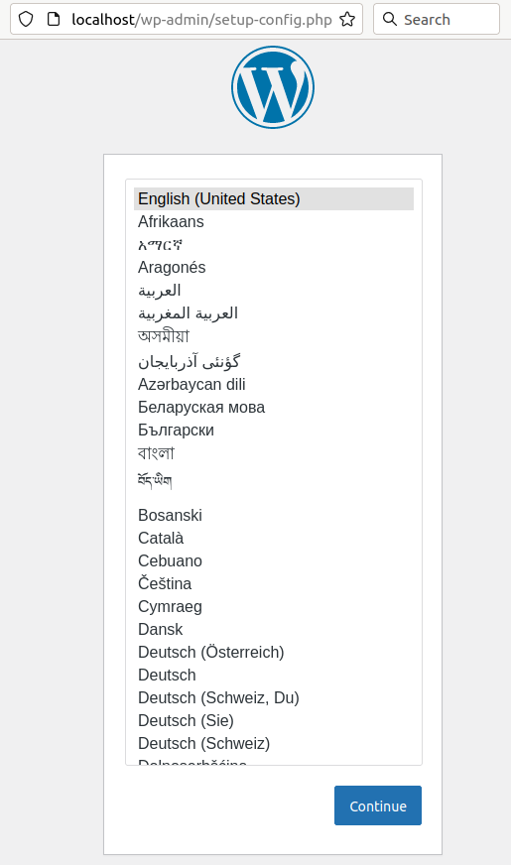
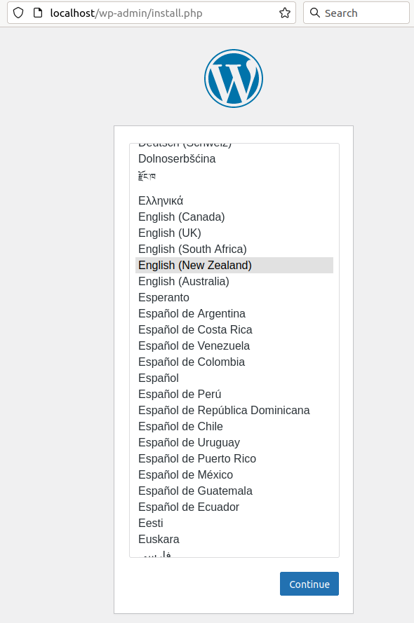
Configure WordPress
Open http://localhost in your browser. Select the language you wish to use and click on continue

Slide 13
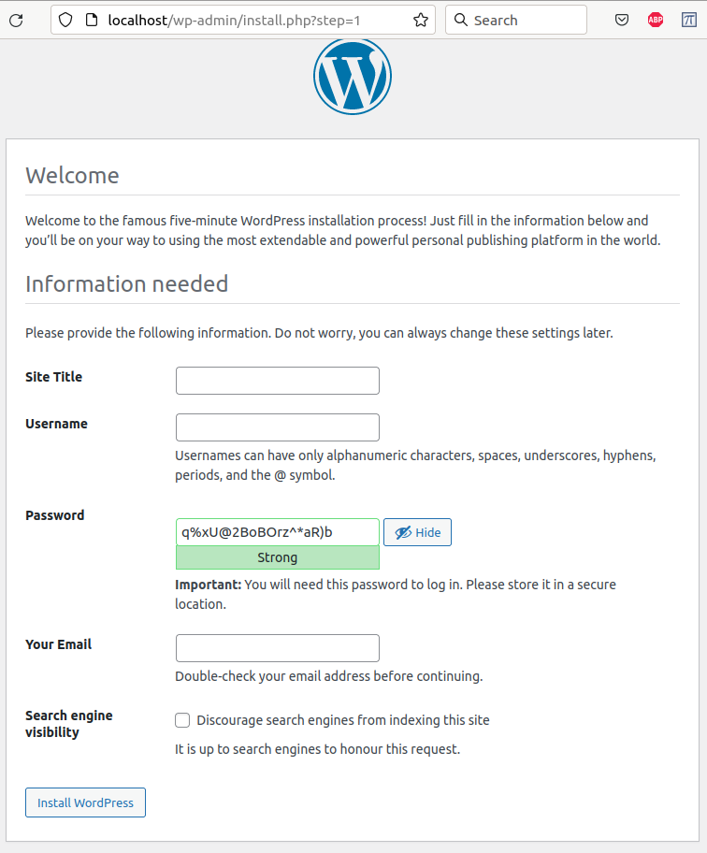
Configure WordPress
The Welcome page requires your input.
Then click on Install Wordpress.
E.g. Test
E.g. Administrator or your name
Tick
Install

Slide 14
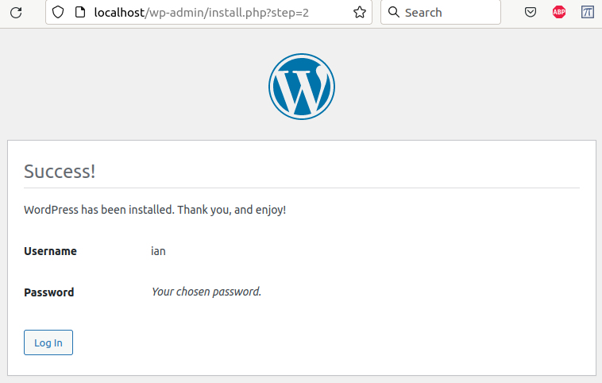
Configure WordPress
The Success page.
Then click on Log In.

Slide 15
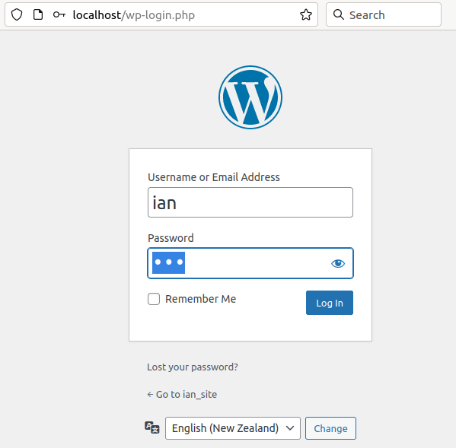
Configure WordPress
The Login page.
Then click on Log In.

Slide 16
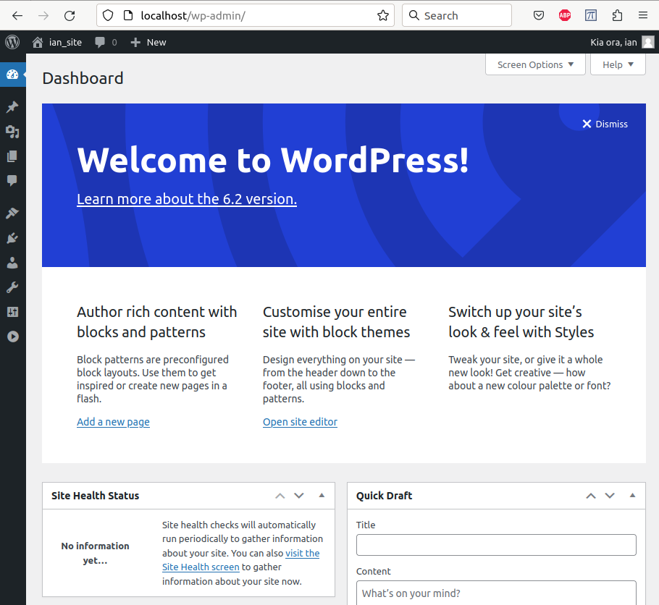
Configure WordPress
The Wordpress Dashboard.
Click to expand left margin

Slide 17
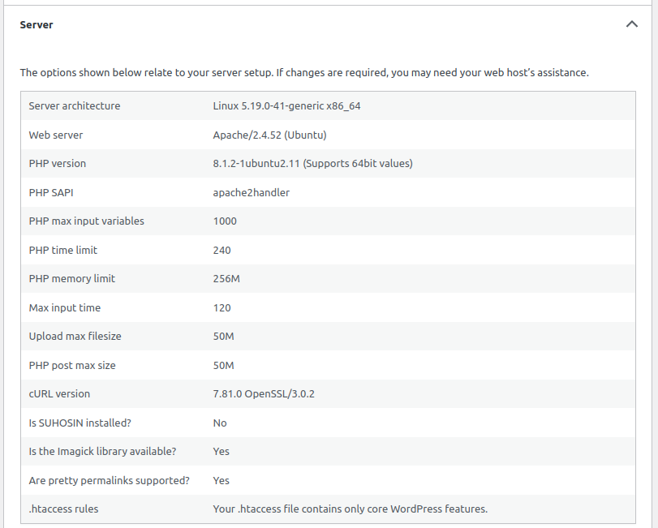
Check Site Health.
Tools →
SiteHealth →
Info →
Server
The changes made in the file
/etc/php/8.1/apache2/php.ini should be displayed.
Changes made in
/etc/php/8.1/apache2/php.ini
max_execution_time = 240
memory_limit = 256M
max_input_time = 120
max_filesize = 50M
max_post_sizwe = 50M

Slide 18
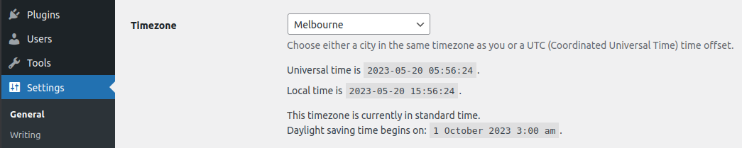
Timezone.
Settings →
General
In Settings → General review the Timezone settings.
It may have defaulted to UTC+0
Use the drop-down menu to set it to your local time, based on city name.

Slide 19
Wordpress Installation Complete
Start learning how to use Wordpress by creating Posts, Pages and tailoring your Appearance.

Slide 20
CiviCRM Plugin to Wordpress Installation
This section describes how to install the CiviCRM plugin to Wordpress. It is based on information at:
https://docs.civicrm.org/installation/en/latest/wordpress/
https://docs.civicrm.org/installation/en/latest/general/requirements/

Slide 21
Mysql setting to change for CiviCRM installation
Most parameters were setup in the Wordpress installation such that they are suitable for CiviCRM.
There is one issue which prevents CiviCRM installation. The error message is:
The fix is described at the bottom of this posting...
https://civicrm.stackexchange.com/questions/38506/installs-fails-with-errordatabase-does-not-support-creation-of-triggers-user
Perform the following:
$ sudo mysql -u root
...snip...
mysql> SET GLOBAL log_bin_trust_function_creators=1;
Query OK, 0 rows affected (0.00 sec)
Mysql> exit;

Slide 22
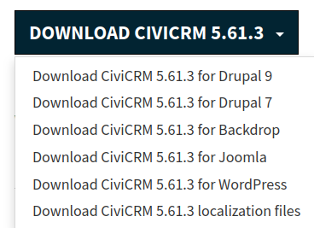
Download the latest CiviCRM
Go to: https://civicrm.org/download
...and download...
Download
Also Download. However initially we don’t use it as we stay with English (USA) so we can use the demonstration data.
A Review of the CiviCRM files now in the /Downloads directory...
$ ls -l ~/Downloads/civicrm*
-rw-rw-r-- 1 ian ian 28938434 May 20 19:30 /home/ian/Downloads/civicrm-5.61.3-l10n.tar.gz
-rw-rw-r-- 1 ian ian 39211624 May 20 19:30 /home/ian/Downloads/civicrm-5.61.3-wordpress.zip

Slide 23
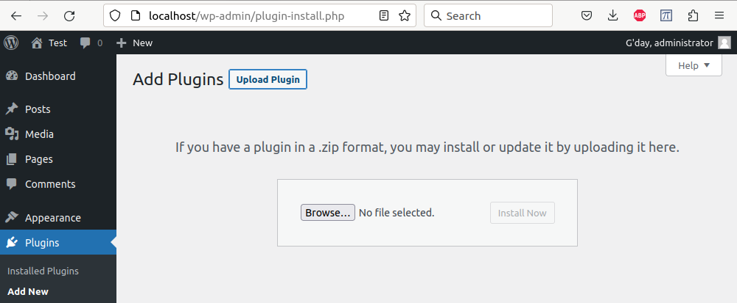
Wordpress: Plugins → Add New → Upload Plugin

Slide 24
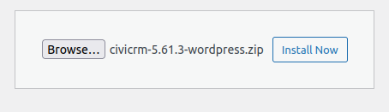
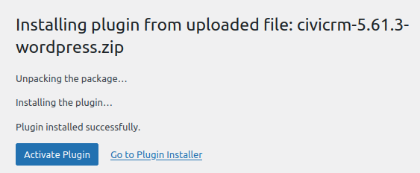
Wordpress: Plugins → Add New → Upload Plugin
Click the Browse button and select the civicrm file in the Downloads folder
Click the Install Now button
Click: Go to Plugin Installer

Slide 25
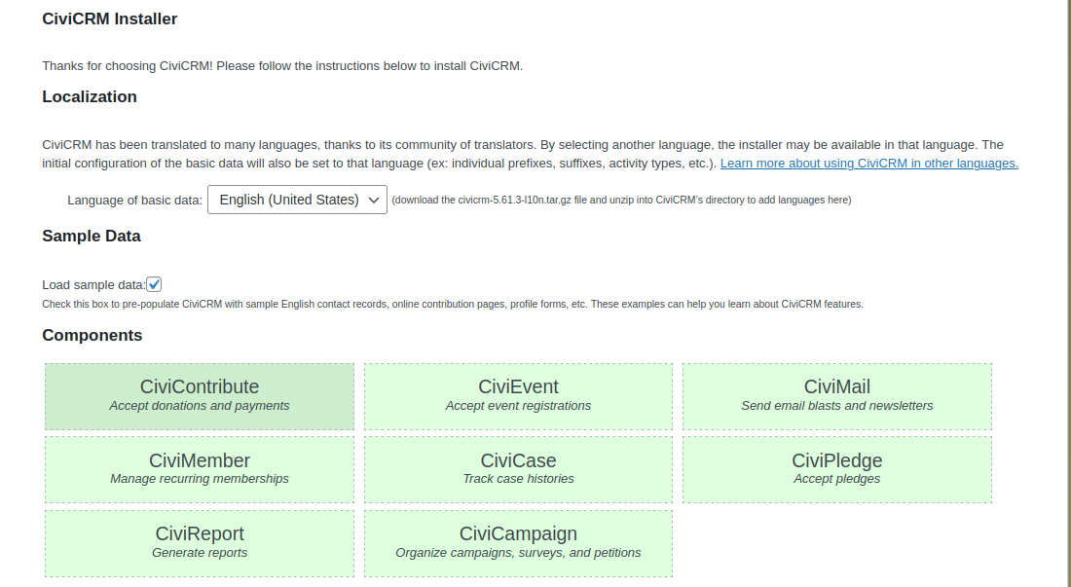
CiviCRM Installer 1/2
Keep English (United States) if wish to load the sample data
Click to load the USA sample data
Click to add additional components

Slide 26
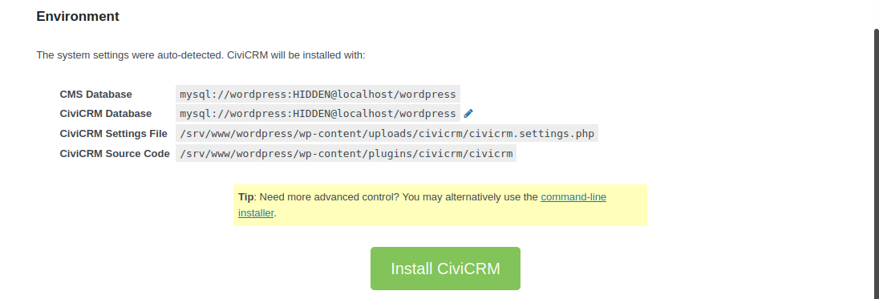
CiviCRM Installer 2/2
Click to install

Slide 27
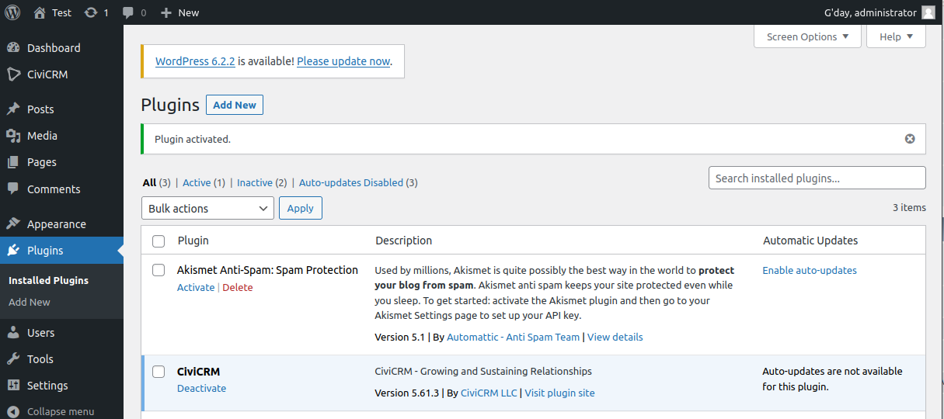
Wordpress: Plugins
Screen now displays
The Panel now display the option CiviCRM

Slide 28
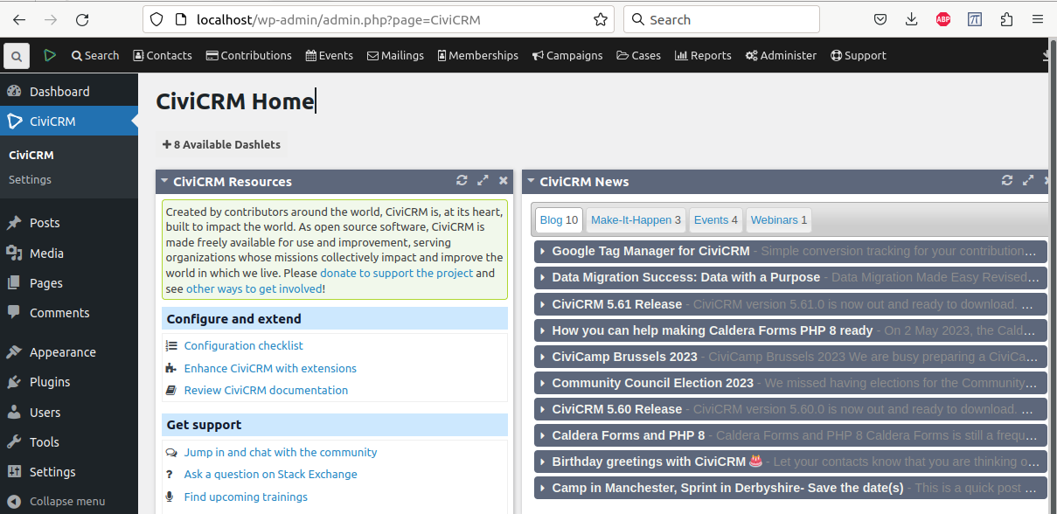
CiviCRM Home
Screen now displays

Slide 29
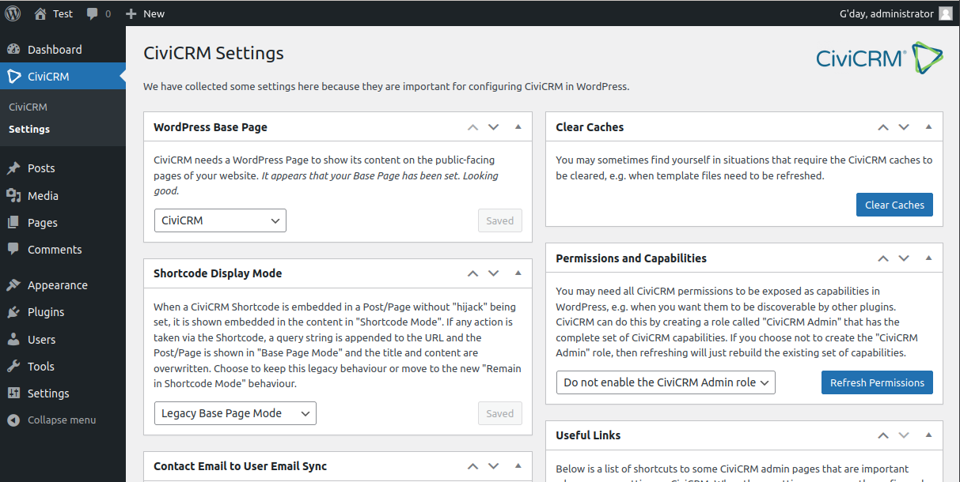
CiviCRM Settings
Screen now displays

Slide 30
Appendix:
Example of Wordpress Update.
Changing localhost to a fixed adress.

Slide 31
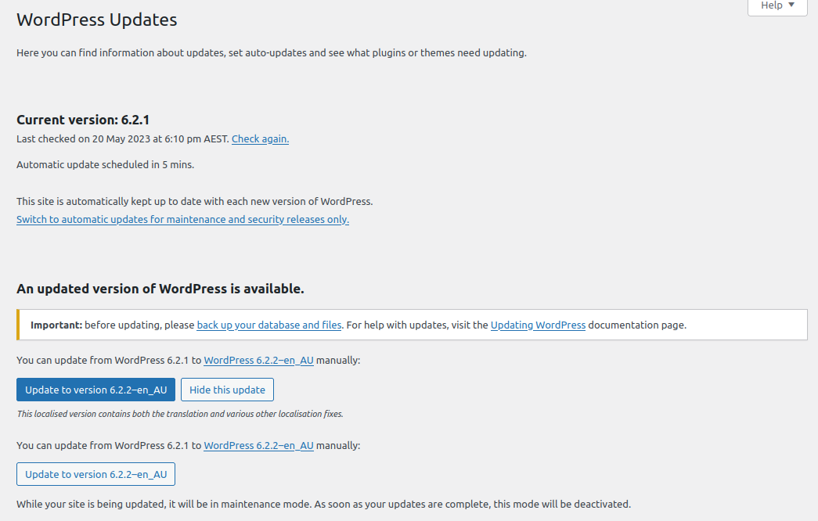
Wordpress Update
Screen now displays

Slide 32
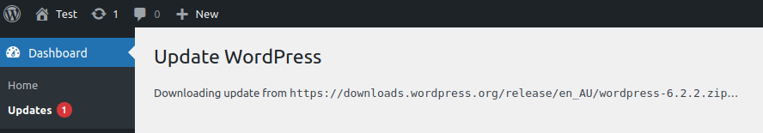
Wordpress Upgrade
Screen now displays

Slide 33
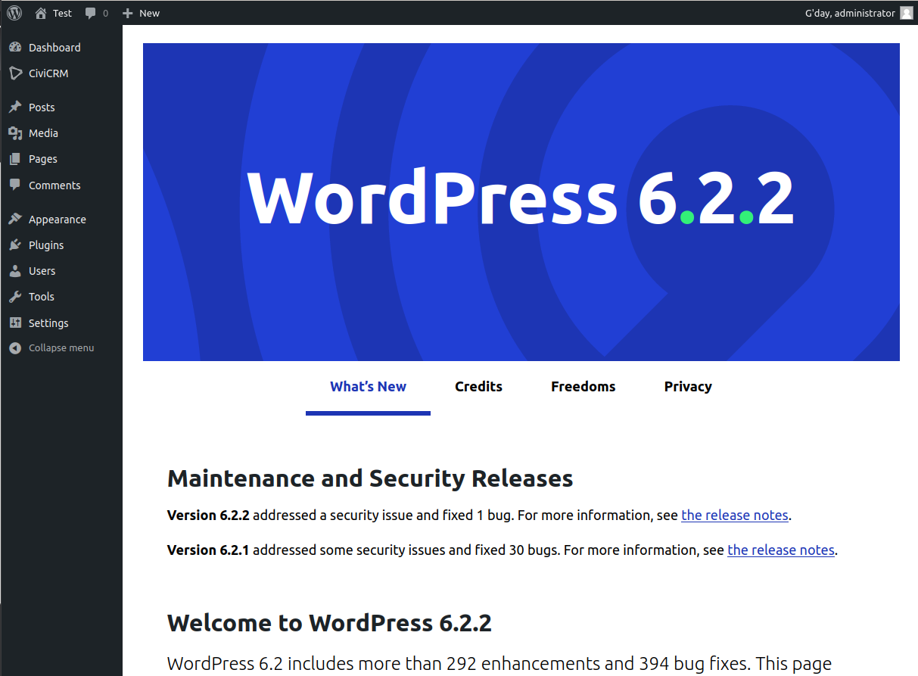
Wordpress Upgraded
Screen now displays

Slide 34
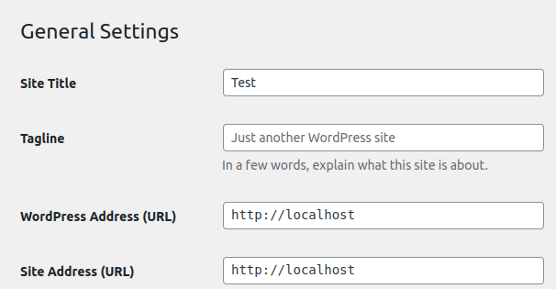
Change of IP Address.
Settings →
General.
Let’s say you have two computers at home. One in the shed and one in the lounge. Both of them get DHCP server addresses from your modem on the address 192.168.1.xxx.
If you’ve just installed Wordpress on the computer in the shed you may want to use the browser on the computer in the lounge to access Wordpress in the shed.
First set the computer in the shed so it boots up with a fixed IP address. E.g. 192.168.1.10. See next page
Change these Wordpress Address and Site Address to http://192.168.1.10
which are in Settings → General.
Change to http://192.168.1.10
Change to http://192.168.1.10

Slide 35
Setup of IP Address.
Setup a static ip address for the ethernet lan port.
$ cd /etc/netplan/
$ sudo pluma 99-static_address_config.yaml
Paste the following lines into the pluma editor and then save the file and exit pluma.
# For fixed ethernet lan address of 192.168.1.10
network:
version: 2
renderer: networkd
ethernets:
enp0s25:
addresses:
- 192.168.1.10/24
routes:
- to: default
via: 192.168.1.254
nameservers
#search: [ns1.xtra.co.nz, ns2.xtra.co.nz]
#addresses: [122.56.237.1, 210.55.111.1]
# home lan
addresses: [192.168.1.254, 8.8.8.8]
Ensure a cable has been run from the PC to the modem/router.
$ sudo netplan apply
$ systemctl restart systemd-networkd.service or reboot the computer.
On another computer on the 192.168.1.xxx network enter into the browser:
http://192.168.1.10/ or http://192.168.1.10/wp-login.php

