Slide 1
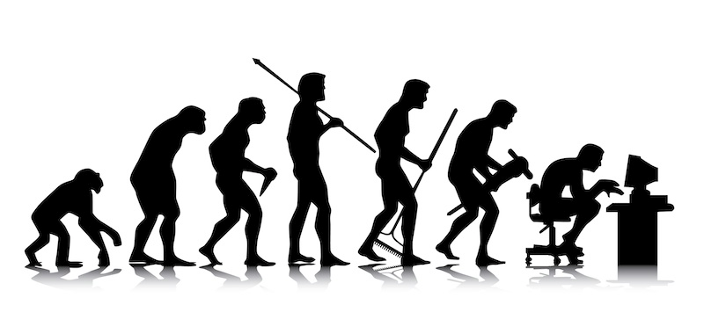
The Evolution of a Python Program
We know how python programmers evolved,
...but how does a python program evolve? ...and why?
A game of “Spot the Differences”.
Hamilton Python User Group
12 September 2016
Ian Stewart
Presentation available from: https://github.com/HamPUG/examples
Appendix to presentation contains reference material.

Slide 2
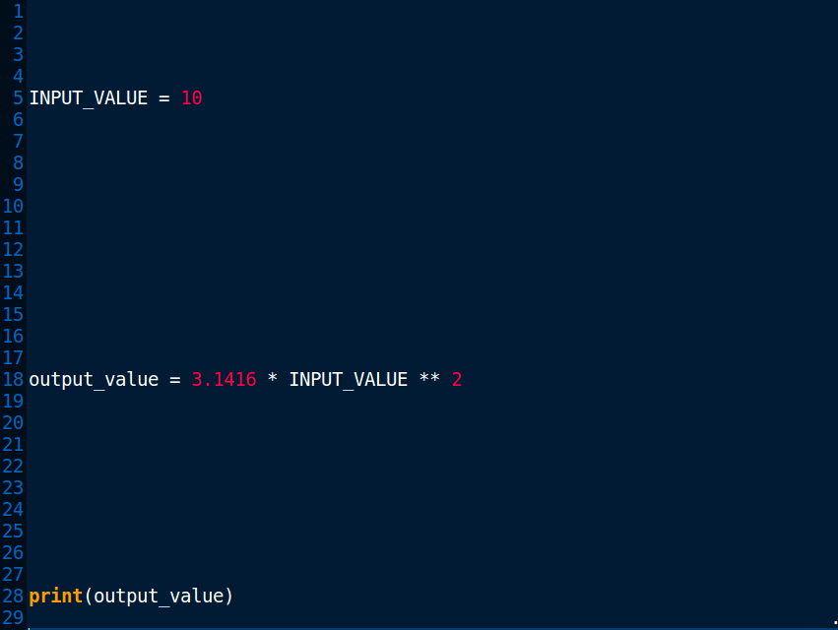

In, Calculate, Out
Appendix
1
circle_01.py

Slide 3
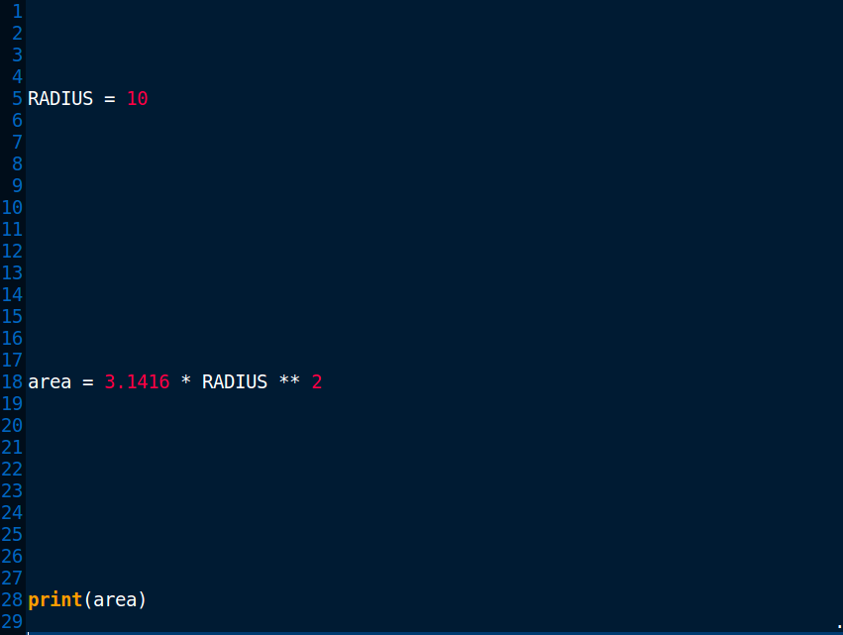

Variable Naming
circle_02.py

Slide 4
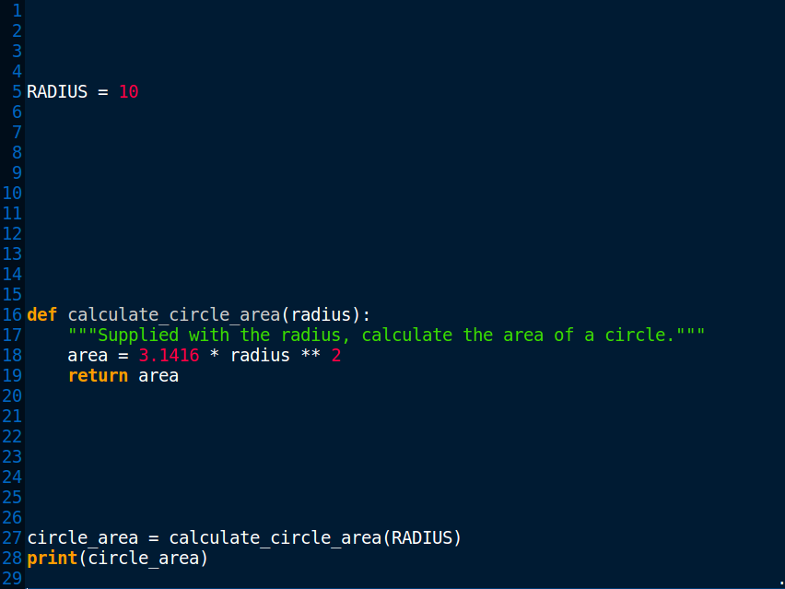

Function
circle_01.py
circle_03.py

Slide 5
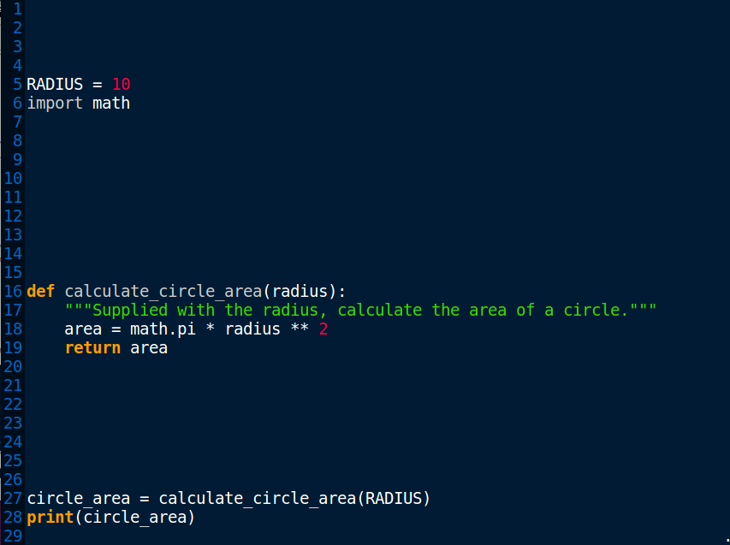

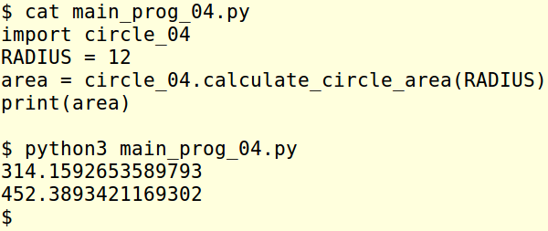
Math and as a Module
Importing a module
Huh? Two answers?
main_prog_04.py
circle_04.py

Slide 6
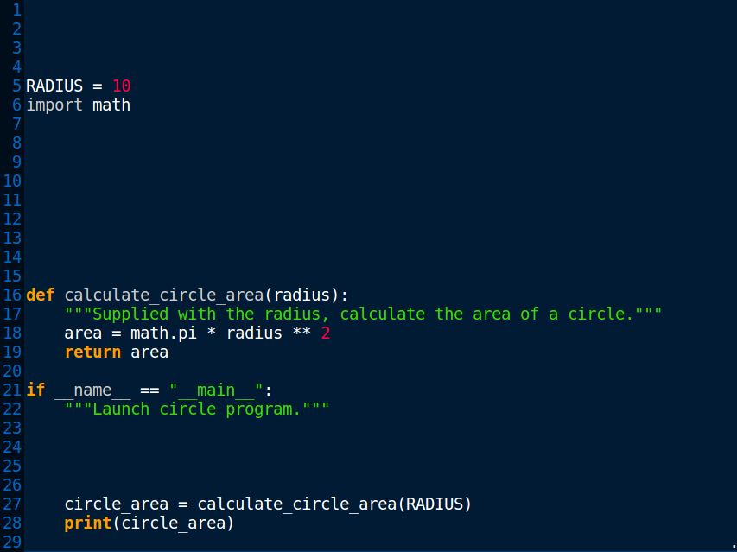

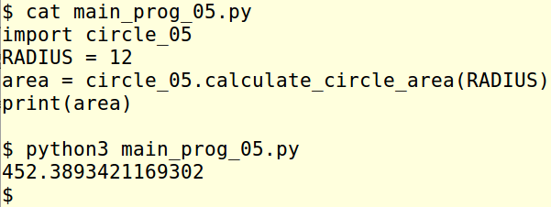
Launch and as module
Importing a module
One answer
Appendix
2
main_prog_05.py
Appendix
5
Appendix
5
circle_05.py
main_prog_05_test.py
circle_05_test.py

Slide 7
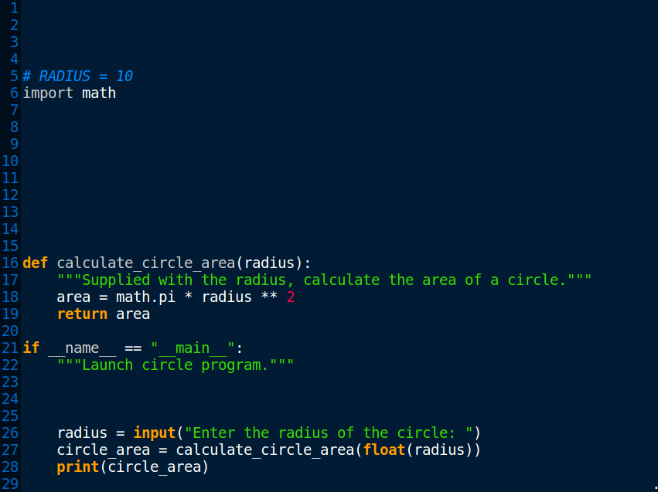
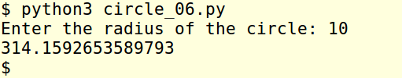
Input()
Appendix
4
circle_06.py

Slide 8
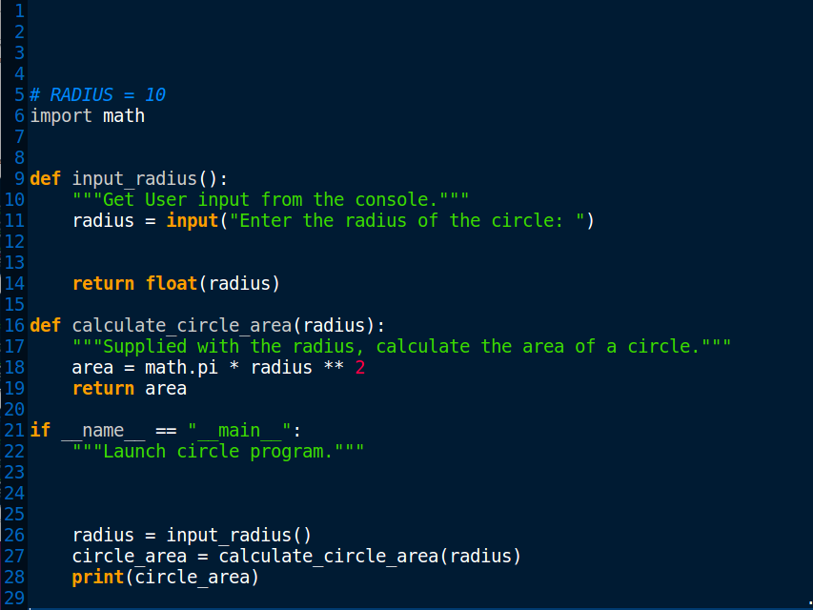
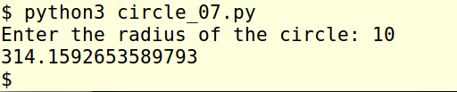
Input() inside a Function
circle_07.py

Slide 9
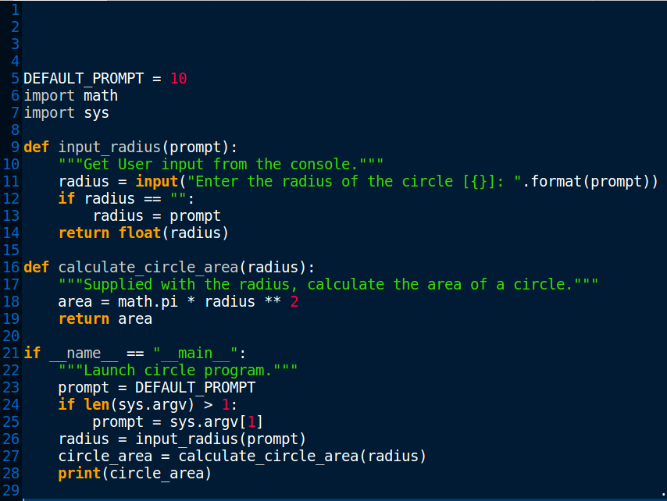
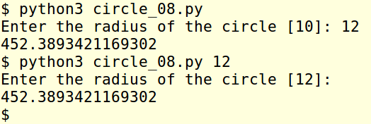
Prompt Input() & sys.argv
Appendix
3
circle_08.py

Slide 10
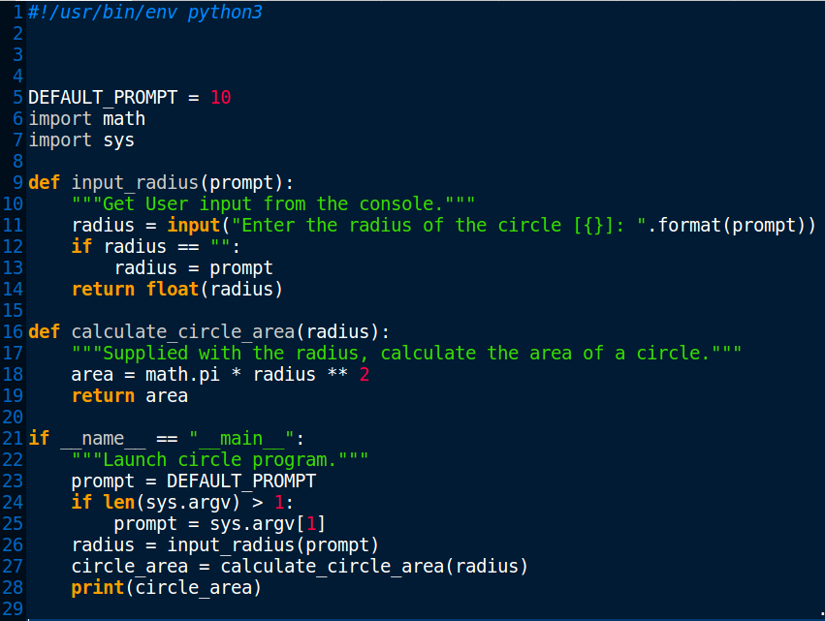
Shebang #!
circle_09.py

Slide 11
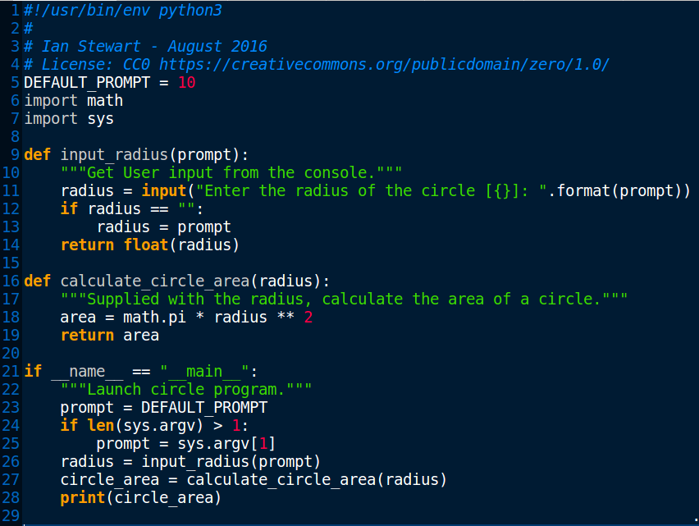
Copyright
Appendix
6
circle_10.py

Slide 12
Python Evolved.
Questions / Comments
See appendix slides for more information...
Presentation and circle.py programs: https://github.com/HamPUG/examples

Slide 13
Appendix Topics
The appendix contains introductions to some aspects of the python code that was used in the examples of this presentation.
1. Binary floating point arithmetic vs. Decimal floating point
2. What is if __name__ == "__main__": ?
3. What is sys.argv ?
4. A better method of checking for numeric User entry data.
5. Doctest inside a function or class docstring.
6. Python enhancement proposals. PEP8 – style.

Slide 14
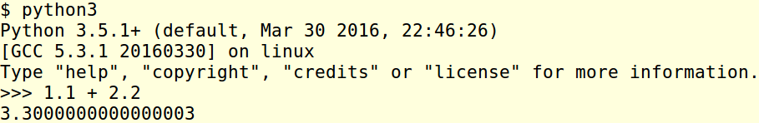

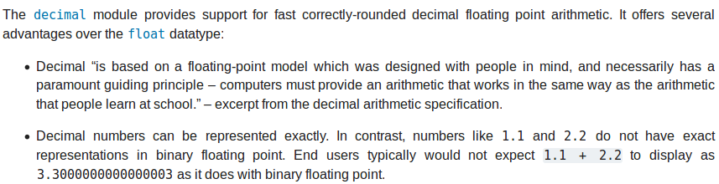
Appendix 1
Binary floating point arithmetic.
Python uses binary floating point. Use the “decimal” library to perform decimal floating point arithmetic.
More info: https://docs.python.org/3/library/decimal.html

Slide 15
Appendix 2
What is: if __name__ == "__main__":
When the Python interpreter reads a source file, it executes all of the code found in it.
Before executing the code, it will define a few special variables. For example, if the python interpreter is running that module (the source file) as the main program, it sets the special __name__ variable to have a value "__main__". If this file is being imported from another module, __name__ will be set to the module's name.
One of the reasons for doing this is that sometimes you write a module (a .py file) where it can be executed directly. Alternatively, it can also be imported and used in another module. By doing the main check, you can have that code only execute when you want to run the module as a program and not have it execute when someone just wants to import your module and call your functions themselves.
More info: http://stackoverflow.com/questions/419163/what-does-if-name-main-do http://ibiblio.org/g2swap/byteofpython/read/module-name.html

Slide 16
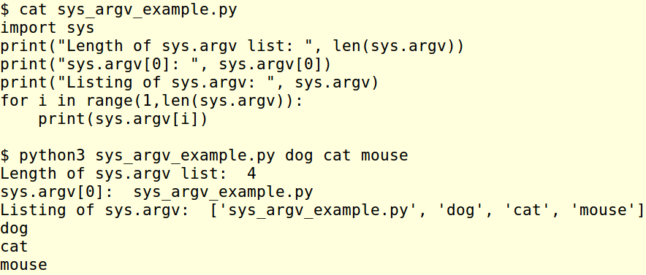
Appendix 3
sys.argv
A list of command line arguments passed to a python script. sys.argv[0] is the script name. With the len(sys.argv) function you receive a count of the number of arguments.
More info: https://docs.python.org/3/library/sys.html

Slide 17
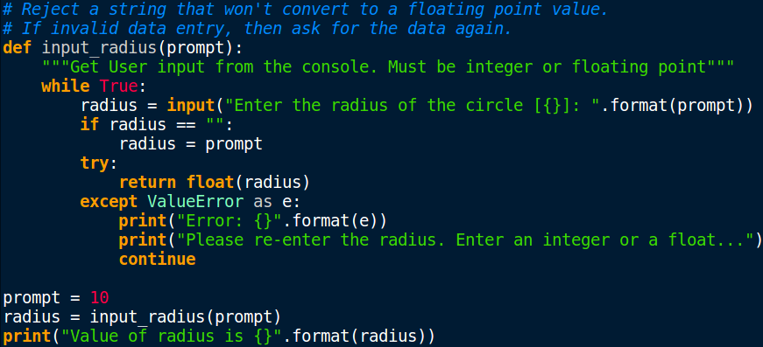
Appendix 4
A method of handling the User’s input to ensure that a valid numeric string is input and not an alphabetic character string.

Slide 18
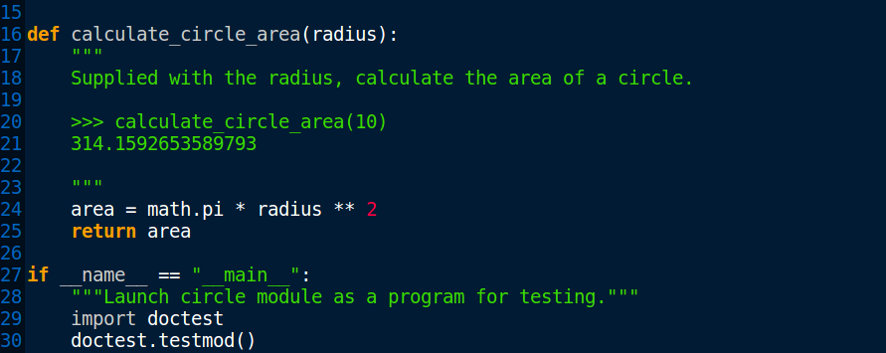
Appendix 5 - 1
Importing doctest to provide testing of a module in the docstring...
>>> calculate_circle_area(10)
314.1592653589793
Command line testing of module...
$ python3 circle_05_text.py
$ python3 circle_05_test.py -v

Slide 19
Appendix 5 - 2
$ python3 circle_05_test.py
$ python3 circle_05_test.py -v
Trying: calculate_circle_area(10)
Expecting:
314.1592653589793 ok
1 items had no tests:
__main__
1 items passed all tests:
1 tests in __main__.calculate_circle_area
1 tests in 2 items.
1 passed and 0 failed.
Test passed.
$

Slide 20
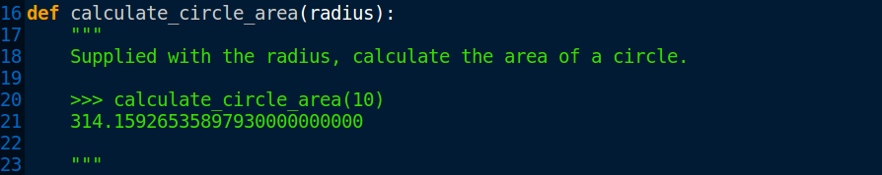
Appendix 5 - 3
$ python3 circle_05_test.py
**********************************************************************
File "circle_05_test.py", line 20, in __main__.calculate_circle_area
Failed example: calculate_circle_area(10)
Expected:
314.15926535897930000000000
Got:
314.1592653589793
**********************************************************************
1 items had failures:
1 of 1 in __main__.calculate_circle_area
***Test Failed*** 1 failures.
$
More info: https://docs.python.org/3/library/doctest.html

Slide 21
Appendix 6
Python Enhancement Proposals – PEP
There are two main documents on the style used for writing python code and document strings within the code..
PEP 8
A document providing coding conventions for the Python code comprising the standard library in the main Python distribution.
PEP 257
A document on the semantics and conventions associated with Python docstrings.
More info: https://www.python.org/dev/peps/pep-0008/ https://www.python.org/dev/peps/pep-0257/

