Slide 1
Text to Speech
A presentation by a lady at google under the control of python3.
Initially designed to use python3 modules:
urllib and subprocess, with the mplayer or ffplay applications.
Now modified to use:
GObject and Gstreamer (Gst)
Authors:
Lawrence D’Oliveiro and Ian Stewart.
Presented:
Hamilton Python User Group – 8 May 2017.

Slide 2
Text to Speech
Two off-line text to speech applications:
espeak
$ espeak "Hello. This is espeak."
$ espeak "The quick brown fox jumps over the lazy dog."
pico2wave
$ pico2wave -w pico_1.wav "Hello. This is pico2wave"
$ pico2wave -w pico_2.wav "The quick brown fox jumps over the lazy dog."

Slide 3
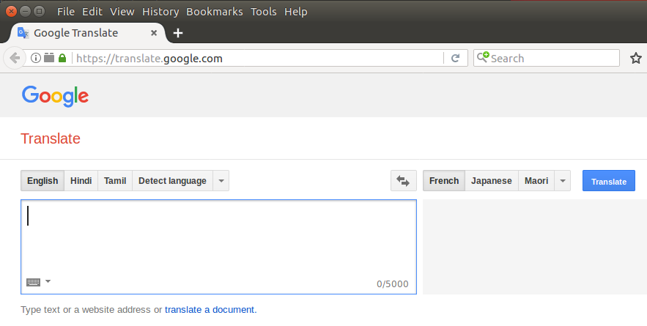
Text to Speech
https:://translate.google.com

Slide 4
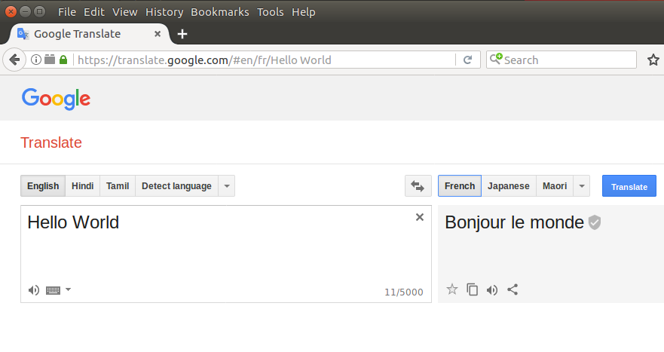
Text to Speech
https:://translate.google.com/#en/fr/Hello World

Slide 5
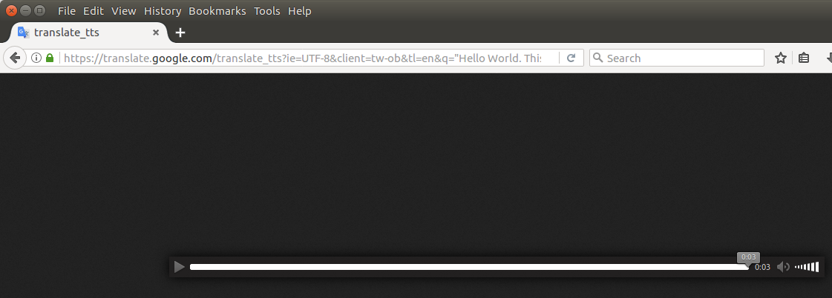
Text to Speech
https://translate.google.com/translate_tts?ie=UTF-8&client=tw-ob&tl=en&q="Hello World. This is a test"
Values:
ie=UTF-8
&client=tw-ob
&tl=en
&q="Hello World. This is a test"

Slide 6
Text to Speech
Using Linux’s wget to retrieve a mp3 file message...
$ MESSAGE="Hello World, it's raining today."
$ echo $MESSAGE
Hello World, it's raining today.
$ wget --quiet --user-agent=Mozilla "https://translate.google.com/translate_tts?tl=en&client=tw-ob&ie=UTF-8&q=$MESSAGE" --output-document=message.mp3
$ ls -l message.mp3
-rw-rw-r-- 1 ian ian 50976 Mar 29 16:18 message.mp3

Slide 7
Text to Speech
An audio player application is used to deliver audio from the mp3. For examples mplayer and ffplay
$ mplayer message.mp3
MPlayer 1.2.1 (Debian), built with gcc-5.3.1 (C) 2000-2016 MPlayer Team
mplayer: could not connect to socket
mplayer: No such file or directory
Failed to open LIRC support. You will not be able to use your remote control.
Playing message.mp3.
libavformat version 56.40.101 (external)
Audio only file format detected.
Load subtitles in ./
==========================================================================
Opening audio decoder: [mpg123] MPEG 1.0/2.0/2.5 layers I, II, III
AUDIO: 24000 Hz, 2 ch, s16le, 32.0 kbit/4.17% (ratio: 4000->96000)
Selected audio codec: [mpg123] afm: mpg123 (MPEG 1.0/2.0/2.5 layers I, II, III)
==========================================================================
AO: [pulse] 24000Hz 2ch s16le (2 bytes per sample)
Video: no video
Starting playback...
A: 2.6 (02.5) of 2.0 (02.0) 0.2%
#<--XXXXXX I hear the audio played to me. Ian. XXXXXX
Exiting... (End of file)
$

Slide 8
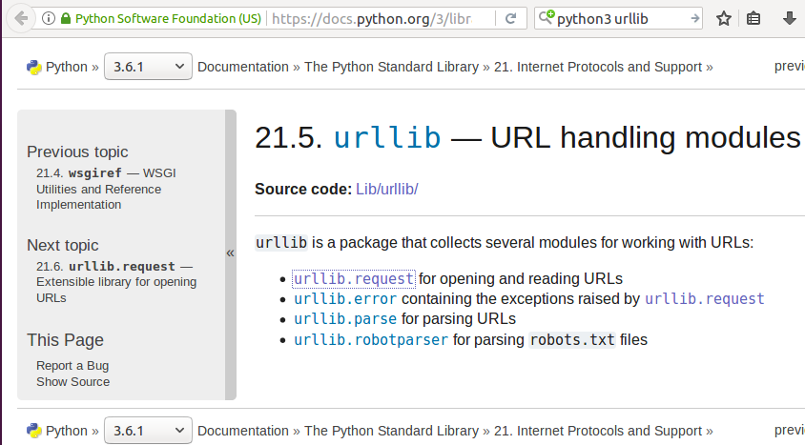
Text to Speech
Python3 urllib package.
https://docs.python.org/3/library/urllib.html

Slide 9
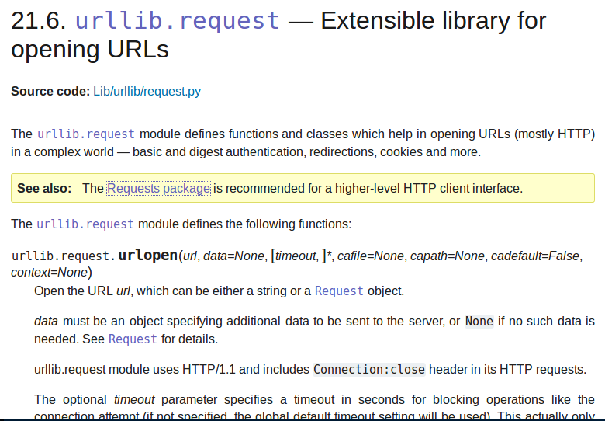
Text to Speech
Python3 module urllib
https://docs.python.org/3/library/urllib.request.html#module-urllib.request

Slide 10
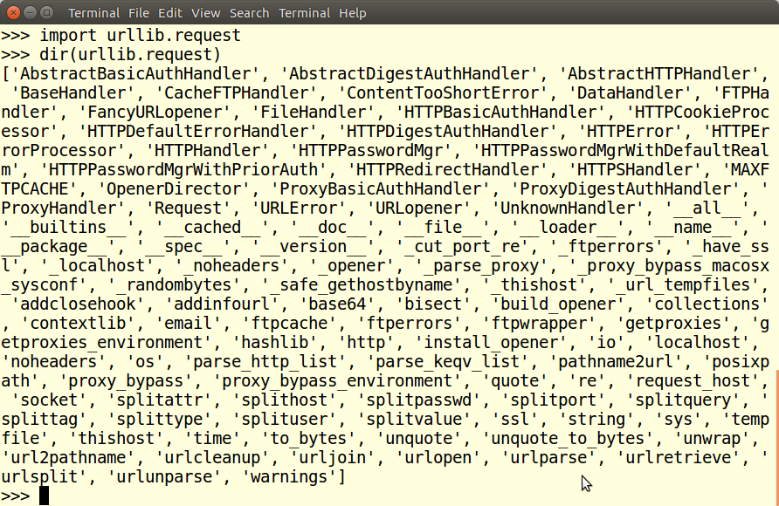
Text to Speech
Python3 module urllib

Slide 11
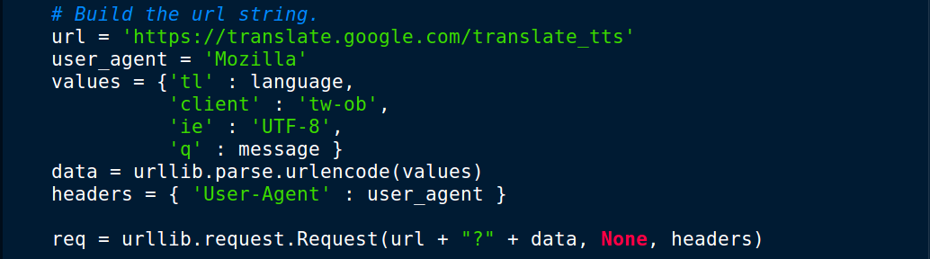
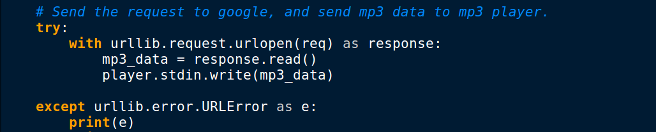
Text to Speech
Build url request. Submit request to google

Slide 12
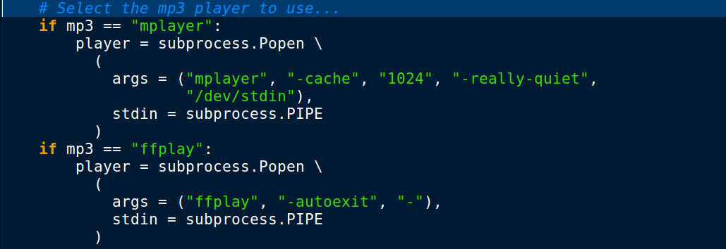
Text to Speech
Use subprocess to pipe the MP3 data to a player
This code is executed before the previous slides bottom section of code.

Slide 13
Text to Speech
How does this presentation work?
Enable LibreOffice/OpenOffice to accept connections.
soffice "--accept=socket,host=localhost,port=2002;urp;StarOffice.ServiceManager"
Launch application: $ python3 google_talk_presenter.py
Import pyuno. Unified Network Object bridge from python to LibreOffice.
Application reads: google_talk_presentation.txt
Locate command with filename of presentation.
[slide_show_file:google_talk_presentation.odp]
Python / pyuno launches Impress slide show.
google_talk_presentation.txt provides the commands to control the slide show and the text that is submitted to google for conversion to speech.

Slide 14
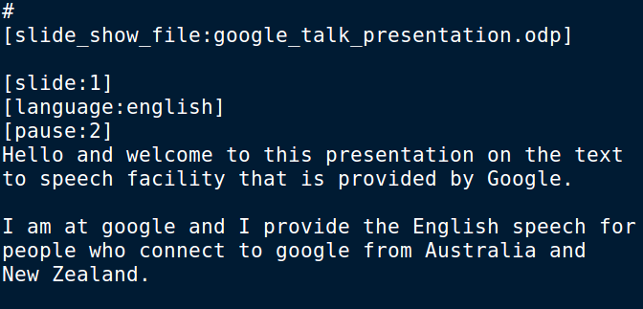
Text to Speech
google_talk_presentation.txt – snippet.

Slide 15



urllib / mp3 player
Block Diagram
Messages and controls text file
Impress slide show .odp file
presenter.py
Python 3 Application
LibreOffice API runs slide show
python uno
bridge
Google Text to Speech
Graphics
processor
urllib.request
subprocess
.Popen .PIPE
Mp3 application mplayer / ffplay
Audio
amplifier

Slide 16
Gstreamer
Block Diagram
Messages and controls text file
Impress slide show .odp file
presenter.py
Python3 Application
LibreOffice API runs slide show
python uno
bridge
Google Text to Speech
Graphics
processor
Gobject Gst
(Gstreamer)
Local mp3 or wav file
Audio
amplifier

Slide 17


Text to Speech
and

Slide 18
__end__

