Slide 1
ipynb_creator
A python program that will:
Read a python file and create a Jupyter ipynb file.
Read a text file and based on delimiters will create a Jupyter ipynb file with multiple cells.
Recommended prerequisite presentation:
ipynb modification using python json module
... to better understand the json involved.
Ian Stewart
2019-08-07

Slide 2
ipynb_creator
Presentation Contents:
Introduction to structure of an ipynb file.
Logic to the python program that creates ipynb files.
Example of making a python program an ipynb file.
ipynb_creator -h and --help
Example of making a text file become an ipynb file.
Rules for creating text files.
Arguments when launching ipynb_creator program
Ian Stewart
2019-08-07

Slide 3
{
"cells": [
{cell 1 dict}, {cell 2 dict}, {cell ... dict}
]
"metadata": { ~15 overall keyword:value pairs}
"nbformat": 4,
"nbformat_minor": 2
}
ipynb highlevel layout.
4 x Dictionary keywords
List of dictionaries
A dictionary with 4 x keywords: cells, metadata, nbformat and nbformat_minor.
For “cells” keyword the value is a list.
The list items are dictionaries for each Jupyter cell.
Markdown cell dictionaries have 3 keywords
Code cell dictionaries have 5 x keywords.

Slide 4
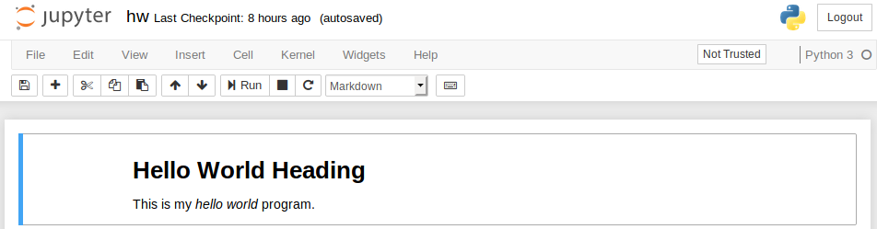
“Markdown” cell ipynb data layout.
{
"cell_type": "markdown",
"metadata": {},
"source": [
"# Hello World Heading\nThis is my *hello world* program.\n"
]
},
3 x Dictionary keywords:
cell_type, metadata, source.
Jupyter renders this markdown cell as...

Slide 5
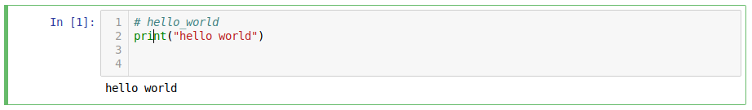
“Code” cell ipynb data layout.
{
"cell_type": "code",
"execution_count": null,
"metadata": {},
"outputs": [],
"source": [
"# hello_world\nprint(\"hello world\")\n\n"
]
},
5 x Dictionary keywords:
cell_type, execution_count, metadata, outputs, source.
Jupyter renders this code cell as...

Slide 6
Logic to the python program
Create a simple template as a python constant. The template has 1 x markdown cell.
Select a python file or text file to become the ipynb file.
Having determined the ipynb file name write the template out to the ipynb file.
Import simplejson.
Use json to load ipynb file and change markdown text.
Use json.dump() to write json data back to the file.
Use json.load(), add cell, and json.dump().
As required, repeat above step until all cells have been written.

Slide 7
Create ipynb template 1/2
TEMPLATE = """{
"cells": [
{
"cell_type": "markdown",
"metadata": {},
"source": [
"template"
]
}
],
"metadata": {
"kernelspec": {
"display_name": "Python 3",
"language": "python",
"name": "python3"
},
1st top level dictionary: “cell_type”
Dummy markdown data
2nd top level dictionary:
“metadata”

Slide 8
Create ipynb template 2/2
"language_info": {
"codemirror_mode": {
"name": "ipython",
"version": 3
},
"file_extension": ".py",
"mimetype": "text/x-python",
"name": "python",
"nbconvert_exporter": "python",
"pygments_lexer": "ipython3",
"version": "3.6.8"
}
},
"nbformat": 4,
"nbformat_minor": 2
}"""
2nd top level dictionary continues
3rd & 4th top level dictionaries

Slide 9
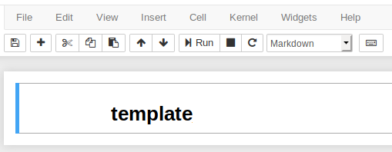
ipynb_creator program logic
If the TEMPLATE was rendered by Jupyter notebook...

Slide 10

ipynb_creator program logic
Write the template out to an ipynb file
Import simplejson module

Slide 11
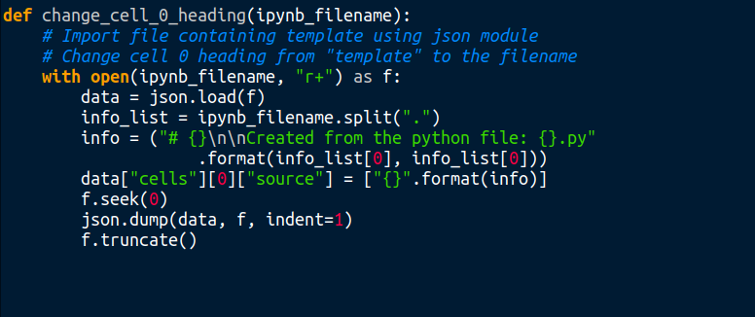
ipynb_creator program logic
Use json to load ipynb file and change markdown text
r+ Position at start
From file beginning, write json data back to the file.

Slide 12
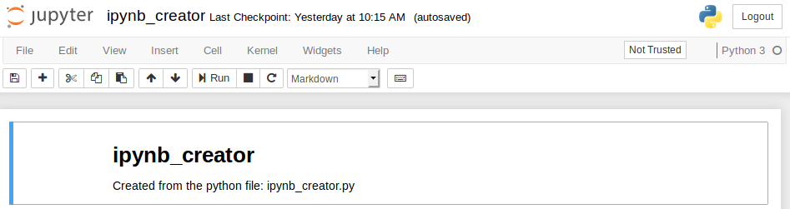
ipynb_creator program logic
If the ipynb file is rendered by Jupyter notebook...

Slide 13
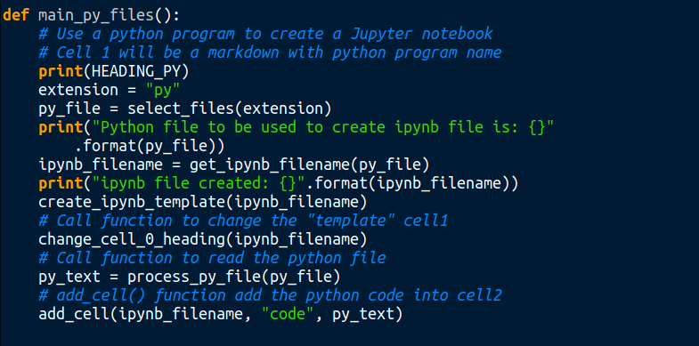
ipynb_creator program logic
Functions to read a python file and add it to ipynb cell 2...

Slide 14
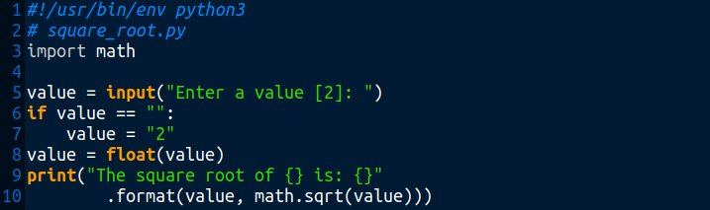
Python square_root.py program example 1/3
$ python3 square_root.py
Enter a value [2]: 3
The square root of 3.0 is: 1.7320508075688772

Slide 15
Python square_root.py program example 2/3
$ python3 ipynb_creator.py
ipynb_creator version: 0.3
Move the contents of a python file to Jupyter notebook? [Y/n]:
Read a python file and create an ipynb file.
Python files (.py) found in the current directory:
1. ipynb_creator.py
2. square_root.py
Select the file for creating the ipynb file [1]: 2
Python file to be used to create ipynb file is: square_root.py
ipynb file created: square_root.ipynb

Slide 16
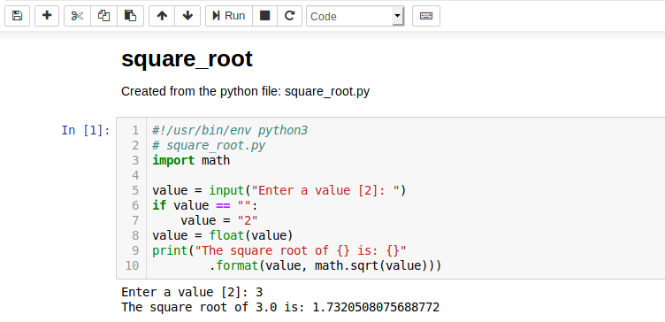
Python square_root.py program example 3/3

Slide 17
ipynb_creator -h and --help
$ python3 ipynb_creator.py -h
ipynb_creator version: 0.3
Usage: ipynb_creator [OPTION]... [FILE]...
Create Jupyter notebook ipynb file(s) upon having been supplied python (.py) or text (.txt) file(s)
[OPTION]...
Options and arguments:
-h print this brief help message and exit.
--help print the full help message which includes an example then exit.
[FILE]...
If no files are provided as arguments then the program will run in a menu
driven mode.

Slide 18
ipynb_creator --help text example
Anything written here is ignored because its before the first delimiter.
This file is stored in my github repository and in my /python/dev/ folder.
I wrote this text in August 2019.
<markdown>
# Hello World Heading
This is my *hello world* program.
<code>
# hello_world
print("hello world")
< markdown The second python program will do some maths.>
# Maths
This is how to obtain the **square root of 2**

Slide 19
ipynb_creator --help text example
< code >
import math
< comment Remember to include the import math!>
a = 2
print(math.sqrt(a))
< markdown >
### *The End*
<comment This is the end of the hello_world.txt example file.>
$ python3 ipynb_creator.py help_text_example.txt
ipynb_creator version: 0.3
ipynb file created: help_text_example.ipynb
Total cells in ipynb file: 5

Slide 20
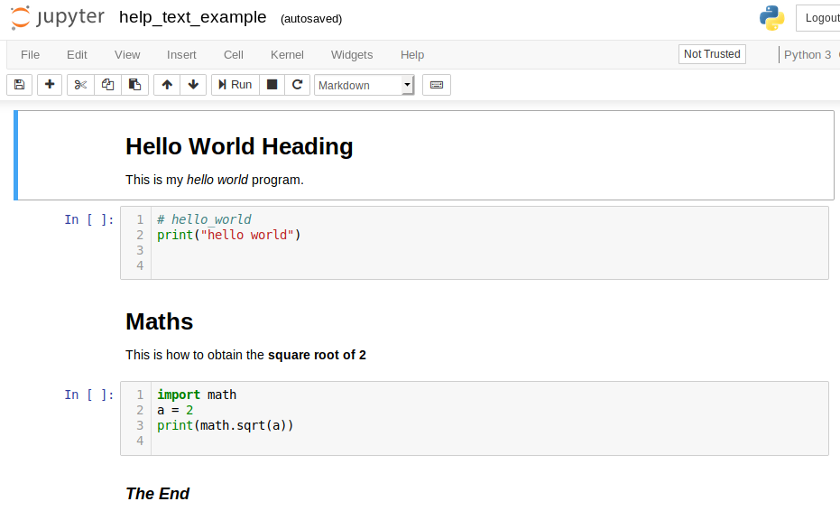
ipynb_creator --help text example

Slide 21
ipynb_creator --help text delimiter rules
For the text (.txt) files the delimiter guidelines are:
o Delimiters start with left angle bracket "<" and end with right angle ">".
o A delimiters left angle bracket "<" must be the first character on a line.
o Delimiters that create Jupyter notebook cells are <markdown> and <code>.
o Delimiter <raw> is accepted but not processed.
o Delimiter <comment> allows one line comments within the text file.
E.g. < comment The next code cell is from my hello_world.py program>
o Other delimiters may include a comment.
E.g. <code This is my /python/hello_world.py program>
o A delimiter may be surrounded by spaces. E.g. < code >
o Text that follows a delimiter becomes the markdown or the code.
o Lines of text before the first delimiter are ignored.

Slide 22
ipynb_creator – launching arguments
Examples of the arguments that may be passed to ipynb_creator on launching
$ python3 ipynb_creator.py
$ python3 ipynb_creator.py read_file.py
$ python3 ipynb_creator.py hw.txt hello_world_1.txt sysarg.py
$ python3 ipynb_creator.py *.py
$ python3 ipynb_creator.py *.txt
$ python3 ipynb_creator.py *.txt *.py
If ipynb_creator moved to /local/bin/ then...
$ ipynb_creator
$ ipynb_creator read_file.py
$ ipynb_creator hw.txt hello_world_1.txt sysarg.py
$ ipynb_creator *.txt *.py

Slide 23
ipynb_creator
Questions?
Demos?

