Slide 1
ipynb-extractor
A python program that will:
Read a Jupyter ipynb file using simplejson module.
Use json to locate the markdown and code cells.
Create a unique folder based on the ipynb filename.
Extract cell markdown data to .md files in the folder
Extract cell code data to .py files in the folder.
Recommended prerequisite presentations:
ipynb modification using python json module
... to better understand the json involved.
Ian Stewart
2019-08-09

Slide 2
ipynb-extractor
Presentation Contents:
Introduction to structure of an ipynb file.
Logic to the python program that extracts from ipynb files.
Example of extracting from a ipynb file.
ipynb-extractor -h and --help
Arguments when launching ipynb-extractor program
Ian Stewart
2019-08-09

Slide 3
{
"cells": [
{cell 1 dict}, {cell 2 dict}, {cell ... dict}
]
"metadata": { ~15 overall keyword:value pairs}
"nbformat": 4,
"nbformat_minor": 2
}
ipynb highlevel layout.
4 x Dictionary keywords
List of dictionaries
A dictionary with 4 x keywords: cells, metadata, nbformat and nbformat_minor.
For “cells” keyword the value is a list.
The list items are dictionaries for each Jupyter cell.
Markdown cell dictionaries have 3 keywords
Code cell dictionaries have 5 x keywords.

Slide 4
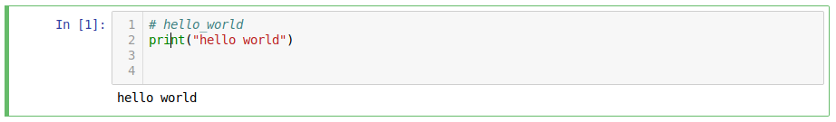
“Code” cell ipynb data layout.
{
"cell_type": "code",
"execution_count": null,
"metadata": {},
"outputs": [],
"source": [
"# hello_world\n,print(\"hello world\")\n,\n"
]
},
5 x Dictionary keywords:
cell_type, execution_count, metadata, outputs, source.
Contents of source list is to be extracted
Jupyter renders this code cell as...

Slide 5
Logic to the python program
Select ipynb file(s).
Based on the filename create a folder
Import simplejson
Using simplejson module load a selected ipynb file.
Iterate through each cell
Determine if the cell is markdown or code
Extract cell source list and write to a file in the folder.
Markdown is written as a .md file.
Code is written as a .py file.
As required, repeat above step until all cells have been written

Slide 6


ipynb-extractor program logic
Import simplejson module
Open ipynb file for read and then json loads as data

Slide 7

ipynb-extractor program logic
Get json’s source data list and output line by line to file.

Slide 8
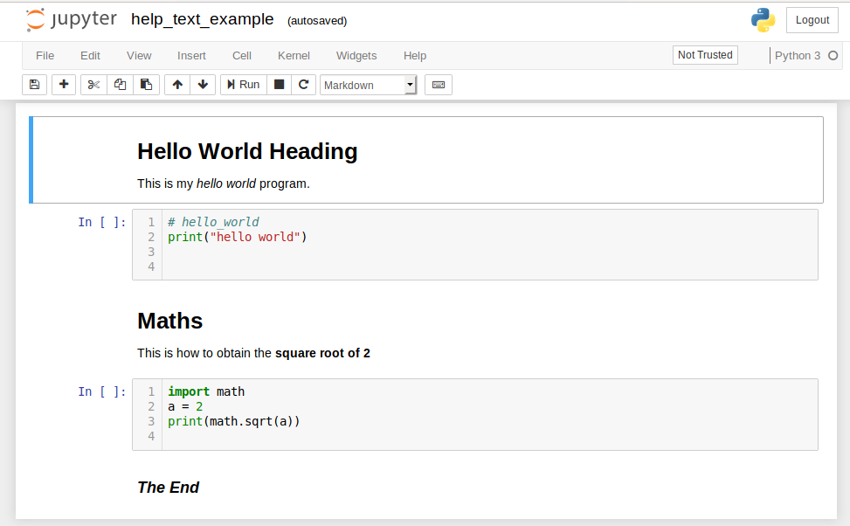
ipynb-extractor example 1/3
Jupyter notebook ipynb file...

Slide 9
example 2/3
$ python3 ipynb-extractor.py help_text_example.ipynb
ipynb-extractor version: 0.1
Read a Jupyter notebook (.ipynb) file and extract to a folder
the markdown and code cells as markdown.md and python.py files.
Created folder `help_text_example`.
ipynb file: help_text_example.ipynb, total cells: 5
ipynb file: `help_text_example.ipynb` cells extracted to folder `help_text_example`
Markdown files: 3, Python files: 2

Slide 10
example 3/3
$ ls -1 help_text_example/
help_text_example_01.md
help_text_example_02.py
help_text_example_03.md
help_text_example_04.py
help_text_example_05.md
$ cat help_text_example/help_text_example_04.py
import math
a = 2

Slide 11
ipynb-extractor -h and --help
$ python3 ipynb-extractor.py -h
ipynb-extractor version: 0.1
Read a Jupyter notebook (.ipynb) file and extract to a folder
the markdown and code cells as markdown.md and python.py files.
Usage: ipynb-extractor [OPTION]... [FILE]...
From Jupyter notebook ipynb file(s) extract the markdown and code cells.
Create a folder based on the ipynb filename. Extract to the folder the
code cells as python (.py) files or as markdown (.md) files.
[OPTION]...
Options and arguments:
-h print this brief help message and exit.
--help print a full help message and exit.

Slide 12
ipynb_creator --help text has example
$ python3 ipynb-extractor.py help_text_example.ipynb
ipynb-extractor version: 0.1
Read a Jupyter notebook (.ipynb) file and extract to a folder
the markdown and code cells as markdown.md and python.py files.
Created folder `help_text_example`.
ipynb file: help_text_example.ipynb, total cells: 5
ipynb file: `help_text_example.ipynb` cells extracted to folder `help_text_example`
Markdown files: 3, Python files: 2

Slide 13
ipynb-extractor – launching arguments
Examples of the arguments that may be passed to ipynb-extractor on launching
$ python3 ipynb-extractor.py
$ python3 ipynb-extractor.py example.ipynb
$ python3 ipynb-extractor.py example1.ipynb example2.ipynb
$ python3 ipynb-extractor.py *.ipynb
If ipynb-extractor moved to /local/bin/ then...
$ ipynb-extractor
$ ipynb-extractor example.ipynb
$ ipynb-extractor example1.ipynb example2.ipynb
$ ipynb-extractor *.ipynb

Slide 14
ipynb-extractor
Questions?
Demos?

