Slide 1
ipynb modification using python json module
Ian Stewart
2019 08 04

Slide 2
ipynb modification using python json module
Jupyter notebook data is saved in the JavaScript Object Notation (json) format.
Jupyter notebook files have the extension ipynb (interactive python notebook).
Using a python program that utilizes the json module modifications may be made to ipynb file(s).
Ian Stewart
2019 08 04

Slide 3
Presentation Contents
Review a Jupyter Notebook with 2 x cells.
Modify the metadata of the cells.
Review the modifications in the ipynb file.
Python program that uses the json module.
Review the python/json code
Demonstration of the program modifying cell metadata

Slide 4
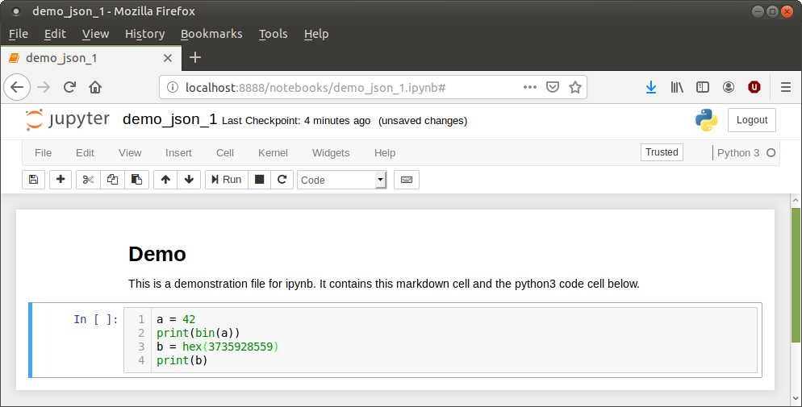
Example of Jupyter Notebook with 2 x cells

Slide 5
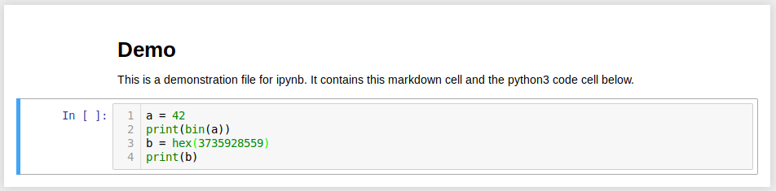
Modifications that may be desirable...
Not deletable
Not editable
Not deletable
editable

Slide 6
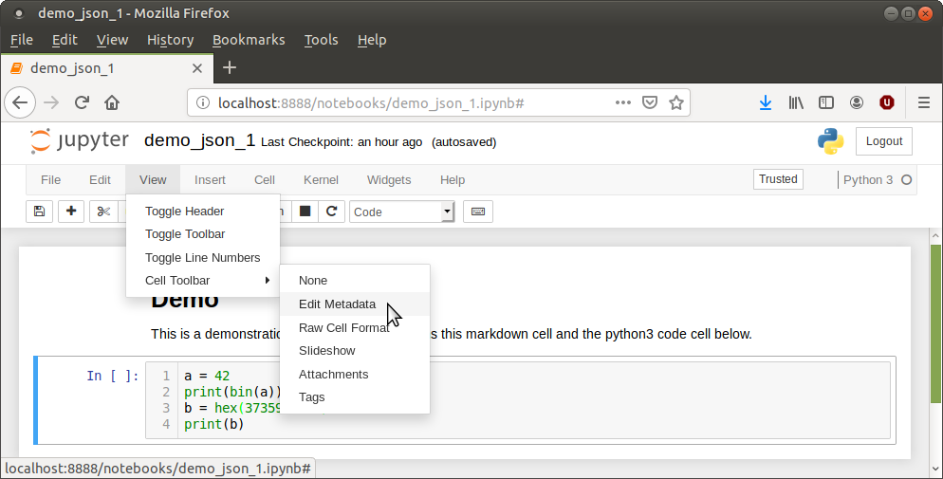
Set cells to Edit Metadata

Slide 7
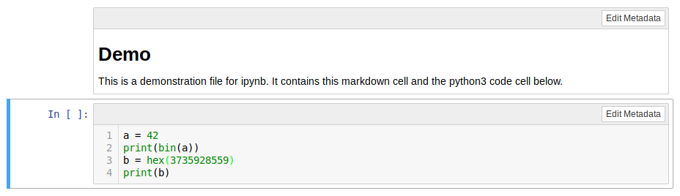
Cells have Edit Metadata capability
Edit Metdata

Slide 8
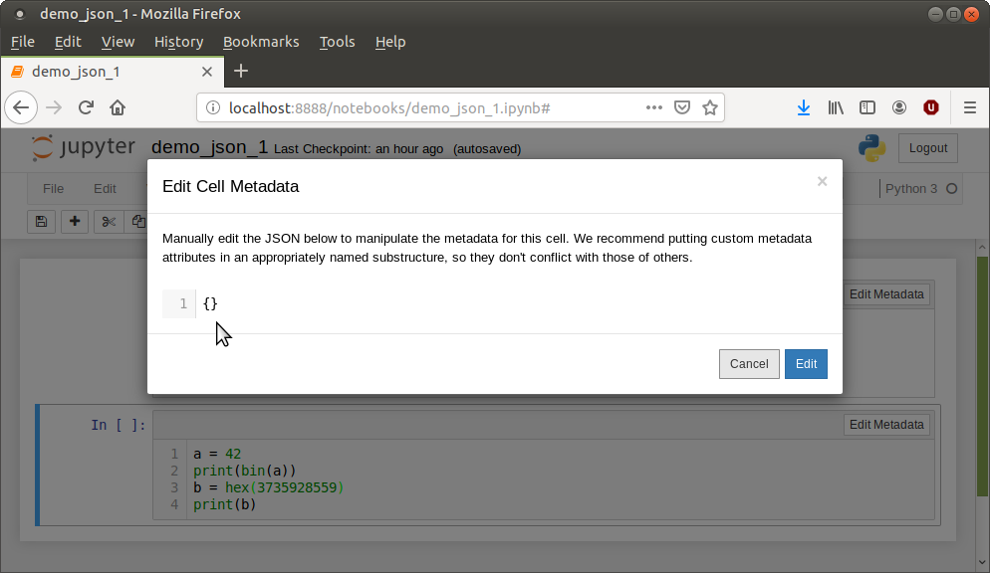
Editing first cell metadata

Slide 9
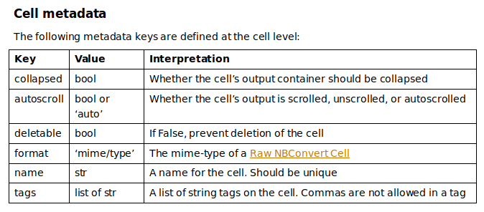
Cell metadata keys
Above table from: https://ipython.org/ipython-doc/dev/notebook/nbformat.html
Not listed: editable – new in version 5

Slide 10
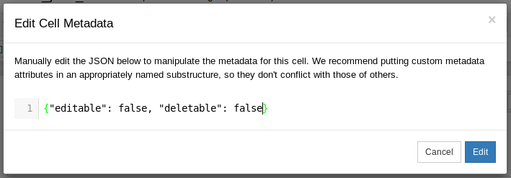
Markdown cell: "editable": false, "deletable": false

Slide 11
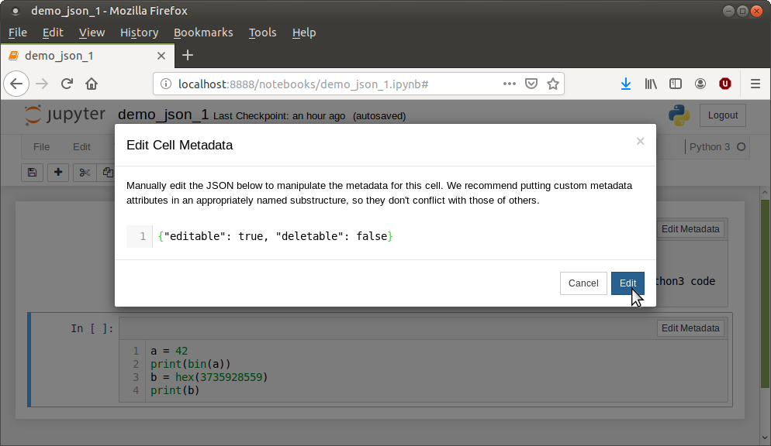
Code cell: "editable": true, "deletable": false

Slide 12
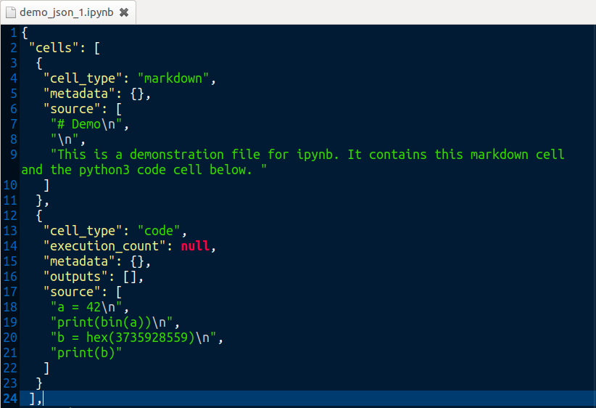
View of Jupyter ipynb script. Before modification
Markdown cell. No metadata
Code cell. No metadata

Slide 13
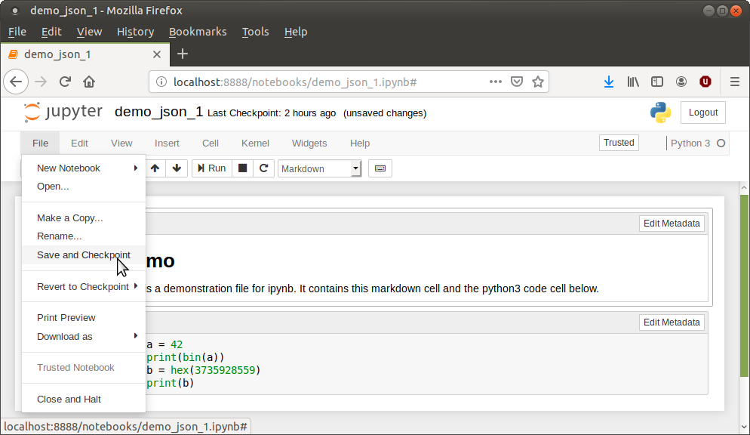
Save Jupyter Notebook so ipynb file is updated

Slide 14
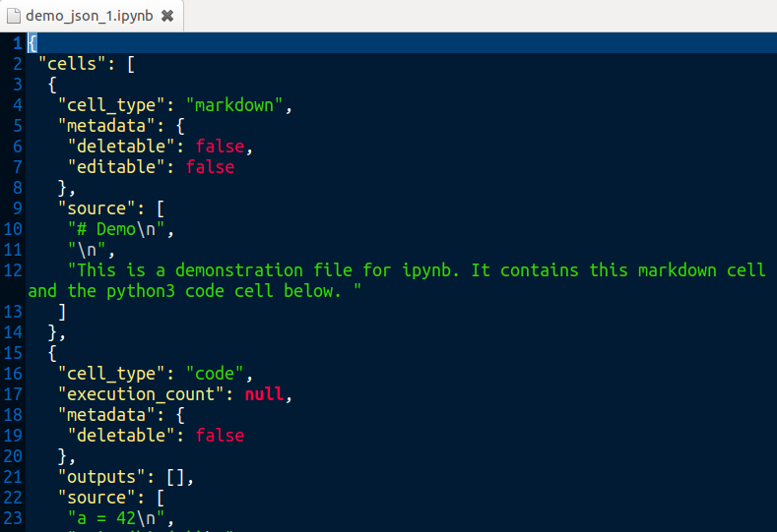
Save Jupyter Notebook so ipynb file is updated
Markdown cell.
With metadata added
Code cell.
With metadata
"Editable": true
Default? So not added?

Slide 15
Any Issue with editing metadata for each cell?
What if each ipynb file has, say, 20 cells, and your project has 20 ipynb files.
Then that’s 400 manual edits required which will take a lot of time.
Solution?

Slide 16
Solution
A python program that imports the simplejson module.
Poll user for the ipynb files to change.
Poll user for cell metadata parameters to modify.
json is used to load each file.
Iterate over each cell and modify the metadata.
json is used to dump the data back to the file.
Jupyter-notebook re-loads the modified file.

Slide 17

json
JSON is a text format that is completely language independent. It was derived from JavaScript.
Website: https://www.json.org/
Wiki: https://en.wikipedia.org/wiki/JSON
ECMA-404, ISO/IEC 21778:2017, RFC 8259
IPYNB notebook documents are stored in the JSON plain text format

Slide 18
json module
Linux distro may include json and simplejson.
Recommended to use simplejson
https://github.com/simplejson/simplejson
Docs: https://simplejson.readthedocs.io/en/latest/
PyPi: https://pypi.org/project/simplejson/
simplejson version 1.0 released 2005-12-25
simplejson version 3.16.1 released 2018-09-07
try:
import simplejson as json
except ImportError:
import json

Slide 19
Python program flow
Get the ipynb files in the current working directory.
User selects the ipynb files to modify.
User selects which metatdata parameters to apply.
Create a backup folder to copy files to before modification.
If metadata to be cleared then loop through for each file:
  backup ipynb file to backup folder.
  open ipynb file as r+
  Use json module to load the file to data variable.
  clear the metadata: data["cells"][i]['metadata'] = {}
  f.seek(0) # to reset file position to the beginning.
  json.dump(data, fin, indent=1) # write data bck to file.

Slide 20
Python program flow
If metadata to be selectively modified:
  Answer queries to select editable and deletable parameters for code and/or markdown cells.
Loop through for each file:
  backup ipynb file to backup folder.
  open ipynb file as r+ (r/w positioned at beginning of file)
  Use json module to load the file to data variable.
  Set the metadata. E.g.:
    data["cells"][i]['metadata']['editable'] = True
  f.seek(0) # reset file position to the beginning.
  json.dump(data, fin, indent=1) # write data back to file.
  f.truncate() # remove remaining part

Slide 21
ipynb highlevel layout.
{
"cells": [
{cell 1 dict}, {cell 2 dict}, {cell ... dict}
]
"metadata": { ~15 overall attribute:value pairs}
"nbformat": 4,
"nbformat_minor": 2
}
4 x Dictionary keywords
List of dictionaries
Each cell has a "metadata":{} dictionary
After modification of every cells metadata in {cell ... dict}:
"metadata": {
"deletable": false,
"editable": false
},
Attribute – value pairs

Slide 22
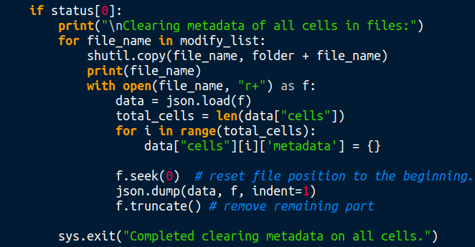
Code to clear cell metadata:
dict keywd, list pointer, dict keywd

Slide 23
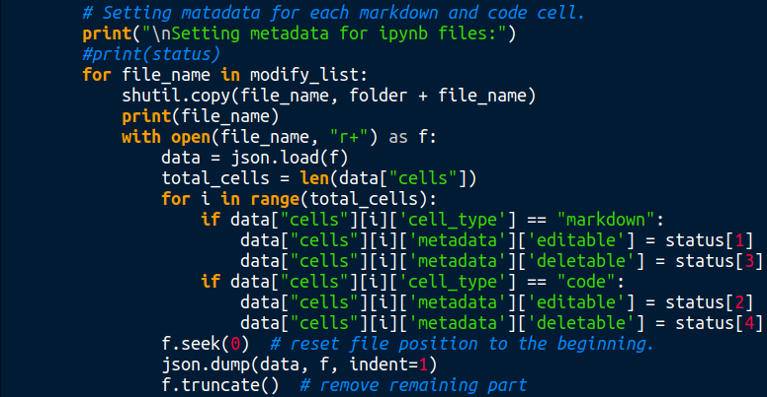
Code to set cell metadata:
dict kw, list pointer,
dict kw, key-value pair

Slide 24
Run program. Clear metadata of all cells
$ python3 modify_notebook_metadata.py
Modify ipynb files by changing the metadata of each cell.
Choose the modification option you wish to apply to the ipynb file(s):
In the directory /home/ian/python/ipynb_modification_using_json_module, there are 1 ipynb files:
1. demo_json_1.ipynb
Enter the number of the file to modify or * for all files: 1
The file selected is: demo_json_1.ipynb
Are you sure you want to modify this file? [Y/n]:
Are there more files you wish to modify? [N/y]:
Clear all cell metadata [N/y]: y
Cell metadata will be cleared. Proceed? [Y/n]: y
A backup of the files before modification is in the folder:
/home/ian/python/ipynb_modification_using_json_module/backup-20190804-085836/
Clearing metadata of all cells in files:
demo_json_1.ipynb
Completed clearing metadata on all cells.

Slide 25
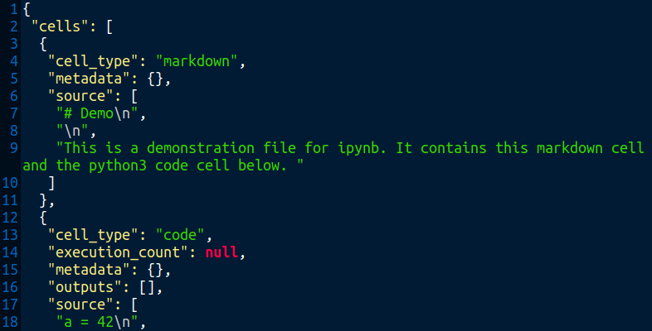
Each cells metadata is cleared
Previously:
"metadata": {
"deletable": false,
"editable": false
},

Slide 26
Run Program. Set cells metadata
In the directory /home/ian/python/ipynb_modification_using_json_module, these are 1 ipynb files:
1. demo_json_1.ipynb
Enter the number of the file to modify or * for all files: 1
The file selected is: demo_json_1.ipynb
Are you sure you want to modify this file? [Y/n]:
Are there more files you wish to modify? [N/y]:
Clear all cell metadata [N/y]:
Set Markdown cell to be editable? [Y/n]: n
Set Code cell to be editable? [Y/n]: y
Set Markdown cell to be deletable? [Y/n]: n
Set Code cell to be deletable? [Y/n]: n
Markdown cells: Editable:False and Deletable:False
Code cells: Editable:True and Deletable:False
Proceed? [Y/n]: y
A backup of the files before modification is in the folder:
/home/ian/python/ipynb_modification_using_json_module/backup-20190804-102327/
Setting metadata for ipynb files:
demo_json_1.ipynb
Completed setting metadata on cells.

Slide 27
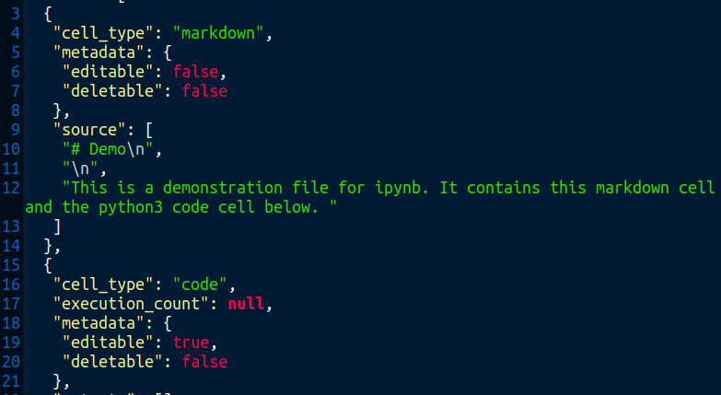
Cell metadata includes “editable” and “deletable”

Slide 28
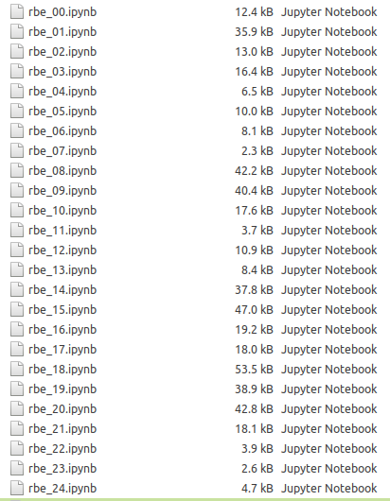
Yeah, big deal – so what?
Let’s say you have 25 x ipynb files and each file has 10+ cells.
...Might be handy?

Slide 29
Set metadata in all cells in 25 x files
$ modify_notebook_metadata
Modify ipynb files by changing the metadata of each cell.
Choose the modifiction option you wish to apply to the ipynb file(s):
In the directory /home/ian/rust/rbe, these are 25 ipynb files:
1. rbe_00.ipynb
2. rbe_01.ipynb
...snip...
24. rbe_23.ipynb
25. rbe_24.ipynb
Enter the number of the file to modify or * for all files: *
Selected all files
Clear all cell metadata [N/y]:
Set Markdown cell to be editable? [Y/n]: n
Set Code cell to be editable? [Y/n]: y
Set Markdown cell to be deletable? [Y/n]: n
Set Code cell to be deletable? [Y/n]: n
1/2

Slide 30
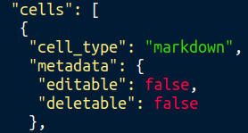
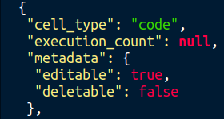
Set metadata in all cells in 25 x files
Markdown cells: Editable:False and Deletable:False
Code cells: Editable:True and Deletable:False
Proceed? [Y/n]: y
A backup of the files before modification is in the folder:
/home/ian/rust/rbe/backup-20190804-104541/
Setting metadata for ipynb files:
rbe_00.ipynb
rbe_01.ipynb
rbe_02.ipynb
...snip...
rbe_23.ipynb
rbe_24.ipynb
Completed setting metadata on cells.
2/2

Slide 31
...And if you do want to “restore” the files so that each cell has no metadata...
(Although these no metadata files already exist in a backup folder)
...then...

Slide 32
Clear cell metadata in 25 x files
$ modify_notebook_metadata
Modify ipynb files by changing the metadata of each cell.
Choose the modification option you wish to apply to the ipynb file(s):
In the directory /home/ian/rust/rbe, these are 25 ipynb files:
1. rbe_00.ipynb
2. rbe_01.ipynb
...snip...
24. rbe_23.ipynb
25. rbe_24.ipynb
Enter the number of the file to modify or * for all files: *
Selected all files
Clear all cell metadata [N/y]: y
Cell metadata will be cleared. Proceed? [Y/n]: y
1/2

Slide 33


Clear cell metadata in 25 x files
A backup of the files before modification is in the folder:
/home/ian/rust/rbe/backup-20190804-104118/
Clearing metadata of all cells in files:
rbe_00.ipynb
rbe_01.ipynb
rbe_02.ipynb
...snip...
rbe_23.ipynb
rbe_24.ipynb
Completed clearing metadata on all cells.
2/2

Slide 34
your_query = input("Questions? ")
the.__end__(".")

