Slide 1
Kiwi PyCon 2017 – Auckland New Zealand
Client / Server Programming Model
Desktop-Bus Communication
pydbus python library
...and systemd
Presenter: Ian Stewart – Hamilton Python User Group (HamPUG)
Email: stwrtn@gmail.com
Website: https://hampug.pythonanywhere.com/
Posted at: https://github.com/irsbugs/kiwipycon2017
This presentation is designed to also be a reference document.

Slide 2
Contents of Presentation
Introduce: Client/Server, D-Bus, pydbus, and gdbus tool
Developing Session D-Bus Server applications for Method Calls and testing with gdbus tool
Developing Session D-Bus Client Applications for Method Calls
Server Emitting a Session D-Bus Signal
Client subscribing to a Session D-Bus Emitted Signal
Demo
Introduce: The System D-Bus
Setup and demo the System D-Bus
Setup systemd
Client / Server Demo using GUI clients
Practical Example
Questions

Slide 3

Client / Server applications
Client / Server Model developed in 1960/70’s as part of ARPANET.

Slide 4
Client / Server applications. Internal Software Bus
Server
Application
Software Bus
Client
Application
1
Client
Application
2

Slide 5
Client / Server applications. Internal Software Bus
Server
Application
Message
Bus
Daemon
Resposible for routing messages.
Transparent.
Launched by: systemd
Software Bus
Client
Application
1
Client
Application
2

Slide 6
Desktop Bus - D-Bus
A software bus that allows computer programs concurrently running on the same machine to communicate.
First stable release: November 2006. 11 years ago. Rev 0.12
Initiated by Havoc Pennington and Alex Larsson from Red Hat, and Anders Carlsson.
Specification at Rev 0.31. 29 June 2017: https://dbus.freedesktop.org/doc/dbus-specification.html

Slide 7
Desktop Bus - D-Bus
The freedesktop.org project developed a free and open-source software library called libdbus.
Two types of D-Bus. System Bus and Session Bus.
Implementations: GDBus, QtDBus, sd-bus, kdbus, more...
GDBus uses the GObject based library GIO (C code).
PyGObject is a Python package which provides bindings for GObject, thus for GIO.
pydbus is a python wrapper accessing PyGObject python for GIO.

Slide 8

pydbus
Creator: Linus Lewandowski. Warsaw – Poland.
Home page: https://github.com/LEW21/pydbus
Wrapper based on using gdbus functions from the python GIO library.
Installation of MIT licensed pydbus:
$ sudo apt install python3-pydbus
$ sudo pip3 install --target /usr/lib/python3/dist-packages pydbus
pydbus files located in: /usr/lib/python3/dist-packages/pydbus/
18 files @ average file size 1.8KBytes
auto_names.py | __init__.py | proxy_signal.py
bus_names.py | _inspect3.py | publication.py
bus.py | method_call_context.py | registration.py
exitable.py | proxy_method.py | request_name.py
generic.py | proxy_property.py | subscription.py
identifier.py | proxy.py | timeout.py

Slide 9
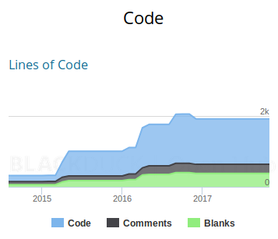
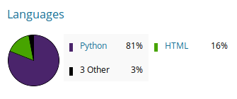
pydbus analysis
Analysis 20 November 2017. By BlackDuck Open Hub:
https://www.openhub.net/p/pydbus
November 2017
Code: 1287
Comments: 257
Blanks: 379

Slide 10
pydbus – Why?
High level.
Simple to implement.
Many aspects of D-Bus are automatically assigned.
Developer can focus on the Client and Server code not the interprocess communication code.
Modular software development.
Data Integrity on the D-Bus seesm to be assured.

Slide 11
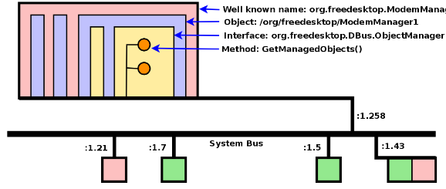
pydbus
Clients and Servers on a dbus.
Layers on a server application
Supply to pydbus.
“Well Known Name”.
Bus name .E.g: org.example.demo.test
Object: E.g: /org/example/demo/test
Interface: org.example.demo.test
Method: get_info()
Unique Connection Name.
(automatic)
Supply to pydbus
Diagram Credit: https://aleksander.es/data/GNOMEASIA2014%20-%20Introduction%20to%20DBus.pdf

Slide 12
gdbus tool
.

Slide 13
gdbus tool
gdbus is a tool / utility included with linux distributions.
Features of gdbus tool:
Simulate method calls to a server.
Debug the server before invoking the client application.
Monitor signals emitted by a server.
Test client or server code in isolation.
Reference:
https://developer.gnome.org/gio/stable/gdbus.html
https://github.com/GNOME/glib/blob/master/gio/gdbus-tool.c

Slide 14
Developing a Server application
.

Slide 15
Method calls to a server application.
Four types of method calls the client can issue to the server through the D-Bus:
Server method has no arguments. E.g. Stop, Play, Rewind, etc.
Server method sends data to the client.
Server method receives data from the client.
Server method receives data from and sends to the client.
The data type is static. For examples...
type='s' for string data
'i' for 32 bit signed integer, 'd' for double precision floating point, 'as' for a list if strings, etc.
For more static types:
https://dbus.freedesktop.org/doc/dbus-specification.html

Slide 16
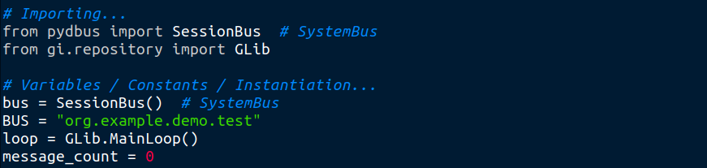
server_demo_1.py – Beginning and End Sections.
1. Session or System Bus
2. Instantiate
3. Well Known Name
1. Glib loop - instatiate
4. publish
2. Glib loop - instatiate

Slide 17
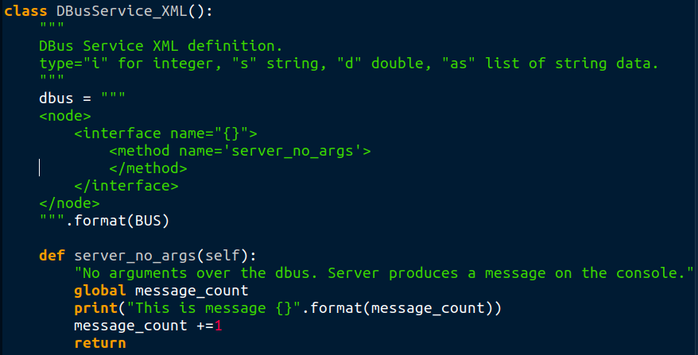
server_demo_1.py – Middle Section. Method Call performs action
5. XML defines method: server_no_args
6. Class Method: server_no_args

Slide 18
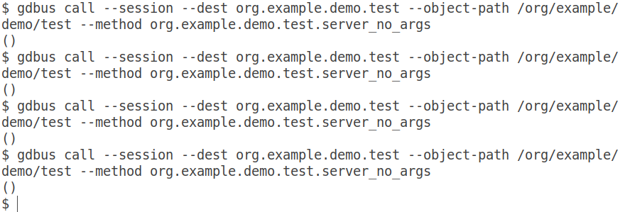
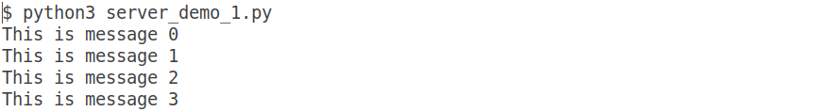
server_demo_1.py – gdbus tool testing method call
Testing Console
Received empty tuple
Server Console

Slide 19
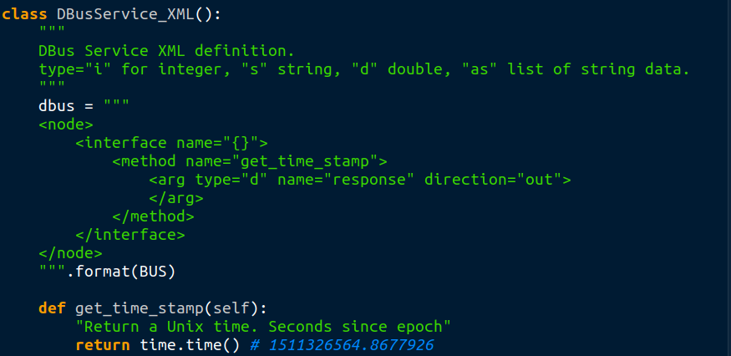
server_demo_2.py – Middle Section – Method Call sends data
Class Method:
get_time_stamp
Send out time stamp as double precision

Slide 20
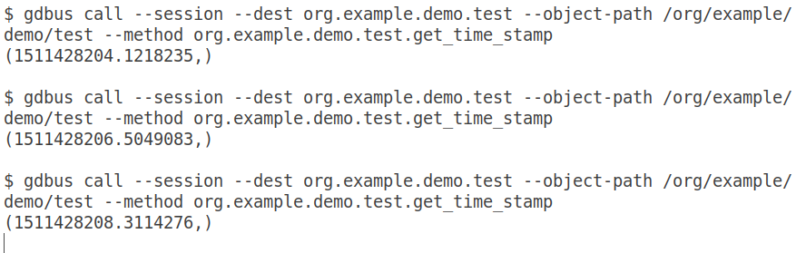
server_demo_2.py – gdbus tool testing method call
Server Console
Testing Console
Receive tuple with time stamp

Slide 21
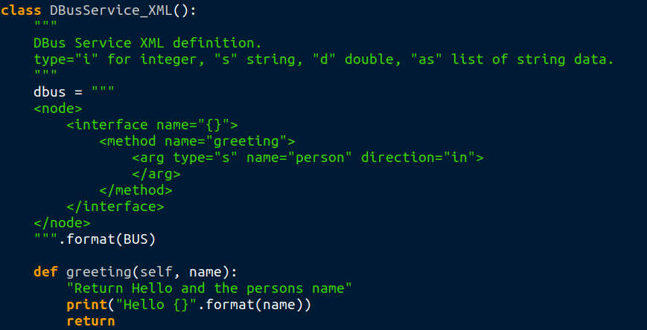
server_demo_3.py – Middle Section – Method Call receives data
Class Mehod:
Greeting receiving a value for name
Output to server console

Slide 22
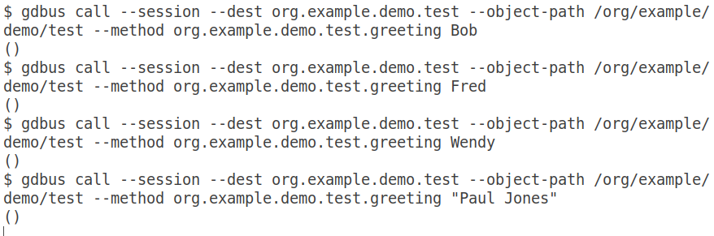
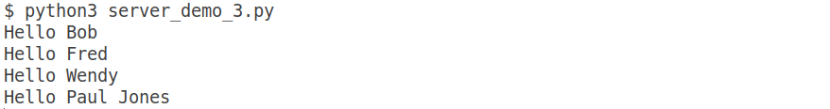
server_demo_3.py – gdbus tool testing method call
Testing Console
Receive empty tuple
Server Console

Slide 23
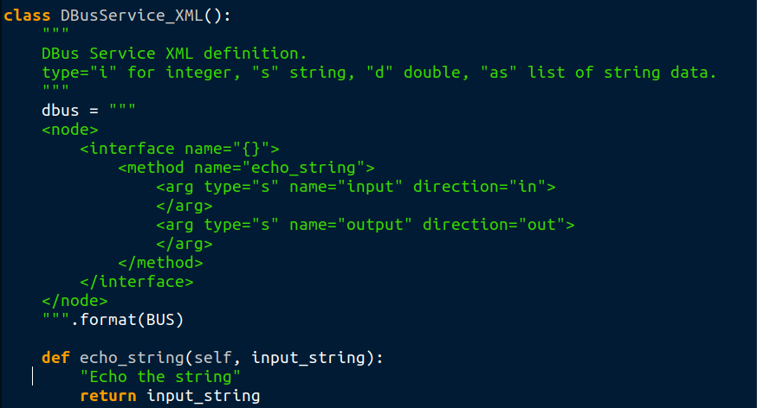
server_demo_4.py – Middle Section – Method Call send & receive data
Class Mehod:
echo_string
Return the input received

Slide 24
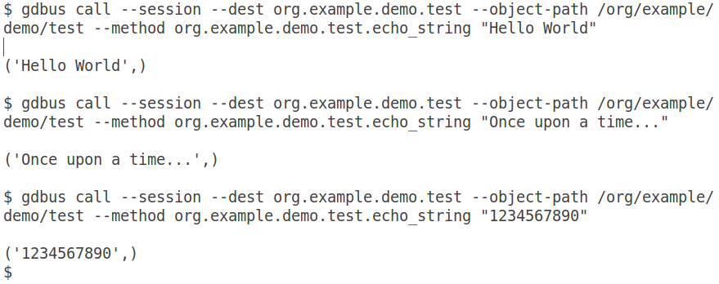
server_demo_4.py – gdbus tool testing method call
Server Console
Testing Console
Receive tuple echoing string sent

Slide 25
Developing a Client application
.

Slide 26
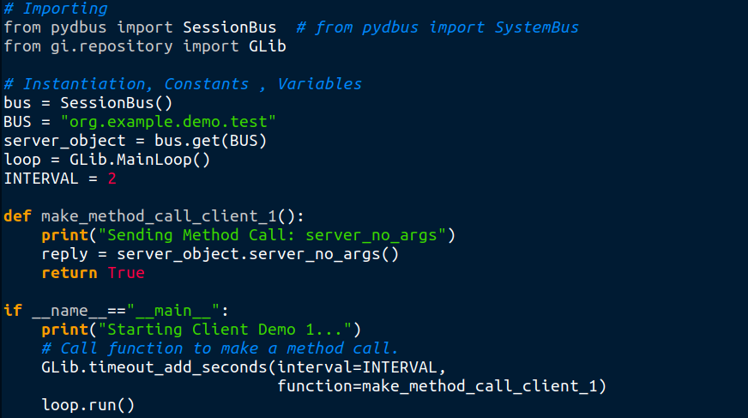
Developing a client application. client_demo_1.py
Instantiate using .get()
Method Call to server
GLib to run a repeating function every 2 seconds

Slide 27
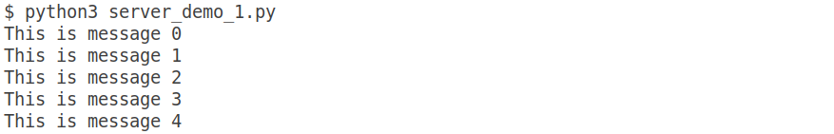
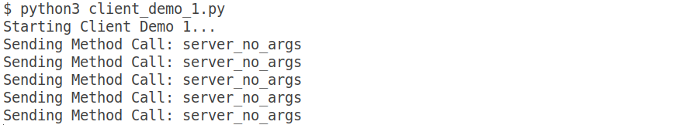
Consoles: server_demo_1.py / client_demo_1.py
Start server before starting client
Server Console
Client Console
Every 2 seconds

Slide 28
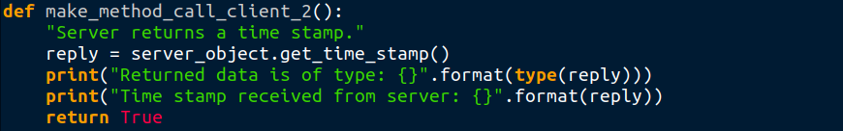
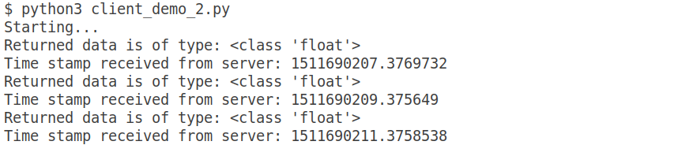
Client_2 code and Consoles: server_demo_2.py / client_demo_2.py
Server returns data.
Client sends no data
Server Console
Client Console

Slide 29
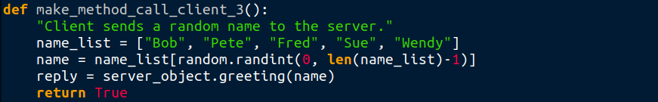
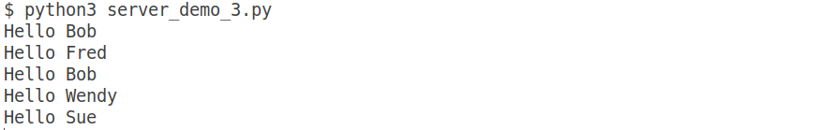

Client_3 code and Consoles: server_demo_3.py / client_demo_3.py
Client sends randomly selected “name” data
Server Console
Client Console

Slide 30
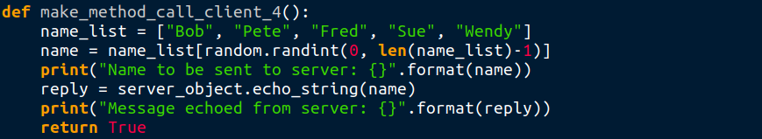
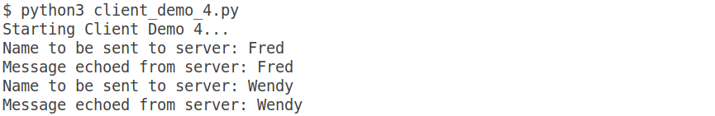
Client_4 code and Consoles: server_demo_4.py / client_demo_4.py
Client sends randomly selected “name” data
Server replies with the name
Server Console
Client Console

Slide 31
Emit a Signal.
Server application emits a signal over the D-Bus:

Slide 32
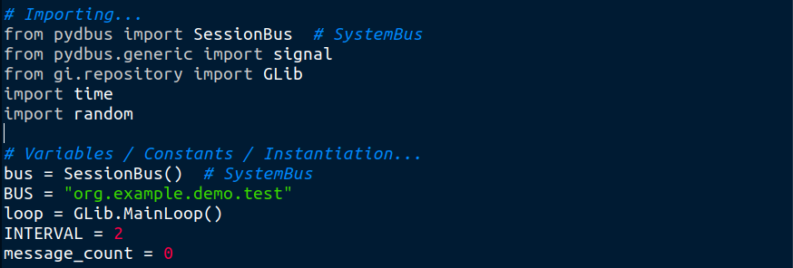
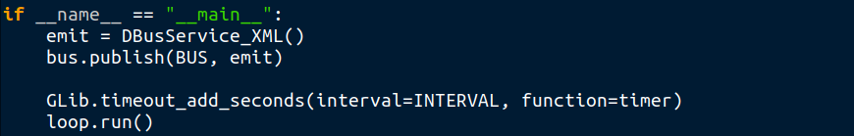
server_demo_5.py – Beginning and End Sections.
Add importing
signal
Add instantiation
Glib to runs a repeating function

Slide 33
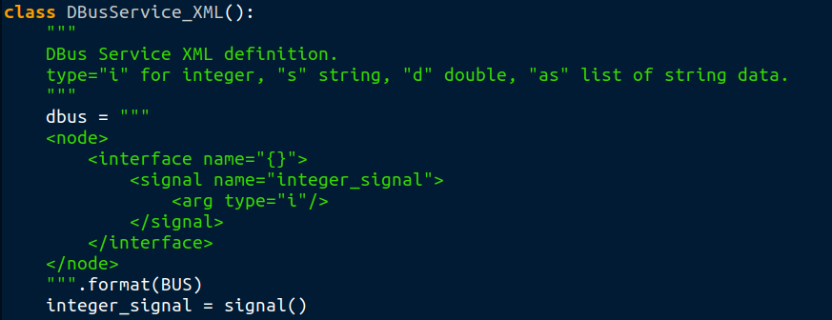
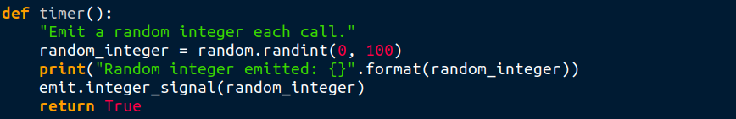
server_demo_5.py – Middle Section – Signal
Define integer_signal
Instantiate
Emit signal

Slide 34
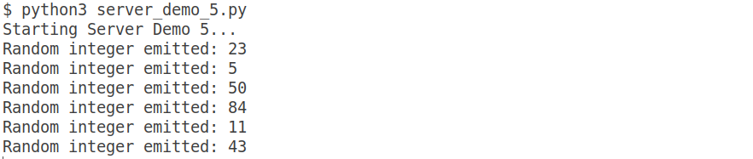
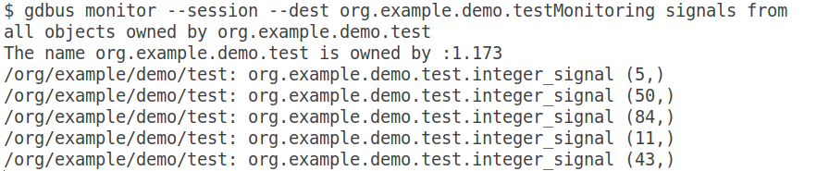
gdbus monitoring emitted signal.
Server Console
Testing Console

Slide 35
Client Subscribes to a Signal.

Slide 36
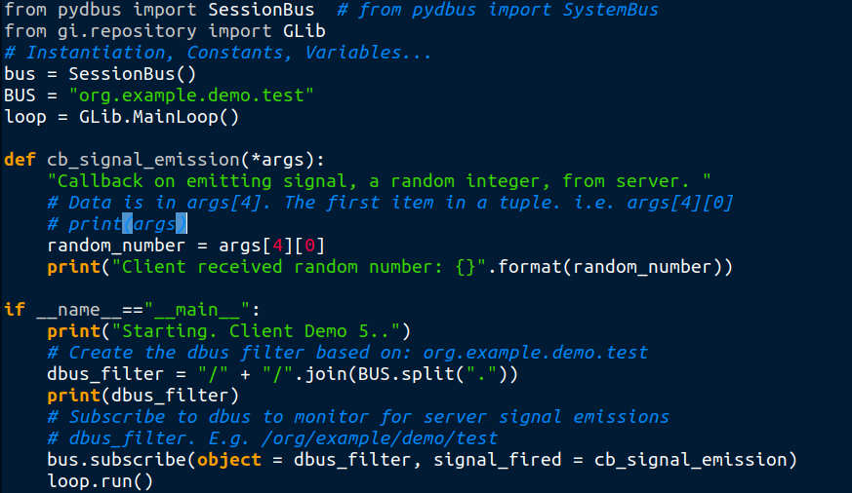
Client_5 code – Subscribe to emitted signals
Callback each time emitted data is received.
Create filter from BUS
.subscribe()

Slide 37
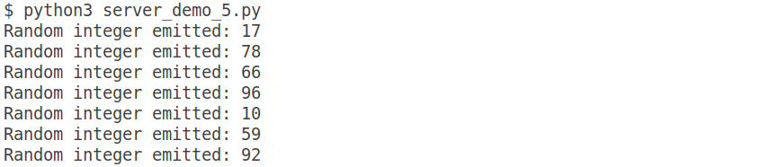
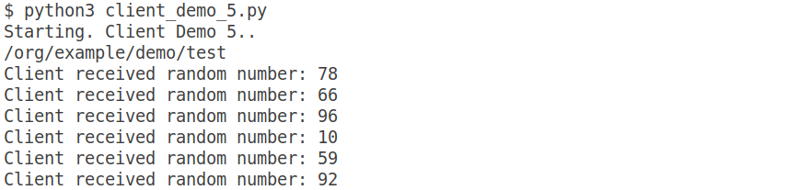
Consoles: server_demo_5.py / client_demo_5.py
Server Console
Client Console

Slide 38
Perform Demo - server_demo_6 / client_demo_6
Start server and demo gdbus receiving random numbers.
Start client. 4 x method calls and subscribed to servers emitted signals.

Slide 39
System D-Bus – rather than Session D-Bus
.

Slide 40
Client / Server applications. Session D-Bus
User #1 account
User #2 account
Server
Application
Server
Application
Session D-Bus
Session D-Bus
Client
Application
1
Client
Application
1
Client
Application
2
Message Bus Daemon – dbus-daemon

Slide 41
Client / Server applications. System D-Bus
Server
Application1
Server
Application2
Message Bus Daemon
dbus-daemon
System D-Bus
Client
Application
1
Client
Application
1
Client
Application
2
User #1 account
User #2 account

Slide 42
Client / Server applications. System D-Bus. systemd control.
root
systemd – systemctl / journalctl
Client
Application
1
Server
Application1
Server
Application2
Message Bus Daemon
dbus-daemon
System D-Bus
Client
Application
1
Client
Application
1
Client
Application
2
User #1 account
User #2 account

Slide 43
Setup and Demo System D-Bus

Slide 44
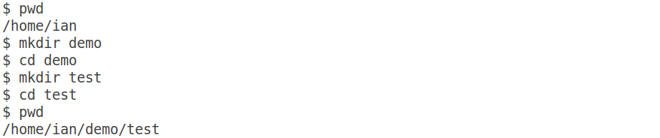
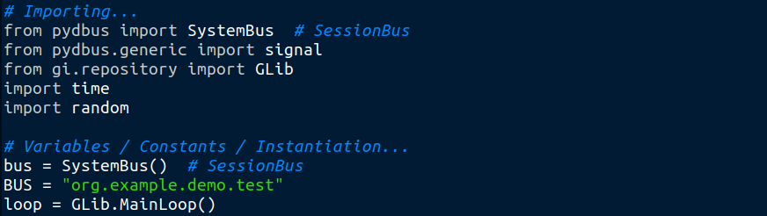
Setup and Demo System D-Bus
Create a suitable directory, then edit server code to use SystemBus...
Use System D-Bus
Use System D-Bus

Slide 45
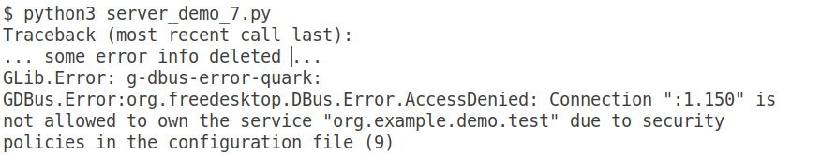
Setup and Demo System D-Bus
Error trying to run server...

Slide 46
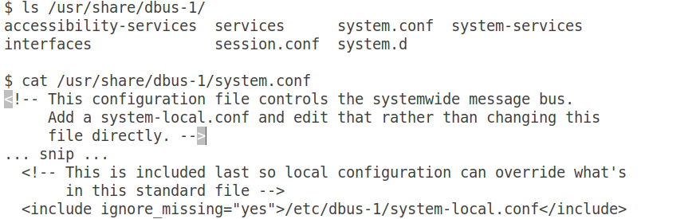
Setup and Demo System D-Bus
/usr/share/dbus-1/system.conf file suggests adding a
/etc/dbus-1/system-local.conf
Add a system-local.conf
Looks for system-local.conf

Slide 47
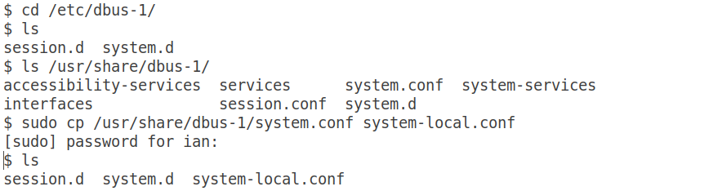
Setup and Demo System D-Bus
Copy template from /usr/share/dbus-1/system.conf
to /etc/dbus-1/system-local.conf
system-local.conf (template)

Slide 48
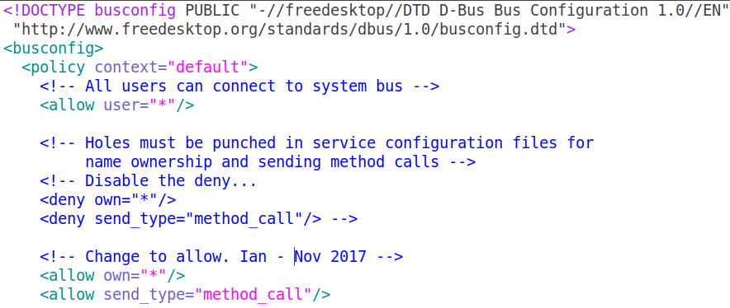
Setup and Demo System D-Bus
Edit system-local.conf to only contain <policy context=”default” section
Comment out the deny’s
Insert the allows
End of file. See this file in server_demo_7.py comments

Slide 49
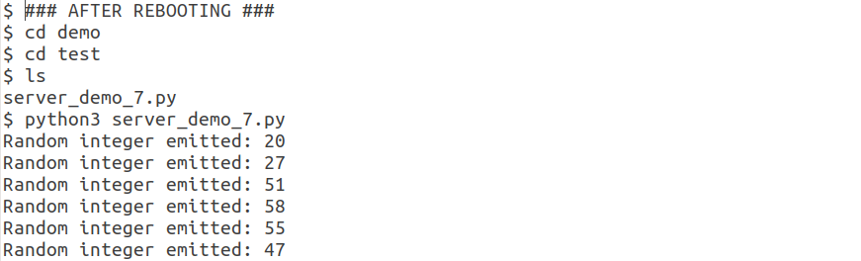
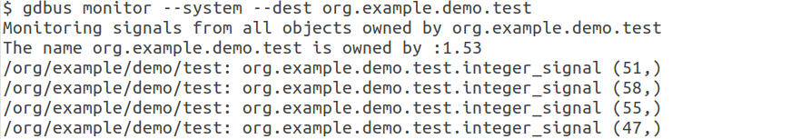
System D-Bus / systemd
After Reboot. Launch the server, and test it is emitting with gdbus-tool
Server Console
Now monitoring system bus
before was session bus
Testing Console

Slide 50
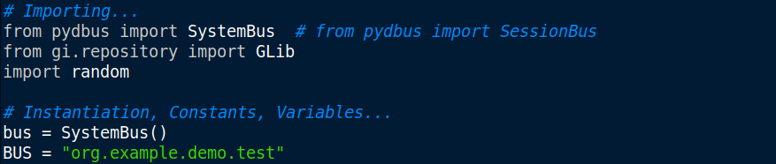
Setup and Demo System D-Bus
Edit client_demo_7.py to use the SystemBus
Changed to SystemBus
SystemBus

Slide 51
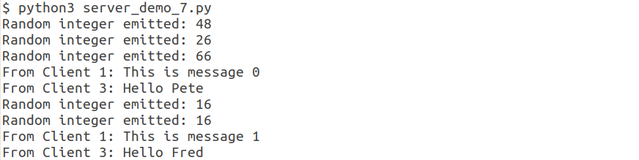
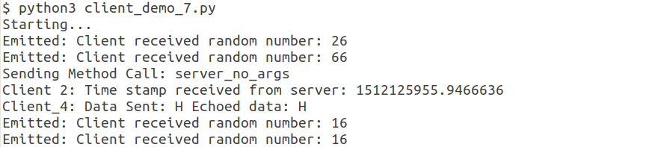
Setup and Demo System D-Bus
Check Server and Client are using System D-Bus OK
Server Console
Client Console

Slide 52
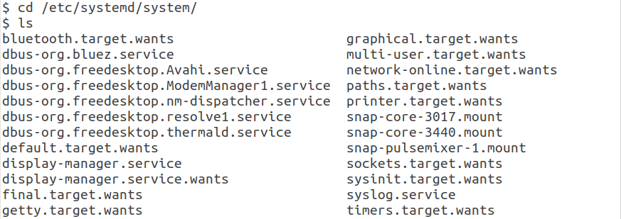
Setup systemd
Now get some systemd things running.
Files currently in /etc/systemd/system/...

Slide 53
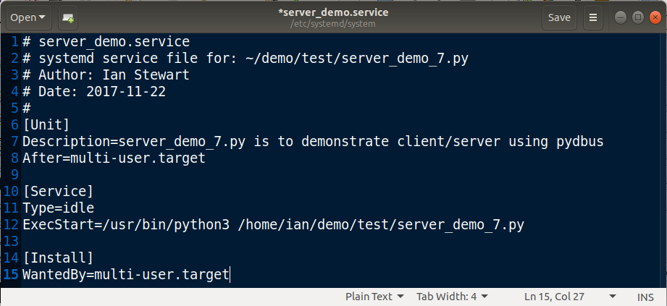
Setup systemd
Create /etc/systemd/system/server_demo.service

Slide 54
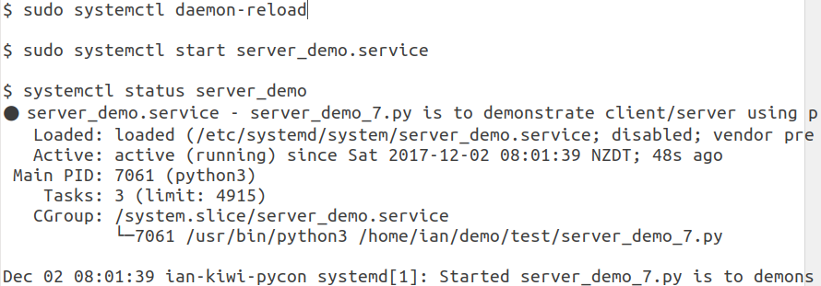
Setup systemd
Use systemctl to reload and start server_demo_7.py
daemon-reload
start service to launch server_demo_7.py
Use systemctl “enable” for server_demo_7.py starts on re-boots...

Slide 55
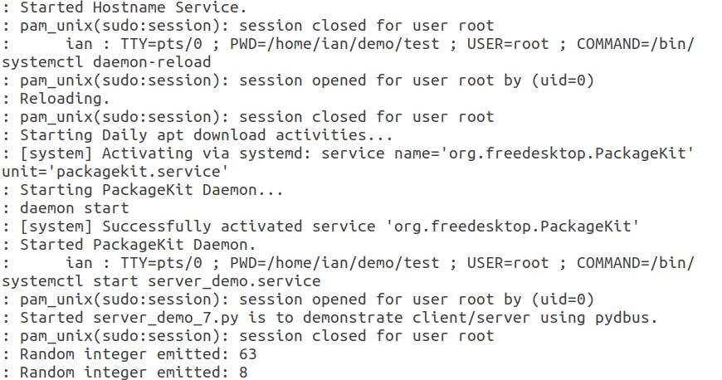
Setup systemd
$ journalctl -e (trimmed). For debugging better to run server from bash
Reload systemd manager configuration
Start the server
print() goes into the log. Probably don’t want this.

Slide 56
systemd
Notes:
Client application may also be started by systemctl
Alternative is to insert into server code a subprocess.call() to start client.
Having the code in a User account ~/demo/test is easier to troubleshoot / edit the code.
Final code version could be moved.
Files created by server app, will be owned by root when created after launching with systemctl. May need some chown().

Slide 57
Demo – with GUI clients.

Slide 58
Example with Cycle Analyst.

Slide 59
Any Questions?
Note:
All demo code and presentation material is available at: https://github.com/irsbugs/kiwipycon2017

Slide 60
End.
Thank you.

