Slide 1
PySide6 – Qt for Python
A Python wrapper for Qt version 6
Hamilton Python Users Group
Ian Stewart
10 Oct 2022

Slide 2
PySide6
Presentation Contents:
GUI Toolkits and their Python wrappers.
History of Qt and PySide
Installation of PySide/Qt6
Review of what is installed.
Utilities
Introduce pyside6-assistant.py program
Demo pyside6-assistant.py.
Code highlights / bugs in pyside6-assistant.py

Slide 3
Open Source – GUI Tookits.
GUI Toolkit | Language | Version | Python Bindings
Tk/Tcl | C | 8.6 | Tkinter
Gtk | C | 4 | PyGObject Introspection – GIR - GTK4
Qt | C++ | 6.4 | 1. PyQt6 – Riverbank Computing. 2. PySide6 – The Qt Company.

Slide 4
Qt History
1991 – Haavard Nord and Eirik Chambe-Eng from Norway, started writing Qt.
1994 – founded Trolltech
2006 – IPO of Trolltech
2008 – Nokia Corporation acquire Trolltech
2008 – Trolltech renamed Qt Software
2009 – Renamed Qt Development Frameworks
2012 – Nokia sold to Digia
2014 – Digia formed “The Qt Company” wholly owned subsidiary.
2016 – The Qt Company went public on NASDAQ Helsinki.
Headquarters – Espoo Finland.
445 Employees world wide.
Website: www.qt.io
Repository: https://github.com/qt/

Slide 5
PySide History.
2009 – Initial Release by Qt.
'Side' is Finnish for binding.
2022-09-12 – PySide6 – V6.3.2 currently available on PyPI
PySide supports Linux, macOS, and Microsoft Windows.
“PySide” supports Qt 4
2015 - “PySide2” to support Qt 5.
2020 – Released “PySide6” supports Qt 6 – for Python V3.6+
“PySide” marketed as “Qt for Python”.
https://wiki.qt.io/Qt_for_Python
Tutorials: https://doc.qt.io/qtforpython/tutorials/index.html

Slide 6
PySide6: Installation slides here

Slide 7
PySide6 Assistant program provides:
Help based on Tree for selection method.
Help based on Search string method
Search through the provided help information. Forward/backwards, case sensitive.
Display Icons supplied.
Search through Python example programs.
  Display code lines either side of a match.
  Ability to display whole program in separate window.
Tree to select an example program and run it.
  Display the example python programs code.
  List all files in the example programs directory.

Slide 8
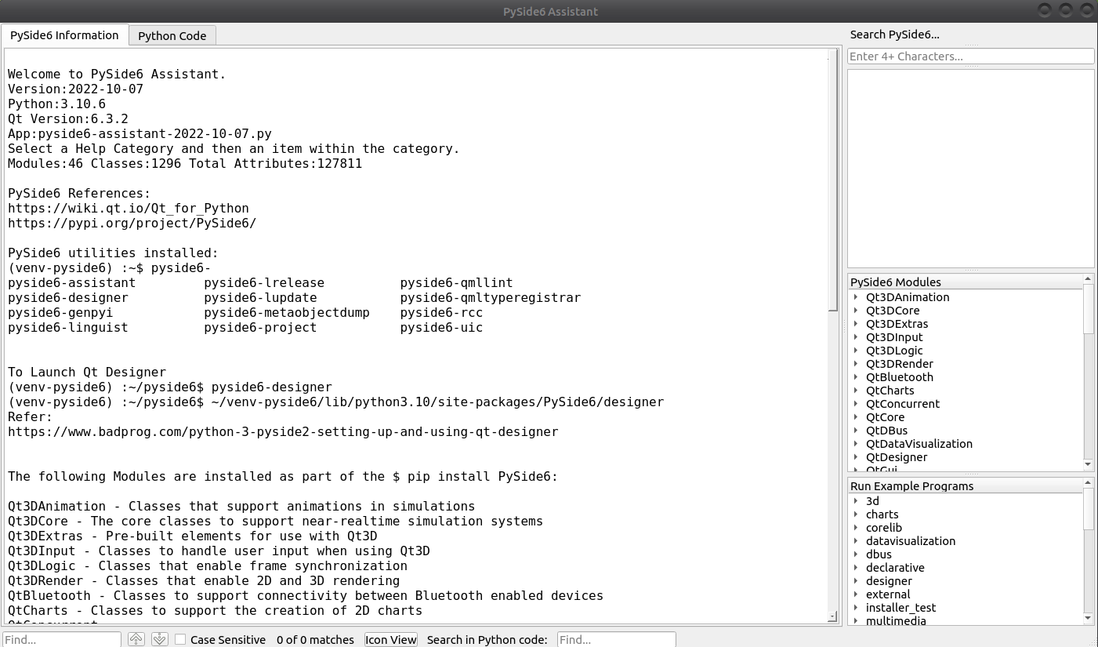

Slide 9
Display Help Information or Python Program Code.
Search
help
Tree Selection
help
Select and launch Example Programs / Display Code
Search Info
Icon
Search Code

Slide 10
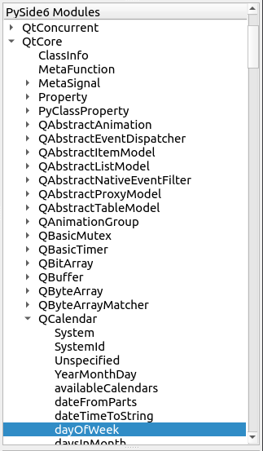
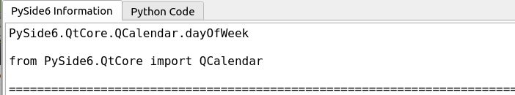
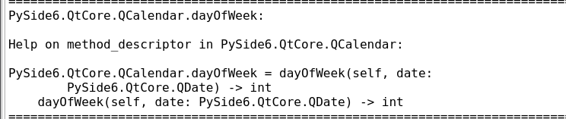
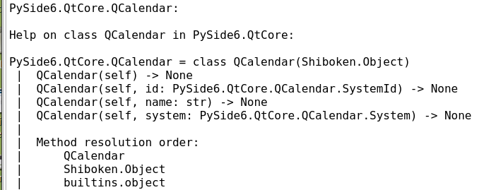

Tree Selection Example:
Help Information
QtCore
Module
Suggested Import
.dayOfWeek Help
QCalendar Help
QCalendar
Class
Attribute
Method

Slide 11
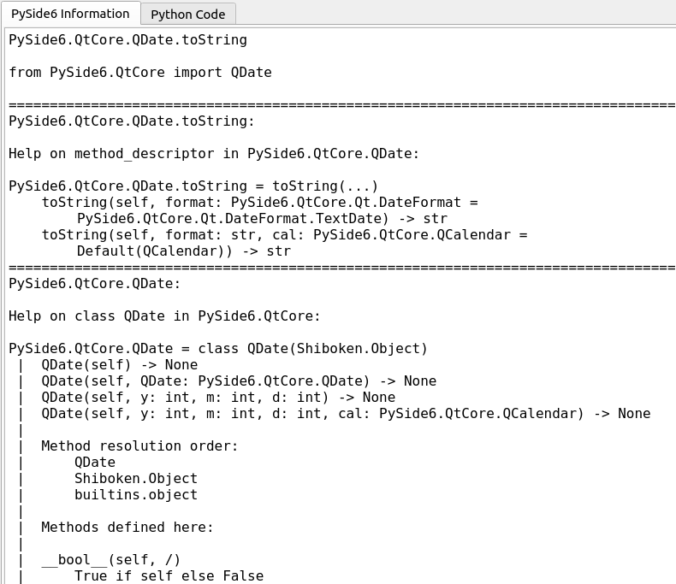
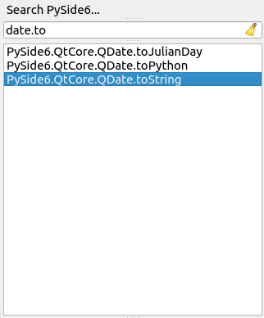

Search Selection Example:
Help Information
Search string
Suggested Import
QDate.toString Help
QDate Help

Slide 12
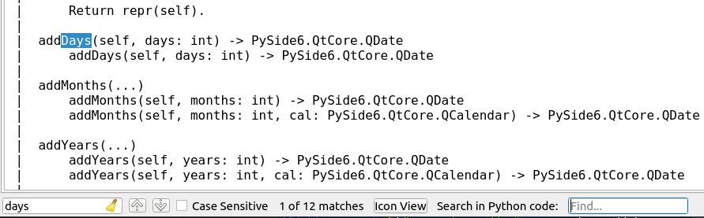
Search through the help information of QDate:
Help Information

Slide 13

Icon View:
Separate window opens and displays this introduction
Qt includes Icons in that may be made use of. They are acquired from QtWidgets.QStyle.StandardPixmap. Their names all start with the letters "SP_".
For example, to add the "Qt" icon so that it shows in the System Tray:
pixmapi = getattr(QtWidgets.QStyle.StandardPixmap, "SP_TitleBarMenuButton")
icon = self.style().standardIcon(pixmapi)
self.setWindowIcon(icon)

Slide 14
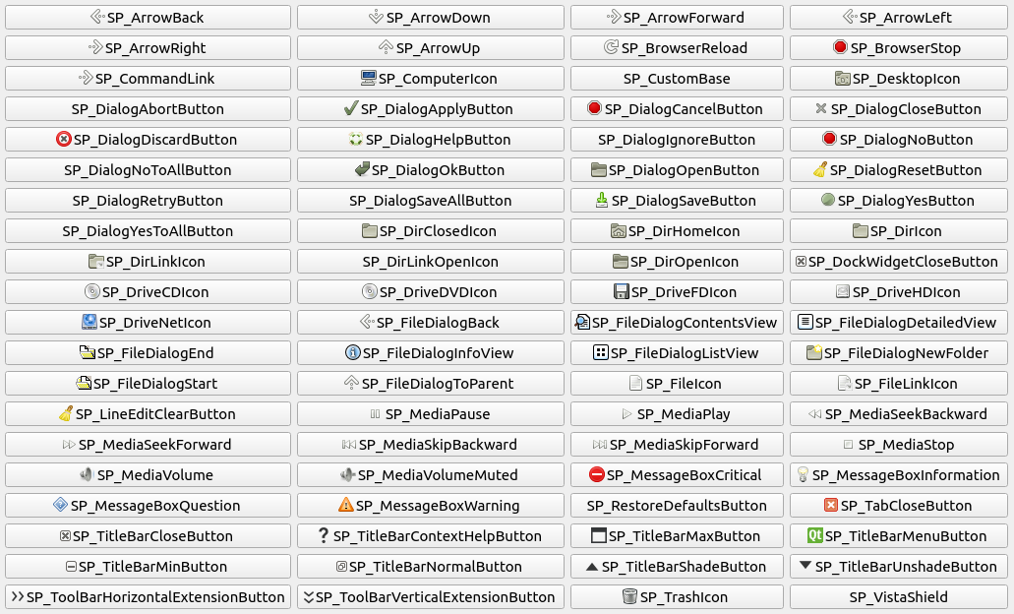
Icon
View

Slide 15
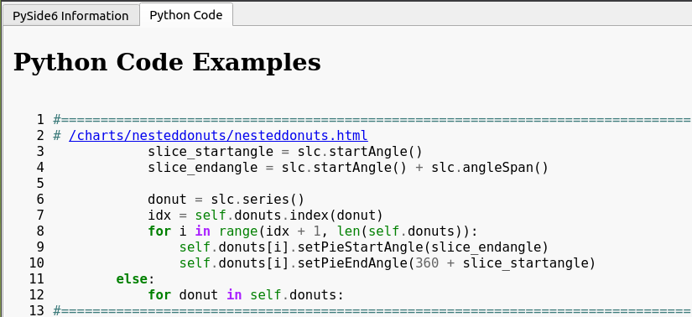
Search through Python example code:
Click to open a separate window that displays all the code in nesteddonuts.py
“.index” - 5th line of code
28 more snippets of code

Slide 16
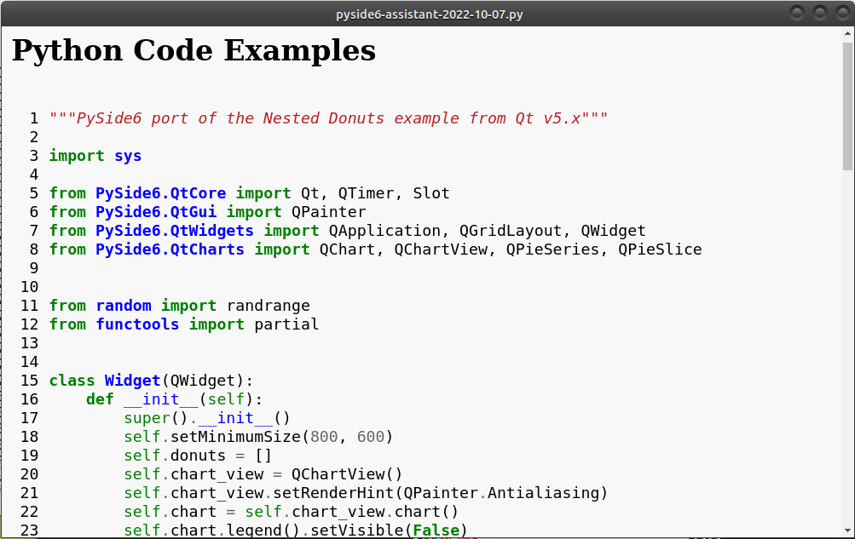
Separate window that displaying all the code in nesteddonuts.py

Slide 17
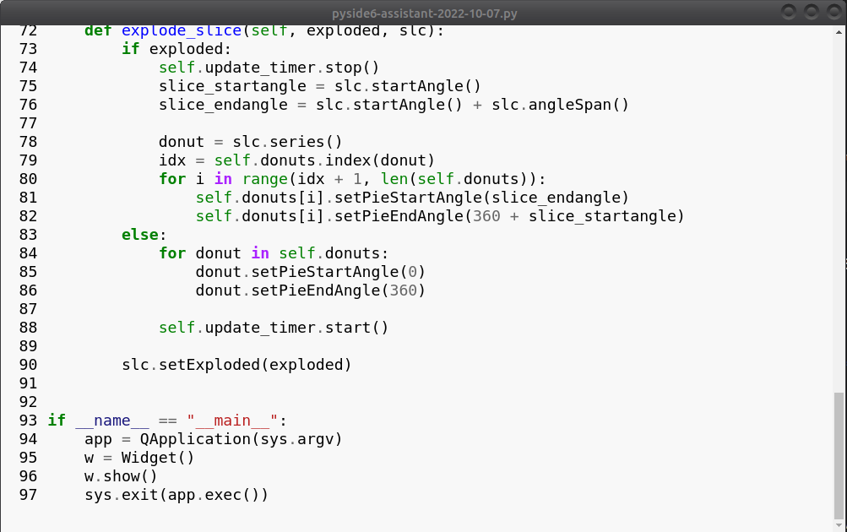
Icon
View
“.index” in snippet

Slide 18
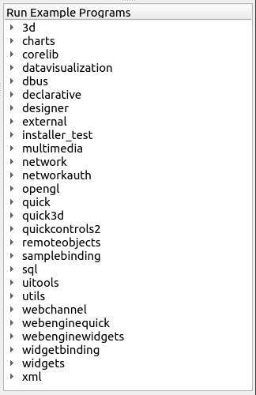
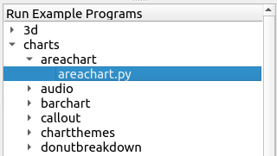
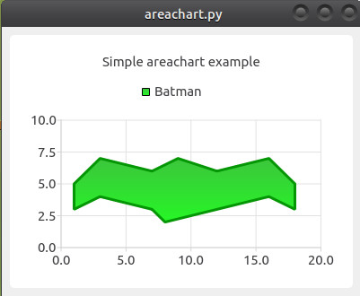
Tree Selection to run example Programs. E.g. Area Chart:

Slide 19
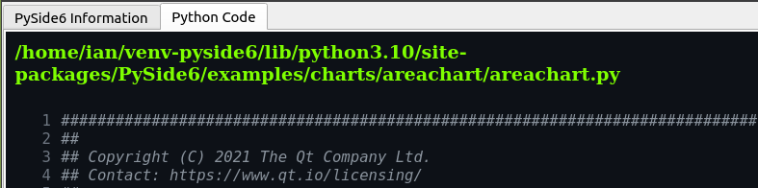
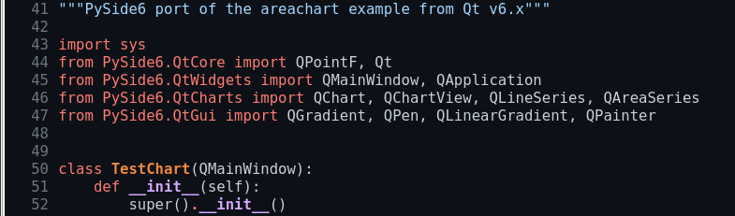
Tree Selection to run example Programs. Area Chart python code:

Slide 20
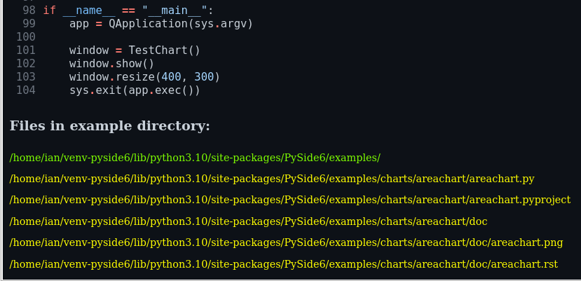
Tree Selection to run example Programs. Area Chart file list:
Folder for examples
Area Chart files

Slide 21
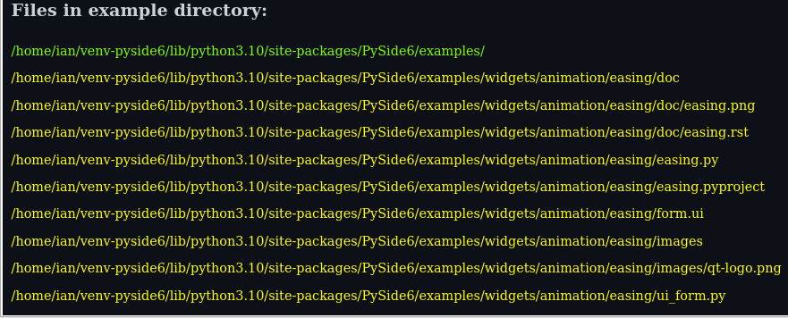
Tree Selection to run example Programs. Animation Easing file list:
Animation Easing files
form.ui converted by
pyside6-uic to ui_form.py

Slide 22
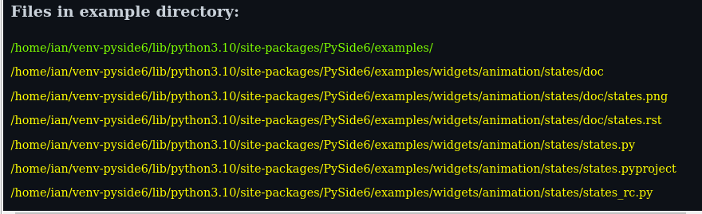
Tree Selection to run example Programs. Animation States file list:
Animation States files
Contains pyside6-rcc generated file states_rc.py

Slide 23
PySide6 - Demo
Tkinter:
Tcl
Highlights / Bugs of pyside-assistant.py code

