Slide 1
PySide6 – Qt for Python
pyside6-assistant.py
Hamilton Python Users Group
Ian Stewart
10 Oct 2022

Slide 2
PySide6 Assistant program provides:
Help based on a Tree selection method.
Help based on a Search string method
Search through the provided help information. Forward/backwards, case sensitive selection.
Display Icons supplied.
Search through Python example programs:
  Display code lines either side of a match.
  Ability to display whole program in separate window.
Tree to select an example program and run it:
  Display the example python programs code.
  List all files in the example programs directory.

Slide 3
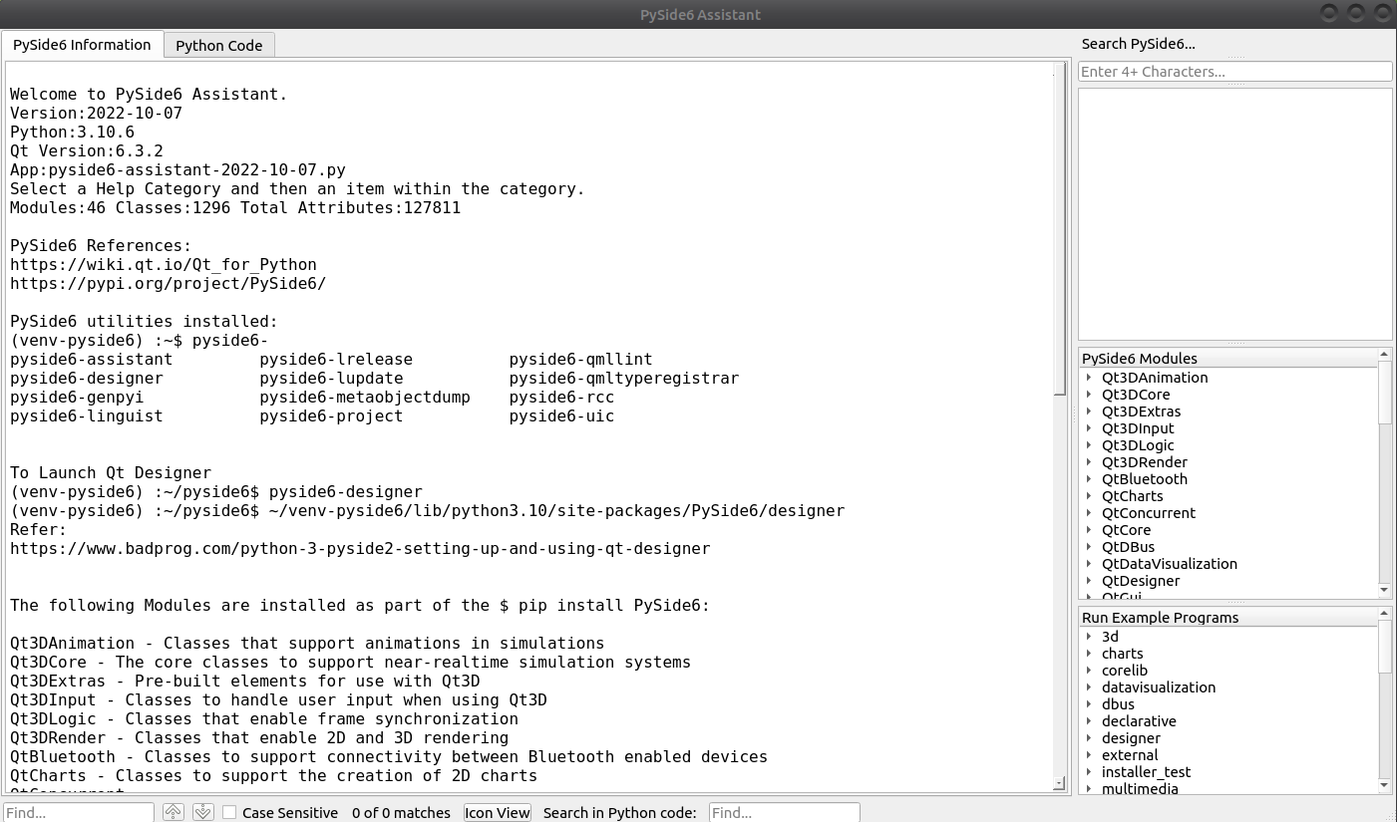

Slide 4
Display Help Information or Python Program Code.
Search
help
Tree Selection
help
Select and launch Example Programs / Display Code
Search Info
Icon
Search Code

Slide 5
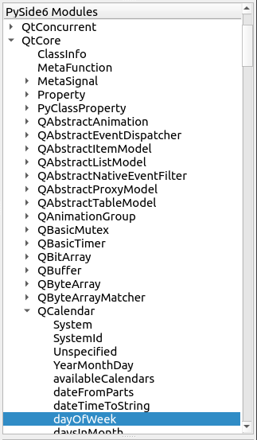
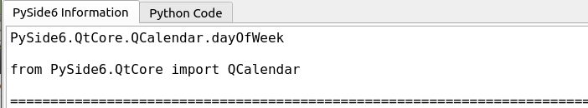
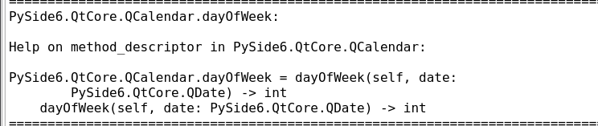
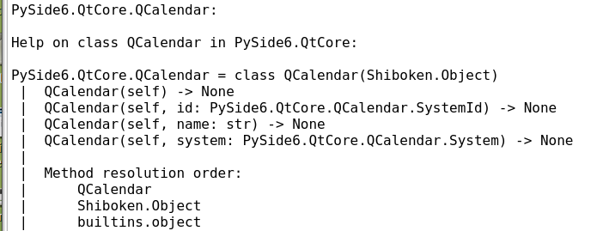

Tree Selection Example:
Help Information
QtCore
Module
Suggested Import
.dayOfWeek Help
QCalendar Help
QCalendar
Class
Attribute
Method

Slide 6
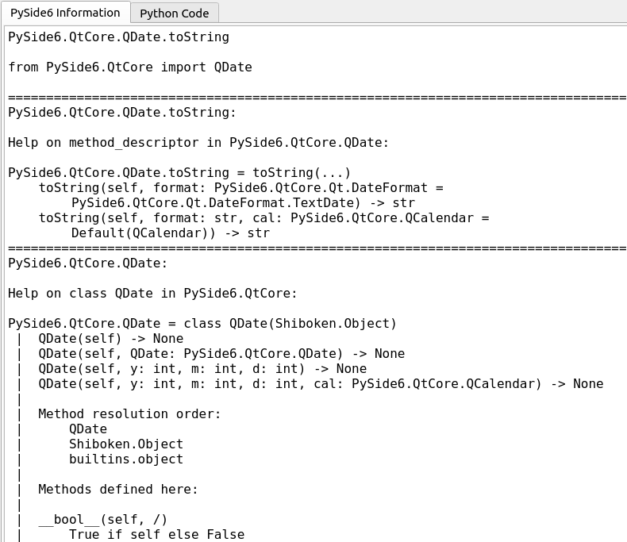
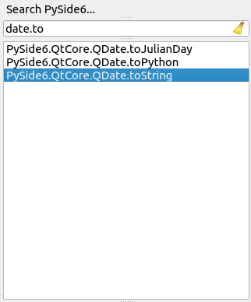

Search Selection Example:
Help Information
Search string
Suggested Import
QDate.toString Help
QDate Help

Slide 7
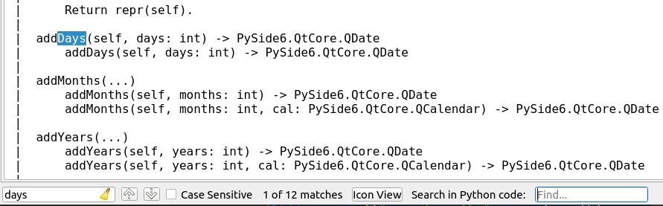
Search through the help information of QDate:
Help Information

Slide 8

Icon View:
Separate window opens and displays this introduction
Qt includes Icons in that may be made use of. They are acquired from QtWidgets.QStyle.StandardPixmap. Their names all start with the letters "SP_".
For example, to add the "Qt" icon so that it shows in the System Tray:
pixmapi = getattr(QtWidgets.QStyle.StandardPixmap, "SP_TitleBarMenuButton")
icon = self.style().standardIcon(pixmapi)
self.setWindowIcon(icon)

Slide 9
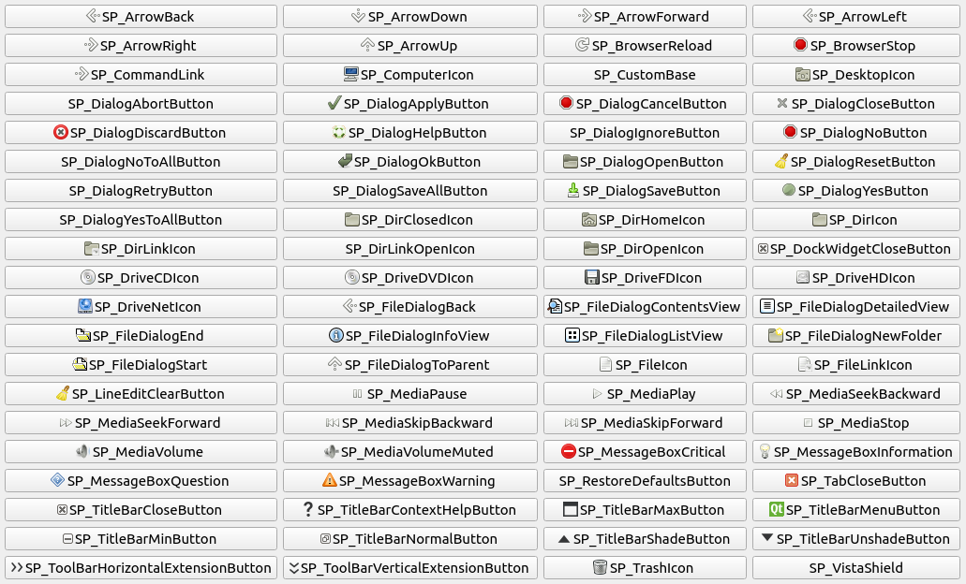
Icon
View

Slide 10
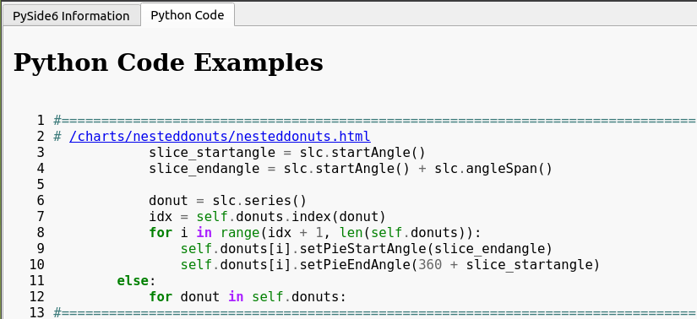
Search through Python example code:
Click to open a separate window that displays all the code in nesteddonuts.py
“.index” - 5th line of code
28 more snippets of code

Slide 11
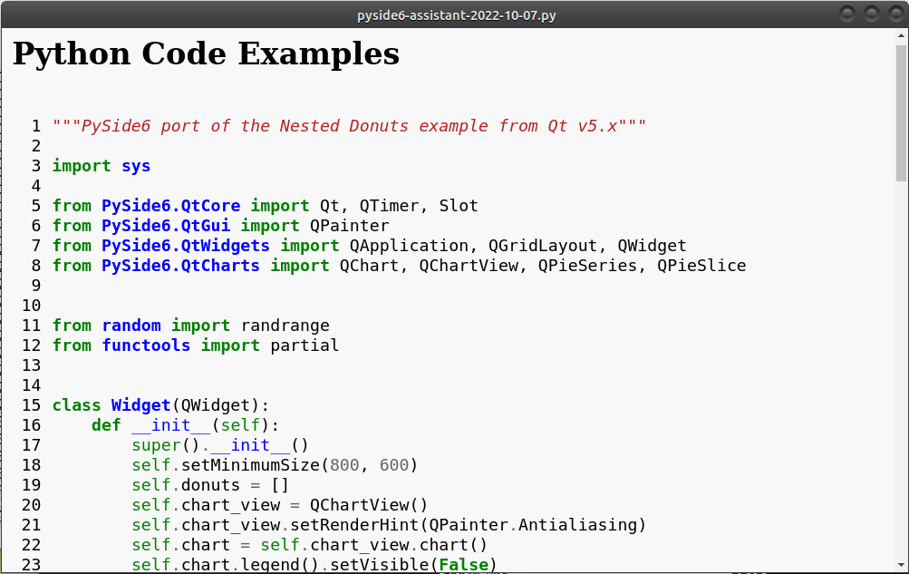
Separate window that displaying all the code in nesteddonuts.py

Slide 12
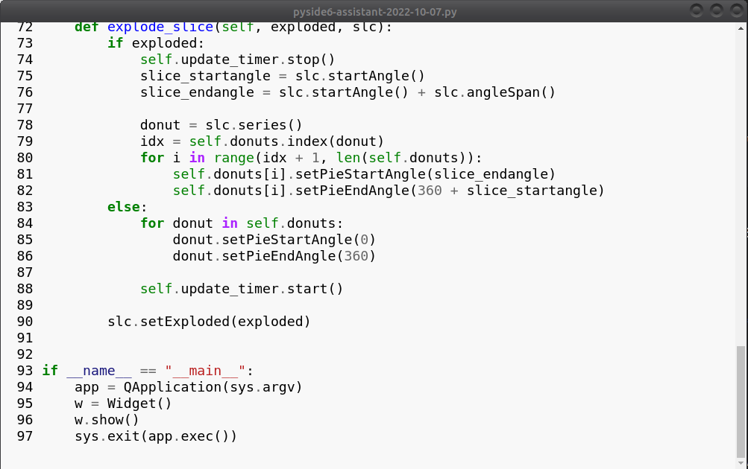
Icon
View
“.index” in snippet

Slide 13
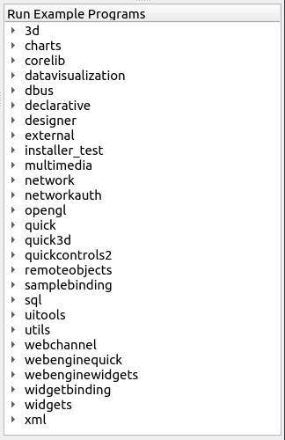
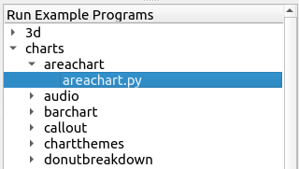
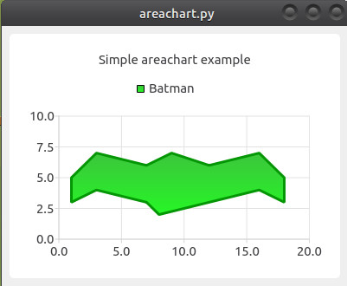
Tree Selection to run example Programs. E.g. Area Chart:

Slide 14
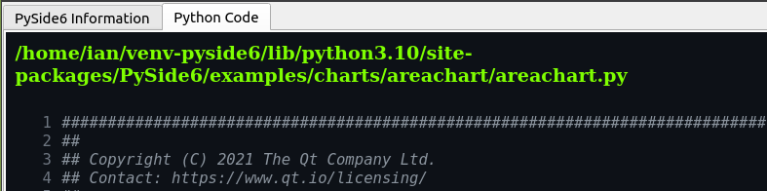
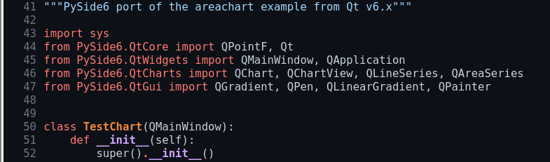
Tree Selection to run example Programs. Area Chart python code:

Slide 15
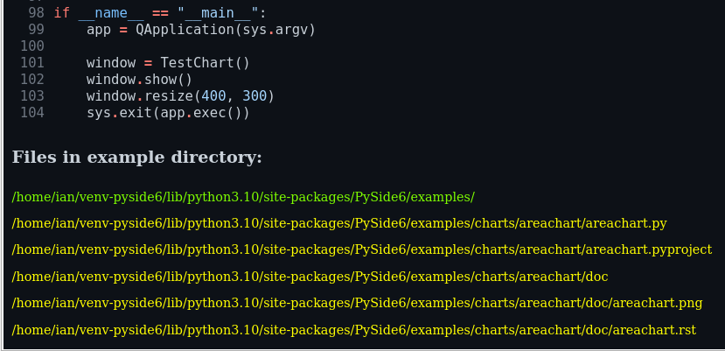
Tree Selection to run example Programs. Area Chart file list:
Folder for examples
Area Chart files

Slide 16
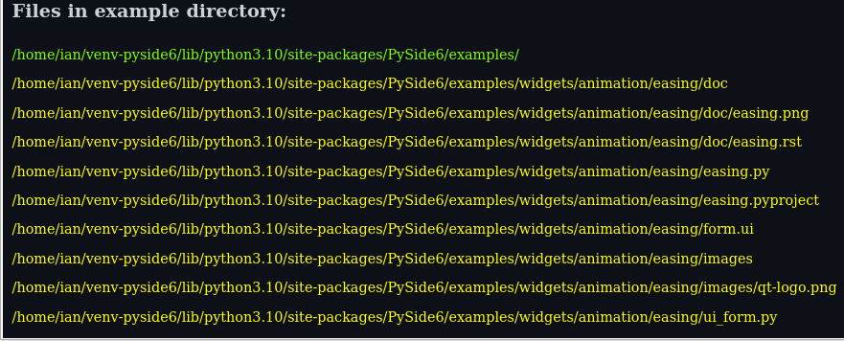
Tree Selection to run example Programs. Animation Easing file list:
Animation Easing files
form.ui converted by
pyside6-uic to ui_form.py

Slide 17
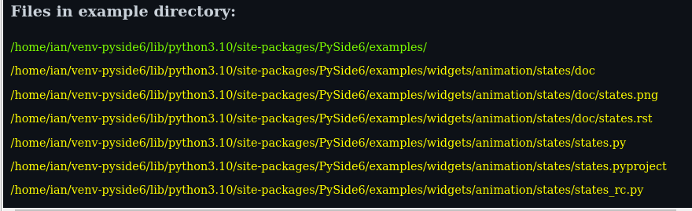
Tree Selection to run example Programs. Animation States file list:
Animation States files
Contains pyside6-rcc generated file states_rc.py

Slide 18
PySide6
Demo
Highlights / Bugs of pyside6-assistant.py code

