Slide 1
PySide6 – “Qt for Python”
A Python wrapper for Qt version 6
Hamilton Python Users Group
Ian Stewart
10 Oct 2022

Slide 2
PySide6
Presentation Overview:
GUI Toolkits and their Python wrappers.
History of Qt and PySide
Installation of PySide/Qt6
Review of what is installed.
Utilities
Introduce pyside6-assistant.py program
Demo pyside6-assistant.py.
Code highlights / bugs in pyside6-assistant.py

Slide 3
Open Source – GUI Tookits.
GUI Toolkit | Language | Version | Python Bindings
Tk/Tcl | C | 8.6 | Tkinter
Gtk | C | 4 | PyGObject Introspection – GIR - GTK4
Qt | C++ | 6.4 | 1. PyQt6 – Riverbank Computing. 2. PySide6 – The Qt Company.

Slide 4
Qt History
1991 – Haavard Nord and Eirik Chambe-Eng from Norway, started writing Qt.
1994 – founded Trolltech
2006 – IPO of Trolltech
2008 – Nokia Corporation acquire Trolltech
2008 – Trolltech renamed Qt Software
2009 – Renamed Qt Development Frameworks
2012 – Nokia sold to Digia
2014 – Digia formed “The Qt Company” wholly owned subsidiary.
2016 – The Qt Company went public on NASDAQ Helsinki.
Headquarters – Espoo Finland.
445 Employees world wide.
Website: www.qt.io
Repository: https://github.com/qt/

Slide 5
PySide History.
2009 – Initial Release by Qt.
'Side' is Finnish for binding.
2022-09-12 – PySide6 – V6.3.2 currently available on PyPI
PySide supports Linux, macOS, and Microsoft Windows.
“PySide” supports Qt 4
2015 - “PySide2” to support Qt 5.
2020 – Released “PySide6” supports Qt 6 – for Python V3.6+
“PySide” marketed as “Qt for Python”.
https://wiki.qt.io/Qt_for_Python
Tutorials: https://doc.qt.io/qtforpython/tutorials/index.html

Slide 6
PySide6/Qt Installation

Slide 7
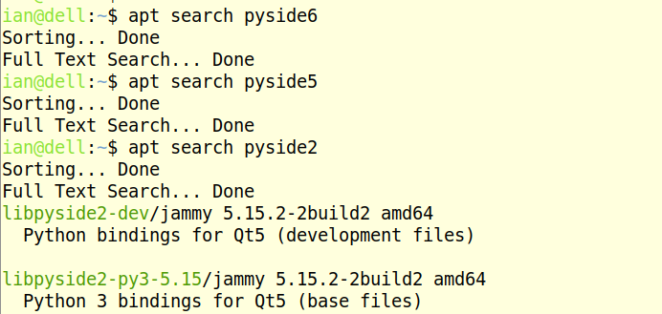
PySide6 Install – Is Pyside6 in distro’s repository?
E.g. Not in 22.04 Ubuntu...

Slide 8
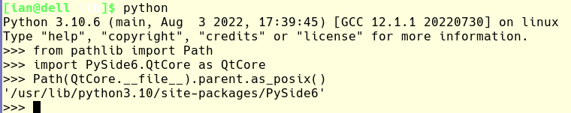
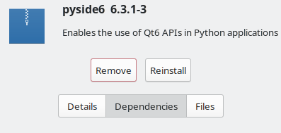
PySide6 Install – Is Pyside6 in distro’s repository?
E.g. Mangaro KDE includes PySide6 in /usr/lib...
Pacman: About half of the PySide6 modules installed by default.

Slide 9
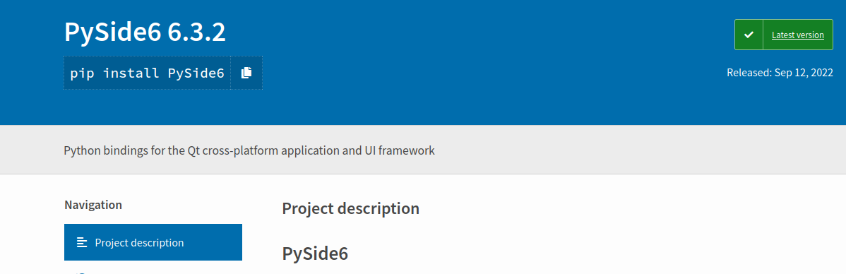
PySide6 Install – Availble in PyPI

Slide 10
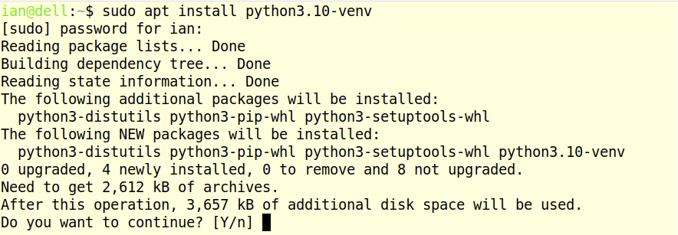
PySide6 Install – Create Virtual Environment

Slide 11
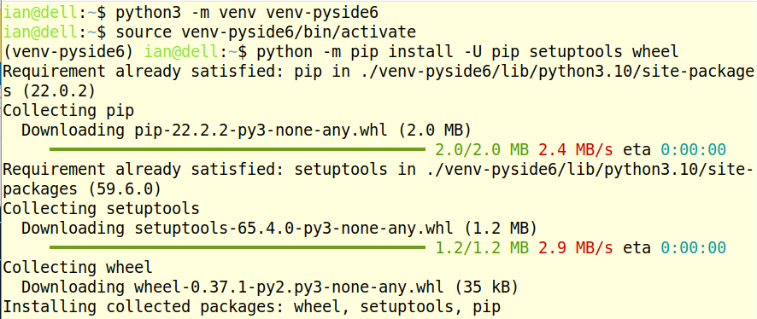
PySide6 Install – Create Virtual Environment

Slide 12
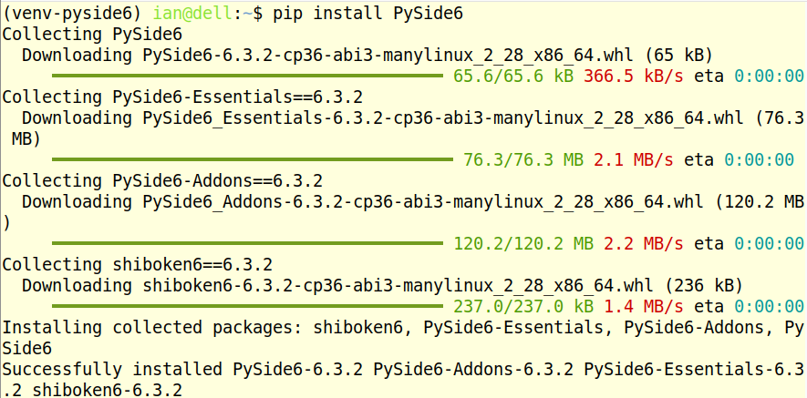
PySide6 Install – Create Virtual Environment

Slide 13
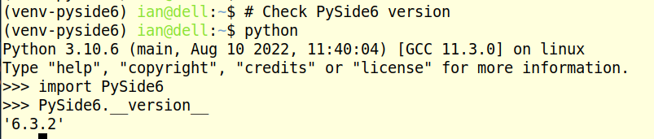
PySide6 Install – Check Version
Make a working directory...

Slide 14
PySide6 Install – What’s downloaded?...
PySide6 Library containing 46 Python modules.
Help on all Modules, Classes, attributes.
Icons.
Example Python/PySide6 programs.
Utilities. Including:
    pyside6-designer. Use “ui loader”.
    pyside6-uic. User Interface Compiler.
    pyside6-rcc. Resource Compiler.
    ...more...

Slide 15
PySide6 – Naming conventions...
PySide6 Library.
“Qt” – Prefix for a Module. E.g. QtWidgets
“Q” – Prefix for a Class. E.g. QPushButton
Attributes – lower camel case. E.g. .setText()

Slide 16
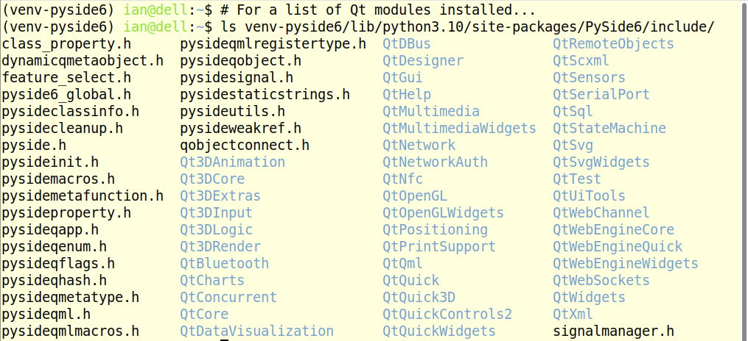
PySide6 – Qt Modules installed
46 Qt Modules...

Slide 17
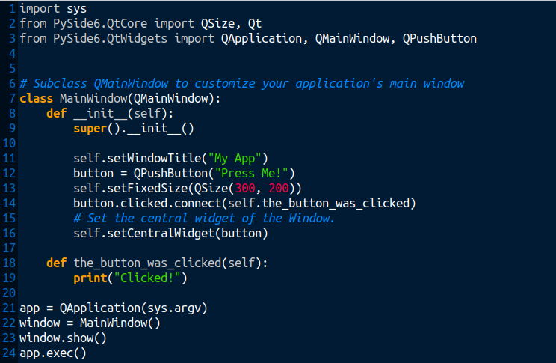
PySide6 – Write a “press me” program
Importing
Create MainWindow
Create Pushbutton
Define Pushbutton callback
Pushbutton callback
Launch

Slide 18
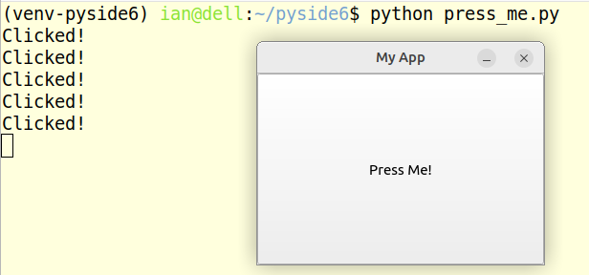
PySide6 – “Press Me” program...

Slide 19
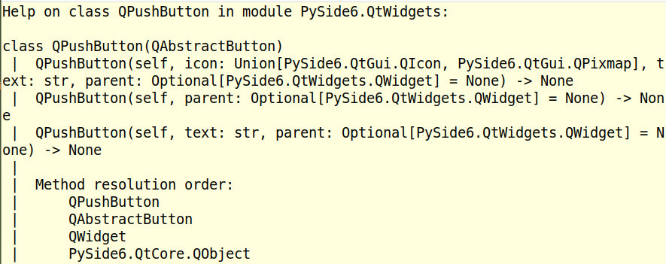
PySide6 – help()...

Slide 20
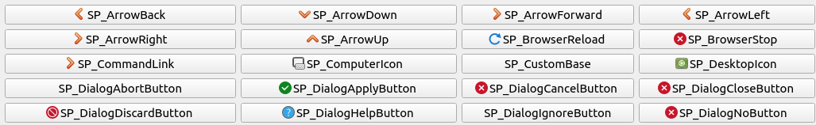
PySide6 – Icons...
About 80 icons are supplied. E.g.
Example code for adding supplied icon...

Slide 21
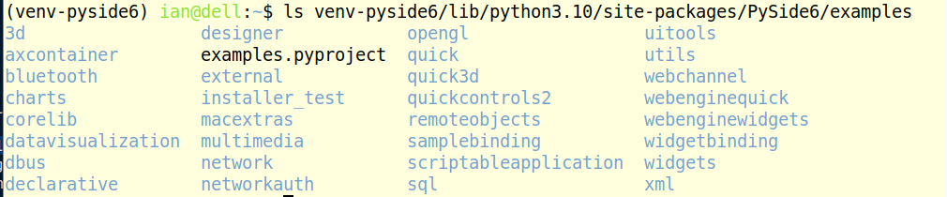
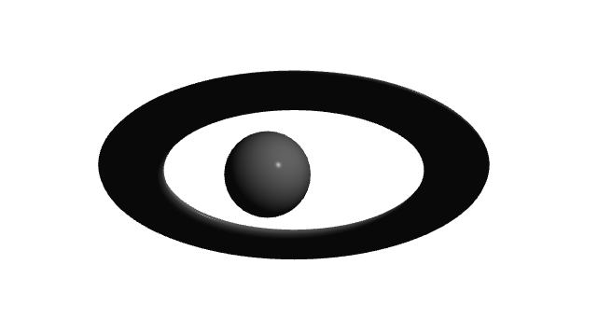
PySide6 – Python Example programs...

Slide 22
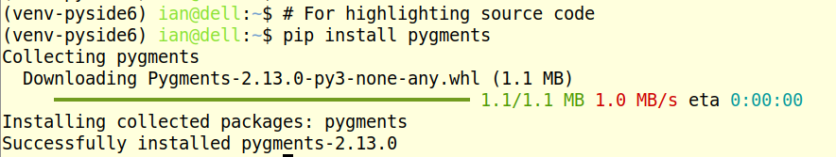
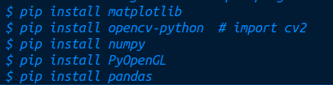
PySide6 Install – Additional Python modules...
Additional Python modules to run examples...

Slide 23
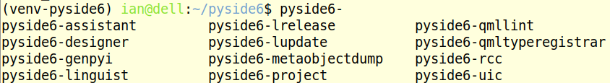
PySide6 – Utilities. Executables Installed...

Slide 24
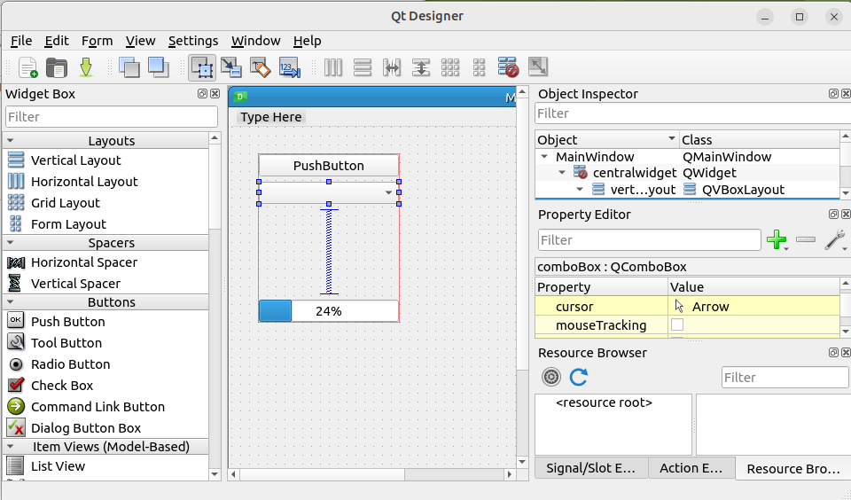
PySide6 – pyside6-designer...

Slide 25
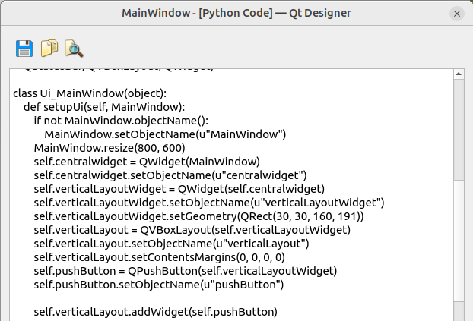
PySide6 – Designer Preview. Python code...

Slide 26
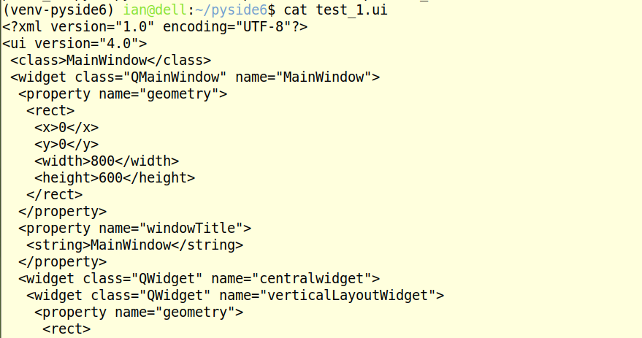
PySide6 – Designer GUI saved as ui file...

Slide 27
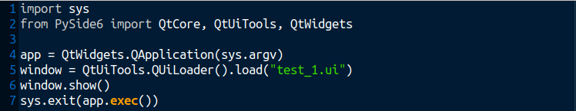
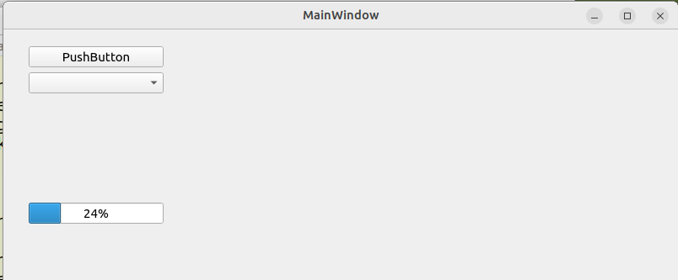
PySide6 – Program to use ui file. Using “ui loader”...

Slide 28
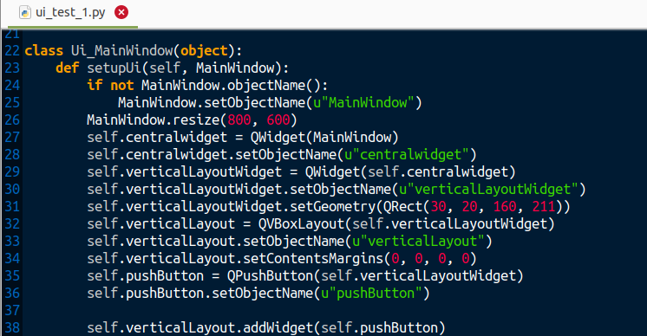
PySide6 – Alternative Method – Use “pyside6-uic” 1/2

Slide 29
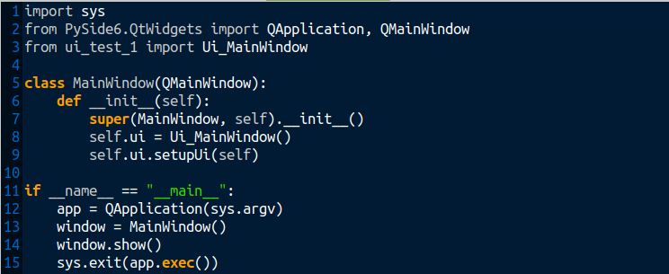
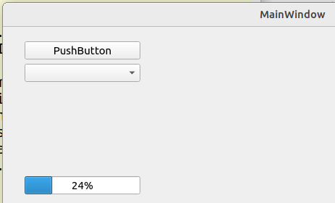
PySide6 – test_1.py, importing ui-test_1 2/2

Slide 30
PySide6 – Qt for Python documentation
Using .ui files from Designer or QtCreator with QUiLoader and pyside6-uic
https://doc.qt.io/qtforpython/tutorials/basictutorial/uifiles.html
https://www.pythonguis.com/tutorials/packaging-data-files-pyside6-with-qresource-system/

Slide 31
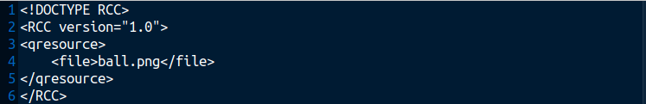
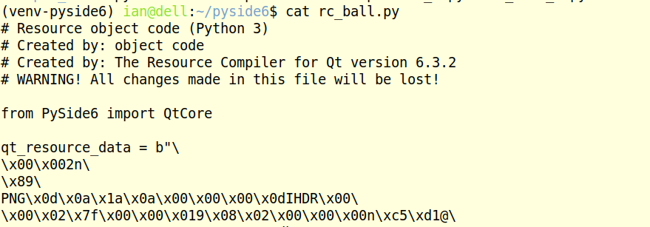
PySide6 – Resource Compiler
ball.qrc file
Resource Compiler
creates rc_ball.py
40KB rc_ball.py file. Continues...

Slide 32
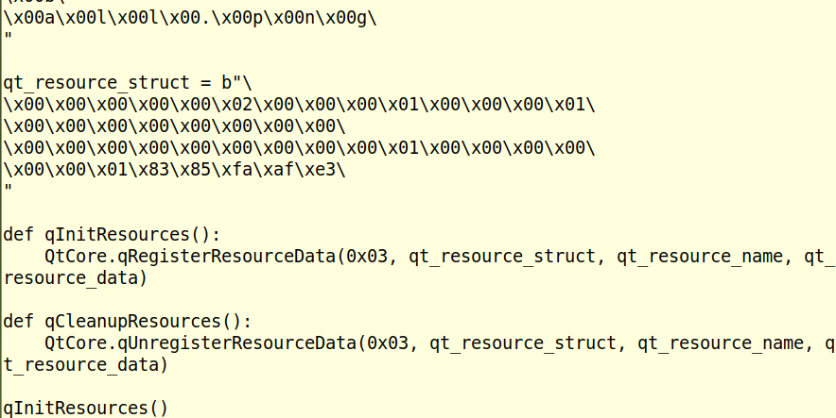
PySide6 – RRC – rc_ball.py file continued...
40KB rc_ball.py file contains image of ball.

Slide 33
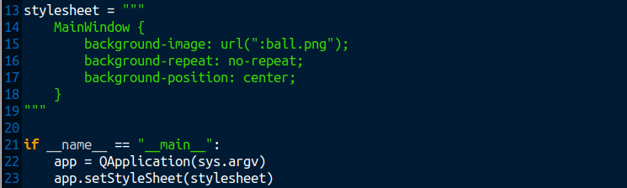
PySide6 – test_1.py using rc_ball.py file.
Add ball image from re_ball.py resource file.

Slide 34
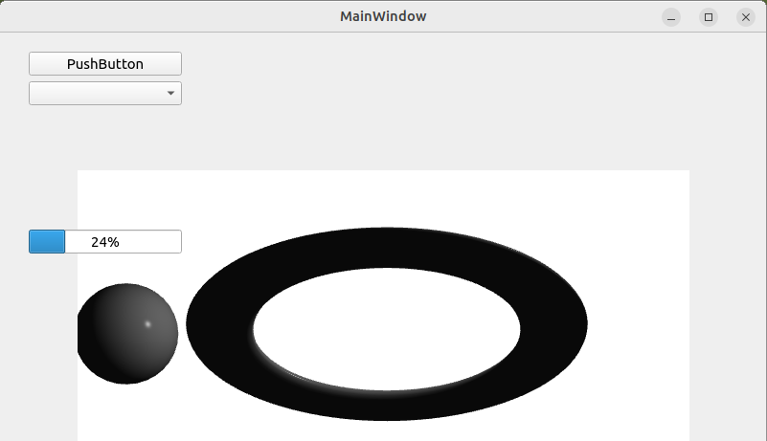
PySide6 – Image from Resource Compiler file.
Ball image added to MainWindow as
Background image.

