Slide 1
Sway
Waikato Linux Users Group
Ian Stewart
28 Nov 2022

Slide 2
Mangaro
Open Source Linux Distribution
Based on Arch Linux
Developed mainly in Austria, France and Germany
First Release 2011
Mangaro GmbH & Co. in 2019 – For commercial agreements.
Editions Official:
  Xfce, KDE Plasma 5, GNOME
Community Maintained Editions also include:
  Budgie, Cinnamon, Deepin, Mate, i3 and Sway
Current Release: 21.3. Released: 2022-06-18. Linux V5.15
Official website: www.manjaro.org
Download: https://manjaro.org/download/

Slide 3
Window Managers
A Tiling window manager with an organization of the screen into mutually non-overlapping frames.
A Stacking (Floating) window manager, of coordinate-based stacking of overlapping objects (windows)

Slide 4
i3 for X11
A tiling window manager
Inspired by wmii
Written in C
Control system similar to vi and vim.
Initial release: 2009
Latest version: 4.21.2 / 24 Oct 2022
Repository: github.com/i3/i3.git
Web-site: https://i3wm.org/
Documentation: https://i3wm.org/docs/

Slide 5
Sway
A tiling window manager.
Inspired by i3 window manager for X11
Written in C
Initial release: 2016
Wayland display server protocol
wlroots compositor library -(framework)
https://github.com/swaywm/wlroots
https://way-cooler.org/book/wlroots_introduction.html
About 50,000 lines of code you were going to write anyway
https://github.com/manjaro-sway/manjaro-sway/releases
Download both the z01 and the zip files, and run the command:
zip -FF manjaro-sway-*.zip --out manjaro-full.zip && unzip manjaro-full.zip
Create a bootable USB stick using Etcher

Slide 6


Sway
Logos

Slide 7
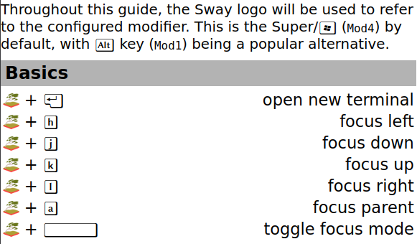
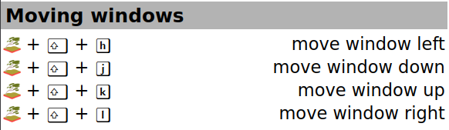
Sway Cheatsheet 1/3 - https://depau.github.io/sway-cheatsheet/

Slide 8
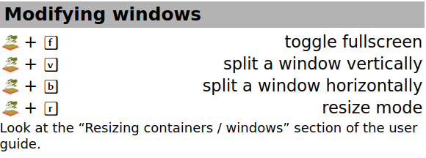
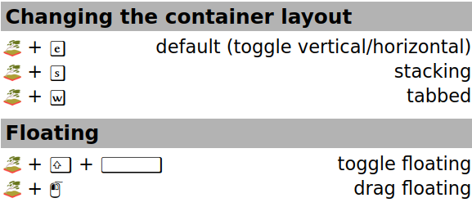
Sway Cheatsheet 2/3 - https://depau.github.io/sway-cheatsheet/

Slide 9
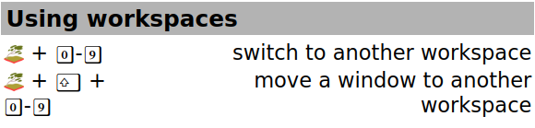
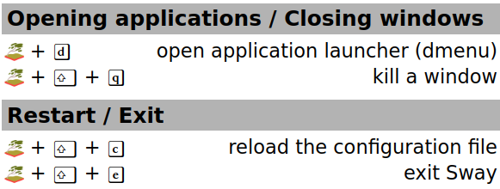


Sway Cheatsheet 3/3 - https://depau.github.io/sway-cheatsheet/

