Slide 1
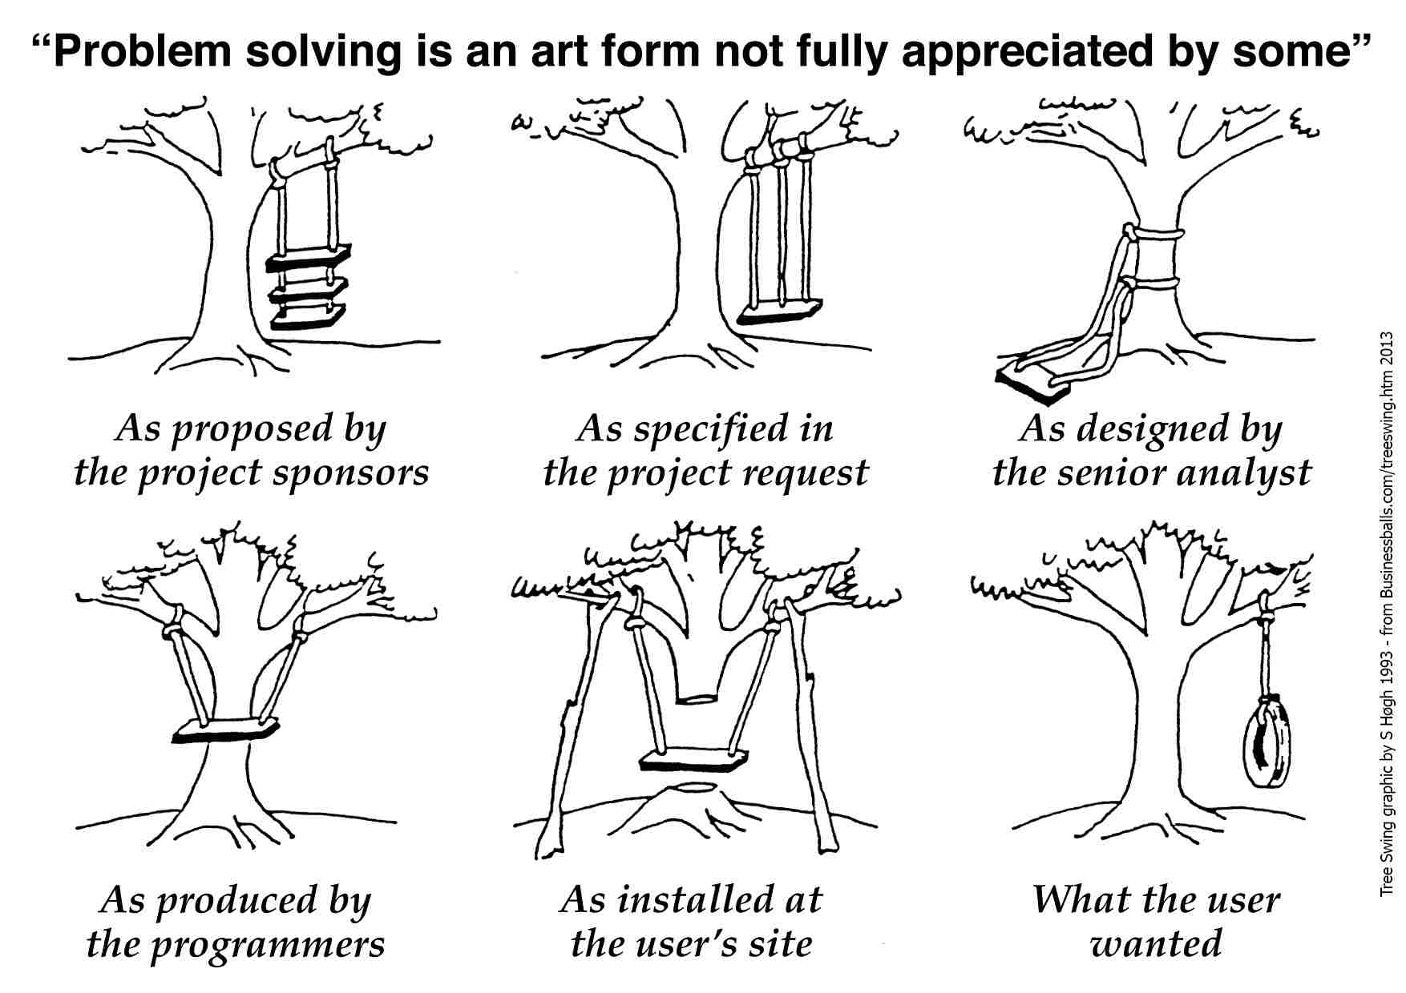
Test Driven Development (TDD) Explained
TDD is a design technique, writing test before functional code is delivered
TDD = Refactoring + TFD (Test First Design)
Red -> Green -> Refactor mantra
JUnits are the perfect example
Advantages include
TDD shortens the programming feedback loop
Concrete evidence that code works ☺ ☺
No repeated bugs and helps in better design
TDD helps to ensure design is clean by focusing on
operations that are callable and testable
Yes
Repeat
Add Test
Write failed test
Write code
Pass
Refactor

Slide 2
Why TDD
It enables you to take small steps while writing software
Much easier to find and fix defects, which cause the TDD tests to break
In traditional testing, more focus is on test case design, in TDD more focus is to verify whether testing will work properly
In TDD, you achieve 100% coverage test. Every single line of code is tested
As per recent survey of agile teams, 53% implementing TDD and 44% implementing ATDD
Disadvantages of TDD
Where should we start?
Test completeness is difficult to judge
TDD is time taking to learn and implement initially
Requirements in TDD approach are far more detailed, but nothing on behavior
Expanded feedback loop between Business and Development team

Slide 3
Comparison of TDD and ATDD
Comparison Unit | TDD | ATDD
Users Involved | Developer and Tester | Business User, Developer and Tester
Focus | TDD is model and paradigm | Focus on capturing requirement in Acceptance test and use to drive development
Agile Steps | Step 1: Code Step 2: Test Step 3: Refactor | Step 1: Discuss Step 2: Develop Step 3: Deliver
Input Documentation | Requirement document is base SRS | Acceptance Criteria +Examples (Data & Scenarios) = Acceptance Test
Test Mapping | Functionality should have test implementation | Each story should have acceptance test
Target Level | Implementation specific | Time bound shared goal

