Slide 1

We are going to discuss:
Topic |  | Facilitator
BDD/TDD | Introduction to TDD | Irshad Ali/Naveen
 | Advantages of using BDD
Implementation of BDD | Gherkin | Irshad Ali/Naveen
 | Cucumber

Slide 2
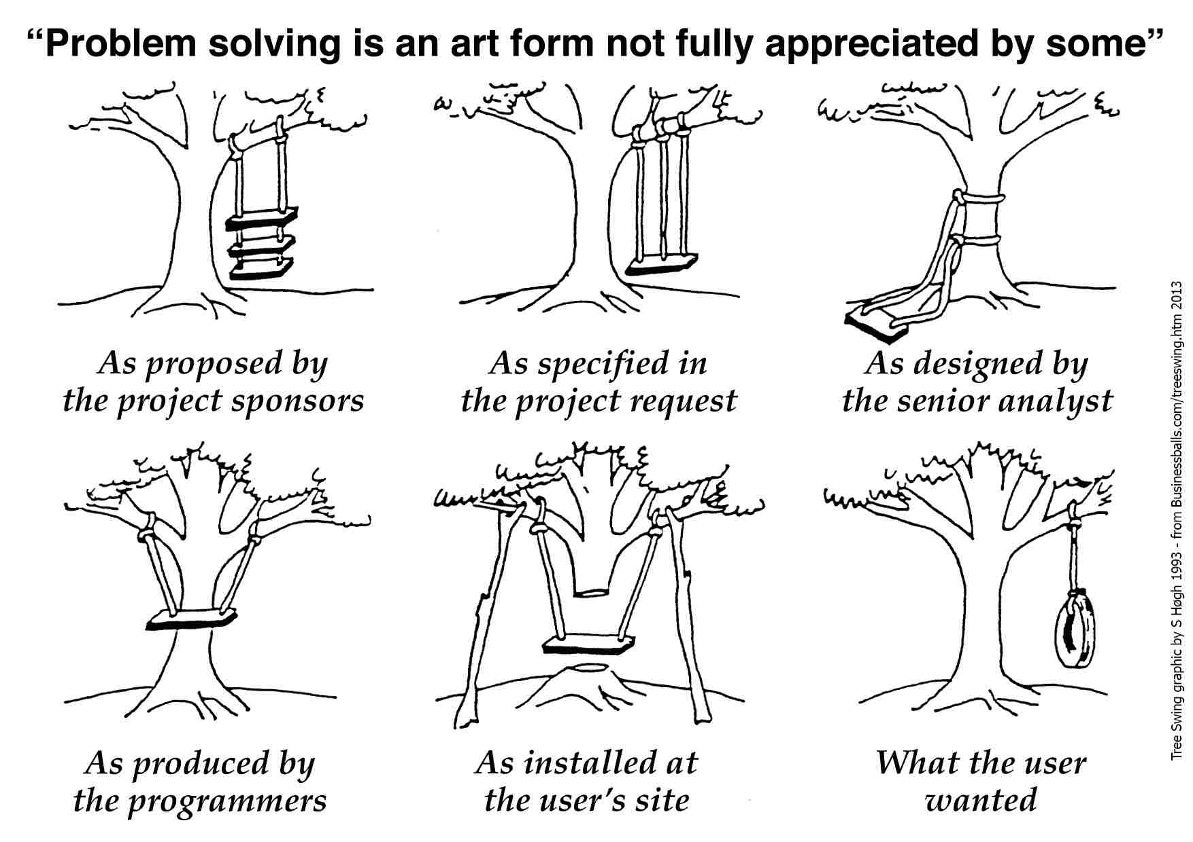
Test Driven Development (TDD) Explained
First, solve the problem. Then, write the code
Red -> Green -> Refactor mantra
JUnits are the perfect example
Want a demo of TDD?
Advantages include
Concrete evidence that code works ☺ ☺
No repeated bugs and helps in better design
Yes
Repeat
Add Test
Write failed test
Write code
Pass
Refactor

Slide 3
Disadvantages of TDD
Where should we start?
Test completeness is difficult to judge
TDD is time taking to learn and implement initially
Requirements in TDD approach are far more detailed, but nothing on behavior
Expanded feedback loop between Business and Development team

Slide 4
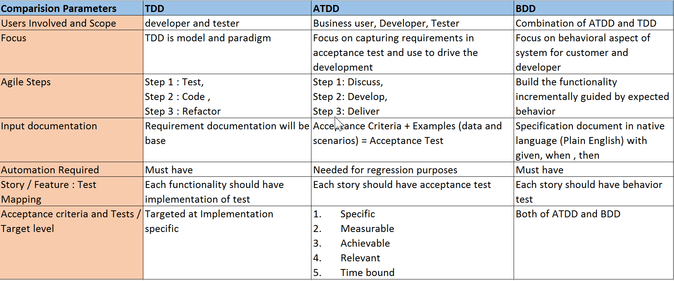
What is ATDD ? How different from TDD

Slide 5
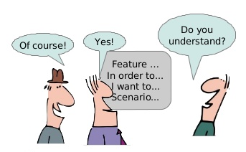
Behavior Driven Development (BDD)
Domain-driven design + TDD = BDD
Extends TDD by utilizing natural language that non-
Stakeholders can understand
Software specified in terms of desired behavior
Hoare logic ----> {P} C {Q}
P – Pre-condition, C – Condition, Q – Post-Condition
In implementation P is always true, C triggers event
and Q is the expected outcome
Specifications should be human readable and understandable
Write failing Acceptance Test
Repeat
Add Test
Write failed test
Write code
Pass
Yes
Refactor

Slide 6
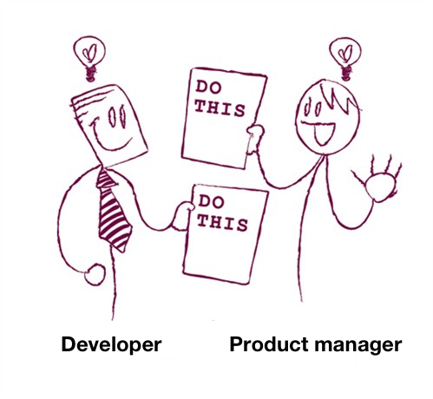
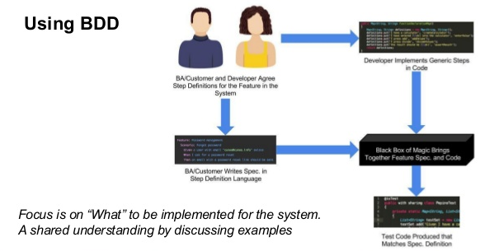
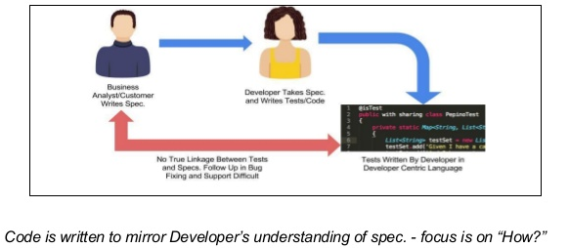
Advantages of BDD over TDD:
More collaboration between Business Analysts,
Developers, QA and Stake holders
Driven by Business value
Frameworks like Cucumber, SpecFlow act as “bridge”
Between business & technical team
User story and Acceptance Criteria defined in Feature
Developers implements Acceptance Criteria

Slide 7
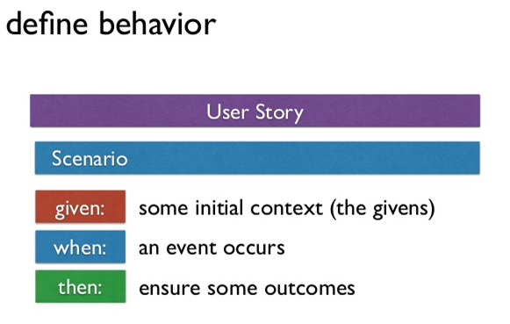
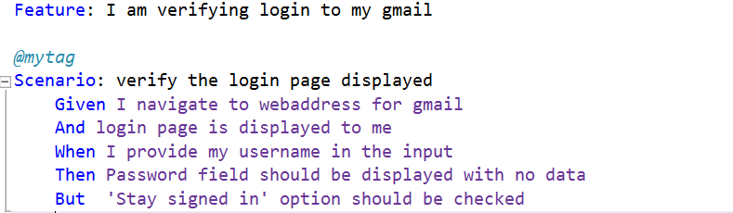
Implementation of BDD:
Gherkin:
English with little extra structure
Every new line starts with special keyword
Keywords are:
Feature
Scenario
Given, When, Then, And, But

Slide 8
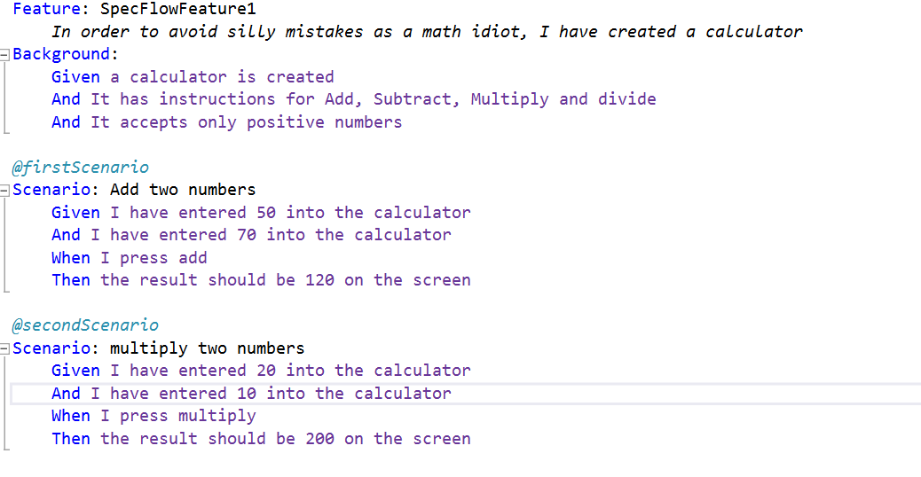
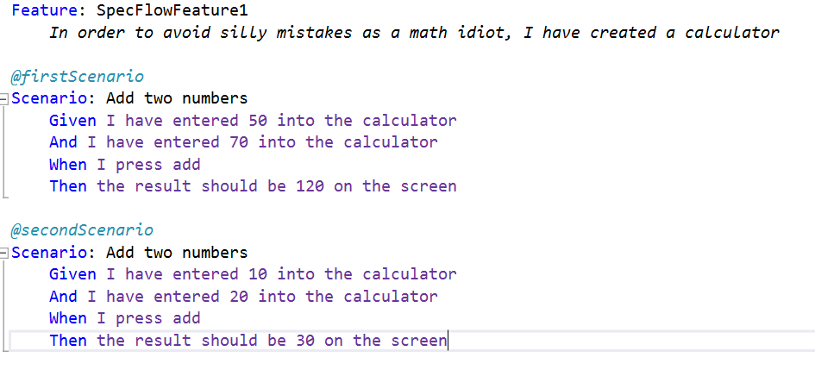
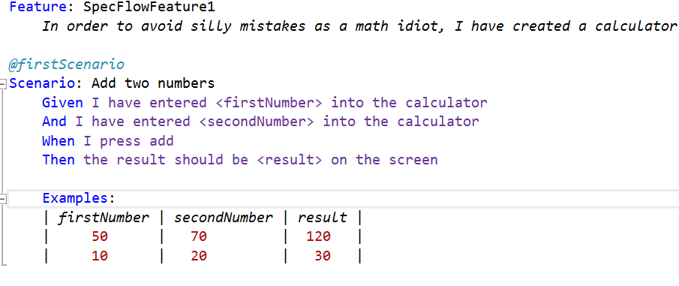
Background
Scenario Outline
Examples
1
2
3

Slide 9
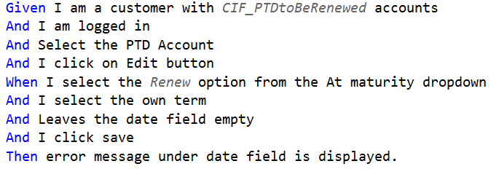
Did you notice:
In the 1st picture, we have a ‘Background’ and under that we have written some pre conditions
This is done when we need a set of conditions need to be executed across all scenario’s of feature file
Ex: In order for me to test the calculator functionality, there should be a calculator application created with some input constraints
When a step file is created, underlying scenario statements change color from purple to black as shown below
In the 3rd picture we are passing parameters in the same feature file, this is done when we know the input set of parameters is fixed.

Slide 10
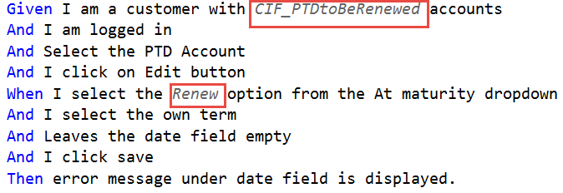
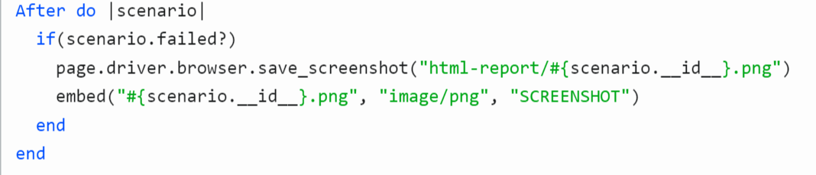
Extra Keywords are:
“ “ “ (Doc Strings)
| (Data Tables)
@ (Tags)
# (Comments)
Other aspects of Gherkin
Passing parameters
You can also pass parameters from a file, that part of the code should be written in Step File.
Scenario Hooks:
The one shown above is for taking screenshots

Slide 11
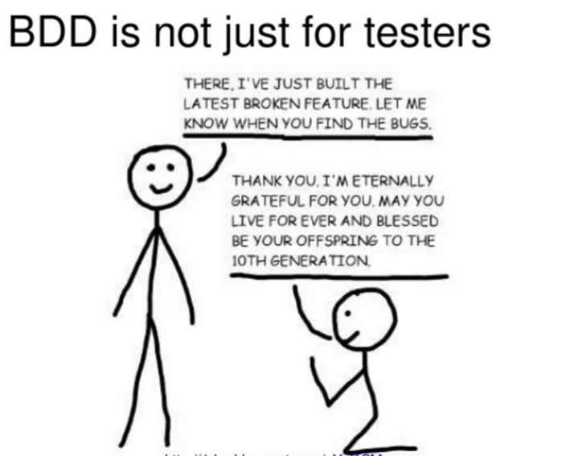
Exercise: Creating Scenarios
Example 1: Signup for an Email
Navigate to Signup page
In case of duplicate email address chosen
Successfully email is created
Example 2: Machine serving Coffee
Accept orders when coffee left in machine
Reject order when coffee is not available
Ask for payment before dispensing coffee
No payment, go back to displaying welcome message
Accepted payment for 2 coffees but only 1 available

Slide 12
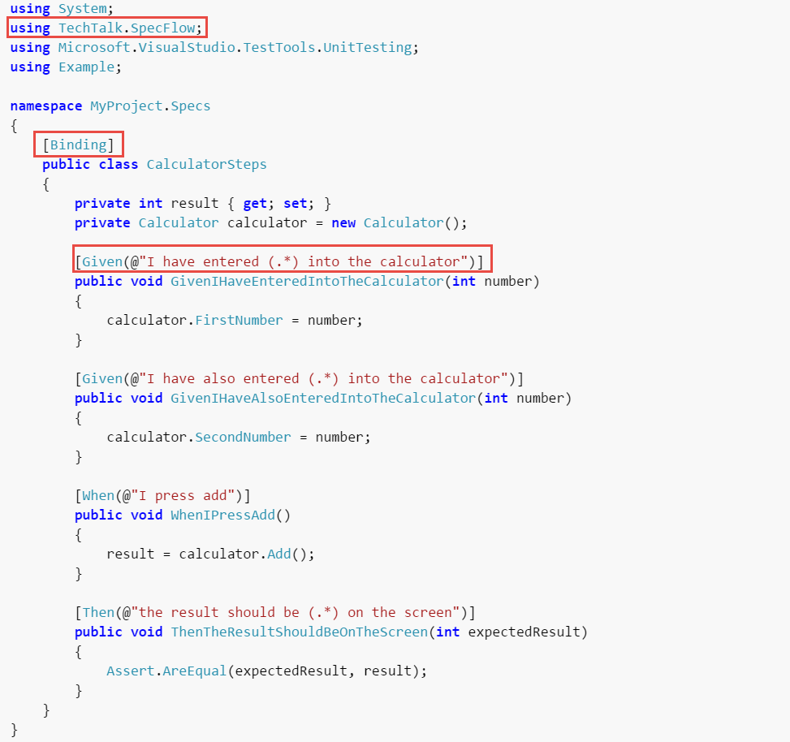
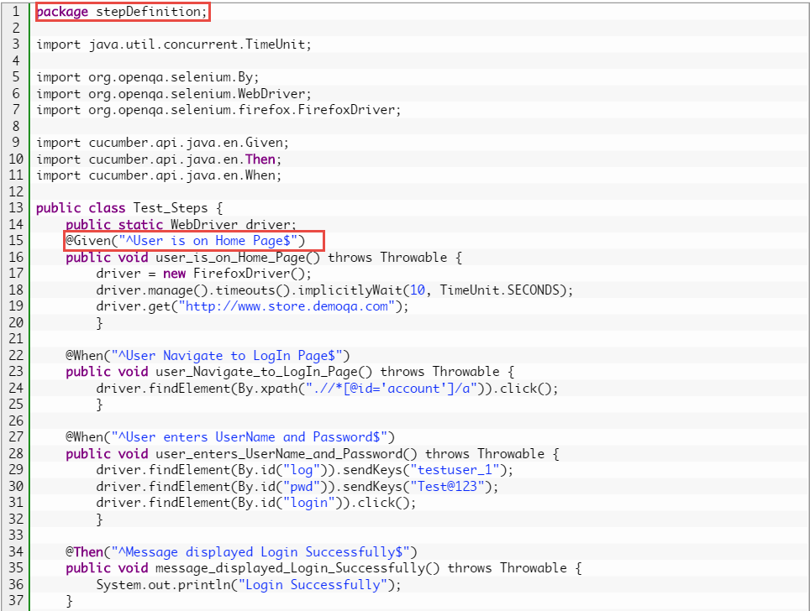
SpecFlow/Cucumber:
This is a sample step file definition in SpecFlow and Cucumber

Slide 13



