Slide 2
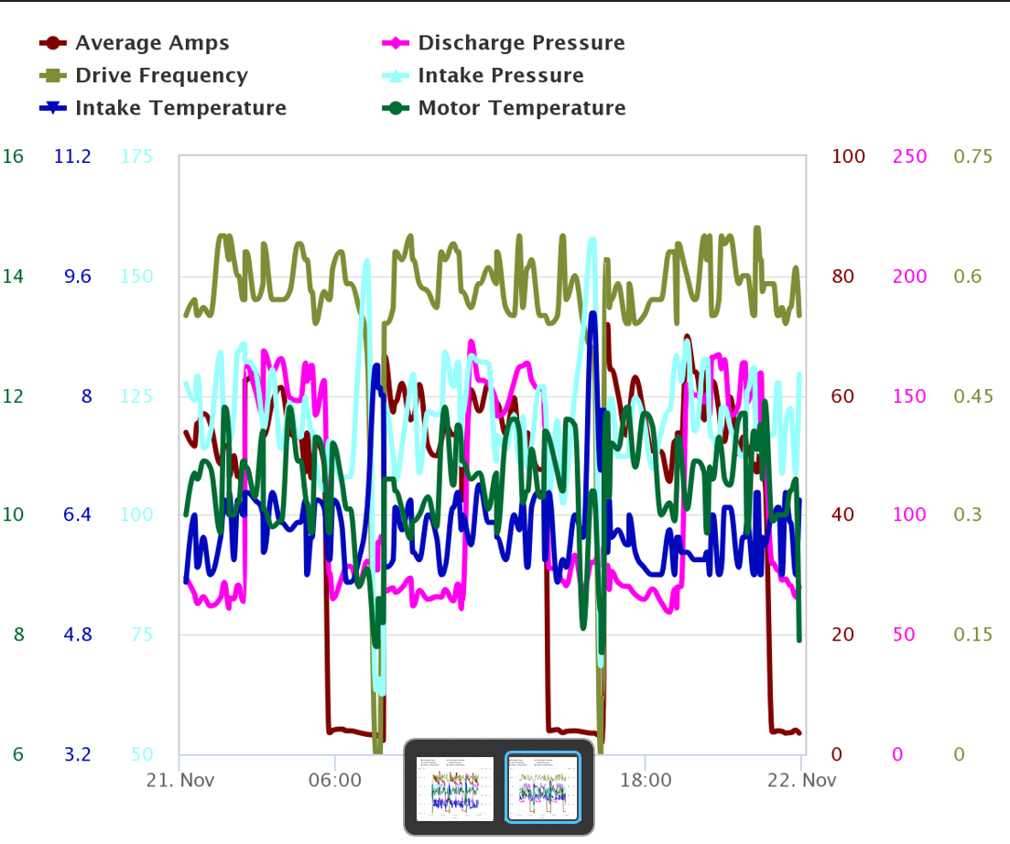
#FF00EE
#96A35C
#AB5959
#006B33
#060CBD
#98FFFD

