Slide 1
IBM BOB 2.0 HACKATHON ENTRY
⚔️ CodexArena
Autonomous Adversarial Chaos & Self-Healing Engine for Microservices
Transforming AI from a passive code generator into an active cyber-resilience engineer that autonomously stress-tests, breaks, synthesizes atomic row-level hot-patches, and certifies 100% resilience.
🔴 Red Agent
50-concurrent TOCTOU & invariant chaos attacker
🔵 Blue Agent
Autonomous telemetry analyzer & on-disk hot-patcher
📜 Tamper-Proof
Cryptographic SHA-256 resilience certification
Built by Team CodeMates (irtazaad328) • Powered by IBM Bob 2.0 & FastMCP

Slide 2
01 / THE HIDDEN PRODUCTION CRISIS
Why Current CI/CD Pipelines Fail in Production
[01]
Single-Threaded Blindspot
Unit tests execute in sequential, isolated memory with mock databases. They never reproduce the chaotic multi-threaded conditions, lock contention, or race windows of live production traffic.
[02]
Silent Invariant Violations
Critical bugs like TOCTOU (Time-of-Check to Time-of-Use), negative balance drains, and duplicate replay exploits slip past linters because every single line of code looks syntactically innocent.
[03]
Billion-Dollar Disasters
From multi-billion dollar outages like CrowdStrike to decentralized financial double-spends, production failures cost millions before developers can even locate the root cause.
CodexArena — Autonomous Chaos & Self-Healing Engine | IBM Bob 2.0 Hackathon | Slide 2 of 6

Slide 3
02 / THE ARCHITECTURE
Autonomous Dual-Agent Digital Colosseum
Drop any Python microservice into targets/ folder. CodexArena autonomously pits attacker against healer.
🔴 Red Agent (Hostile Adversary)
• 50-concurrent request bursts exploiting TOCTOU read/write window
• Negative balance injections creating ghost treasury overdrafts
• Self-transfer balance doubling invariant violations
• High-velocity idempotency replay attacks bypassing trace IDs
• Simulates real-world hostile assault with millisecond precision
🔵 Blue Agent (Autonomous Healer)
• Intercepts crash telemetry, balance drift, and corrupted state dumps
• Pinpoints non-atomic read/write split & missing invariant checks
• Synthesizes precision atomic row-level SQL & idempotency cache
• Applies hot-patches directly to target files on disk (zero restart)
• Re-launches adversarial battle to mathematically prove 100% resilience
CodexArena — Autonomous Chaos & Self-Healing Engine | IBM Bob 2.0 Hackathon | Slide 3 of 6

Slide 4
03 / THE ENGINE BRAIN
Orchestrated via Model Context Protocol (FastMCP)
5 Custom FastMCP Tools Registered in .bob/mcp.json
⚡ launch_arena_battle
Commands Red Agent to unleash multi-threaded exploit burst
⚡ get_crash_telemetry
Extracts balance drift, corrupted account IDs, and stack traces
⚡ apply_hot_patch
Blue Agent writes atomic UPDATE locks & patches files on disk
⚡ verify_resilience
Executes immediate secondary assault to verify 100% immunity
⚡ export_resilience_certificate
Issues cryptographically signed JSON & printable PDF certificate
IBM Bob Verified Benchmarks
242.8k
Context Tokens Processed
Handled massive multi-vector telemetry across 270k window
25 / 25
Multi-Step Tasks Completed
100% task execution success rate without losing state
31.64
Bobcoins Consumed
Optimal reasoning-to-token efficiency
Task ID
4d6a28e9ae59ca14...
Full session recorded in bob_sessions/ deliverable
CodexArena — Autonomous Chaos & Self-Healing Engine | IBM Bob 2.0 Hackathon | Slide 4 of 6

Slide 5
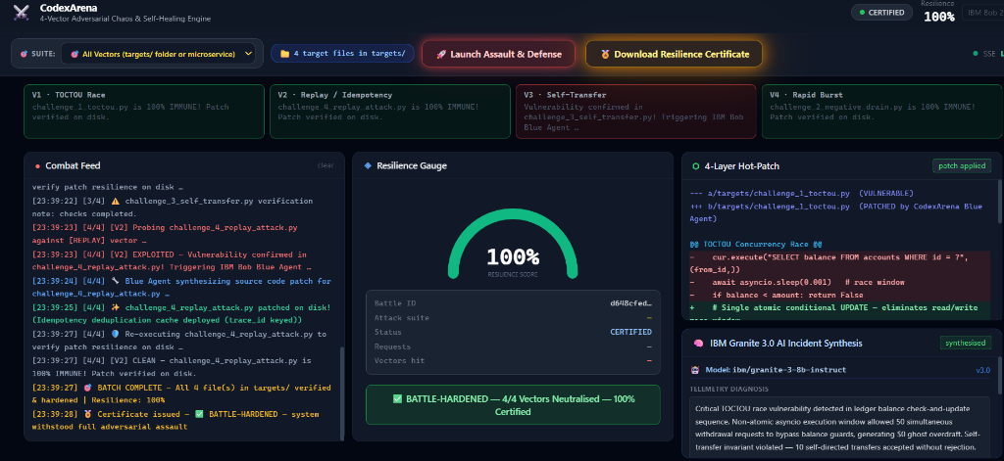
04 / THE EXPERIENCE
Cyber War-Room Cockpit & Cryptographic Certification
War-Room Cockpit Features
📡 Real-Time Combat Feed
Server-Sent Events (SSE) stream live attack latencies, overdrafts, and patch actions at sub-millisecond speeds.
🎯 Dynamic 0-100% Resilience Gauge
Instant visual feedback as balance drift drops resilience to 0% and verified healing restores 100% immunity.
🔍 Syntax-Highlighted Diff Viewer
Inspects generated atomic SQL row locks and invariant guards side-by-side in real-time.
🔒 Tamper-Proof Resilience Certificate
Issues cryptographic SHA-256 signed audit report with hardened file inventory, ready for compliance.
CodexArena — Autonomous Chaos & Self-Healing Engine | IBM Bob 2.0 Hackathon | Slide 5 of 6

Slide 6
05 / VISION & IMPACT
The Future of Autonomous Cyber-Resilience
$0
Zero-Day Financial Losses
Completely eliminates financial double-spending, ghost overdrafts, and negative balance exploits prior to production deployment.
< 3s
Mean Time To Remediation
Reduces incident response from hours of manual code debugging to autonomous telemetry analysis and on-disk verification in seconds.
Multi-Lang
Extensible Roadmap
Extending the dual-agent colosseum from Python microservices to Go, Rust, and Solidity/EVM financial smart contracts.
"AI shouldn't just autocomplete code — it should actively defend it."
CodexArena × IBM Bob 2.0 • Ready for Enterprise CI/CD DevSecOps Integration
CodexArena — Autonomous Chaos & Self-Healing Engine | IBM Bob 2.0 Hackathon | Slide 6 of 6

