Slide 1
EXCELERATE REMOTE INTERNSHIP | COHORT 0510
Internship Reflection
& Engineering Leadership Journey
A comprehensive reflection on four weeks of full-cycle cross-platform Flutter development, agile sprint leadership, and production-grade delivery.
PRESENTER & LEAD
Irtaza Ahmad
Team Lead | Team 6
CORE DELIVERABLE
Ed Tech App
Cross-Platform Mobile Portal
FINAL OUTCOME
15 Screens | 100% QA
55/55 Automated Tests Passing

Slide 2
STRATEGIC GOALS & VISION
Internship Objectives & Milestones
How our objectives bridged academic concepts with production-grade software delivery.
01
Flutter Mastery
• Mastered the complete Flutter & Dart mobile application lifecycle.
• Designed responsive UI widgets adhering strictly to Material 3 principles.
• Implemented declarative routing across 15 interactive destinations.
02
Figma to Working Code
• Translated multi-role UX wireframes into dynamic, pixel-perfect layouts.
• Connected asynchronous JSON catalog feeds with loading states and retry fallbacks.
• Enforced strict regex form validation on Auth, Payment & Feedback workflows.
03
Agile Leadership
• Coordinated 8 team members across remote collaborative sprints.
• Conducted continuous Git code reviews and resolved architectural merge conflicts.
• Built automated widget test suites ensuring 100% regression-free releases.

Slide 3
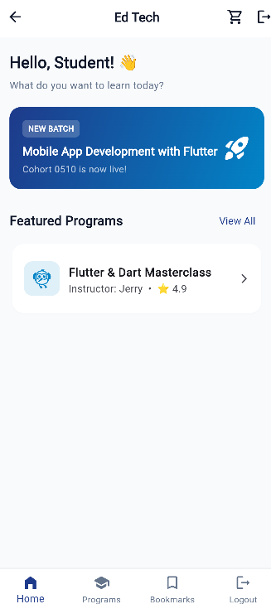
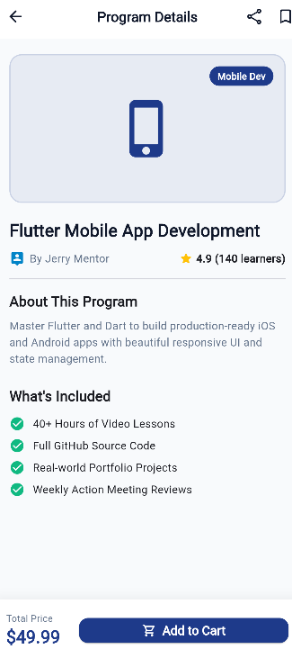
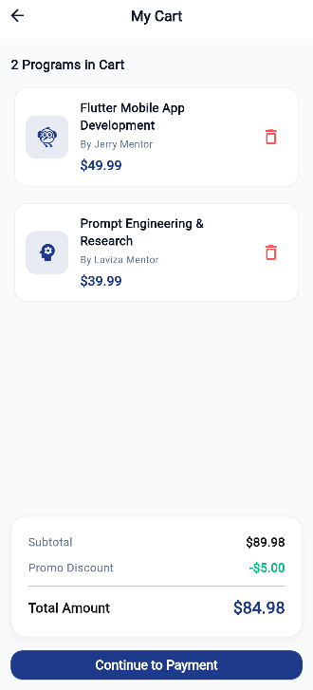
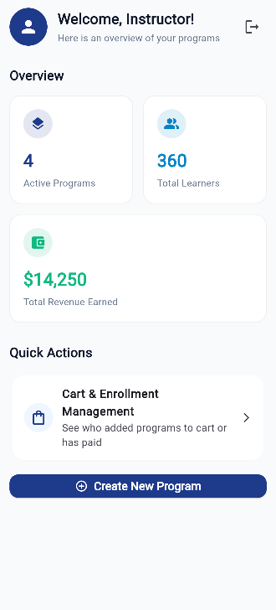
PRODUCT SHOWCASE
Interactive 15-Screen Architecture in Action
High-fidelity mobile application connecting learners with courses and instructors with analytics.
Learner Portal
Home & Progress
Course Details
Syllabus Accordion
Dynamic Cart
Promo: EXCELERATE10
Teacher Dashboard
KPIs & Analytics

Slide 4
ORGANIZATIONAL IMPACT
Technical Contributions & Leadership Impact
Specific engineering solutions and team leadership contributions delivered during the internship.
Conflict Resolution & Code Reviews
Reviewed and integrated dozens of Git pull requests across multi-branch sprints. Handled complex cart state divergence and missing model dependencies while strictly preserving team member attribution in git history.
Unified State Architecture
Architected the reactive EnrollmentService singleton, seamlessly synchronizing user-scoped cart items and verified course enrollments across Home, Details, Cart, and Profile without cross-account data leakage.
Interactive Form Engineering
Implemented robust validation logic and stateful user experiences across Auth, Checkout, and the newly added 5-Star Course Feedback module with instant qualitative and quantitative validation rules.
Team Mentorship & High-Standard QA
Mentored teammates on Flutter best practices, debugged missing model dependencies, and instituted automated testing standards resulting in a 100% pass rate across 55 test cases in 12 test files.

Slide 5
QUALITY ASSURANCE & METRICS
Quantifiable Delivery: 100% Verified Codebase
Objective validation metrics achieved through rigorous automated testing and static analysis.
15 Screens
Full Learner & Instructor Workflows
Automated Test Suite Breakdown
✔ Learner Auth Validation (auth_validation_test.dart) — 7 / 7 PASSED
✔ Teacher Auth Validation (teacher_auth_test.dart) — 8 / 8 PASSED
✔ Payment & Checkout Validation (payment_validation_test.dart) — 11 / 11 PASSED
✔ Promo Coupon & Receipt Verification (cart_receipt_test.dart) — 4 / 4 PASSED
✔ Dynamic Learner Cart Operations (learner_cart_test.dart) — 5 / 5 PASSED
✔ Profile Settings & Logout Flow (profile_settings_screen_test.dart) — 6 / 6 PASSED
✔ Course Feedback Form Validation (feedback_form_test.dart) — 3 / 3 PASSED
✔ Teacher Analytics & Dashboard KPIs (teacher_dashboard_test.dart) — 4 / 4 PASSED
✔ Program Details & Syllabus Accordion (program_details_test.dart) — 5 / 5 PASSED
✔ Administrative Cart Pipeline (cart_management_test.dart) — 4 / 4 PASSED
55 / 55 Tests
100% Pass Rate Across 12 Suites
0 Compile Errors
Clean Static Analysis & Clean Tree

Slide 6
REFLECTION & FUTURE OUTLOOK
Key Takeaways & Professional Growth
Transforming practical engineering experience into long-term career momentum.
01
Technical Mastery
Concrete Competencies:
• Advanced Flutter & Dart architecture
• Reactive state management patterns
• Client-side data caching & JSON parsing
• Comprehensive automated widget testing
• Clean Git branching, merge resolution, and CI
02
Leadership Mindset
Professional Evolution:
• Agile sprint coordination & task breakdown
• Mentoring teammates & empathetic code reviews
• Navigating technical ambiguity under deadlines
• Establishing high engineering standards across a distributed remote team
03
Career Trajectory
Future Application:
• Directly bridges academic computer science with industry software engineering
• Solid foundation for building scalable, high-performance mobile and cloud solutions
Special thanks to Excelerate mentors & Team 6 peers!

