Slide 1
V-SCRIBE
EXAM VIRTUAL ASSISTANT FOR THE SPECIALLY ABLED

Slide 2
THEME - Social Inclusion of Disadvantaged People
COLLEGE NAME - Ramaiah Institute of Technology
TEAM NAME - dedsec
TEAM MEMBERS -
Anant Raj
Mumtaz Irteqa Ahmed
Kolli Saivenu
Sathvik BK

Slide 3
PROBLEM STATEMENT
It is very difficult for a specially abled, blind person or person with his hands paralysed to find a scribe who could write the exam for him/her. Most people are busy in their day to day life and therefore blind people waste a considerable amount of time in finding a scribe thus wasting their precious time. Also the scribes come with their own problems.
Their writing may not be legible.
They may not be technically sound in the field so may end up writing something different from what the examinee may have dictated.
There could be a conflict of interest between the scribe and the examinee which is difficult to establish.
Linguistic limitation
Poor availability
Not reliable
Money has to be paid to the scribe after each exam (Difficult for poor students)
No initiative taken by the education boards to provide a Scribe (responsibility falls on the student to get their own scribes)

Slide 4

APPROACH
Our approach to solving this problem is introducing a new examination system which does not require a scribe. The application that we intend to create leverages the power of voice recognition and speech to text technology.
The blind person can give simple voice commands like "go to next question", "read out current question", "read out the answer I wrote" to perform the appropriate tasks. The blind person can also give the answer to a particular question using his voice.
The system could also work for MCQ type questions. The whole system of examination will be voice controlled and there is no need for an external scribe in such an environment.

Slide 5
FLOW OF SOLUTION
The blind person who wishes to take the exam can login using fingerprint recognition or facial recognition which is employed in a lot of exam centres.
After the examination starts, the blind person can ask simple questions like "what is the current question", "how much time is left", etc., to get information about the exam.
As for writing the answer, the blind person has two options; Either he/she could type the answer using the keyboard (if possible) or could give the answer using his/her voice.
This process does not require a scribe and can be taken up by a specially abled person independently.

Slide 6
Features
Navigate from one question to another using just your voice
Have the our V-Scribe read out the question for you
Answer the question through the power of your voice
Mark questions for review so that you can come back later
Know how much time is left and how many questions are left to answer.
Give your answers in a wide range of formats.Eg you can choose to answer the question in points or in paragraph
Edit your answer if you think you have made a mistake
V-Scribe automatically converts symbols, thus increasing readability. Eg converting the word delta to its appropriate symbol

Slide 7
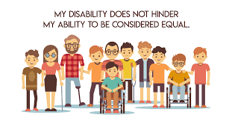

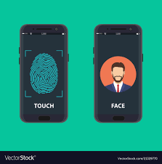


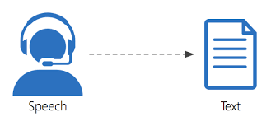

REPRESENTATION
Specially abled students
Authorization
Access granted
Access denied
V-SCRIBE Examination
Methodology
Answers
In
Braille document
Results

Slide 8
WHY V-SCRIBE ?
Simple : Users can become accustomed to the virtual scribe as the process dictating is a cake walk.
Secure : Employs face detection technology to authenticate a student.
Interactive : Hassle-free dictation and better interaction.
User-friendly : Guides through the process of automated examination.
Independent : No human dependency during the examination apart from the user.
Multi-formatting : Switch between paragraph and point wise mode, objective type, descriptive mode of answering.
Text to Braille conversion for publishing answers to the users, on demand.

Slide 9
ANALYSIS OF DIFFERENCES BETWEEN OUR SOLUTION AND THE CURRENTLY AVAILABLE TECHNOLOGY
Currently, there is no automatic, independent system available for the specially abled to give exams, other than the traditional scribe based system. There are software’s such as JAWS but those are used by blind people only to communicate with the computer. As per our research, currently there is no product such as the one proposed above for the blind in assisting them to give their exams. Such a system would revolutionize the way the examination process for the specially abled and could make their life a tad bit easier.

Slide 10
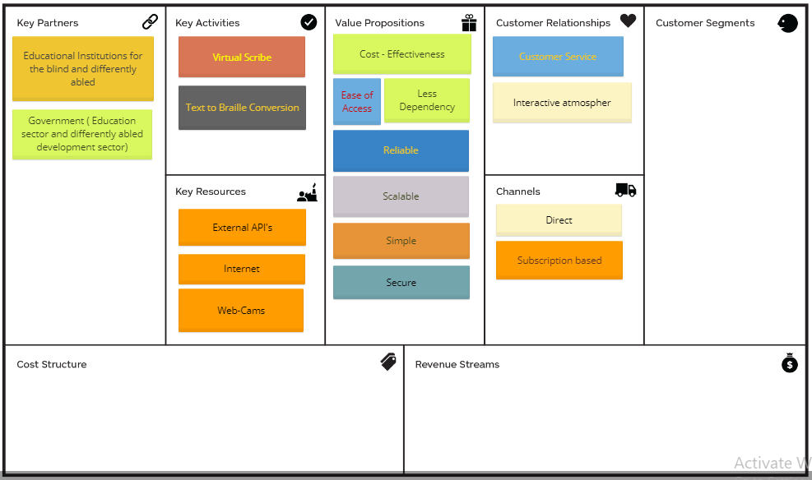
BUSINESS MODEL
Target Audience : Educational boards that provide education to Blind and differently abled students (more than 40 lakhs)

Slide 11
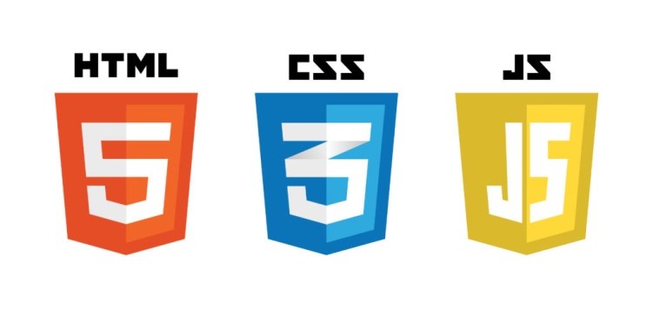



TECHNOLOGY STACK
Client side
Server side
API
Google Text to Speech API
Google Speech Recognizer
Facial Recognition API

Slide 12
Demo Link
Youtube link for our app demo:
https://www.youtube.com/watch?v=3-dK5BlAyW8&feature=youtu.be

Slide 13
THANK YOU

