Slide 1
Salaries for Professors
Irtiza Kaleem

Slide 2
Introduction - Dataset
2008-2009 nine-month academic salary for professors at a U.S college.
397 rows, 6 columns
rank: A factor with 3 levels: AsstProf, AssocProf, Prof
discipline: A factor with 2 levels: Department A (theoretical) and B (applied)
yrs_since_phd: Years since PhD was first received
yrs_service: Years of service
sex: A factor with 2 levels: Male and Female
salary: 9-month salary, in dollars

Slide 3

Analysis – 1 of 4 What percentage of records are Assistant Professors with less than 5 years of experience?
Ans: 15.87%

Slide 4
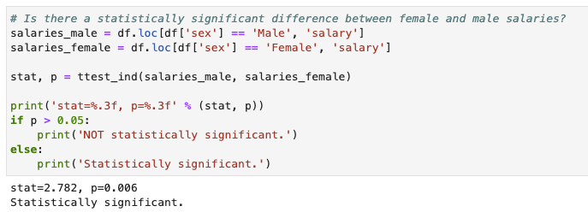
Analysis – 2 of 4 Is there a statistically significant difference between female and male salaries?
Ans: Yes
Null Hypothesis: The female average salary IS NOT different than the male average salary.
Alternative Hypothesis: The female average salary IS different than the male average salary.
p-value is probability of obtaining results at least as extreme as the observed results, given that the null hypothesis is true.
On average, males have 14k higher salary than females:
Male Avg. Salary: 115,090
Female Avg. Salary: 101,002

Slide 5
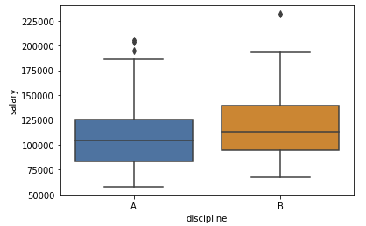
Analysis – 3 of 4 What is the distribution of salary by rank and discipline?
Histograms of Salary by Rank and Discipline
Salary distribution by Rank (Left) shows Professors have the highest salary distribution, reflecting increasing salaries with rank.
Salary distribution by Discipline (Right) is higher for applied programs (B), likely due to higher demand than theoretical programs.

Slide 6
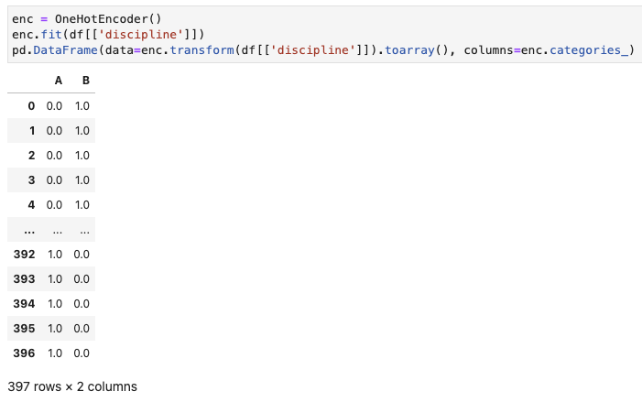
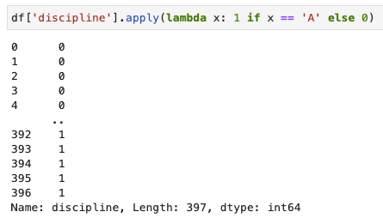
Analysis – 4 of 4 How would you recode discipline as a 0/1 binary indicator?

Slide 7
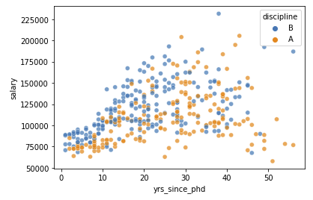
Exploratory Data Analysis Observation 1 of 3 – Rank and Discipline
On average, a higher faculty rank has higher salary.
Discipline B faculty has higher salary range for less years since PhD.

Slide 8
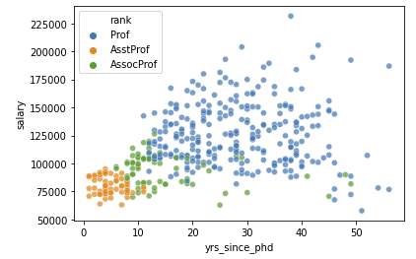
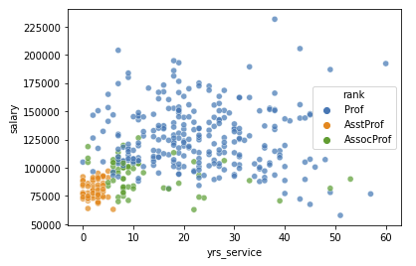
Exploratory Data Analysis Observation 2 of 3 – Years since PhD and Service
Years since PhD has a positive correlation with salary and rank.
Similar, but weaker, relationship is observed with Years of Service.

Slide 9
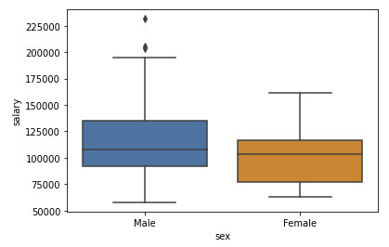
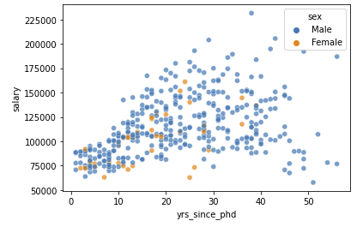
Exploratory Data Analysis Observation 3 of 3 – Salary vs. Gender
Overall, Male faculty have higher salaries on average, but may not be a strong predictor.

Slide 10
Model Building Regression – ML Pipeline
Features: ['yrs_since_phd', 'yrs_service', 'rank', 'discipline', 'sex’]
Target Variable: salary (continuous variable)
Train Test Split: 80:20
Cross Validation: 3-Fold
Hyperparameter Tuning: Grid Search on max_depth and min_samples_split

Slide 11
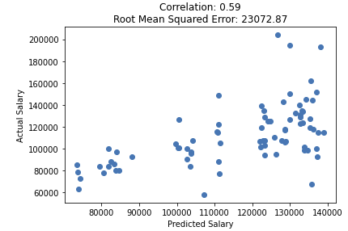
Model Building Regression – Results
Rank is the most important feature to predict salary, aligned with with earlier observation in EDA.
Gender is the least important variable with negligible importance.
The model performance is not strong, with salary estimation error +/- $23k.

Slide 12
Model Building Classification – ML Pipeline
Features: ['yrs_since_phd', 'yrs_service', 'rank', 'discipline', 'sex’]
Target Variable: higher than median salary (binary variable)
Train Test Split: 80:20
Cross Validation: 3-Fold
Hyperparameter Tuning: Grid Search on max_depth and min_samples_split

Slide 13
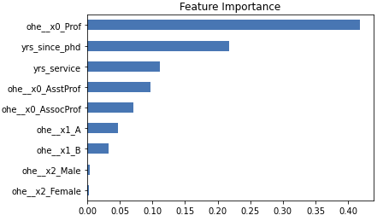
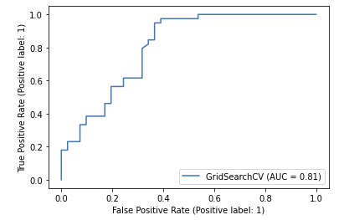
Model Building Classification – Results
The feature importance is similar to regression model.
The model accuracy is 79%.
AUC is 0.81 i.e. the probability that model will rank a randomly chosen positive instance higher than a randomly chosen negative one.

Slide 14
Dataset Enhancement State at least 3 research questions you would like to address and describe your thought process behind how you formulated these research questions.
Likelihood of Faculty Churn:
As we observed high variance in salaries, it may result in faculty to pursue other opportunities and is an important question for the college to research.
Salary Offer on Contract Renewal:
Following the earlier question, the college would also like to know the market demand for their faculty’s profile. This would enable them to offer them the right salary and retain them.
Impact of Demographic Profile on Salary:
Although there are very low number of female faculty at the college, we observed the average salary for women is less than their male counterparts. Also, we saw a non-linear salary trajectory salary as years of service increase. Age could be a leading factor, however, we can also analyze additional personal attributes such as race, color, religion and national origin.

Slide 15
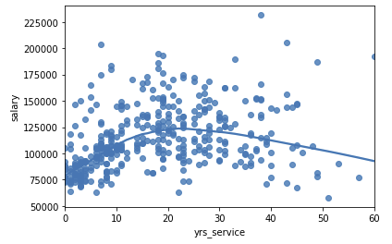
Dataset Enhancement Prepare a list of 5-7 additional attributes you would like to add to the dataset. Prepare a brief explanation for each attribute.
There is a large variance in Professor salaries. Following attributes would provide more insight on their skills and experience that may impact salary:
No. of cited publications
Awards received
No. of projects in collaboration with industry/other institutions.
No. of programs taught (both within and outside college)
Compensation details
As shown in the plot (right), there is a non-linear trend as experience increases. Age may be an important factor to review.

Slide 16
Dataset Enhancement Estimate and justify the appropriate sample size (and sampling technique, if desired) that would be required to address the research questions you defined.
The sampling should be performed on other universities as well to analyze variability amongst university faculties.
Since there are fewer female faculty at the current university, and likely the case in others, we need to ensure that females are fairly represented as a group.
Firstly, universities should be randomly selected, followed by stratified sampling by gender.

Slide 17
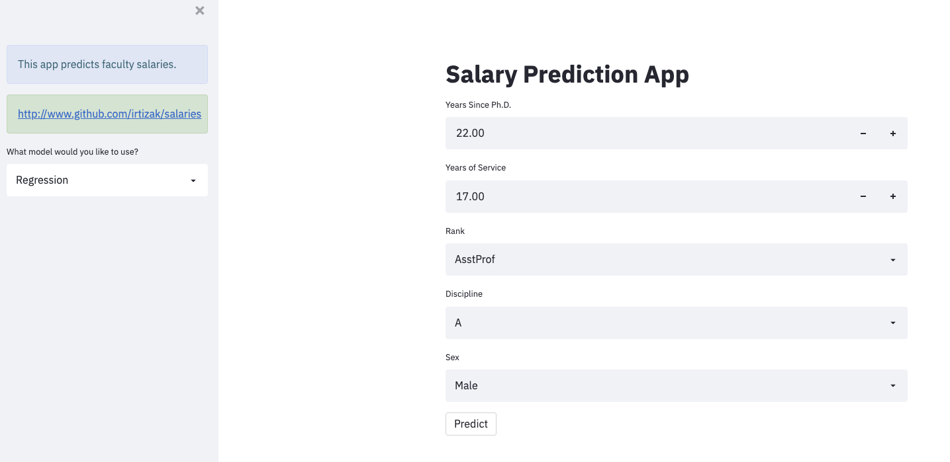






Annex: Model Deployment
The project is version controlled using Git and synced on GitHub.
Created Streamlit application to translate model into data product.
Used Dockerfile and Kubernetes to deploy model on GCP.
http://34.127.106.181/

