Slide 1

Battle of Neighborhoods
Chennai, TamilNadu, INDIA

Slide 2
SCOPE
Pincode based top trending venues using Foursquare API
01
Cluster analysis of locations using k-mean clustering
02
Identifying locations where number one activity is movie going.
03

Slide 3

Python packages
Folium, Geopy, JSON, NumPy, Pandas, Requests, Sklearn

Slide 4
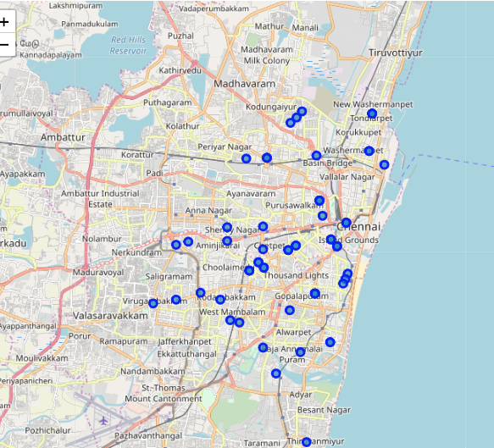
Locations
FOLIUM MAP

Slide 5
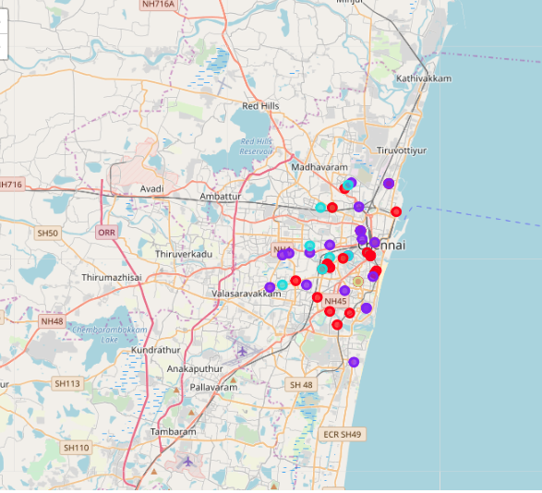
Location
CLUSTERS

Slide 6
Locations With Most Movie Going Activity
Cluster0: Sembiam and Vadapalani
01
Cluster1: None
02
Cluster2: Agaram, Perambur
03
Cluster4: Perambur North
04

