Slide 1

IKIBONDO: AI-driven baby health risk monitoring and vaccination scheduling system
IRUMVA Gad Anaclet (223000471)
TUMUKUNDE Gentille (223021200)
University of Rwanda, School of Science and Technology
December 11, 2025
[Insert GitHub URL here] (Include requirements.txt for package versions: e.g., pandas, numpy, scikit-learn, imblearn)

Slide 2
Project overview & motivation
Background: Child health in Rwanda faces challenges like manual tracking, data loss, delayed interventions, and low vaccination coverage.
Problem Statement: Lack of real-time risk assessment, automated vaccination tracking, and integrated decision support for CHWs and clinicians.
Objectives: Develop HealthRiskModel (ML classifier for Low/Medium/High risk).Implement Vaccination Status Logic (rule-based).Build integrated IKIBONDO system for deployment.
Progress: System architecture designed; ML model trained and evaluated; rule-based logic implemented.

Slide 3
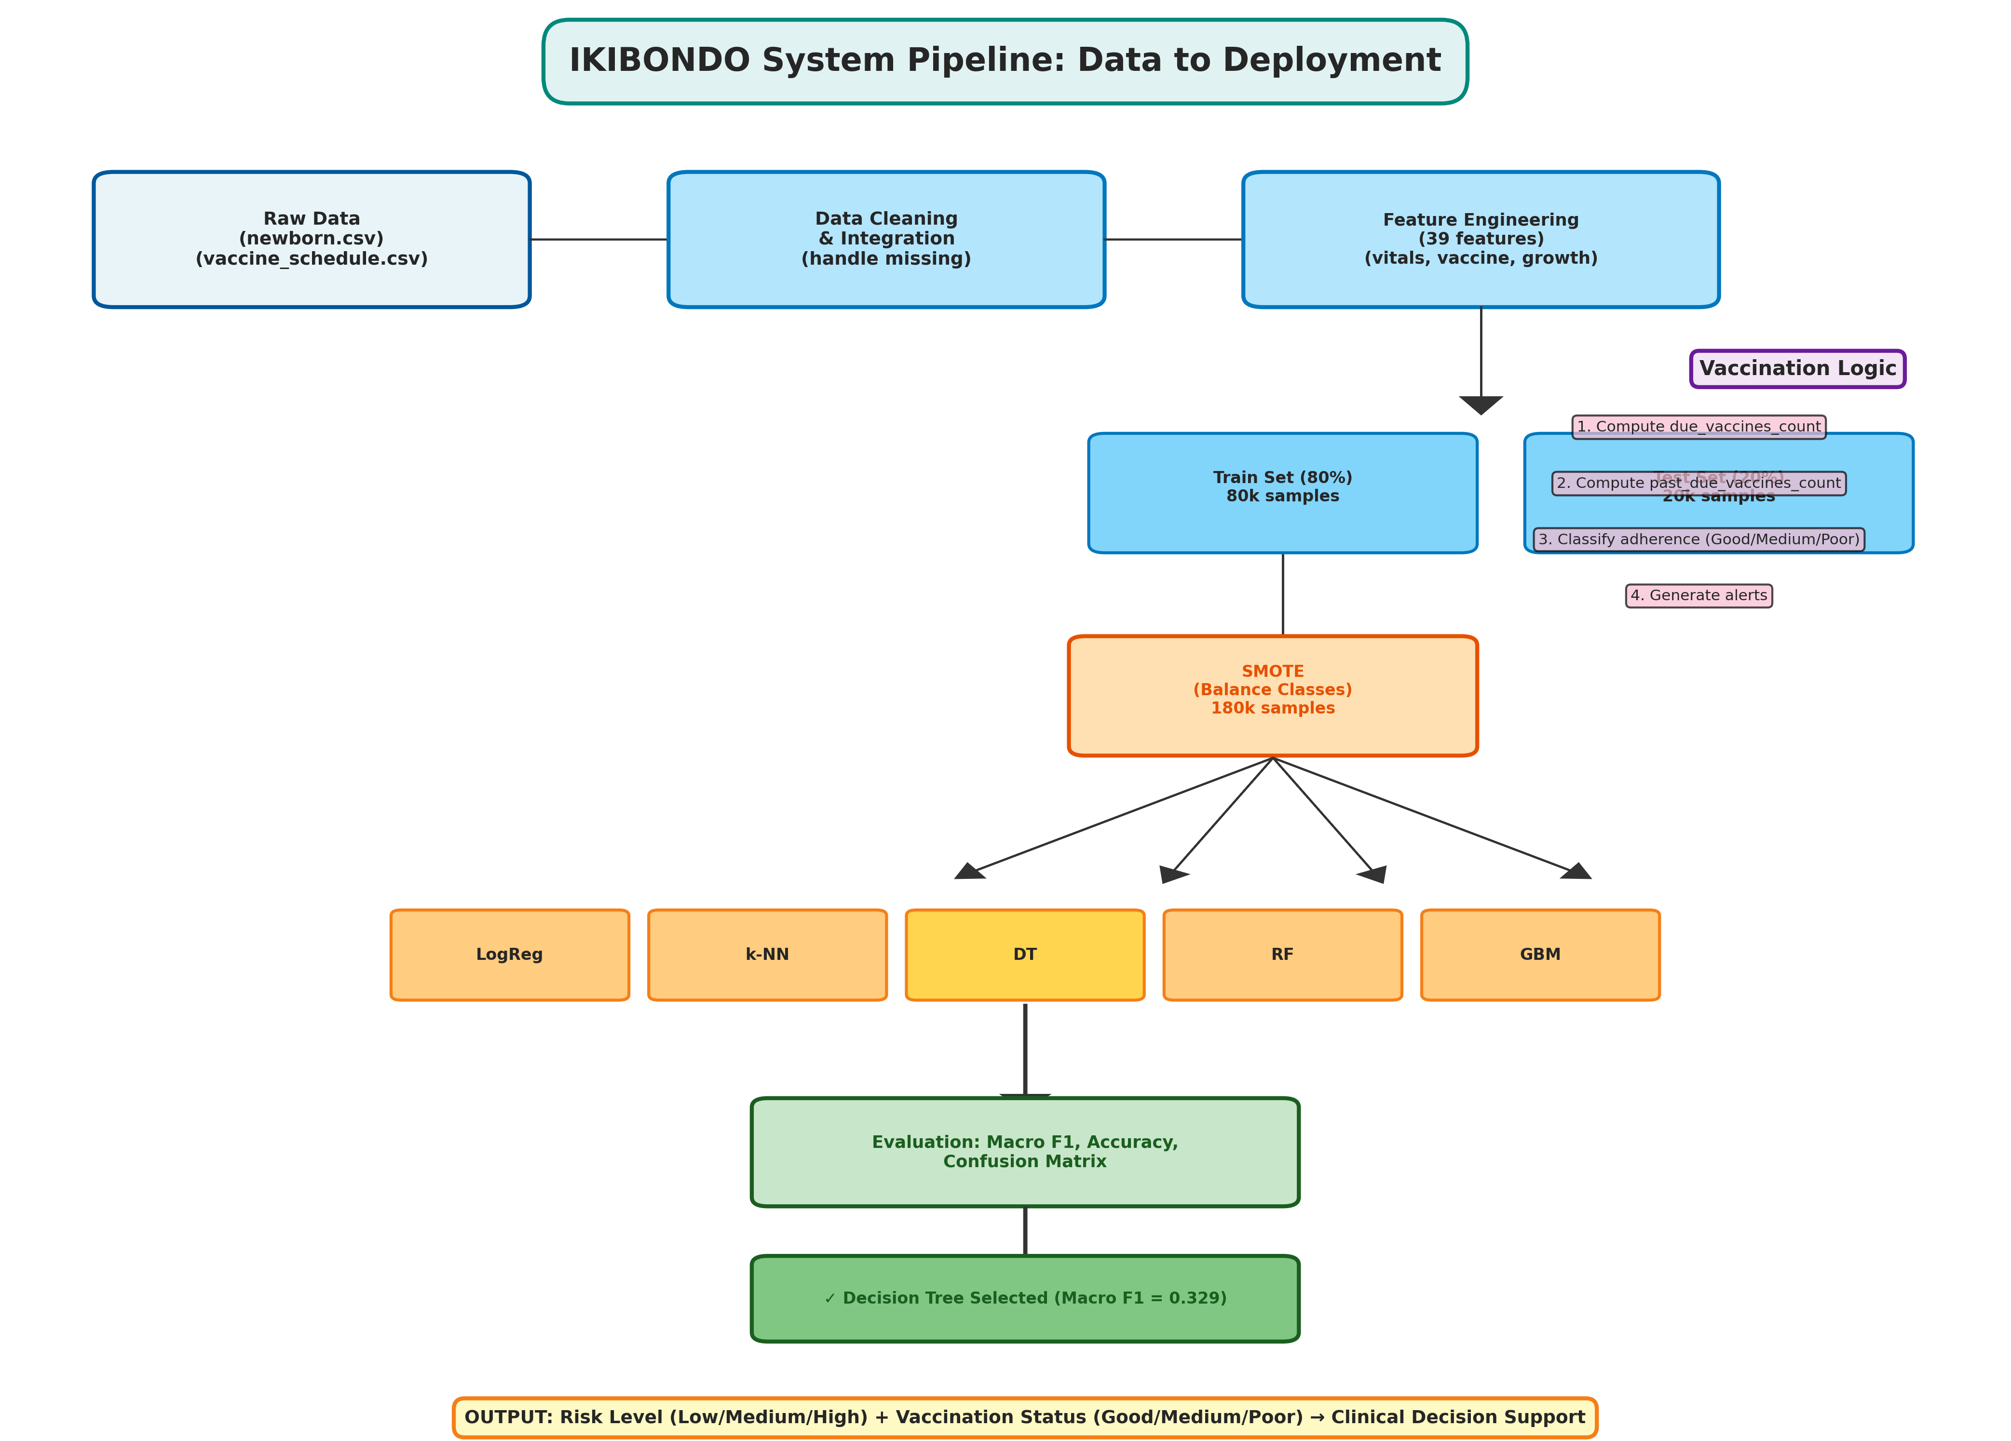
System Architecture
Components: Data Integration: Synthetic dataset (100k records), WHO growth standards, Rwanda vaccine schedule.
  ML Module: HealthRiskModel for risk prediction.
  Vaccination Module: Rule-based adherence classification (Good/Medium/Poor).
  User Interface (Planned): CHW dashboard, caregiver app, clinician portal.
Progress: Full pipeline implemented (data flow from collection to inference).

Slide 4
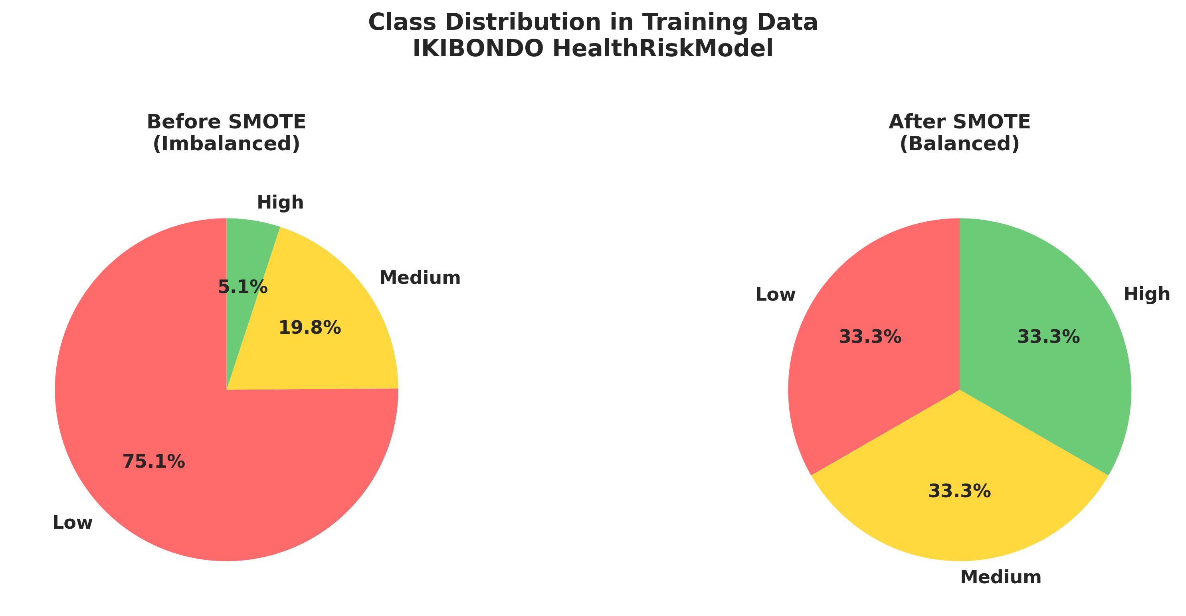
Data & Preprocessing
Dataset: 100k synthetic newborn records (0-6+ years); features include demographics, vitals, growth, feeding, immunization.
Feature Engineering: 39 features (20 numeric, 10 binary, 5 categorical) e.g., age_months, bmi_like, fever_flag, due_vaccines_count.
Preprocessing Steps: Cleaning, validation, scaling (StandardScaler), encoding (OneHotEncoder), SMOTE for imbalance.
Class Distribution (Before/After SMOTE):
  Before: Low ~75%, Medium ~19%, High ~5%.
  After: Balanced (60k each class).Progress: Dataset processed; code in preprocessing.py and HealthRiskModel_smote.py.

Slide 5
HealthRiskModel - ML Design
Task: Multi-class classification (Low=0, Medium=1, High=2).
Imbalance Handling: SMOTE on training data (80/20 split).
Models Evaluated: Logistic Regression, KNN, Decision Tree, Random Forest, Gradient Boosting.
Selected Model: Decision Tree (best macro F1=0.329; interpretable for clinical use).Why Decision Tree? Balances classes, captures non-linear patterns, avoids majority bias.
Progress: Models trained; best model serialized (HealthRiskModel_best_smote.joblib).

Slide 6
Model Training & Evaluation
Model | Accuracy | Macro F1
Logistic Regression | 0.314 | 0.257
KNN | 0.331 | 0.265
Decision Tree | 0.580 | 0.329
Random Forest | 0.751 | 0.286
Gradient Boosting | 0.751 | 0.286

Slide 7
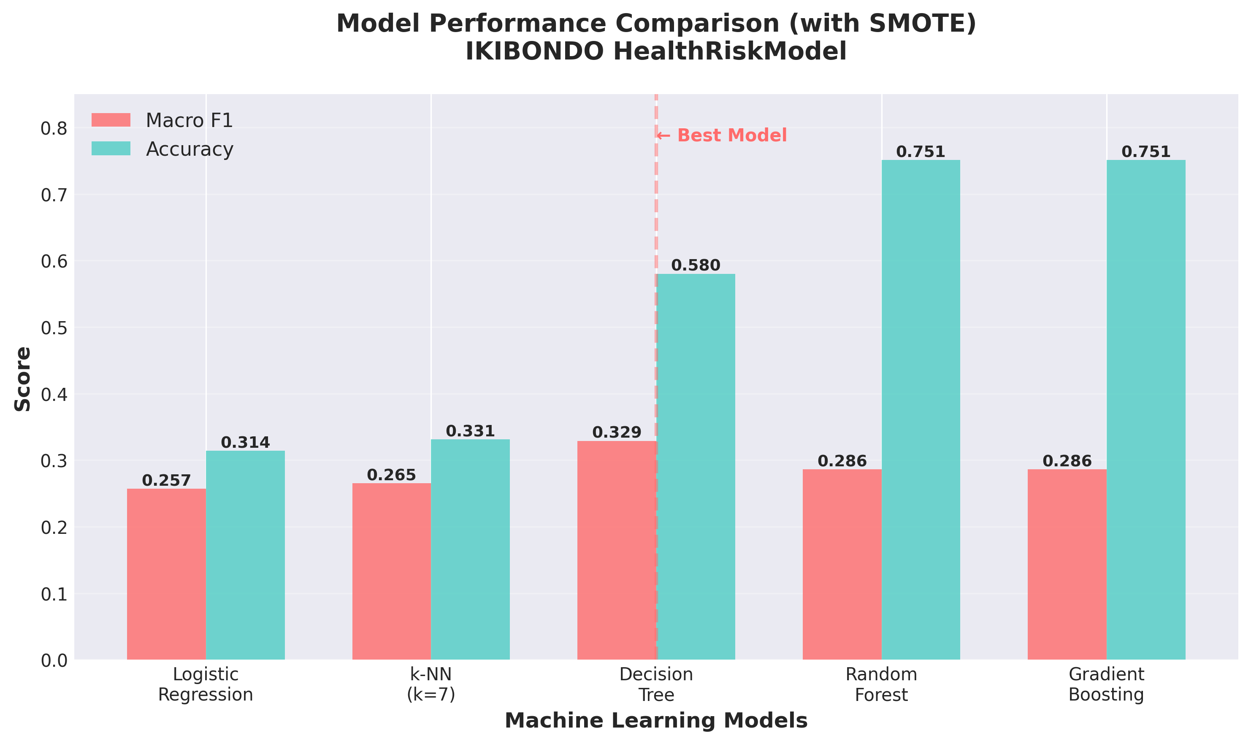
Progress continue…

Slide 8
Vaccination Status Logic
Approach: Rule-based (deterministic, no ML needed).
Rules:
  Compute due/past_due vaccines from Rwanda schedule.
  Classify: Good (no overdue, done=Yes), Poor (overdue, done=No), Medium (partial).
  Generate alerts (e.g., urgent reminder if MR1 overdue >30 days).
Progress: Logic implemented and integrated; achieves 100% accuracy on test data.
Why Rules? Deterministic; ML overkill and less interpretable.

Slide 9
System Workflow & Inference
Key Steps: Data collection → Cleaning → Feature engineering → Preprocessing → Prediction → Alerts.
Inference Example: Load model, predict risk/probabilities, suggest actions (e.g., urgent referral for High risk).
Progress: Full end-to-end pipeline working; code in Appendix A3 (Inference Example).

Slide 10
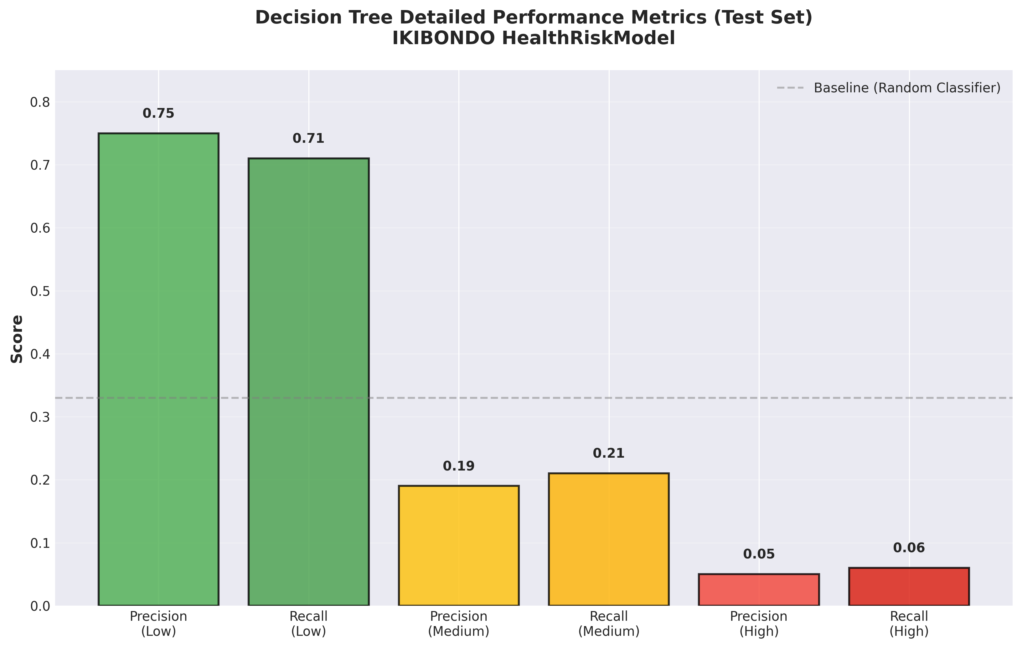
Results & Performance Highlights
Strengths:
Macro F1=0.329 (balanced across classes);
~71% Low-risk accuracy; alerts prioritize safety (more false positives OK).
Trade-offs: Lower precision for Medium/High; synthetic data limits real-world applicability.
Progress: Model ready for deployment; outperforms baselines on imbalanced data.

Slide 11
Limitations & Challenges
Synthetic data may not match real-world.
Feature thresholds need refinement with experts.
Handles missing values poorly; no longitudinal data yet.
Resource constraints for deployment in rural areas.
Progress: Identified; plan to address in future work.

Slide 12
Conclusion
KIBONDO integrates ML and rules for automated risk monitoring and vaccination tracking.
Achieved balanced performance (macro F1=0.329); poised to improve child health in Rwanda.
Next Steps: Clinical validation, deployment, and scaling.
Call to Action: Seek feedback from Rwanda Ministry of Health and pediatricians.

Slide 13

Thank you
-----

