Slide 1
NLP 4th week Progress Team IRun
20172864 서정현
20172848 정석우
20170364 한태균

Slide 2
Project Overview
1. Crawl fixture data using RapidAPI Football-API
2. Crawl tweet data using tweeter API
3. ‘Document’ data, divide based on the rating of the players
4. Construct TF-IDF vector space model of documents
5. Construct similarity computation model using TF-IDF matrix and input query

Slide 3
Project Overview
Evaluation is conducted by comparing the player ratings of other existing rating by matches (ex. whoscored.com)
It can be expected to present a new rating to evaluate the player from social media reactions

Slide 4
Last week’s progress
Finished making API crawler(tweeter API + Football API)
collected ~3000 (tweets) and make document
(0~6.5, 6.5~7.0, 7.0~7.5, 7.5~8.0, 8.0~8.5, 8.5~)
Constructed TF-IDF model (lnc method)
Data preprocessing

Slide 5
this week’s progress overview
Refining stop word
Recollect data (EPL, Serie A, LaLiga)
Collect real Query (tweets) (test data (not training data))
VSM model Refactoring
Add Graph

Slide 6

Inappropriate Stop word
Good, Great, Proud … <- Words that are typically excluded when searching for information in IR.
But! Exceptional in our project.
What a good player!

Slide 7
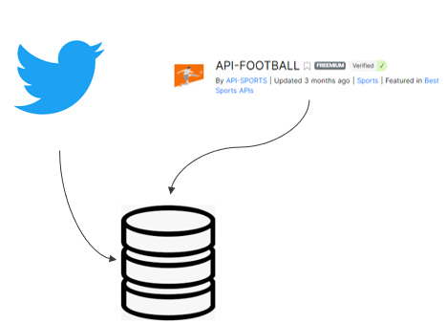
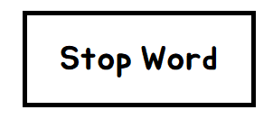

Unfortunately..
Twitter allows free crawling up to tweets 1 weeks ago.
Therefore, the existing data could not be used(TT)
The dataset was not good anyway, so we had to get a new one.
Storage

Slide 8
So,
Change logic to allow data to accumulate
Facilitates data processing and testing.
Good!
Storage

Slide 9





Other Bad news…
All the big football leagues in Europe have ended..
So, what data sets will be available in the future?

Slide 10


We are going to America
It’s the league season until October.
Maybe we can use K-league data
(But is there a comment in English?)

Slide 11
Last week data
Documents | # of Tweets | # of total words | Average # of words in a tweet
0~6.5 | 691 | 7596 | 10.9942
6.5~7.0 | 1479 | 18136 | 12.2623
7.0~7.5 | 883 | 11120 | 12.5934
7.5~8.0 | 1022 | 11258 | 11.0156
8.0~8.5 | 553 | 6115 | 11.0578
8.5~ | 102 | 1606 | 15.745
Total | 4730 | 55831 | 11.8035

Slide 12
Data in this week
Documents | # of Tweets | # of total words | Average # of words in a tweet
0~6.5 | 2626 | 15826 | 6.0266
6.5~7.0 | 3633 | 21339 | 5.8736
7.0~7.5 | 2504 | 15570 | 6.2180
7.5~8.0 | 2447 | 14432 | 5.8978
8.0~ | 1433 | 8675 | 6.0537
Total | 12643 | 75,842 | 5.9987

Slide 13
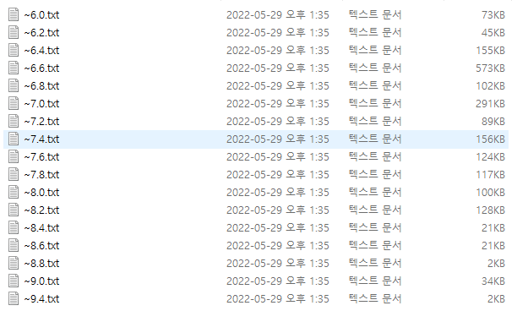
Think about..
Q) Why didn’t we narrow the gap between the scores?
A) Actually, we tried!

Slide 14
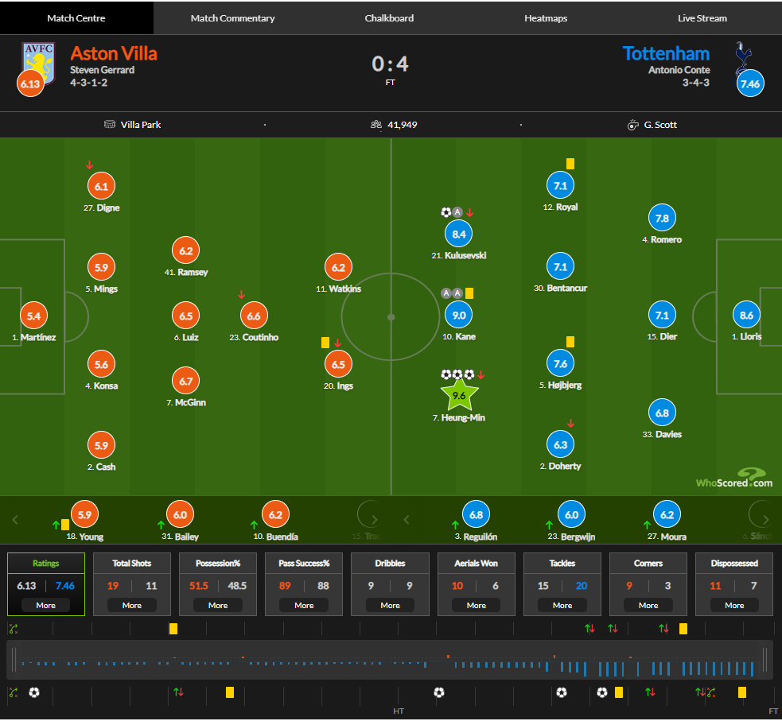
__Reminder__ How to evaluate
Comparison of the scores of each player in the https://1xbet.whoscored.com/ and predictive scores in the IRun model
Let’s dig it!

Slide 15
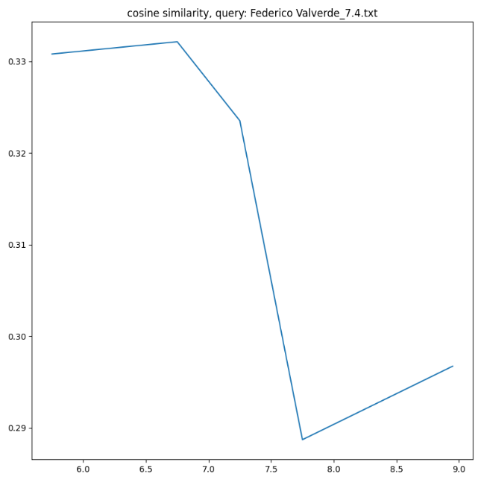
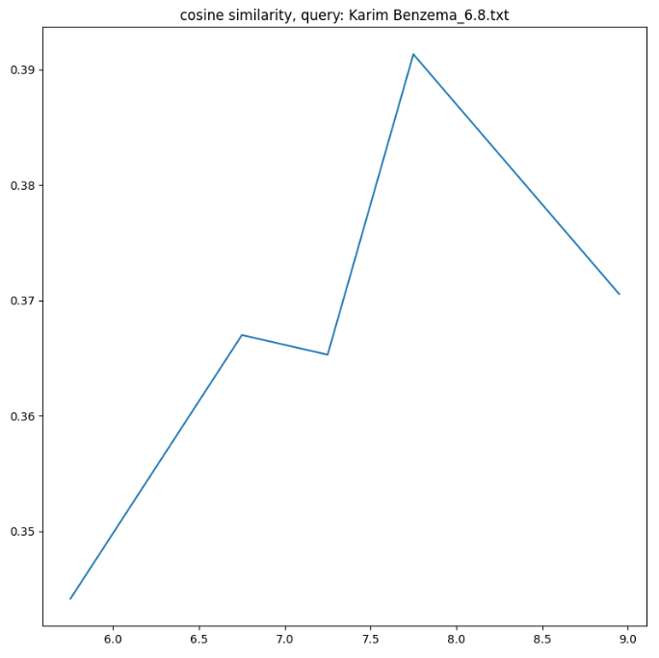


Result
Match : Liverpool(0) vs Real Madrid(1)
Champions League Final Stage
Federico Valverde
(FW)
Irun model:
[6.5 ~ 7.0]
Whoscored.com:
[7.4]
Karim Benzema
(FW)
Irun model:
[7.5~8.0]
Whoscored.com:
[6.8]

Slide 16
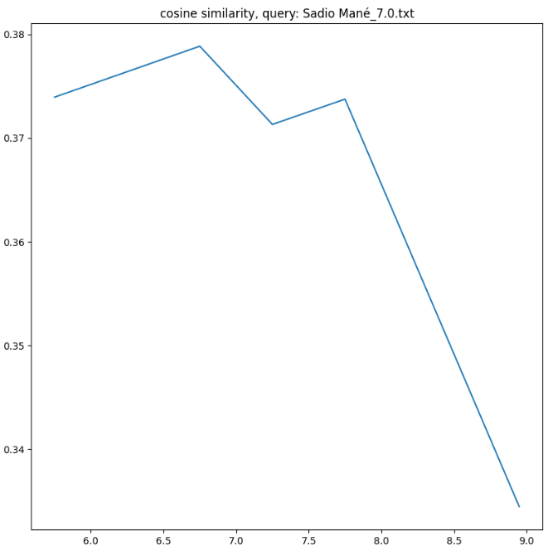
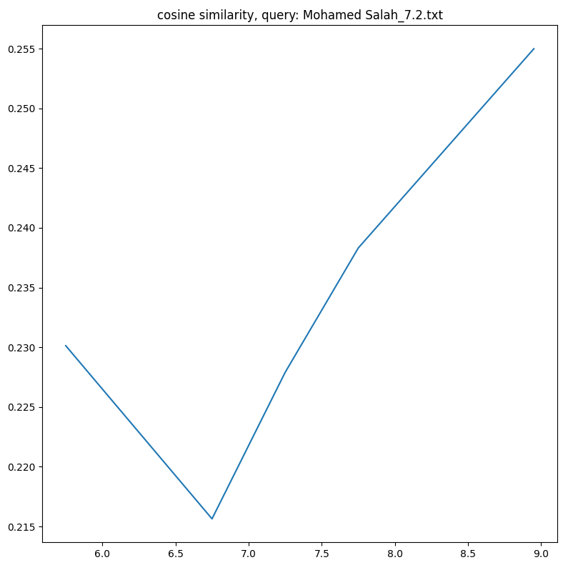


Result
Match : Liverpool(0) vs Real Madrid(1)
Champions League Final Stage
Sadio Mane
(FW)
Irun model:
[6.5 ~ 7.0]
Whoscored.com:
[7.0]
Mohamed Salah
(FW)
Irun model:
[8.0~9.9]
Whoscored.com:
[7.2]

Slide 17
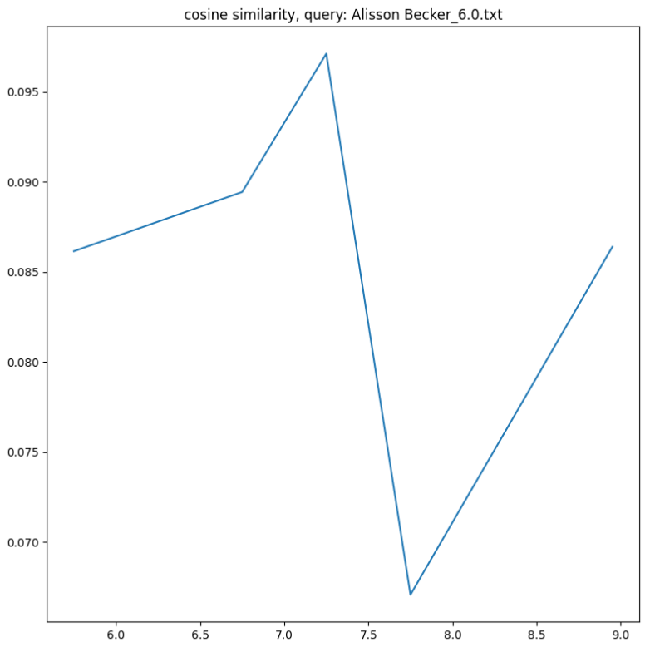
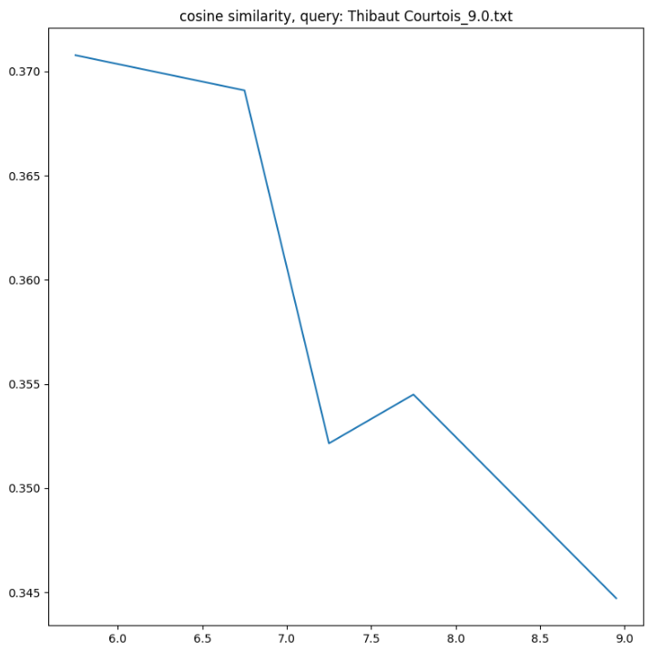


Result
Match : Liverpool(0) vs Real Madrid(1)
Champions League Final Stage
Alisson Becker
(GK)
Irun model:
[7.0 ~ 7.5]
Whoscored.com:
[6.0]
Courtois
(GK)
Irun model:
[~6.0]
Whoscored.com:
[9.3]

Slide 18
Future plans
~1 weeks : Detailed Design, Set a goal
~2 weeks : Crawling Match, Player Data. VSM modules
~3 weeks : Crawling tweets. VSM modules.
~4 weeks : Data processing, Evaluation modules.
~5 weeks : Finishing development and modularization
+ data processing + Get better results !
~6 weeks : Bug fix.
CLEAR

Slide 19
Thank you

