Slide 1
NLP Report Team IRun
20172864 서정현
20172848 정석우
20170364 한태균

Slide 2
Summary week1
-> Main idea
-> Environment
-> How it works
-> How to evaluate
-> Current progress
-> Role
-> Future plans

Slide 3


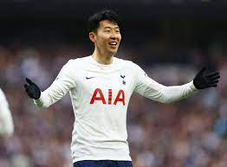

Main Idea - IRun
query
IRun-Machine
Sport player comments
(EPL)
Predicted score

Slide 4


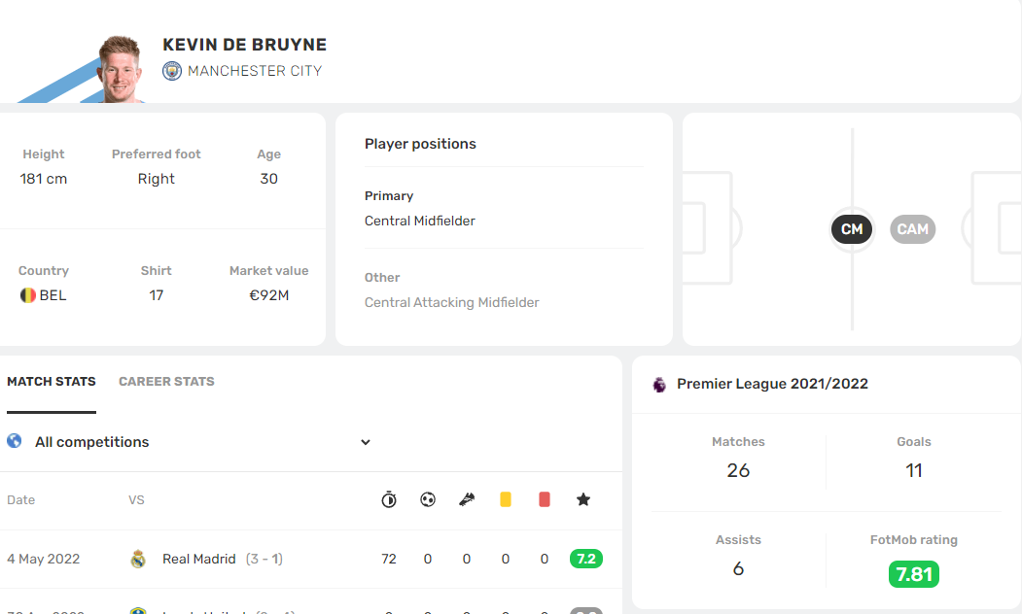
Goal!
There’re many rating sites exist through objective indicators.
But we can create a new rating standard through comments that it is subjective data

Slide 5


Envionment
Python 3
Selenium
Twitter API - tweepy
(https://github.com/bear/python-twitter)

Slide 6

How it works
Dataset?
Collecting comment for each players via twitter @mension!
(e.g. @HKane)

Slide 7
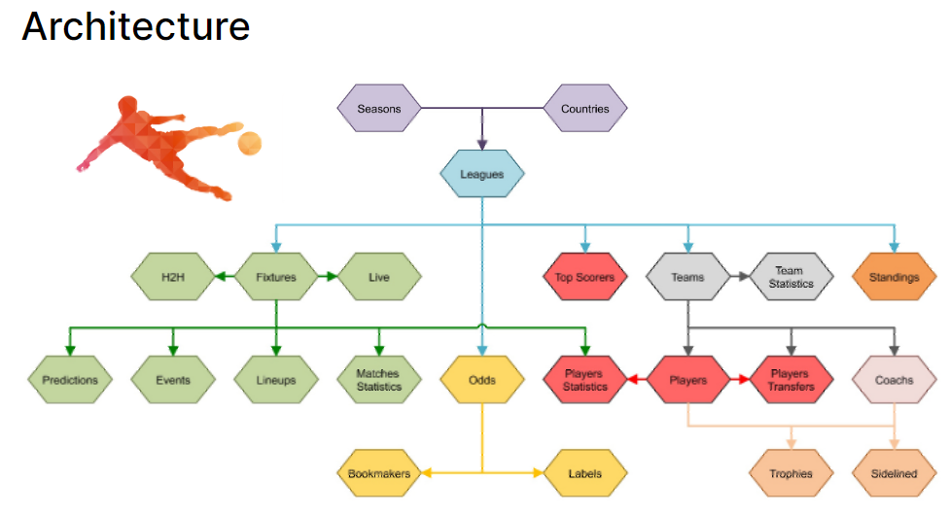
How it works
Football-API
→ We can know each player’s league schedule and rating!!
We can join the Twitter comment data set with a date to collect which players received ratings and comments at that time.
https://rapidapi.com/api-sports/api/api-football/details

Slide 8
How it works - Data Set
Crawling the match schedule
Crawling list of players who played in the match
Check the player’s mentioned tweets(at that time).
Crawling the comments
Data processing and classification -> make documents

Slide 9



How it works
What is documents?
-> Document by dividing sections
by rating ->> VSM
(Interval can be subdivided into decimals)
0~1
1~2
2~3
8~9
9~10

Slide 10
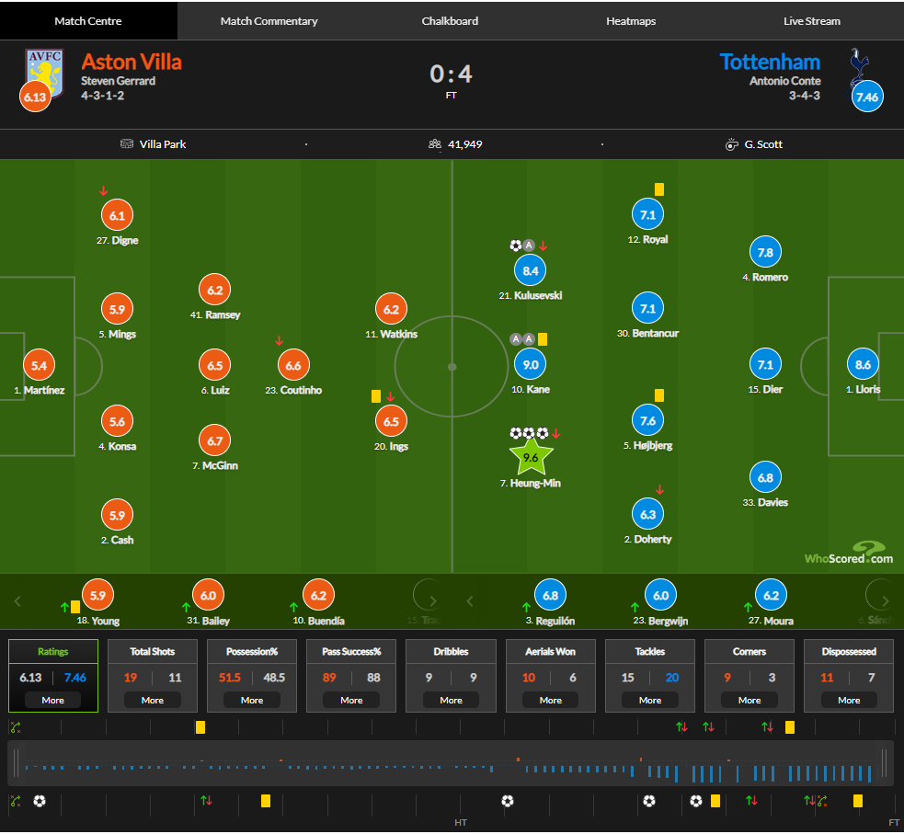
How to evaluate
Comparison of the scores of each player in the https://1xbet.whoscored.com/ and predictive scores in the IRun model

Slide 11
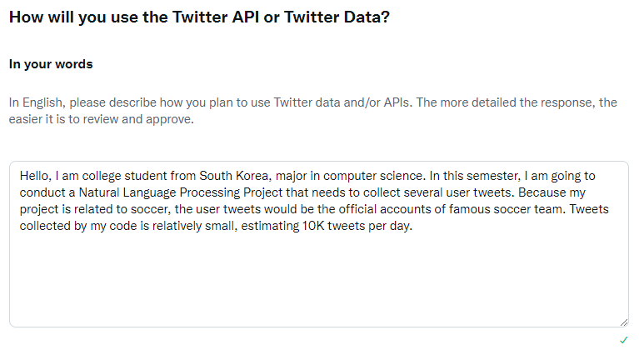
Current progress
Acquire Twitter API permission

Slide 12
Role
Crawling - 20172848 정석우
VSM - 20170364 한태균
Evaluation - 20172864 서정현
Docs - together

Slide 13
Future plans
~1 weeks : Detailed Design, Set a goal
~2 weeks : Crawling Match, Player Data. VSM modules
~3 weeks : Crawling tweets. VSM modules.
~4 weeks : Data processing, Evaluation modules.
~5 weeks : Finishing development and modularization
~6 weeks : Bug fix.

Slide 14
Thank you

