Slide 1
IRun 3rd week Progress
20172848 정석우
20172864 서정현
20170364 한태균

Slide 2
Project Overview
1. Crawl fixture data using RapidAPI Football-API
2. Crawl tweet data using tweeter API
3. ‘Document’ data, divide based on the rating of the players
4. Construct TF-IDF vector space model of documents
5. Construct similarity computation model using TF-IDF matrix and input query

Slide 3
Project Overview
Evaluation is conducted by comparing the player ratings of other existing rating by matches (ex. whoscored.com)
It can be expected to present a new rating to evaluate the player from social media reactions

Slide 4
This week’s progress overview
1. Finished making tweeter API and Football API crawler, Collected total ~5000 documents (tweets)
2. Made corpus data, divided into total 6 groups by rating
3. Constructed TF-IDF Model
4. Computed cosine similarity between input query and documents

Slide 5
Data preprocessing
Crawler gets fixture data (match date, starting XI, player rating after the fixture) and tweets about the match from start date to end date
Collected total 4730 tweets, divided into 6 groups by player’s rating after the fixture 0~6.5, 6.5~7.0, 7.0~7.5, 7.5~8.0, 8.0~8.5, 8.5~
Removed stop words and meaningless words
Finally made corpus data for TF-IDF model

Slide 6
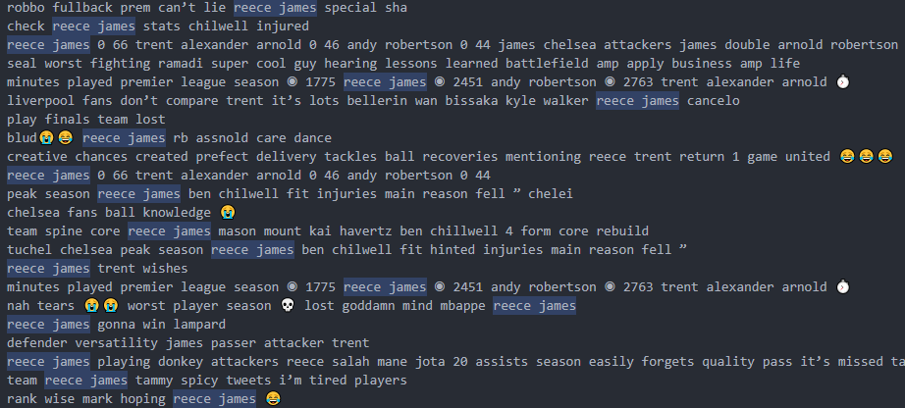
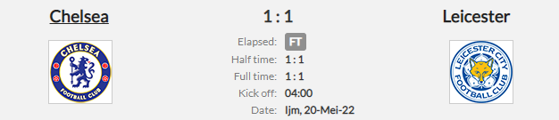
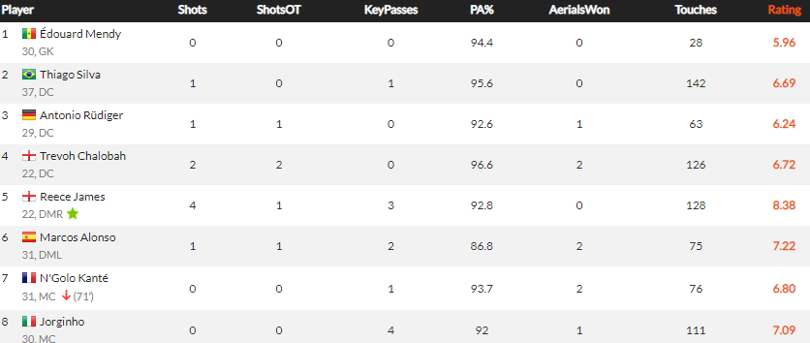

Data preprocessing
Tweets mentioning each player
Rating 8.0~8.5 document

Slide 7
Data preprocessing
Documents | # of Tweets | # of total words | Average # of words in a tweet
0~6.5 | 691 | 7596 | 10.9942
6.5~7.0 | 1479 | 18136 | 12.2623
7.0~7.5 | 883 | 11120 | 12.5934
7.5~8.0 | 1022 | 11258 | 11.0156
8.0~8.5 | 553 | 6115 | 11.0578
8.5~ | 102 | 1606 | 15.745
Total | 4730 | 55831 | 11.8035

Slide 8
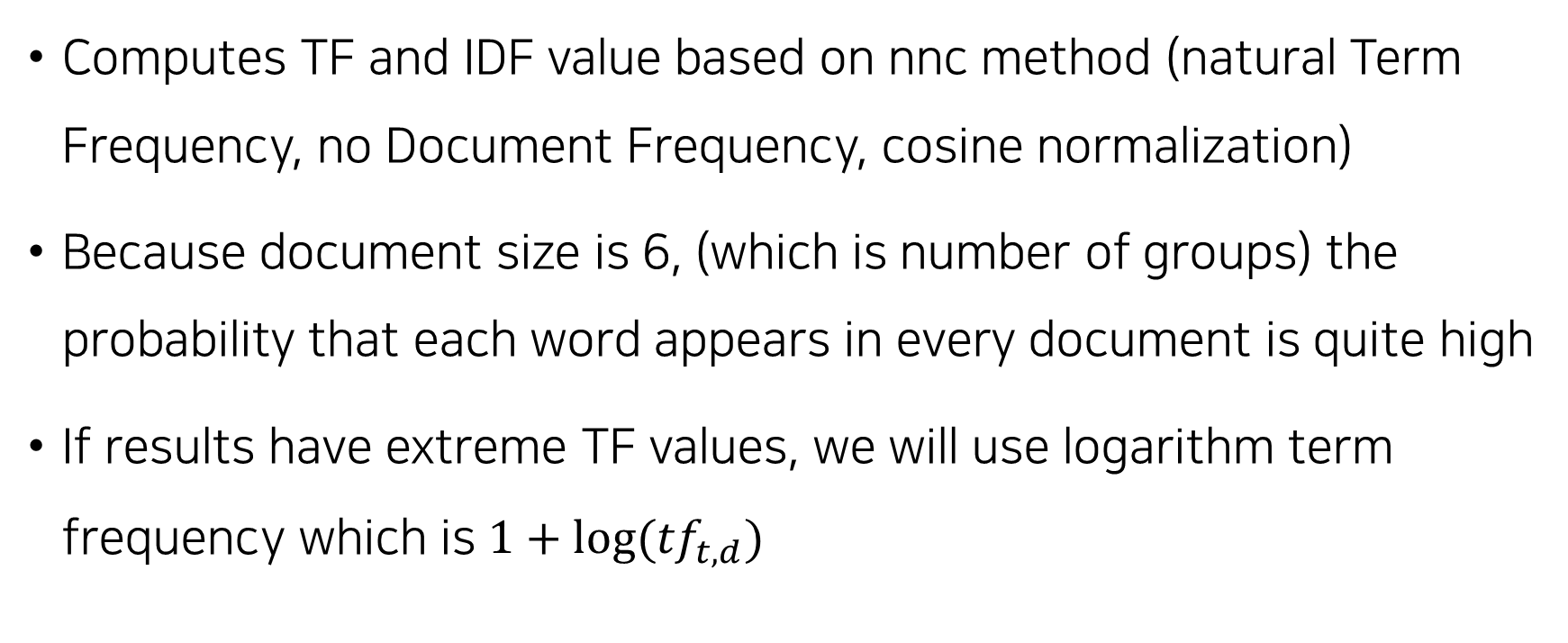
TF-IDF Model
Computes TF and IDF value based on nnc method (natural Term Frequency, no Document Frequency, cosine normalization)
Because document size is 6, (which is number of groups) the probability that each word appears in every document is quite high
If results have extreme TF values, we will use logarithm term frequency which is $1+log⁡({tf}_{t,d})$

Slide 9
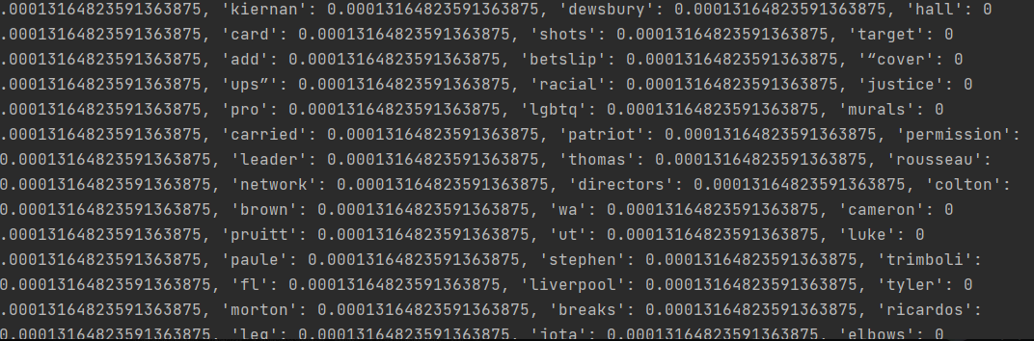
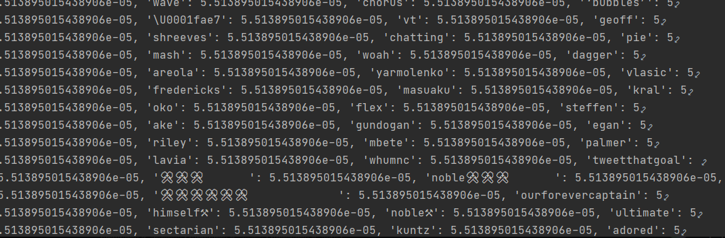
Corpus Segmentation Results

Slide 10
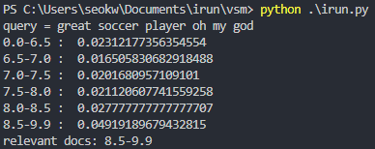
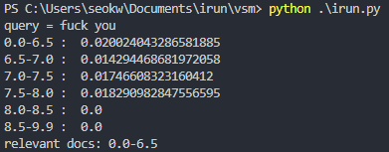
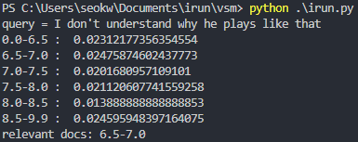
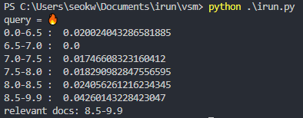
Results

Slide 11
Limitations & Improvements
More stop words to get enough, good quality document (Numbers, players’ name don’t contain any meaningful context)
Tweets contains not enough words compared to scripts, novel, or even news articles (average 11 words in a tweet)
Certain document has more words -> split into groups delicately, more documents

Slide 12
Next Week to-do list
Stop word optimizing
Apply LSA into vector space model
Evaluation via whoscored API

Slide 13
Thank you

