Slide 1
NLP 5th week Progress Team IRun
20172864 서정현
20172848 정석우
20170364 한태균

Slide 2
Index
Project Overview
Progress
Execution
Notes:
I will divide my presentation into 3 parts.
First, I will talk about our project summary.
Next, I will discuss current progress.
Lastly, We’re going to look at execution

Slide 3

Project Overview
Notes:
Let’s start with project summary.

Slide 4
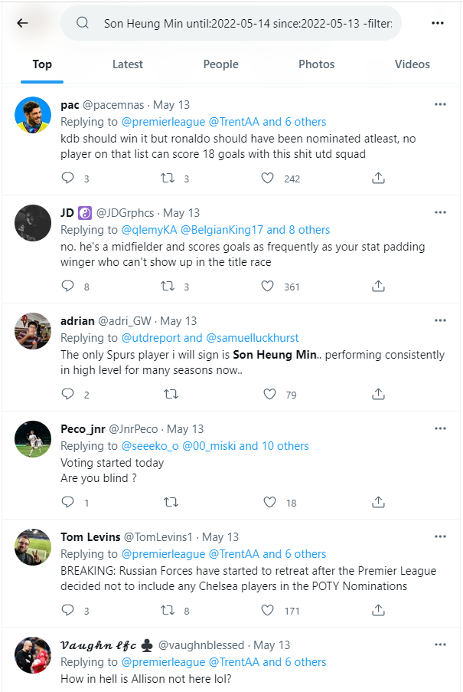
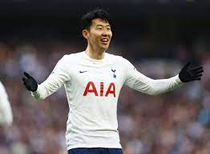
Summary
Query
User Rating: 8.5
Notes:
The goal of our project is to predict a player rating for a match through Twitter replies

Slide 5




Summary
IRun Rating
Son 8.5
new indicator !
Notes:
Player ratings are given by various sites such as whoscored or fotmob.
We expect this ‘Irun rating’ could be a new football rating indicator given by non-professional users.

Slide 6

Progress
Notes:
Now, Let’s move on to progress.

Slide 7
Weekly Plan
~1 weeks : Detailed Design, Set a goal
~2 weeks : Individual Crawling of Match, Rating, Tweets
~3 weeks : Sum up & Create docs, VSM
~4 weeks : Data processing, Evaluation modules
~5 weeks : Improve accuracy, modularization
~6 weeks : Irun rating: discrete → continuous, web test
Notes:
This is our weekly plan.
This week we tried to

Slide 8




Data Collection
Documents | Last Week Tweets | This Week Tweets
0~6.5 | 2626 | 3299
6.5~7.0 | 3633 | 3809
7.0~7.5 | 2504 | 2671
7.5~8.0 | 2447 | 2556
8.0~ | 1433 | 1503
Total | 12643 | 13838

Slide 9
Fix Stopwords
Add
Player name
Team name
Number
Meaningless words
player
team
time
play
left
right
etc
Remove
Meaningful words
appropriate
important/importance
interested/interesting/interest
necessary/necessarily
novel
problem
sensible
significant/significantly
successfully
etc

Slide 10
Module
irun.py
api_football
_requester
api_football
_module.py
twitter_crawler
doc_maker.py
twitter_crawler.py
vsm
vsm.py
query_maker.py
twitter_secret.py
corpus
0.0-6.5.txt
6.5-7.0.txt
7.0-7.5.txt
7.5-8.0.txt
8.0-9.9.txt
api_football _secret.py

Slide 11
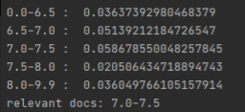
Rating Derivation Algorithm
The problem with the last result
We don't want an interval, we want a specific value !

Slide 12
Rating Derivation Algorithm
Apply min-max normalization to the result.
Apply exp(x * 𝛼) - 1 to the result.
Normalize the result by dividing by sum of result.
Calculate the rating as the dot product of result and docs_weight.

Slide 13
Rating Derivation Algorithm
result = [ 0.123, 0.126, 0.133, 0.151, 0.146 ]
0.0-6.5.txt
<5>
6.5-7.0.txt
<6.5>
7.0-7.5.txt
<7.5>
7.5-8.0.txt
<8.5>
8.0-9.9.txt
<10>
Apply min-max normalization to the result.
Apply exp(x * 𝛼) – 1 to the result. (𝛼=5)
Normalize the result by dividing by sum of result.
Calculate the rating as the dot product of result and docs_weight.

Slide 14
Rating Derivation Algorithm
result = [ 0.123, 0.126, 0.133, 0.151, 0.146 ]
0.0-6.5.txt
<5>
6.5-7.0.txt
<6.5>
7.0-7.5.txt
<7.5>
7.5-8.0.txt
<8.5>
8.0-9.9.txt
<10>
Apply min-max normalization to the result.
Apply exp(x * 𝛼) – 1 to the result. (𝛼=5)
Normalize the result by dividing by sum of result.
Calculate the rating as the dot product of result and docs_weight.

Slide 15
Rating Derivation Algorithm
result = [ 0.123, 0.126, 0.133, 0.151, 0.146 ]
0.0-6.5.txt
<5>
6.5-7.0.txt
<6.5>
7.0-7.5.txt
<7.5>
7.5-8.0.txt
<8.5>
8.0-9.9.txt
<10>
result = [0.0, 0.107, 0.357, 1.0, 0.821]
Apply exp(x * 𝛼) – 1 to the result. (𝛼=5)
Normalize the result by dividing by sum of result.
Calculate the rating as the dot product of result and docs_weight.

Slide 16
Rating Derivation Algorithm
result = [ 0.123, 0.126, 0.133, 0.151, 0.146 ]
0.0-6.5.txt
<5>
6.5-7.0.txt
<6.5>
7.0-7.5.txt
<7.5>
7.5-8.0.txt
<8.5>
8.0-9.9.txt
<10>
result = [0.0, 0.107, 0.357, 1.0, 0.821]
Apply exp(x * 𝛼) - 1 to the result. (𝛼=5)
Normalize the result by dividing by sum of result.
Calculate the rating as the dot product of result and docs_weight.

Slide 17
Rating Derivation Algorithm
result = [ 0.123, 0.126, 0.133, 0.151, 0.146 ]
0.0-6.5.txt
<5>
6.5-7.0.txt
<6.5>
7.0-7.5.txt
<7.5>
7.5-8.0.txt
<8.5>
8.0-9.9.txt
<10>
result = [0.0, 0.107, 0.357, 1.0, 0.821]
result = [0.0, 0.709, 4.964, 147.413, 59.773]
Normalize the result by dividing by sum of result.
Calculate the rating as the dot product of result and docs_weight.

Slide 18
Rating Derivation Algorithm
result = [ 0.123, 0.126, 0.133, 0.151, 0.146 ]
0.0-6.5.txt
<5>
6.5-7.0.txt
<6.5>
7.0-7.5.txt
<7.5>
7.5-8.0.txt
<8.5>
8.0-9.9.txt
<10>
result = [0.0, 0.107, 0.357, 1.0, 0.821]
result = [0.0, 0.709, 4.964, 147.413, 59.773]
Normalize the result by dividing by sum of result.
Calculate the rating as the dot product of result and docs_weight.

Slide 19
Rating Derivation Algorithm
result = [ 0.123, 0.126, 0.133, 0.151, 0.146 ]
0.0-6.5.txt
<5>
6.5-7.0.txt
<6.5>
7.0-7.5.txt
<7.5>
7.5-8.0.txt
<8.5>
8.0-9.9.txt
<10>
result = [0.0, 0.107, 0.357, 1.0, 0.821]
result = [0.0, 0.709, 4.964, 147.413, 59.773]
result = [0.0, 0.003, 0.023, 0.693, 0.281]
Calculate the rating as the dot product of result and docs_weight.

Slide 20
Rating Derivation Algorithm
result = [ 0.123, 0.126, 0.133, 0.151, 0.146 ]
0.0-6.5.txt
<5>
6.5-7.0.txt
<6.5>
7.0-7.5.txt
<7.5>
7.5-8.0.txt
<8.5>
8.0-9.9.txt
<10>
result = [0.0, 0.107, 0.357, 1.0, 0.821]
result = [0.0, 0.709, 4.964, 147.413, 59.773]
result = [0.0, 0.003, 0.023, 0.693, 0.281]
Calculate the rating as the dot product of result and docs_weight.

Slide 21
Rating Derivation Algorithm
result = [ 0.123, 0.126, 0.133, 0.151, 0.146 ]
0.0-6.5.txt
<5>
6.5-7.0.txt
<6.5>
7.0-7.5.txt
<7.5>
7.5-8.0.txt
<8.5>
8.0-9.9.txt
<10>
result = [0.0, 0.107, 0.357, 1.0, 0.821]
result = [0.0, 0.709, 4.964, 147.413, 59.773]
result = [0.0, 0.003, 0.023, 0.693, 0.281]
rating = 8.891

Slide 22

Web
What we have done :: get tweets about a player, made a criteria to create a rating for them -> Made simple web api to convert user-input query into ‘irun-rating’
An example of single sentence query input : “His play is amazing; his every shooting becomes a nightmare to the goalkeepers”, or “His pass is the worst. Even my 5-year-old child can pass well than him”
Notes:
So to conclude, we have done with making criteria for rating generation. So we made a simple web api to convert user input query to our irun rating. An example of single sentence query input is like below.

Slide 23
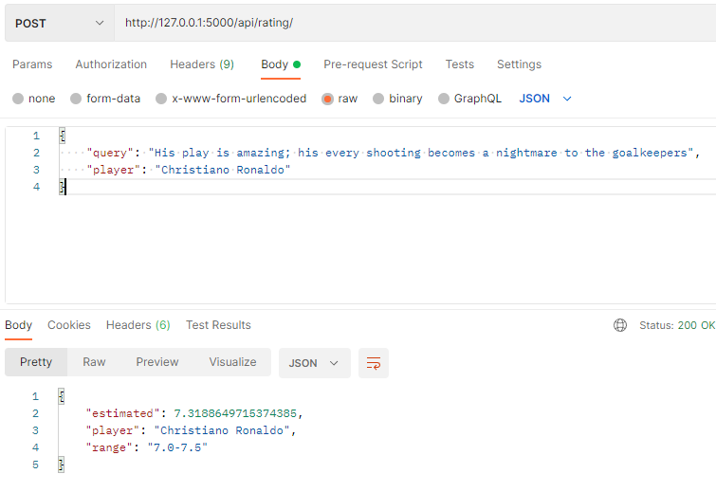
Web
Notes:
First example query is ‘his play is amazing, his every shooting becomes a nightmare to the goalkeepers’.
This query got 7.31 irun rating.

Slide 24
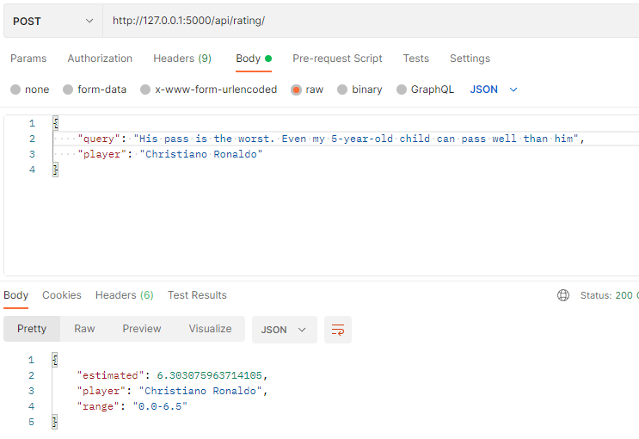
Web
Notes:
Here is another query example : ‘his pass is the worst, even my 5-year-old child can pass well than him’ and this query got 6.30 irun rating.

Slide 25

Execution
Notes:
Now, Let’s see a Execution.

Slide 26
직접 실행화면 보이기
make_query ? – 어떤 매치?
Irun 지난 주 결과와 비교!
web 테스트

Slide 27
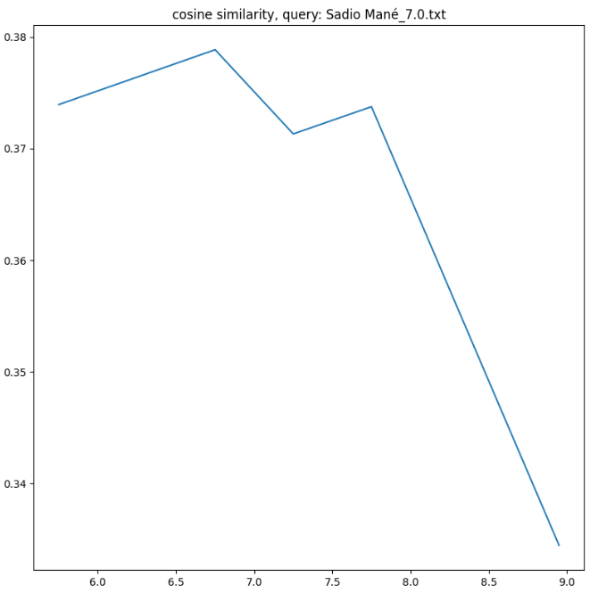
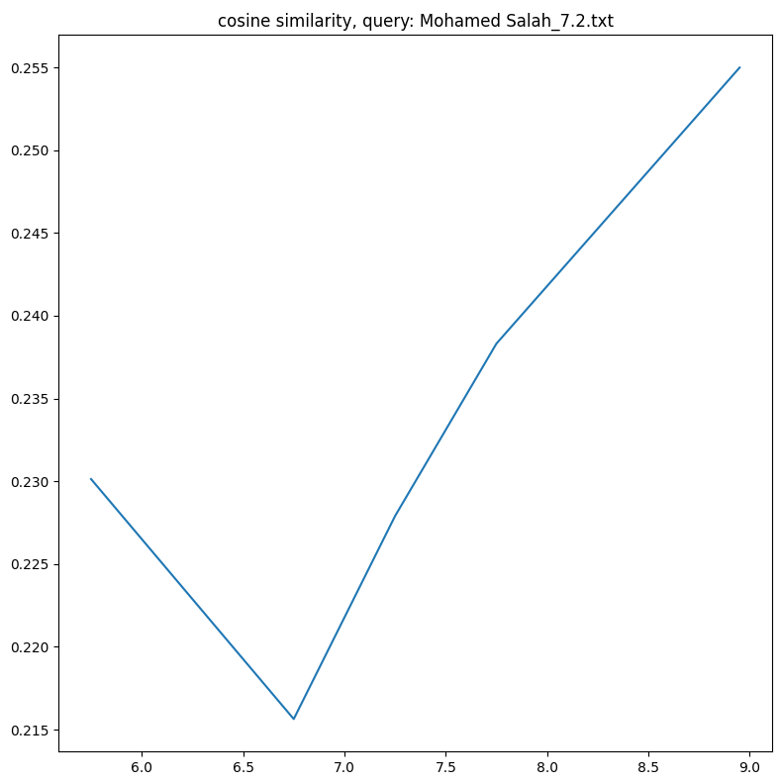


Last Week Result
Match : Liverpool(0) vs Real Madrid(1)
Champions League Final Stage
Sadio Mane
(FW)
Irun model:
[6.5 ~ 7.0]
Whoscored.com:
[7.0]
Mohamed Salah
(FW)
Irun model:
[8.0~9.9]
Whoscored.com:
[7.2]

Slide 28
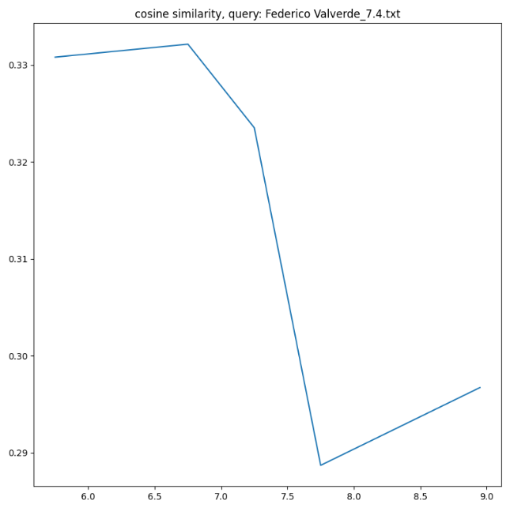
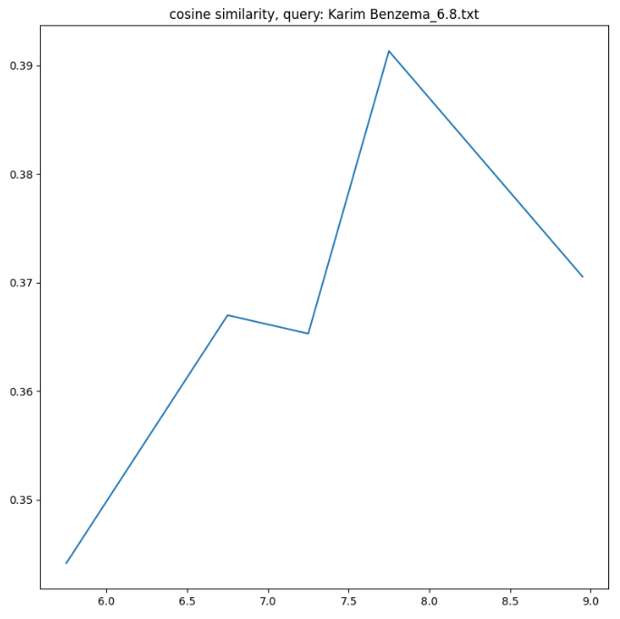


Last Week Result
Match : Liverpool(0) vs Real Madrid(1)
Champions League Final Stage
Federico Valverde
(FW)
Irun model:
[6.5 ~ 7.0]
Whoscored.com:
[7.4]
Karim Benzema
(FW)
Irun model:
[7.5~8.0]
Whoscored.com:
[6.8]

Slide 29
Thank you

