Slide 1
IRun 3rd week Progress
20172848 정석우
20172864 서정현
20170364 한태균

Slide 2
Project Overview
1. Crawl fixture data using RapidAPI Football-API
2. Crawl tweet data using tweeter API
3. ‘Document’ data, divide based on the rating of the players
4. Construct TF-IDF vector space model of documents
5. Construct similarity computation model using TF-IDF matrix and input query

Slide 3
This week’s progress overview
1. Finished making tweeter API and Football API crawler, Collected total ~3000 documents (tweets)
2. Constructed TF-IDF Model
3. Made corpus data, divided into total 6 groups by rating

Slide 4
Data preprocessing
Crawler gets fixture data (match date, starting XI, player rating after the fixture) and matches with the tweets from start date to end date
Collected total N tweets, divided into 6 groups by player’s rating after the fixture 0~6.5, 6.5~7.0, 7.0~7.5, 7.5~8.0, 8.0~8.5, 8.5~
Removed stop words and meaningless words
Finally made corpus data for TF-IDF model

Slide 5
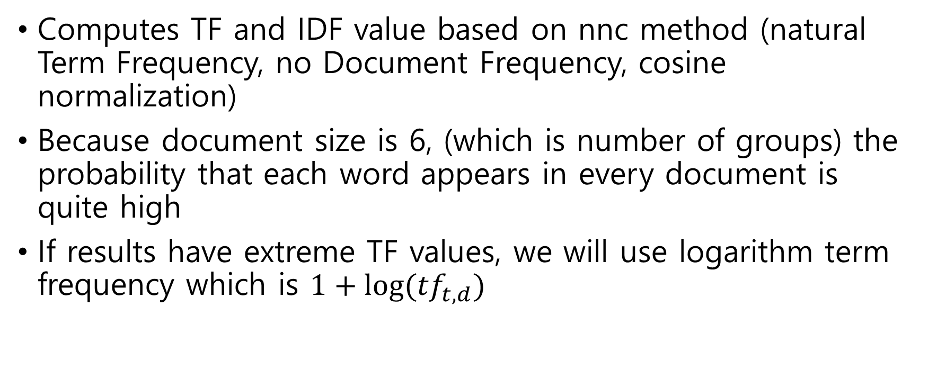
TF-IDF Model
Computes TF and IDF value based on nnc method (natural Term Frequency, no Document Frequency, cosine normalization)
Because document size is 6, (which is number of groups) the probability that each word appears in every document is quite high
If results have extreme TF values, we will use logarithm term frequency which is $1+log⁡({tf}_{t,d})$

Slide 6
Corpus Segmentation Results

Slide 7
Thank you

