Slide 1
ACISI × Avyora Health
Healthcare, within reach.
One patient visit at Avyora Health – Westlands, from phone check-in to checkout.
acisi.co.ke
Demo clinic. All patients, staff and phone numbers shown are fictional.

Slide 2
One visit, six steps
Follow Grace Wairimu through a morning at Avyora Health – Westlands. Every screen in this walkthrough is the real ACISI system.
1
2
3
4
5
6
Phone check-in
Reception
Department queues
Consultation
Checkout
Patient record
Grace checks in from home and pays the KES 100 check-in fee by M-Pesa.
Her arrival appears at the front desk straight away. A walk-in is added too.
Each department has its own queue; each doctor sees only theirs.
The doctor writes notes and a prescription, then signs with a PIN.
The prescription is waiting at the front desk for billing and payment.
Grace can see and download her visit record on her phone.
Departments set up for Avyora
Demo team
General Consultation · Paediatrics · Gynaecology · Pharmacy & Checkout
Achieng Otieno (front desk) · Dr. Kiprono Langat (General Consultation) · Dr. Fatuma Abdi (Paediatrics) · Dr. Nyambura Gichuru (Gynaecology) · Mwende Musyoka (checkout)

Slide 3
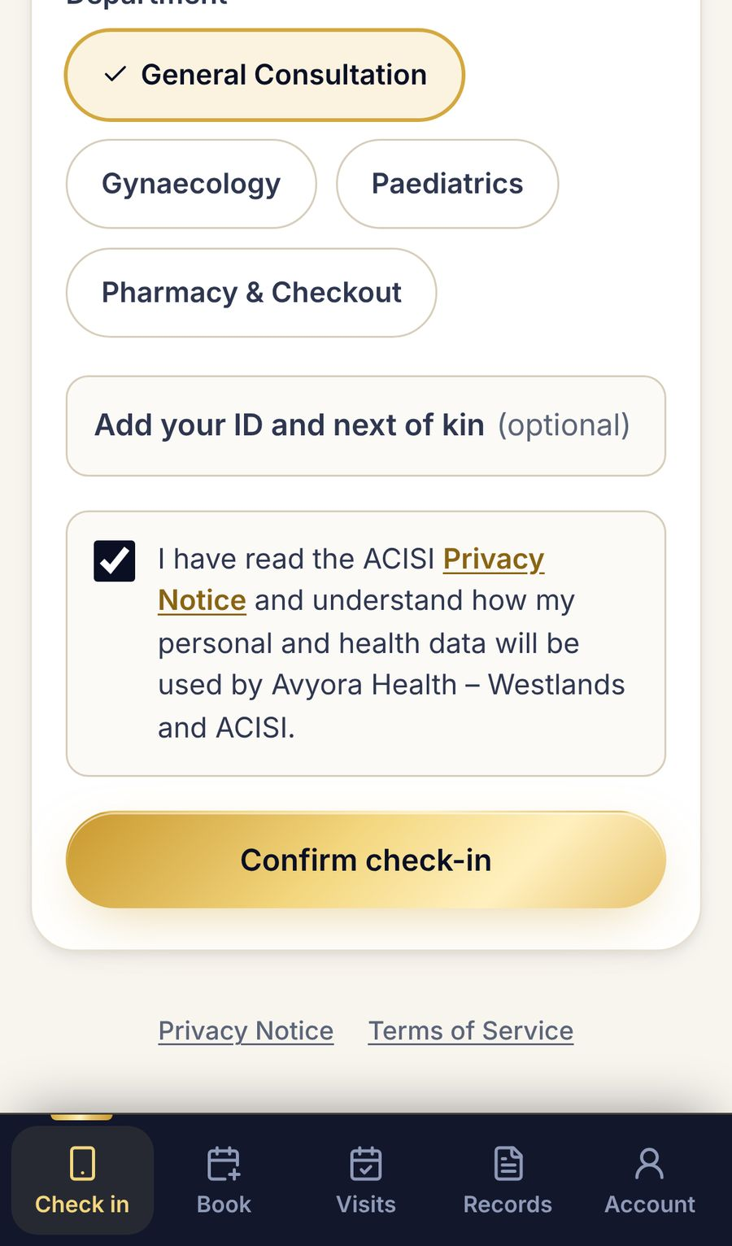
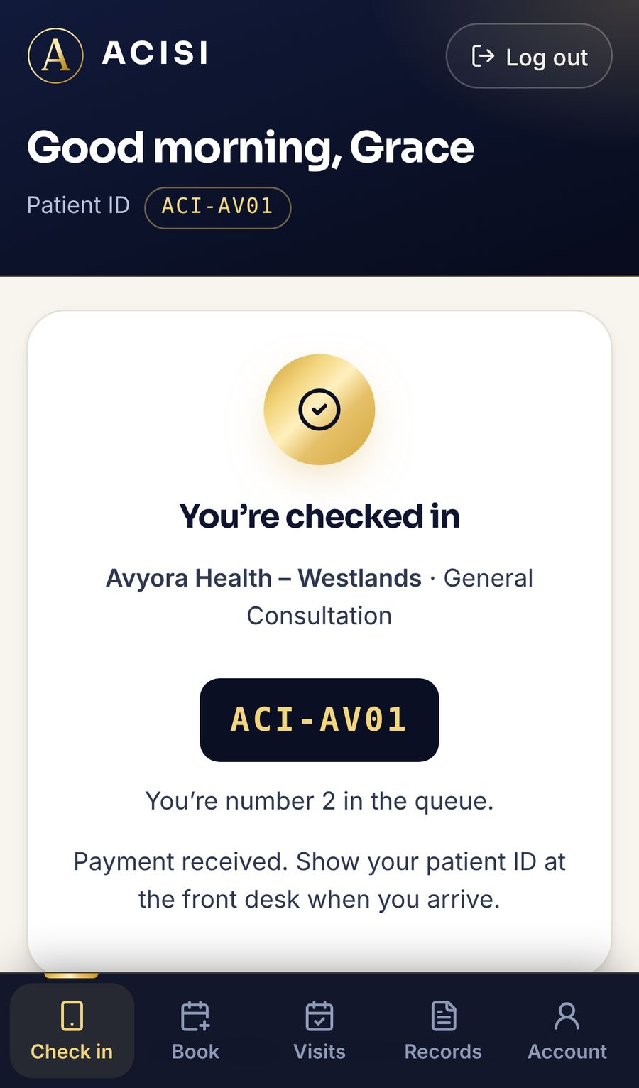
Check in from home
01
PATIENT'S PHONE
Patients check in from their phone before they arrive. No app to install.
Shown: Grace picks the clinic and department, confirms, and pays the KES 100 check-in fee by M-Pesa. She is told her place in the queue.

Slide 4
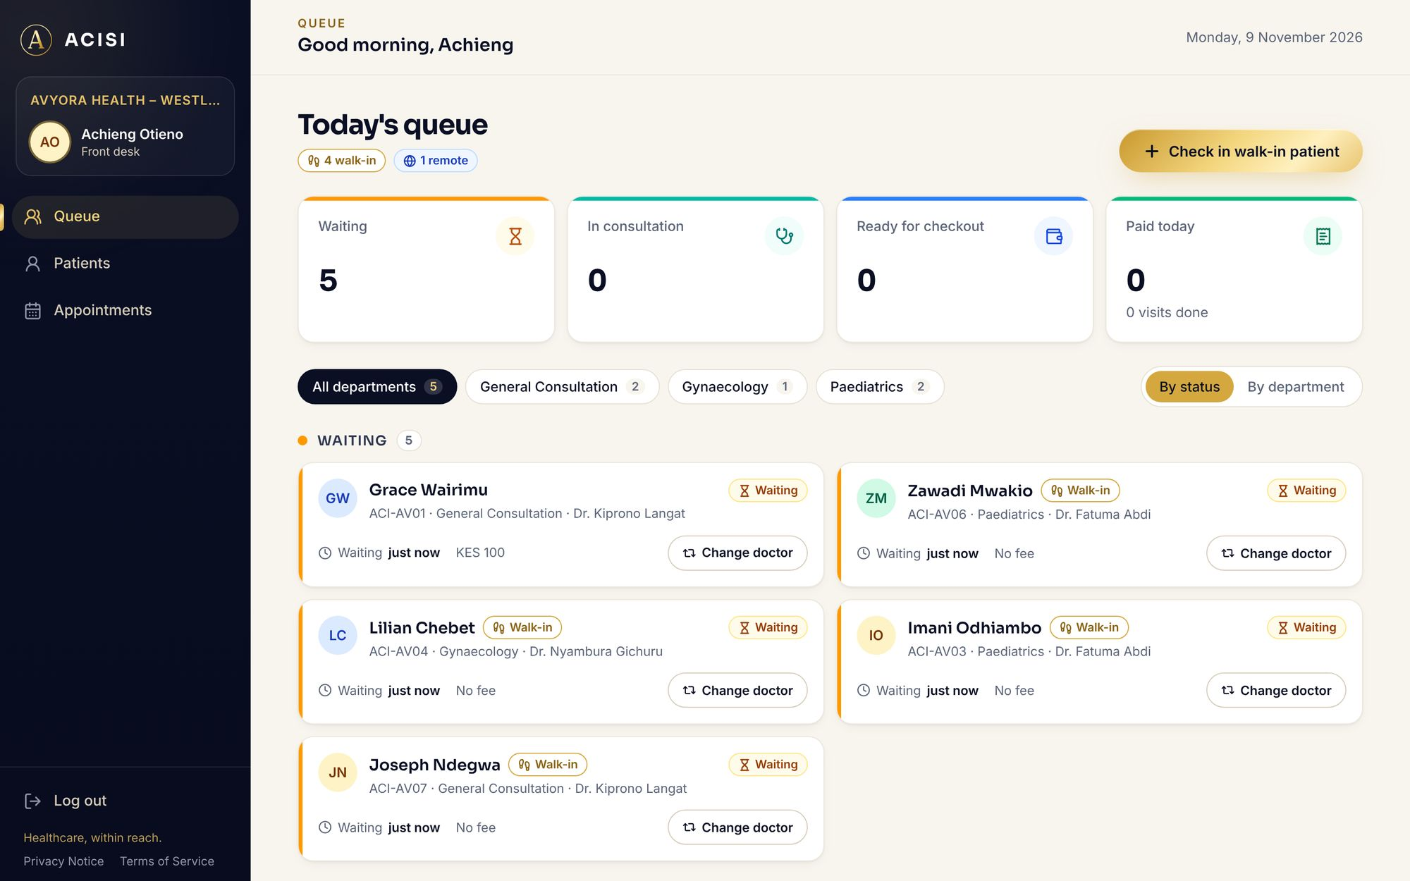
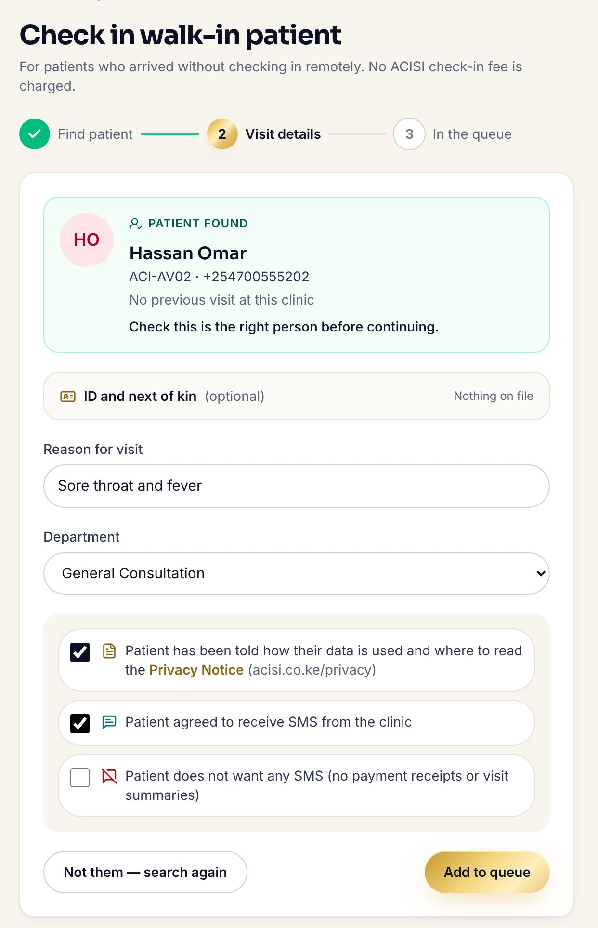
Reception sees who's coming
TODAY'S QUEUE
02
FRONT DESK
WALK-IN CHECK-IN
Reception sees who's coming before they walk in, and adds walk-ins in a few taps.
Shown: Grace's remote check-in appears in the queue without a page refresh. Then Achieng checks in Hassan Omar, who walked in.

Slide 5
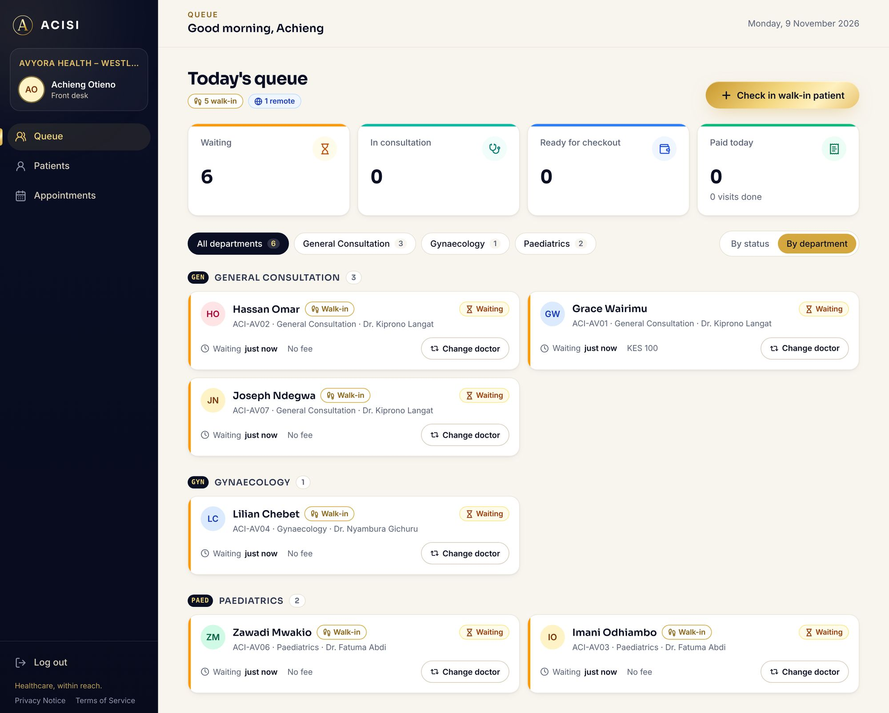
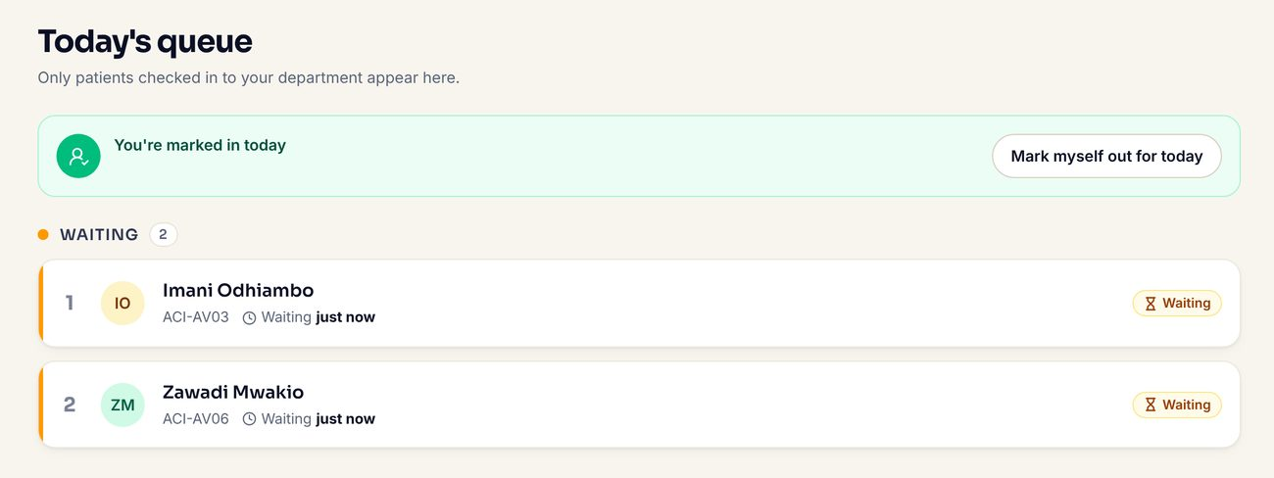
A queue for every department
RECEPTION: BY DEPARTMENT
03
DEPARTMENTS
Each department gets its own queue, and each doctor sees only their own patients.
PAEDIATRICS DOCTOR'S QUEUE
Shown: reception's view by department, and Dr. Fatuma Abdi's Paediatrics queue, which lists only her two patients.

Slide 6
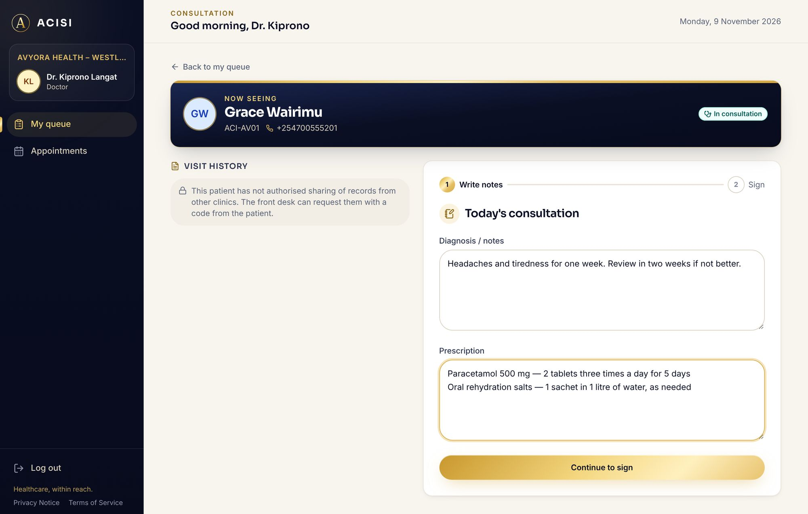
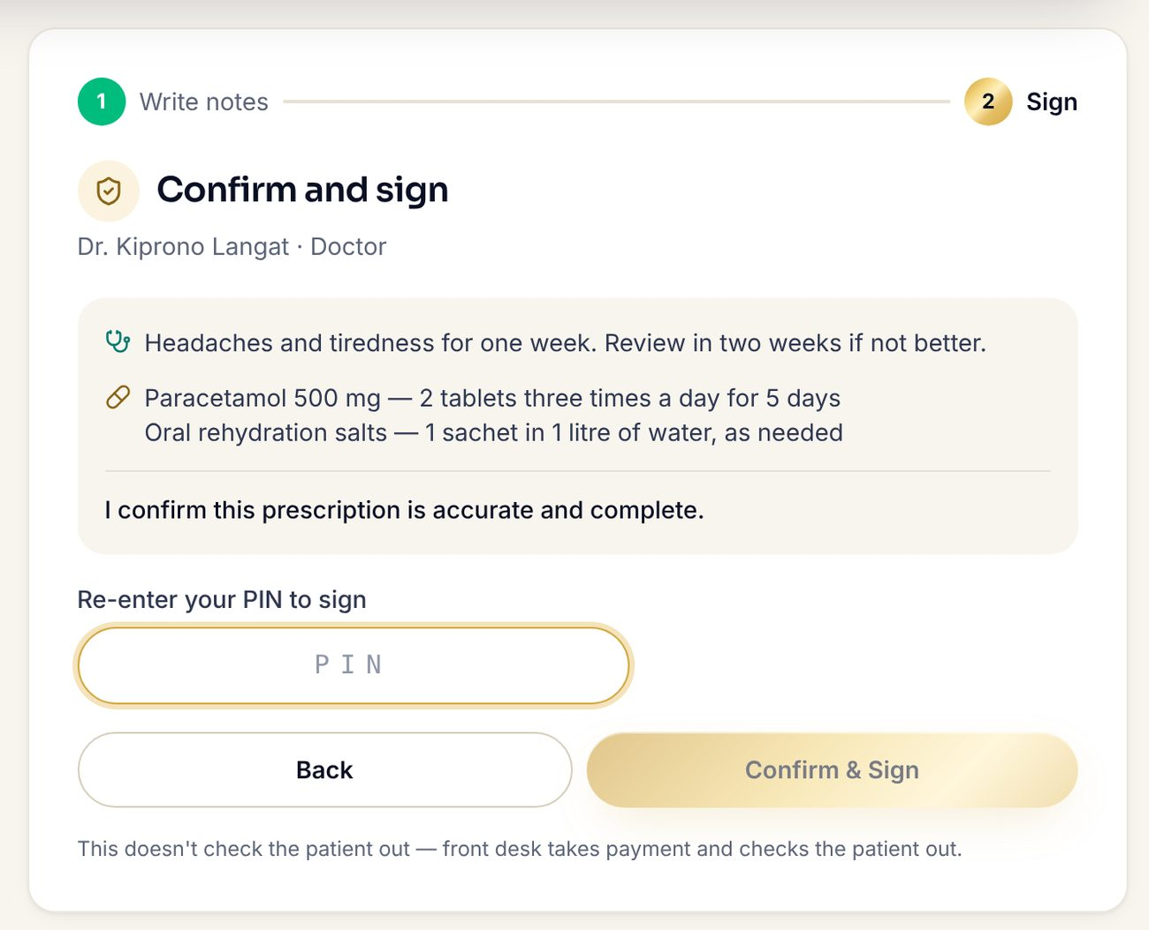
Notes and prescription in one place
WRITE NOTES
04
DOCTOR
Doctors record consultation notes and a digital prescription, signed with their PIN.
CONFIRM AND SIGN
Shown: Dr. Kiprono Langat writes the notes and prescription, then confirms and signs. Nothing has to be rewritten by hand.

Slide 7
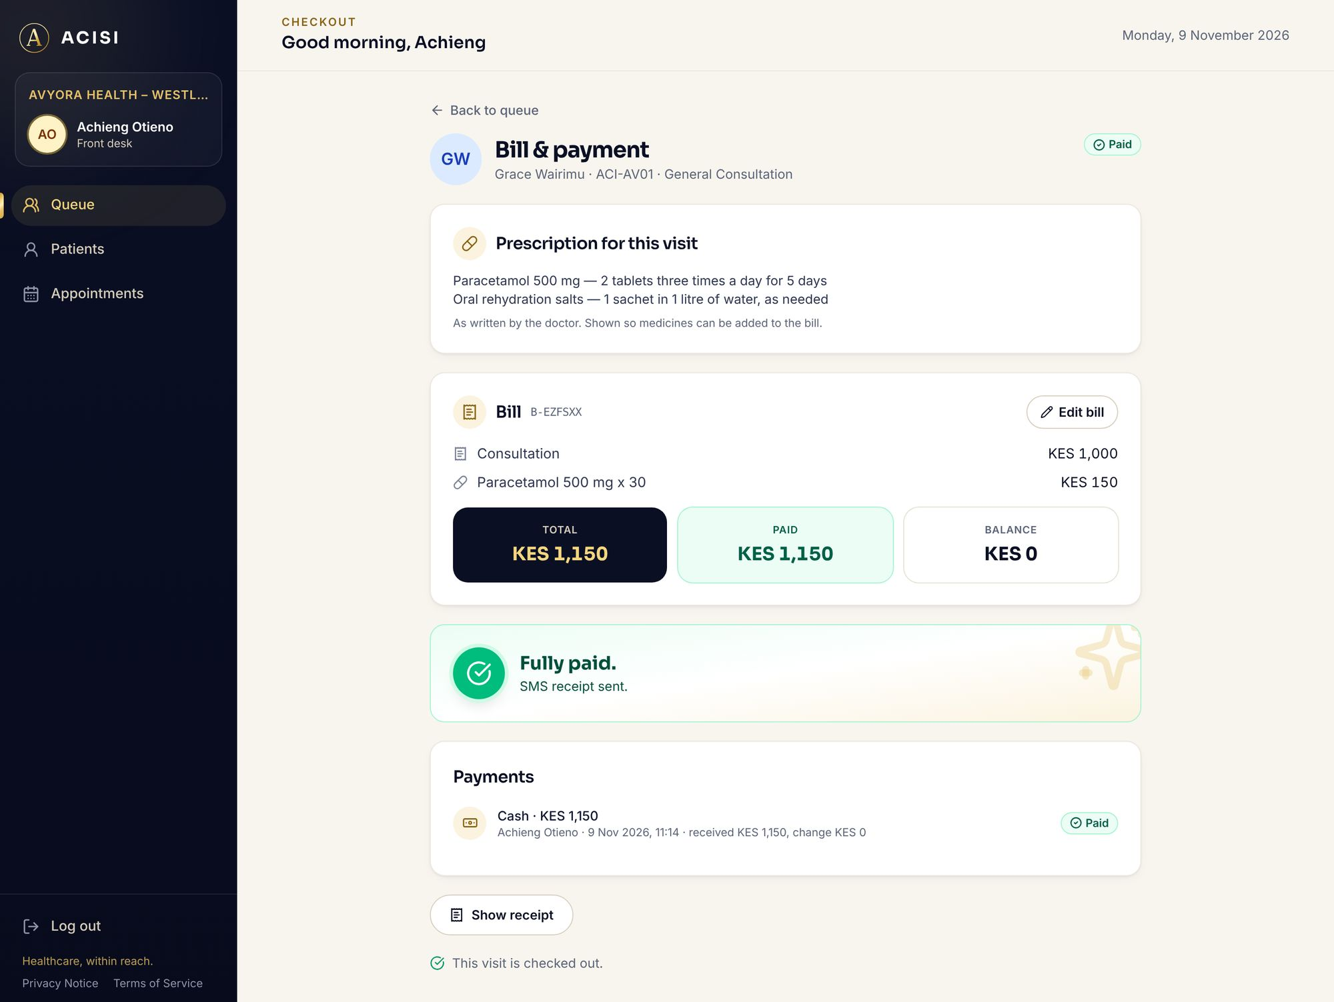
Prescription ready at checkout
05
CHECKOUT
The prescription is waiting at the front desk: bill, take payment and send the receipt by SMS.
Shown: the doctor's prescription, the bill (consultation and medicine), a cash payment, and the visit checked out.

Slide 8
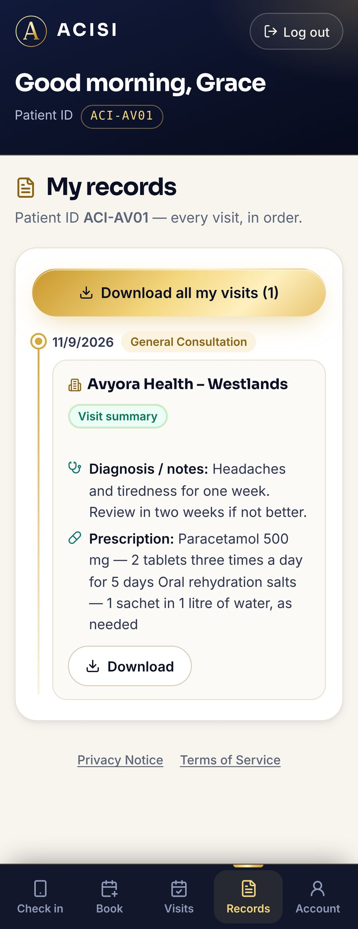
Patients keep their own record
06
PATIENT'S PHONE
Patients can view and download their own visit record at any time.
Shown: after checkout, Grace opens My records and sees today's visit at Avyora Health – Westlands, ready to download.

Slide 9
Run ACISI free for one week, set up with your own departments and staff.
acisi.co.ke
[Phone number]
Healthcare, within reach.

