Slide 1
Basics of Protocol
Name: G Vamsi Girish
M.Tech: NIT Trichy VLSI System

Slide 2
What is protocol
a set of rules or procedures for transmitting data between electronic devices, such as computers.
Why its needed?
Protocol it needed for interact with each component in on-chip SOC.
Example: How to interact processor to USB driver or printer without connects. We can’t tell directly to processor do some operation.
Types of protocols
1.ON-Chip : this protocol used to communicate various IP blocks in chip(SOC).
Example: AXI,APB,AHB.
Limitations: Bandwidth
2.Peripheral protocol : this protocol communication happen between SOC block to external devices.
example: PCIE,USB.
Limitations: number of ports.

Slide 3
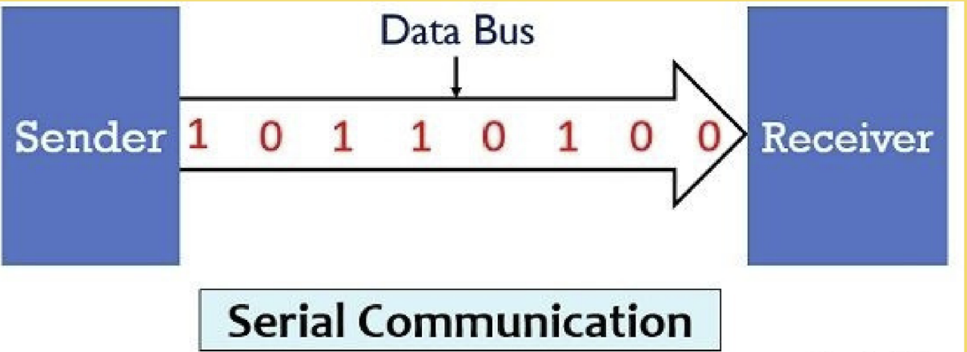
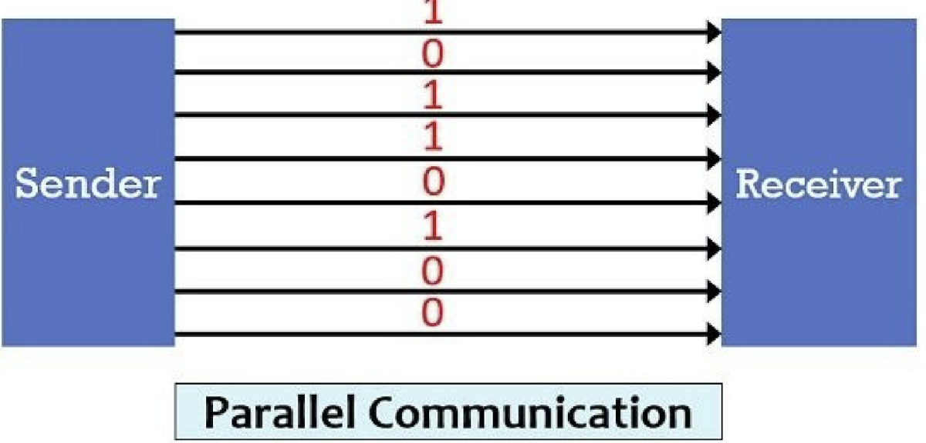
Serial protocol
Serial communication protocols assume that bits are transmitted in series down a single channel.
Parallel Protocol parallel bus communication transmits multiple bits of data simultaneously sampled at the speed defined by an additional clock line, and within the defined edges of an optional chip select line.
What is mean by interconnect?
physical or logical connection between two electronic devices or networks.

Slide 4
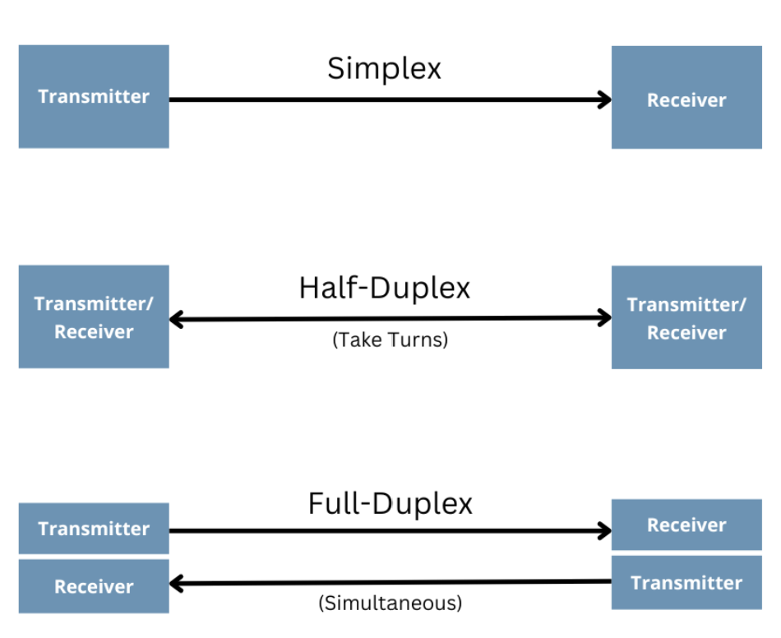
what mean by duplex? Types of duplex in communication.
Half Duplex: only data will send from initiator to target or target to initiator. Its will not happen both same time.
Example: I2C bus protocol.
full duplex: data received and transmit happen both at same time as well.
Example:SPI protocol.
Simplex: the data can send or receive entire life cycle.
Example: keyboard.

Slide 5
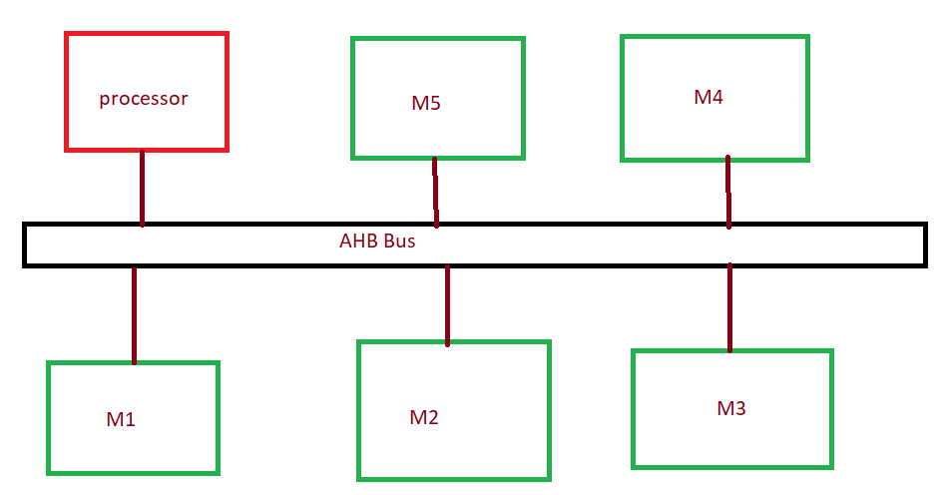
Full Bus Mastering Bus mastering is a bus design that allows an expansion card (or plug-in board) to access the computer's memory independently of the CPU. This allows data transfer between the peripheral and the main system memory while the CPU is being used by other devices
Arbitration : process of giving grant in particular master in multiple masters.

Slide 6
Burst Length Burst length is the amount of data transferred between the CPU and memory in each transmission
What is mean by handshaking :
Assume initiator is busy with slave1.
Another slave2 want to send data to mater.
Master will give as signal to slave2 like , I am busy another operation.
This mechanism is called handshaking.
Initiator(master): it initiate the transaction request. Target: its just like respond based on initiator.
Example: Memory device

Slide 7
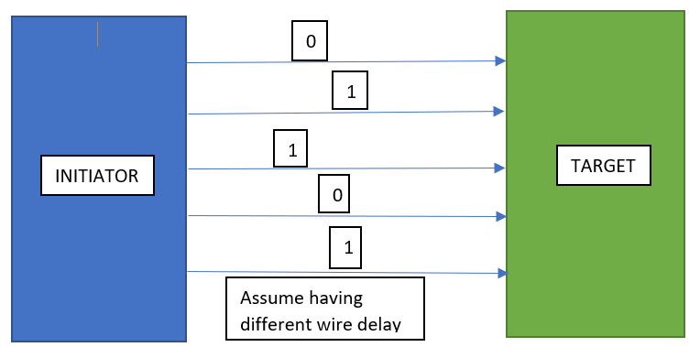

Bandwidth limitation is parallel protocol
In parallel protocol having bandwidth limitations due to Skew.
How skew is effecting in operating frequency.
Initiator issued data with same time, but target won’t receive this data with same time due to wire delay.

Slide 8
specifications
How to overcome this?
Using serial protocol its possible
Example : PCIE is best for this
Low power Consumption
Complexity of the circuit
Overall cost of the product.
Performance
Area

Slide 9
Components of protocol
System level architecture
State diagram
Modules
Waveforms
Observations results
Conclusions:
* Advantages
* Disadvantages
* How to overcome those disadvantages.
Parameters:
speed
Latency and loading effect.
Throughput
Area
One practical example.

Slide 10
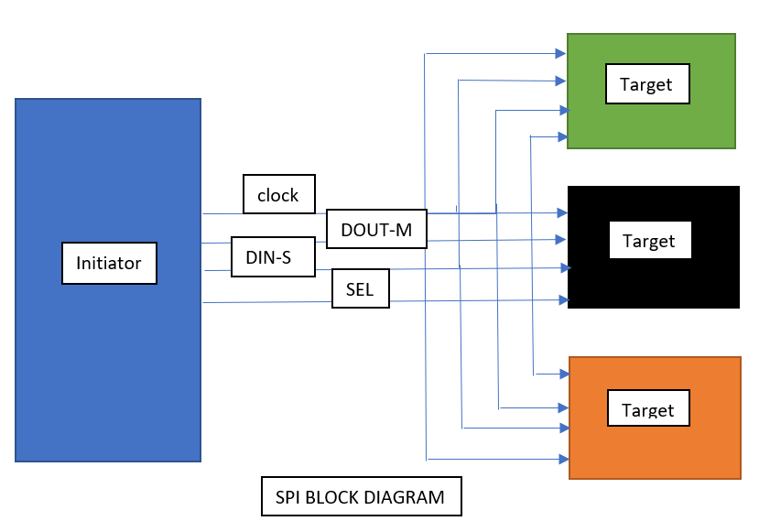
Disadvantages of SPI(Serial peripheral interface) protocols
Used a greater number of wires.
The communications well defined in advance( like we can’t send random amount data).
The controller must control all the communication.
It usually require separate select line.
SPI having only one initiator and multiple targets.
SPI work as a full duplex mode and select target based on select line.

Slide 11
I2C bus protocol
I2C(Inter-Integrated Circuit).
It’s a half duplex mode.
Here is Two pins required
* SCL
*SDA(bidirectional pin)

Slide 12
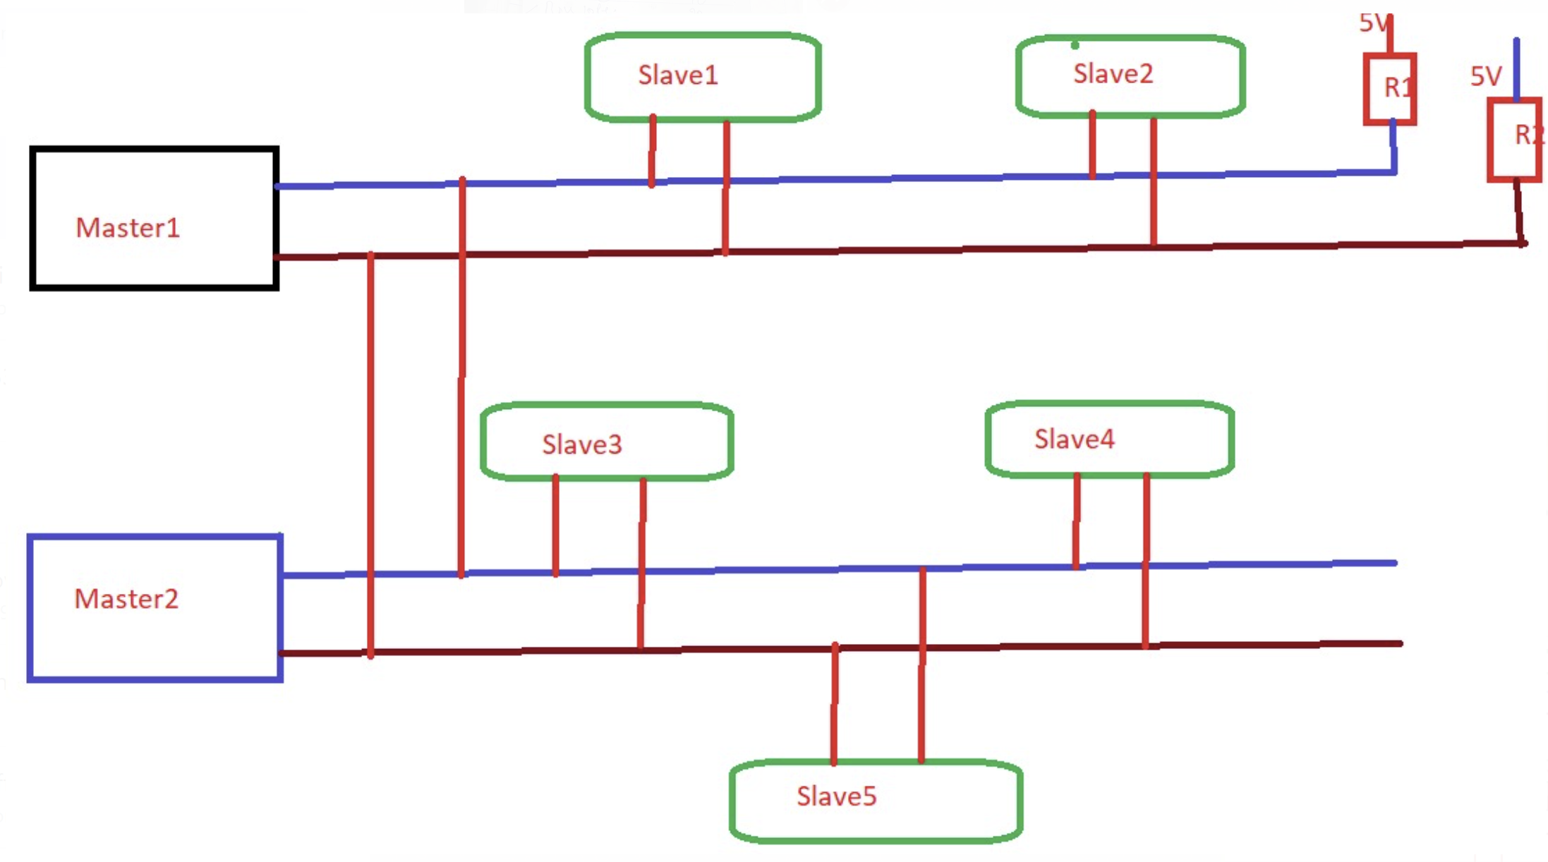
Block Diagram I2C:

Slide 13
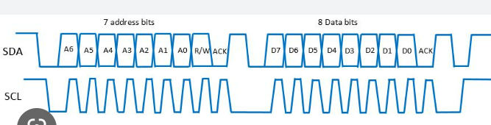
I2C waveform
Start bit
Address
Read/write
Acknowledgement
Data
Acknowledgement
Stop bit

Slide 14
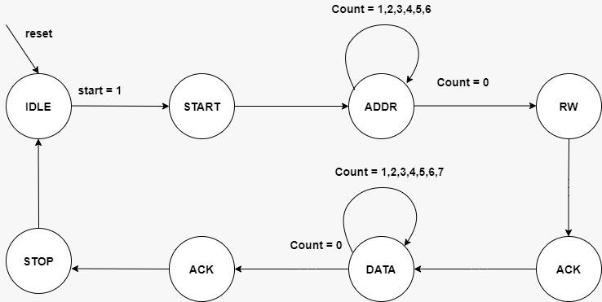
I2C state diagrams roughly
Mealy or Moore type
Based on specification.
*Power
* Area
* operating frequency
* Glitches
Speed consideration, I will use moore type FSM.
Why because FF to FF moore type combinational delay is very less.

Slide 15
Advantages and Disadvantages of I2C
Has a low pin/signal count even with numerous devices on the bus
Flexible, as it supports multi-master and multi slave communication.
Simple as it only uses 2 bidirectional wires to establish communication among multiple devices.
Adaptable as it can adapt to the needs of various slave devices.
Support multiple masters.

Slide 16
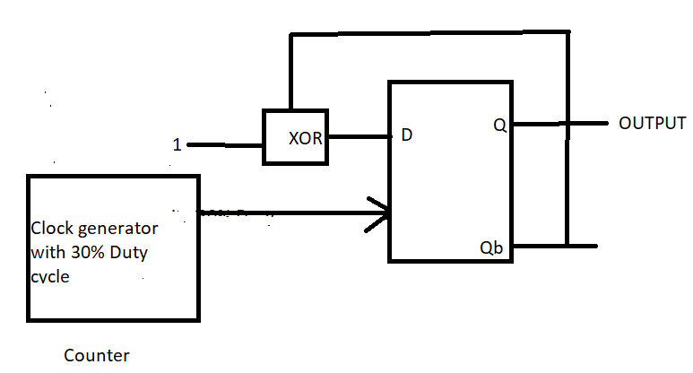
Practice Question: 1
Q3Q2Q1Q0
0001
0010
0011
0100
0101
0110
0111
1000
1001
1010
T-FF

Slide 17
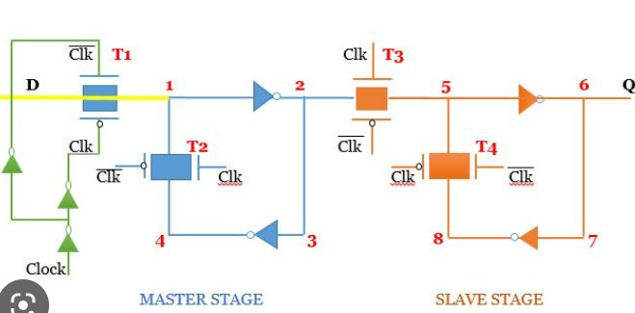
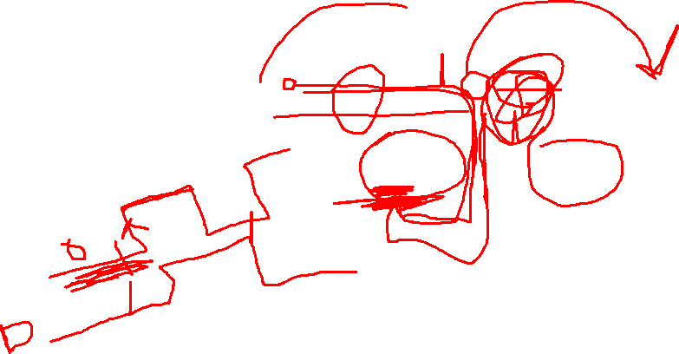
Practice Question:2
1.what is mean by setup and hold time setup violation hold violation ,skew latency negative hold time is good ?

Slide 18
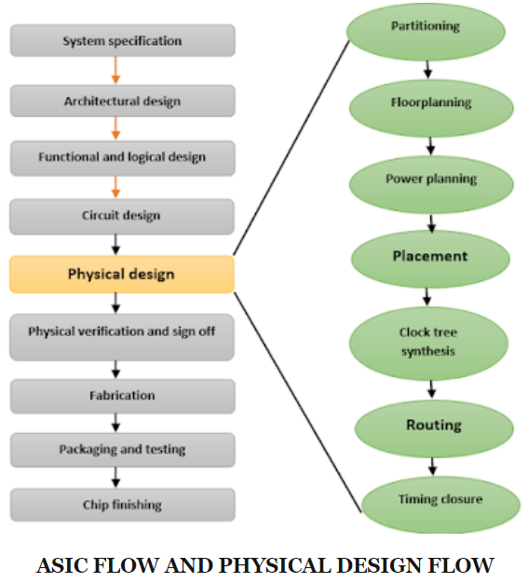

VLSI Flow chat
The physical design is the process of transforming a circuit description into the physical layout, which describes the position of cells and routes for the interconnections between them.
The main concern is the physical design of VLSI-chips is to find a layout with minimal area, further the total wire length has to be minimized. For some critical nets there are hard limitations for the maximal wire length.

Slide 19
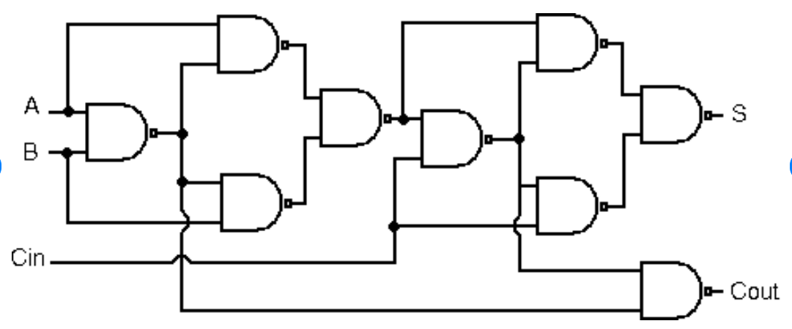
Why Non-Blocking using in Sequential circuits

Slide 20
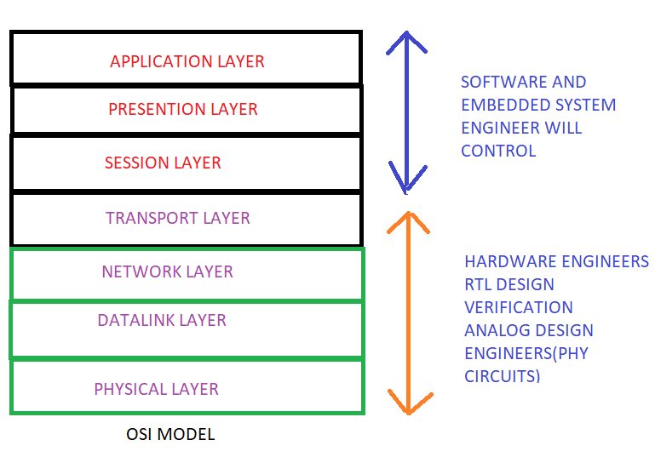
OSI Model
Top three layers working on software and embedded system design engineers.
Software engineer will do find the required software for particular project.
Embedded system design engineers will do designing of drivers.
Based on software conditions , hardware engineer will do some computation operations.

Slide 21
Important subjects
Digital circuits(Made easy gate book and theory class notes)
Computer architecture(I will share one book)
Analog basics( gate questions and Himanshu you tube)
Physical design(Entuple coaching)
Verilog and system Verilog ( coaching VLSI Guru is good)
Protocol Knowledge( VLSI Guru very good)

Slide 22
APB Syllabus:
background
AMBA Bus Architecture.
APB Interface Diagram.
Operation Of APB.
PIN Description.
APB State machine
Write transfer
* with wait states
* without wait states
Read transfer
* with wait states
* without wait states
Error response.
Master Simulation Result.
APB Interface Diagram with two slaves.
Summary of APB Protocol
1.advantages
2.disadvantages
3.application(low power )
AHB Course Syllabus
Background
Protocol and its types
AHB bus
Interconnect
Arbitration
AHB Bus architecture
Pin diagram
Bus interconnect.
Basic data transfer and wait states
Multiple data transfer with wait states
Transfers types
Two cycle response
Error response
Slave response with types
Split transaction
Retry transfer
AXI Syllabus:
Back ground
Protocol and its types.
Comparison of APB AHB AXI.
AXI interconnect in system on chip(SOC).
Interface and interconnect.
Handshaking mechanism.
AXI Architecture
Write and read signals with channels.
Operation of AXI write and read data.
Main difference between AXI and AHB with speed consideration.

Slide 23

Change your thought process
G Vamsi Girish

