Slide 1
Chapter 6
Unique Marketing Issues
11-<number>

Slide 2
Chapter Objectives
1 of 2
Explain the purpose of market segmentation.
Describe the importance of selecting a target market.
Explain why its important for a start-up to establish a unique position in its target market.
Describe the importance of the ability to position a company’s products on benefits rather than features.
Illustrate the two major ways in which a company builds a brand.
6-<number>

Slide 3
Chapter Objectives
2 of 2
Identify the four components of the marketing mix.
Explain the difference between a core product and an actual product.
Contrast cost-based pricing and value-based pricing.
Explain the differences between advertising and public relations.
Weigh the advantages and disadvantages of selling direct versus selling through intermediaries.
11-<number>

Slide 4
Selecting a Market and Establishing a Position in the Market
Important Questions That All Startups Must Ask
  In order to succeed, a new firm must address this important issue: Who are our customers are how will we appeal to them?
  A well-managed start-up approaches this query by following a three-step process:
    Segmenting the market.
    Selecting a target market.
    Establishing a unique position in the target market
11-<number>

Slide 5
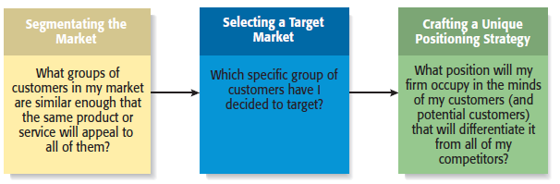
The Process of Selecting a Target Market and Positioning Strategy
11-<number>

Slide 6
Market Segmentation
Involves studying a firm’s
industry and determining the
different target markets in that
industry.
Markets can be segmented in
a number of different ways,
including
- Product type
- Price point
- Customers served
Segmenting the Market
3-<number>

Slide 7
Example: Segmenting the Computer Industry by Product Type
Handheld Computers
Netbooks
(new category)
PCs
Minicomputers
Mainframes
11-<number>

Slide 8
Selecting a Target Market
Once a firm has segmented
the market, a target market
must be chosen.
The market must be sufficiently
attractive and the firm must have
the capability to serve it.
The Netbook segment of the
computer industry is new, and
is being targeted by startups
like Eee PC.
Target Market
3-<number>

Slide 9
Establishing a Unique Position
1 of 2
After selecting a target market, the
firm’s next step is to establish a
“position” within the market that
differentiates it from its rivals.
A “position” is the part of a market
that the firm is claiming as its own.
A firm establishing a unique
position in its customers’ minds
by drawing attention to two or
three of the product’s attributes.
Positioning
3-<number>

Slide 10
Establishing a Unique Position
2 of 2
Positioning (continued)
  Firms often develop a “tagline” to reinforce the position they have staked out in their market, or a phrase that is used consistently in a company’s literature and thus becomes associated with the company.
  An example is Nike’s familiar tagline, “Just do it.”
    The beauty of this simple three-word expression is that it applies equally to a 21-year-old triathlete and a 65-year-old mall walker.
11-<number>

Slide 11
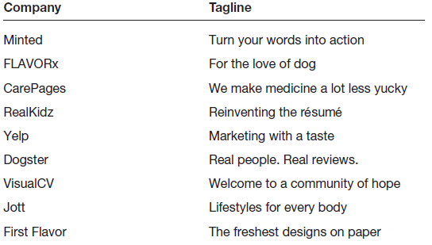
Taglines—Developed to Reinforce a Firm’s Positioning Strategy
Match the Company to its Tagline
Sure Girl
11-<number>

Slide 12
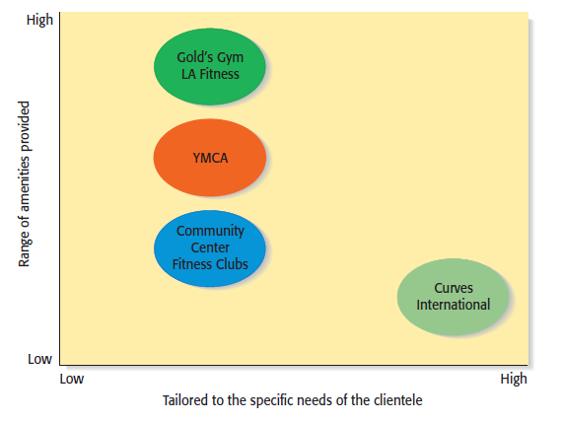
Product Attribute Map—Illustrates a Firm’s Positioning Strategy Relative to Rivals
Curves International
11-<number>

Slide 13
Selling Benefits Rather Than Features
1 of 2
Selling Benefits Rather Than Features
  Many entrepreneur make the mistake of positioning their company’s products or services on features rather than benefits.
  A positioning or marketing strategy that focuses on the features of a product, such as its technical merits, is usually much less effective than a campaign focusing on what the merits of the product can do.
  Consider the example of the following slide.
11-<number>

Slide 14
Selling Benefits Rather Than Features
2 of 2
Two difference approaches to promoting a cell phone
Approach
Illustration
“Our cell phones are equipped with sufficient memory to store 1,000 phone numbers.”
Selling Features
“Our cell phones let you store up to 1,000 phone numbers, providing you access to the phone numbers of your family, friends, and business acquaintances instantly.
Selling Benefits
The first statement tells a prospect how many phone numbers the cell phone will hold but doesn’t say why that’s important. The second statement tells a prospect how buying the product will enhance his or her life or business.
Conclusion
11-<number>

Slide 15
Establishing a Brand
1 of 5
Establishing a Brand
  A brand is the set of attributes—positive or negative—that people associated with a company.
    These attributes can be positive, such as trustworthy, dependable, or easy to deal with.
    Or they can be negative, such as cheap, unreliable, or difficult to deal with.
  The customer loyalty a company creates through its brand is one of its most valuable assets.
Brand Management
  Some companies monitor the integrity of their brands through a program called “brand management.”
11-<number>

Slide 16
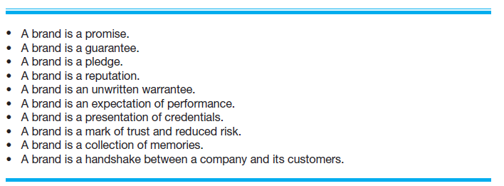
Establishing a Brand
2 of 5
Different Ways of Thinking About the Meaning of a Brand
11-<number>

Slide 17
Establishing a Brand
3 of 5
Establishing a Brand
  So how does a firm establish a brand?
    On a philosophical level, a firm must have meaning in its customer’s lives. It must create value—something for which customers are willing to pay.
    On a more practical level, brands are built through a number of techniques, including advertising, public relations, sponsorships, support of social causes, and good performance.
    A firm’s name, logo, Web site design, and even its letterhead are part of its brand.
11-<number>

Slide 18
Establishing a Brand
4 of 5
Power of a Strong Brand
  Ultimately, a strong brand can be a very powerful asset for a firm.
Cobranding
  A technique that companies use to strengthen their brands is to enter into a cobranding arrangements with other firms.
  Cobranding refers to a relationship between two or more firms where the firm’s brands promote each another.
11-<number>

Slide 19
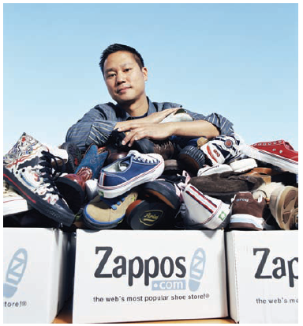
Establishing a Brand
5 of 5
Zappos is a hot brand.
From the outset, Zappos’s CEO
Tony Hsieh has worked hard to
ensure that Zappos’s brand
stands for competitive pricing,
strong customer service, and a
pleasant shopping experience.
11-<number>

Slide 20
The Four Ps of Marketing for New Ventures
Product
Price
Marketing Mix
Promotion
Place (or distribution)
11-<number>

Slide 21
Product
Product
  Is the good or service a firm offers to its target market.
  The initial rollout is one of the most critical times in the marketing of a new product.
  All firms face the challenge that they are unknown and that it takes a leap of faith for the first customers to buy their products.
    Some startups meet this challenge by using reference accounts.
11-<number>

Slide 22
Core Product vs. Actual Product
Core Product
Actual Product
The product itself, such as an antivirus software program.
The product plus all the attributes that come with it such as quality level, features, design, packaging, and warranty.
11-<number>

Slide 23
Price
Price
  Price is the amount of money consumers pay to buy a product.
  The price a company charges for its products sends an important message to its target market.
    For example, Oakley positions its sunglasses as innovative, state-of-the-art products that are both high quality and visually appealing.
    This position in the market suggests a premium price that Oakley charges.
  Most entrepreneurs use one of two methods to set the price for their products, as shown on the next slide.
11-<number>

Slide 24
Core Product vs. Actual Product
Cost-Based Pricing
Value-Based Pricing
The list price is determined by adding a markup percentage to a product’s cost.
The list price is determined by estimating what consumers are will to pay for a product.
11-<number>

Slide 25
Promotion
Promotion
  Refers to the activities the firm takes to communicate the merits of its product to its target market.
  There are several common activities that entrepreneurs use to promote their products and services.
Advertising
  Advertising is making people aware of a product or service in hopes of persuading them to buy it.
11-<number>

Slide 26
Pluses and Minuses of Advertising
Pluses
Raise customer awareness of a product.
Explain a product’s comparative features and benefits.
Create associations between a product and a certain lifestyle.
Minuses
Low credibility.
The possibility that a high percentage of people who see the add
will not be interested .
Message clutter.
Relative costliness compared to other forms of promotion.
Intrusiveness.
11-<number>

Slide 27
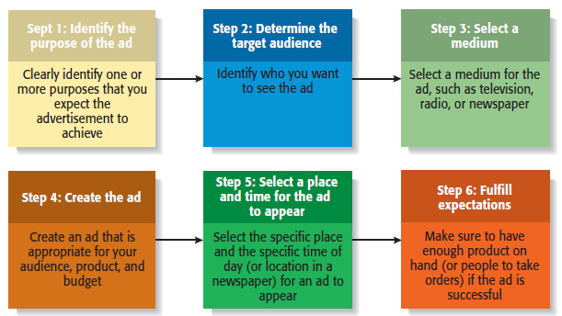
Steps Involved in Putting Together an Advertisement
11-<number>

Slide 28
Google AdWords and AdSense Program
1 of 2
AdWords
  Allows advertisers to buy keywords on the Google home page.
  Triggers text-based ads to the side (and sometimes above) search results when the keyword is used.
  The program includes local, national, and international distribution.
  Advertisers pay a certain amount per click.
  Advertisers benefit because they are able to place their ads in front of people who are already searching for information about their product.
11-<number>

Slide 29
Google AdWords and AdSense Program
2 of 2
AdSense
  Allows advertisers to buy ads that will be shown on other Web sites instead of Google’s home page.
  Google selects sites of interest to the advertiser’s customers.
  Advertisers are charged on a pay-per-click or a per-thousand impression basis.
  Advertisers benefit because the content of the ad is often relevant to the Web site.
  Web site owners benefit by using the service to monetize their Web site.
11-<number>

Slide 30
Public Relations
Public Relations
  One of the most cost-effective ways to increase the awareness of the products of a company is through public relations.
  Public relations refer to efforts to establish and maintain a company’s image with the public.
  The major difference between public relations and advertising is that public relations is not paid for—directly.
11-<number>

Slide 31
Public Relations Techniques
Press release
Media coverage
Articles in industry
press and periodicals
Blogging
Monthly newsletter
News conference
Civic, social, and community
involvement
11-<number>

Slide 32
Other Promotions Techniques
Viral Marketing
Guerrilla Marketing
Facilitates and encourages people to pass along a marketing message about a particular product or service.
A low-budget approach to marketing that relies on ingenuity, cleverness, and surprise rather than traditional techniques.
11-<number>

Slide 33
Place (or Distribution)
Place
  Encompasses all the activities that move a firm’s product from its place of origin to the consumer.
  The first choice a firm has to make regarding distribution is whether to sell its products directly to consumers or through intermediaries (such as wholesalers and retailers).
  Within most industries, both choices are available, so the decision typically depends on how a firm believes its target market wants to buy its product.
11-<number>

Slide 34
Selling Direct Vs. Selling Through an Intermediary
1 of 2
Approach to Distribution
Description
Selling Direct
Many firms sell direct to customer, maintaining control of the distribution and sales process.
Selling Through Intermediaries
Other firms sell through intermediaries and pass off their products to wholesalers who place them in retail outlets to be sold.
11-<number>

Slide 35
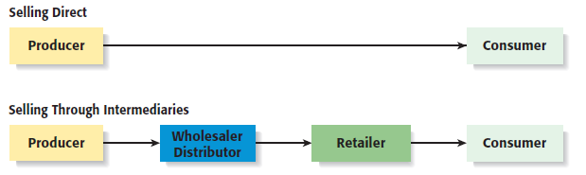
Selling Direct Versus Selling Through a Intermediary
2 of 2
11-<number>

Slide 36

All rights reserved. No part of this publication may be reproduced, stored in a retrieval system, or transmitted, in any form or by any means, electronic, mechanical, photocopying, recording, or otherwise, without the prior written permission of the publisher. Printed in the United States of America.
Copyright ©2010 Pearson Education, Inc. publishing as Pearson Education

