Slide 1
UX Scenario Document File Version 4.4 — completed for ICBC
Irving College Baptist Church
LG webOS TV • App 1.0.1
Launcher: Irving College BC
Prepared October 20, 2026. Not a statement of LG certification.
Browser evidence is labeled; physical LG TV behavior remains unverified.
Document field | Value
Submission Date | Not yet submitted; prepared 2026 / 10 / 20
App Ver. | 1.0.1
App Developer | Irving College Baptist Church icbcnextsteps@gmail.com
1
Notes:
<number>

Slide 2
Table of Contents
1. Basic Information
2. Document History
3. Page Description / Live Playback Controls
4. Detailed Login Information — Not Applicable
5. Main Page Description — Home and Library
6. Sub Page Description — Flow, Privacy, Archive, Exit
7. Paid Content — Not Applicable
8. In-App Ad — Not Applicable
Appendix — Review window, evidence and unresolved checks
2
Notes:
<number>

Slide 3
1. Basic Information
Area | Item | Input by Developer
App | App Title | Irving College Baptist Church; launcher: Irving College BC
App | Category | Life / Religion (selected by church)
App | File Type | Web — packaged HTML5 application
App | Optimized Resolution | 1920 x 1080
App | Service Area | United States only (requested storefront territory)
App | Service Language | English
App | Geo-IP Block | No geo-IP blocking implemented in app; hosting restrictions not independently audited
App | SDK / Tooling | webOS TV Web app; official CLI 3.2.6. Exact launch-platform / SDK selection must match Seller Lounge.
App | In-App Ad / Paid Content | Neither; no advertising, login, purchase or subscription flow
App | Sound (Game Type) | Not a game. Sermon speech/audio; music excluded by church
Test | Service URL | Packaged IPK, not a hosted app URL. Media: https://live.irvingcollege.church
Test | Test URL | No separate test URL or activation. Use the uploaded 1.0.1 IPK and archive route.
Test | Service Platform | webOS TV. Individual chipsets: All for Web, per portal instruction.
Test | App ID / Contact | church.irvingcollege.icbc | icbcnextsteps@gmail.com
3
Notes:
<number>

Slide 4
2. Document History
No. | Prepared / Sent | App Version | File Name | Contents
1 | 20 Oct 2026 / not submitted | 1.0.1 | ICBC-LG-UX-Scenario-v4.4-1.0.1 | Completed LG v4.4 template; screenshots, controls, N/A sections, and honest test scope
Reference: separate icbc-lg-webos project. Samsung app and production streaming server unchanged.
The church reported a successful visual launch of the earlier 1.0.0 build in Mac webOS26 Simulator. This does not establish playback or physical TV compatibility.
Version 1.0.1 adds a branded splash and a local Privacy & Support screen; 30 automated tests pass.
4
Notes:
<number>
<number>

Slide 5
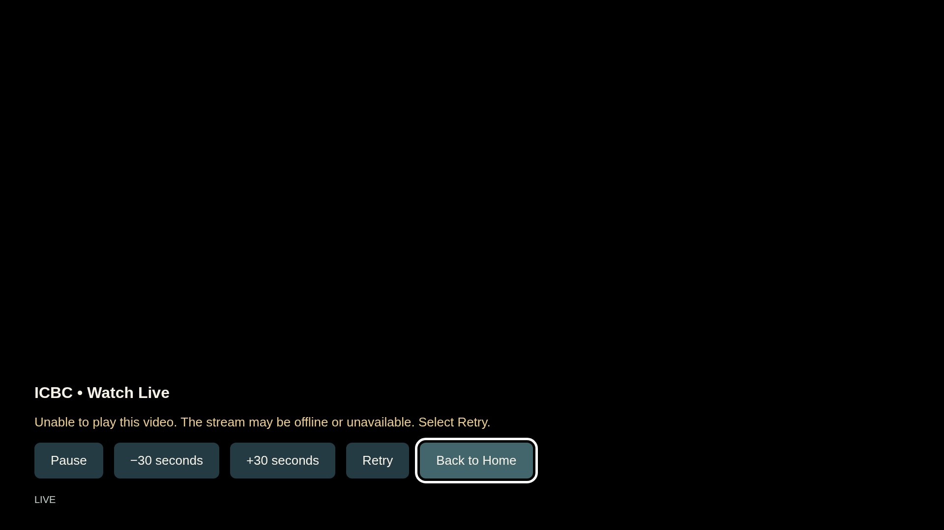
3. Page Description
Live player and recovery controls
Description
1 | Pause / Play: toggle playback when available.
2 | Rewind: disabled for livestream.
3 | Fast-forward: disabled for livestream.
4 | Retry: reconnect the selected stream.
5 | Back to Home: close media and restore home focus.
1
2
3
4
5
Detailed Information
Captured in Chromium with a deliberately aborted media request. This is the actual error UI, not proof the production stream is offline.
Only Sunday worship is streamed, starting 10:30 AM U.S. Central Time (America/Chicago). Duration varies.
For unavailable or stalled playback, the app shows a recovery message. Retry uses the same URL; no sign-in is required.
5
Notes:
<number>

Slide 6
4. Detailed Login Information
Not Applicable — no login
All catalog and playback controls are available without an account.
No test IDs, passwords, activation codes or device registration are required.
Internet access is required to request the church catalog and media.
Use recorded sermons for review outside the Sunday broadcast window.
Detailed Information
This section is not applicable to the actual app; no sample credentials, payment data or advertising examples are included.
6
Notes:
<number>

Slide 7
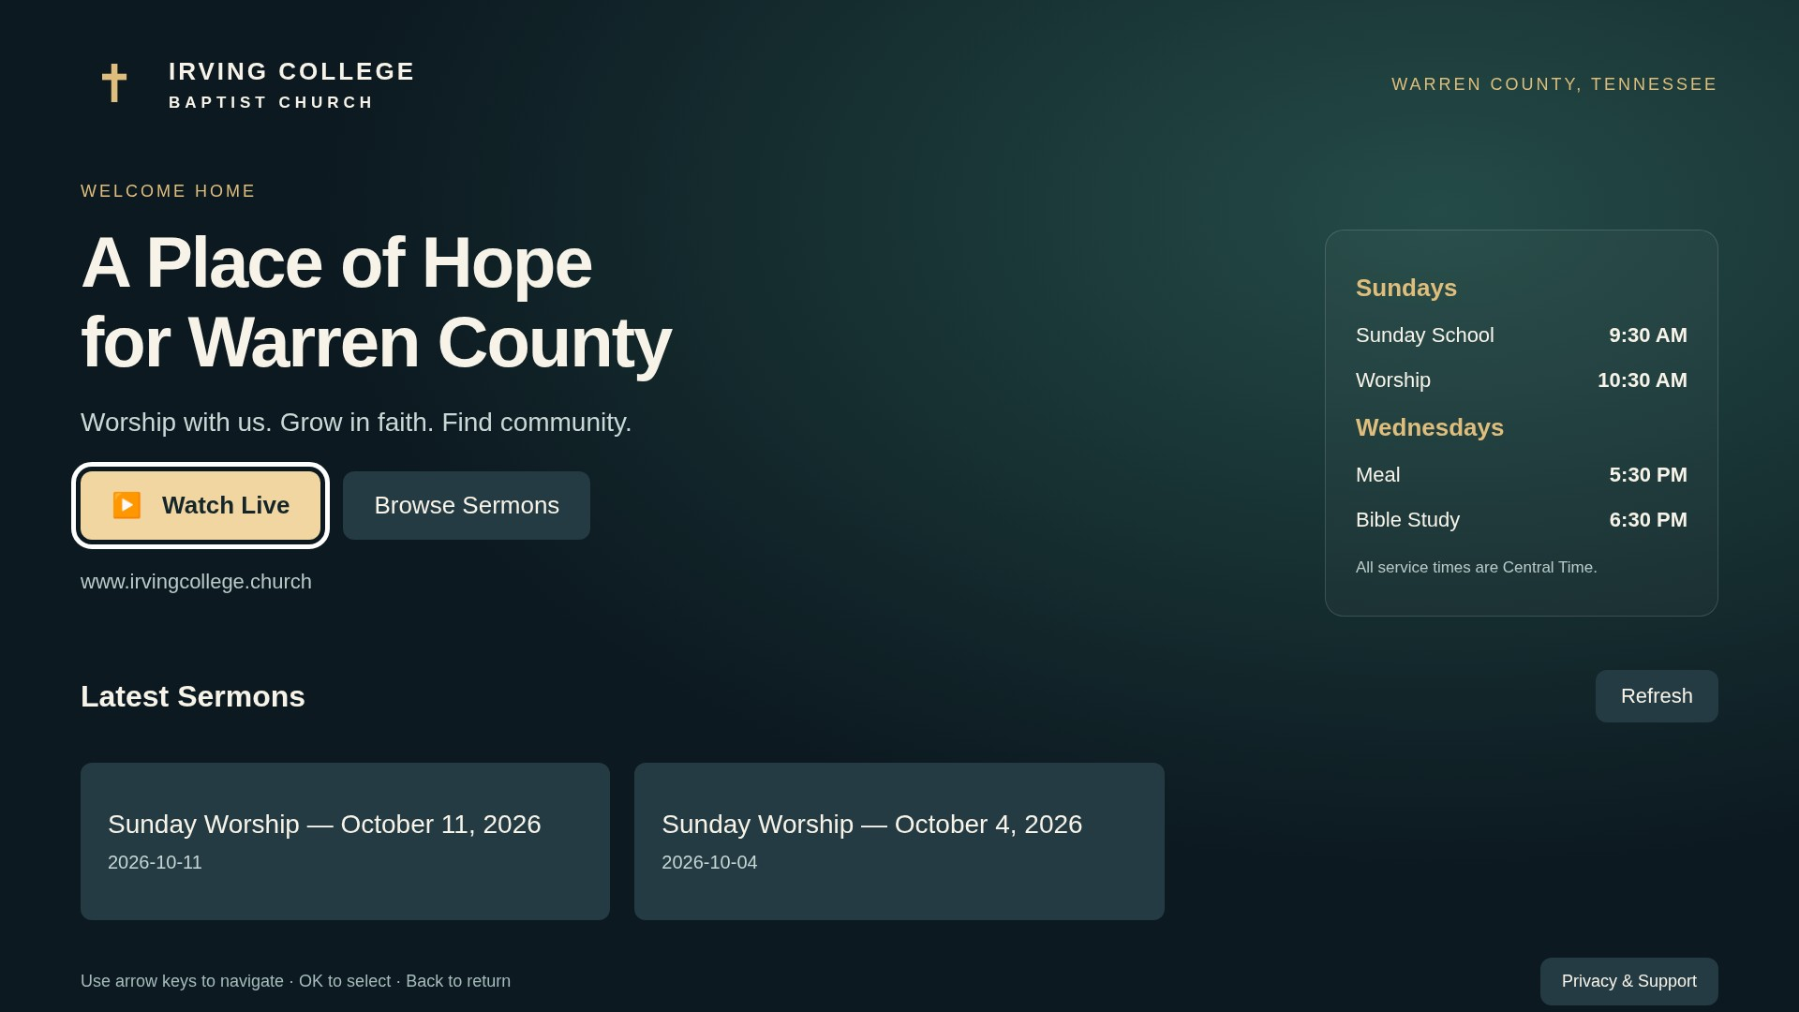
5. Main Page Description
1. Home / entry page
Description
1 | Watch Live: opens the church livestream.
2 | Browse Sermons: scrolls to the archive and focuses the first sermon.
3 | Refresh: reloads the catalog; keeps prior entries if request fails.
4 | Privacy & Support: opens the local policy/contact screen.
1
2
3
4
Detailed Information
The page shows church branding, service times and sermon cards. The original Samsung visual design and content URLs are retained.
Arrows move focus; OK activates. Pointer movement focuses controls; click activates. The wheel scrolls naturally.
Screenshot uses an authentic production catalog snapshot through request interception, so it does not verify production CORS.
7
Notes:
<number>

Slide 8
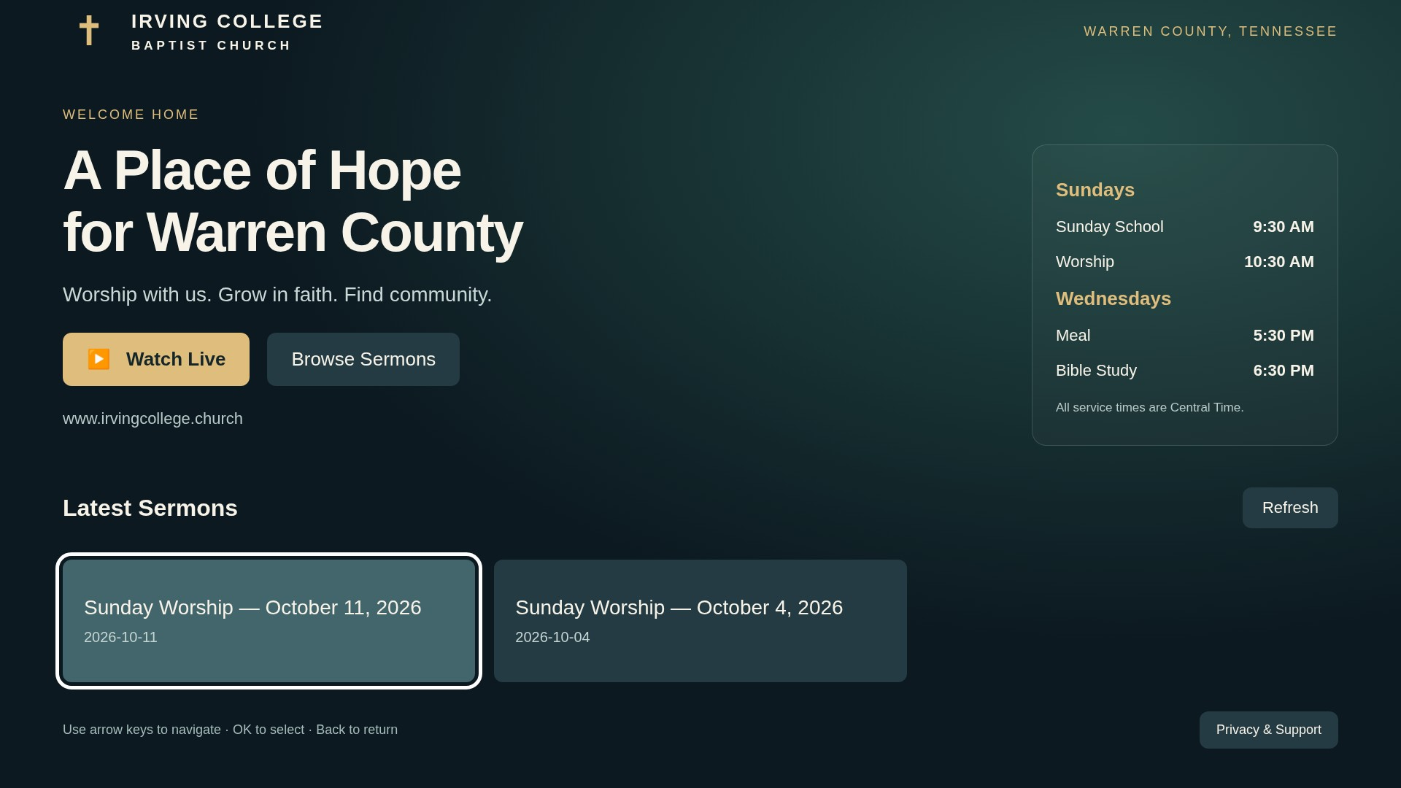
5. Main Page Description
2. Recorded sermon library
Description
1 | First sermon card: select to open its video.
2 | Second sermon card: select to open its video.
3 | Refresh: request the latest server catalog.
3
1
2
Detailed Information
The server controls catalog order. Longer catalogs scroll; titles and metadata are inserted as text.
Back from a scrolled library returns to the home position and Watch Live focus. Playback Back restores the selected sermon card.
The two displayed records come from the captured production catalog. No production sermon playback was verified.
8
Notes:
<number>

Slide 9
6. Sub Page Description
1. Navigation flow
Home / entry
Watch Live
Live player
Browse Sermons
Archive player
Privacy & Support
Back
Stay / Exit
Player → Back / Stop → Home with restored focus
Privacy → Back → Home | Exit dialog → Stay → Home
Detailed Information
No account or purchase route exists. Retry reopens the selected media; Refresh requests the catalog again.
At entry this candidate uses a custom exit confirmation. Confirm model-specific LG Back requirements before final submission.
9
Notes:
<number>
<number>

Slide 10
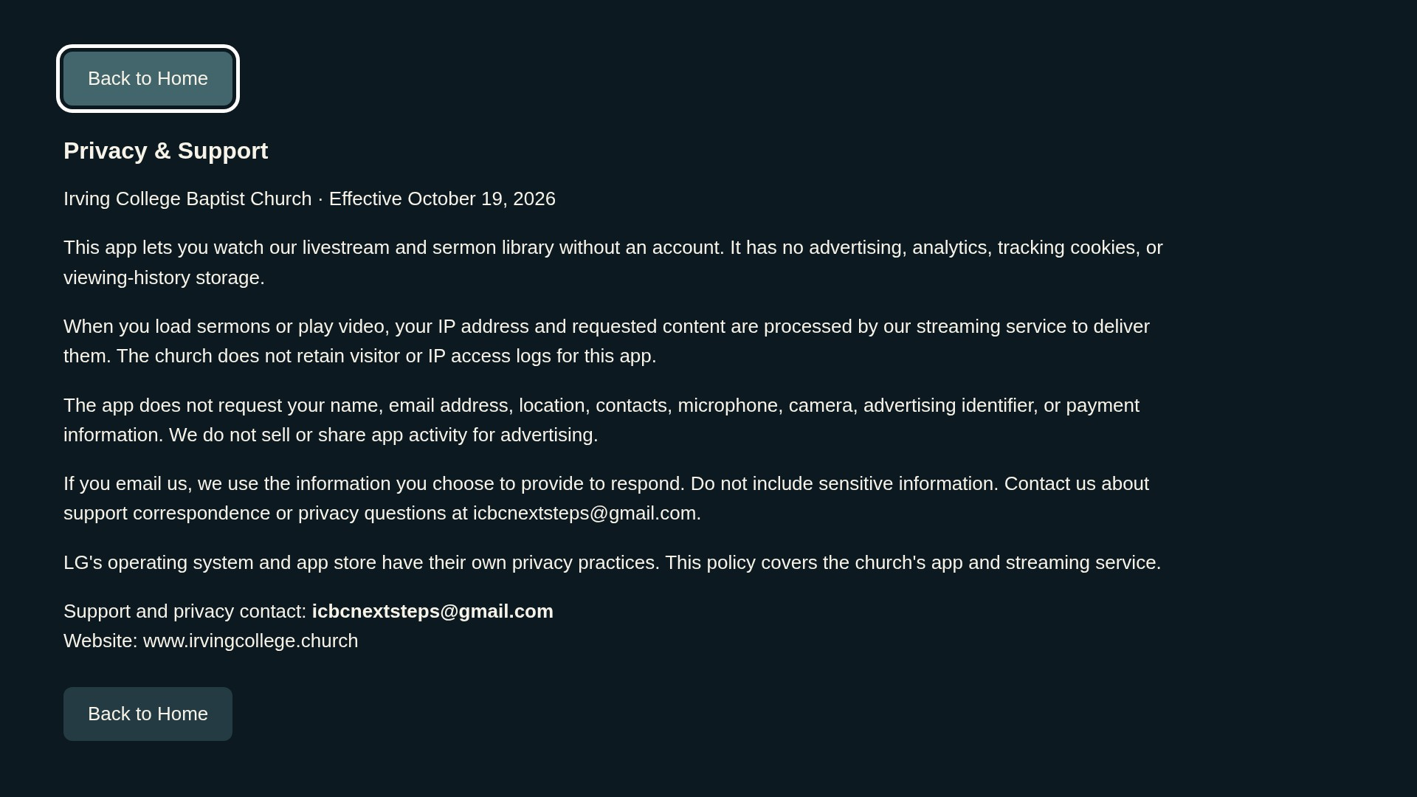
6. Sub Page Description
2. Privacy & Support
Description
1 | Back to Home: return to the home footer control.
2 | Bottom Back to Home: same return action after reading the notice.
1
2
Detailed Information
Support and privacy contact: icbcnextsteps@gmail.com. The church confirms no retained visitor/IP access logs.
Ordinary network data is processed transiently to deliver content. No ads, analytics, accounts or viewing-history storage are implemented.
Remote Back returns home and restores focus. The public policy is in the repository at docs/privacy-policy.md.
10
Notes:
<number>

Slide 11
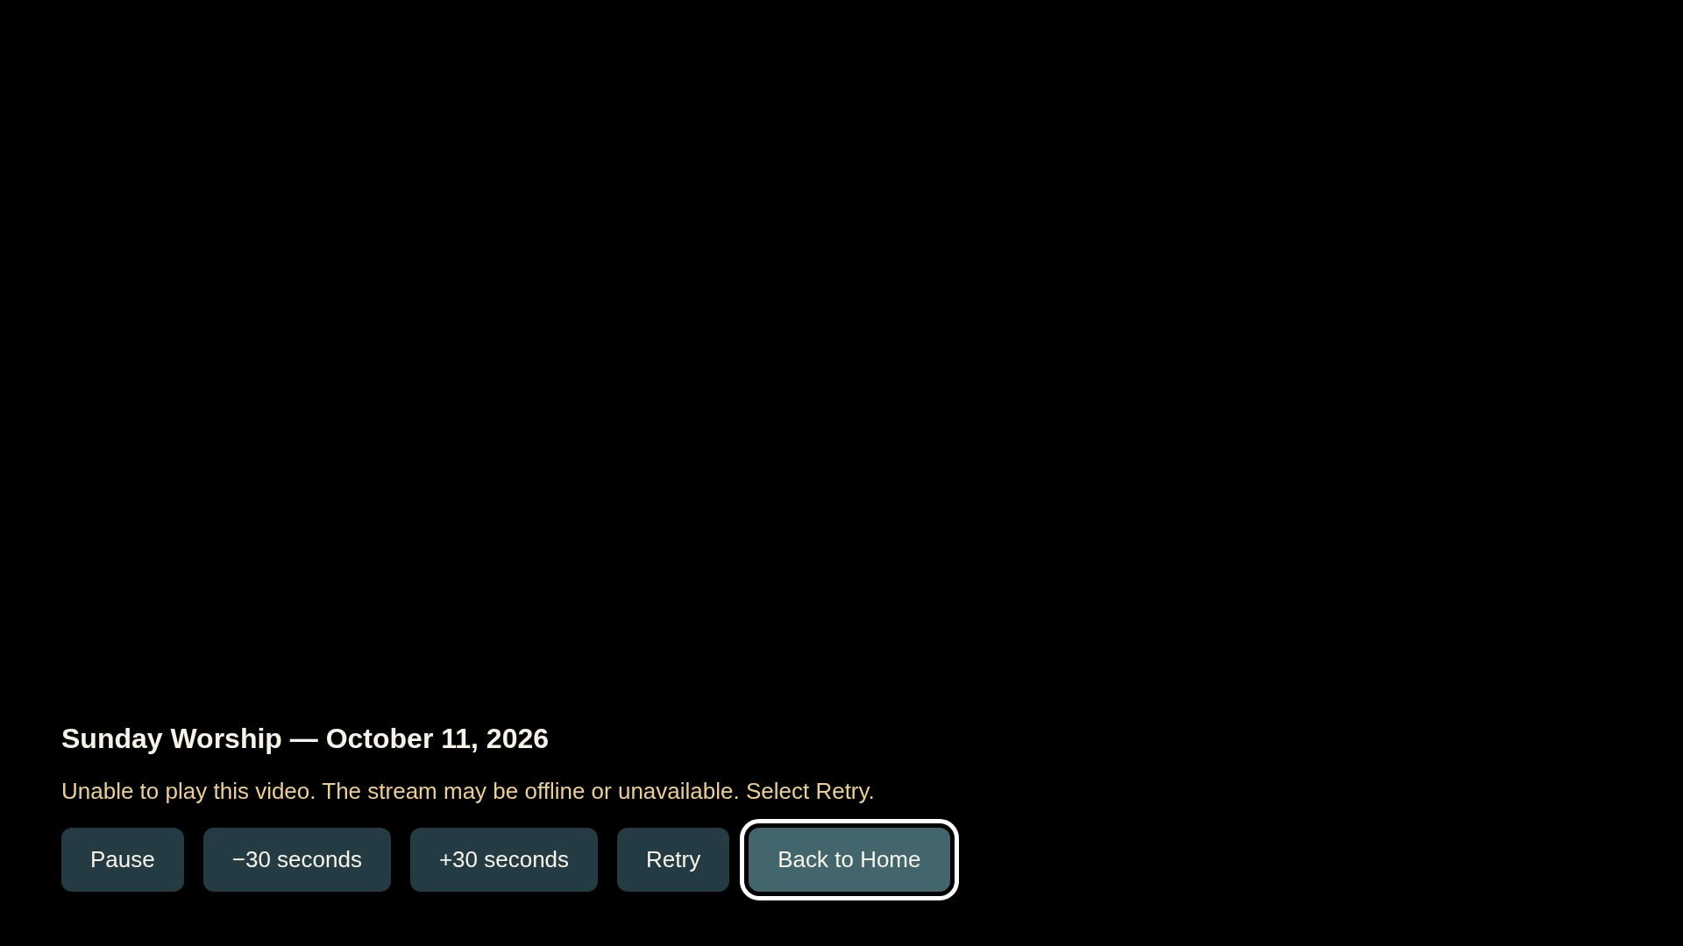
6. Sub Page Description
3. Archive player and recovery
Description
1 | Pause / Play: toggle the recorded video.
2 | Rewind: seek back 30 seconds.
3 | Fast-forward: seek ahead 30 seconds.
4 | Retry: reopen the selected sermon URL.
5 | Back to Home: release media and restore the sermon card.
1
2
3
4
5
Detailed Information
Captured with a controlled aborted media request to show recovery and available archive controls. It is not successful production playback.
Dedicated media keys are supported where available; visible buttons provide the same functions. Stop returns home.
Actual MP4 playback, audio, seek ranges, end/replay and network recovery remain physical-device tests.
11
Notes:
<number>

Slide 12
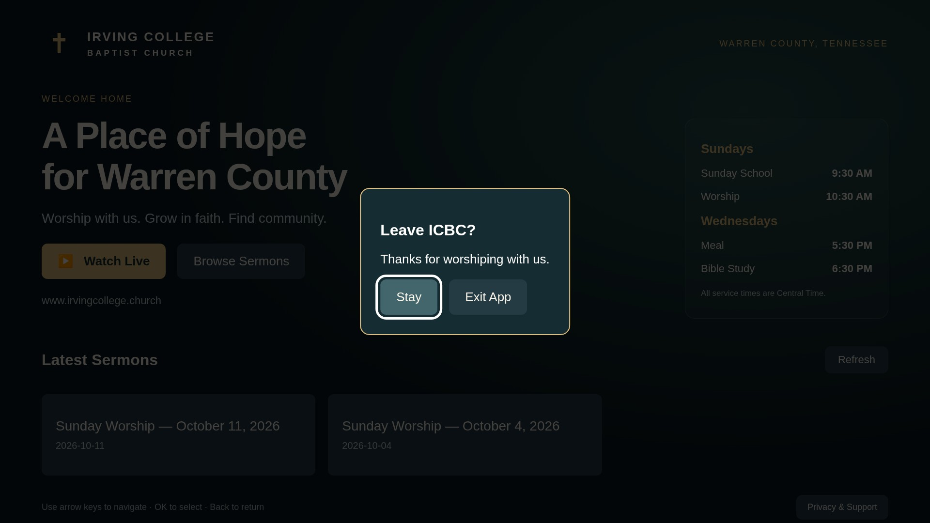
6. Sub Page Description
4. Entry-page exit confirmation
Description
1 | Stay: dismiss the dialog and restore Watch Live focus.
2 | Exit App: request closure using the webOS runtime.
1
2
Detailed Information
Back from the home entry page opens this candidate’s custom confirmation. The backdrop blocks underlying pointer controls.
Back dismisses the dialog; arrow keys are scoped to it. Native window closure is not proven by browser tests.
Review the webOS23–25 Home requirement in LG’s current self-checklist alongside its general Back guide before selecting those model groups.
12

Slide 13
7. Paid Content
Not Applicable — free content
The app has no purchases, paid subscriptions, vouchers, billing SDK or payment method.
No credit-card or payment test data is required for QA.
No separate payment or account activation is required on the church website to use the app.
Detailed Information
This section is not applicable to the actual app; no sample credentials, payment data or advertising examples are included.
13
Notes:
<number>

Slide 14
8. In-App Ad
1. Banner advertising — Not Applicable
The application has no banner advertising, ad slots or advertising SDK.
The church confirms music is excluded from its broadcasts for rights reasons.
No advertisement test account or ad-fill configuration is applicable.
Detailed Information
This section is not applicable to the actual app; no sample credentials, payment data or advertising examples are included.
14
Notes:
<number>

Slide 15
8. In-App Ad
2. Video advertising — Not Applicable
The app has no preroll, midroll, postroll, rewarded ads or video advertising integration.
Video is requested from the church’s HTTPS media host.
HLS.js is bundled locally for playback fallback; it is not an advertising or analytics SDK.
Detailed Information
This section is not applicable to the actual app; no sample credentials, payment data or advertising examples are included.
15
Notes:
<number>

Slide 16
[Appendix] Reviewer availability and evidence
Broadcast: Sunday worship only, starting 10:30 AM U.S. Central Time. The ending time varies; use archives outside this window.
Contact: icbcnextsteps@gmail.com | Territory: United States only | Language: English
Catalog: https://live.irvingcollege.church/sermons/catalog.json
Live HLS: https://live.irvingcollege.church/hls/stream.m3u8
30 automated tests pass. HTML video/HLS fixtures and adapter mocks are tested; these are not physical LG TV results.
All document screenshots are Chromium captures of app 1.0.1. Catalog bytes are a real snapshot; player images deliberately exercise error UI. No synthetic video is depicted as church content.
Church representative confirms sermon distribution rights, music exclusion and no visitor/IP log retention. Full content/rating questionnaire remains the publisher’s responsibility.
16
Notes:
<number>

Slide 17
[Appendix] Remaining validation before submission
Physical LG TV testing has not been performed: native live/archived playback, remote hardware, TV exit and lifecycle still need validation.
Production catalog CORS remains open: the read-only catalog response lacked Access-Control-Allow-Origin. No production server configuration was changed.
Recheck the updated 1.0.1 build in the Mac simulator; only the earlier build’s appearance was reported by the church.
Confirm Seller Lounge launch-platform / SDK selection and target models. The app is a Web package, not a chipset-specific native binary.
Transfer actual results into LG’s official self-checklist. This UX scenario is not that separate form.
Public policy: https://github.com/irvingcollege/icbc-lg-webos/blob/main/docs/privacy-policy.md
Prepared from the church-supplied UX Scenario v4.4 template. Submission date is deliberately unclaimed until the publisher actually submits.
17

