Slide 1
Irving College Baptist Church
Application UI Description | App version 1.0.1
Seller Office App ID: 3202610049560

Slide 2
Revision History
Version | Date | Description | Author | Related App Version
1.1 | 2026-10-18 | Added actual app preview images and completed navigation, use cases, menus and key mappings. Documentation correction for resubmission. | Irving College Baptist Church | 1.0.1

Slide 3
Contents
UI Structure
Use Cases
Menus and Functions — App preview images
Remote Control Keys
Language Options

Slide 4
UI Structure
Home: church info + service times
Watch Live / HLS
Browse Sermons / Refresh
Player: live or archived MP4
Home → RETURN → Exit confirmation
Select an action or sermon with OK. Player Back/RETURN restores Home and prior focus.
Errors remain on the relevant screen: Retry for playback; Refresh for the catalog.
Exit confirmation: Stay returns Home; Exit App closes the application.

Slide 5
Contents
UI Structure
Use Cases
Menus and Functions — App preview images
Remote Control Keys
Language Options

Slide 6
Use Cases
Main use cases
• Watch the public live HLS stream when a broadcast is available.
• Browse the public sermon catalog and play an archived MP4 sermon.
• Read church branding, website and Central Time service schedule on Home.
• Use TV remote arrows/OK, Return and media controls.
• Recover from unavailable streams, catalog failures and empty catalogs.
• Confirm application exit from Home.
Access: free; no login, subscription, purchasing or test credentials.

Slide 7
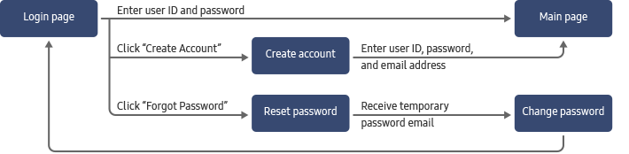
Use Cases — Watch Live
1. On Home, focus Watch Live and press OK.
2. The full-screen player connects to the public HLS broadcast.
3. On a Samsung TV the app uses native AVPlay; browser previews use HTML video/HLS.js.
4. Use Play/Pause or the on-screen button. Live rewind/forward controls are disabled.
5. If the stream is offline or fails, read the status message and choose Retry.
6. Choose Back to Home or press RETURN to close playback and restore prior focus.
Stream: https://live.irvingcollege.church/hls/stream.m3u8
Broadcast availability is not guaranteed outside church services. No successful physical-TV playback is claimed in this document.

Slide 8
Use Cases — Browse Sermons
1. On Home select Browse Sermons; focus moves to the first available sermon (or Refresh for an empty catalog).
2. Use arrows to select a sermon card; press OK to open its archived MP4.
3. In the player use Play/Pause, −30 seconds and +30 seconds. Dedicated media keys provide the same functions.
4. RETURN / Back to Home closes the player and restores the selected sermon.
5. Refresh requests the public catalog again. An empty list has a clear message; network/format errors explain recovery.
Catalog: https://live.irvingcollege.church/sermons/catalog.json
No test account is required. Catalog titles and dates are provided by the church server.

Slide 9
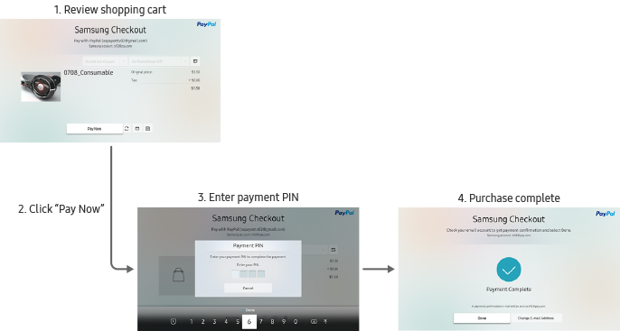
Use Cases — Access, Errors and Exit
No login or in-app purchase
All content is publicly accessible. No account/password, payment, subscription, advertisement or purchase flow is implemented.
Network recovery
Loading and unavailable-stream messages appear in the player. Retry reconnects the selected video. The catalog provides Refresh and distinct empty/error messages. No fake replacement videos are shown.
Exit and background behavior
RETURN closes playback, returns from archive scrolling to Home, or opens the Home exit confirmation. Stay dismisses the confirmation; Exit App exits. Hidden playback is paused. The platform EXIT key remains under Samsung system behavior.

Slide 10
Contents
UI Structure
Use Cases
Menus and Functions — App preview images
Remote Control Keys
Language Options

Slide 11
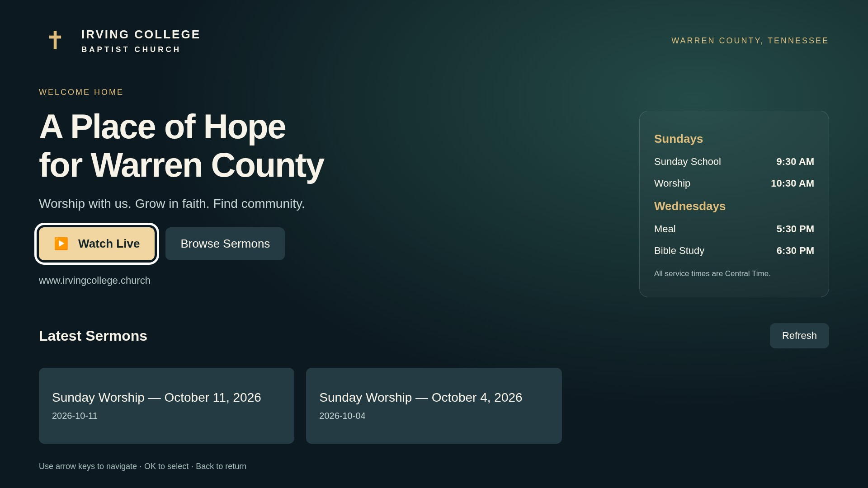
Menus and Functions
1.- App preview images — Home
UI element | Function
Watch Live | Open live player
Browse Sermons | Focus archive
Service times | Central Time
Refresh | Reload catalog
Sermon card | Open MP4
Genuine Chromium rendering of the app. Existing app artwork is shown unchanged. Catalog content is the real church response captured on 2026-10-13; this is not a physical-TV photograph.

Slide 12
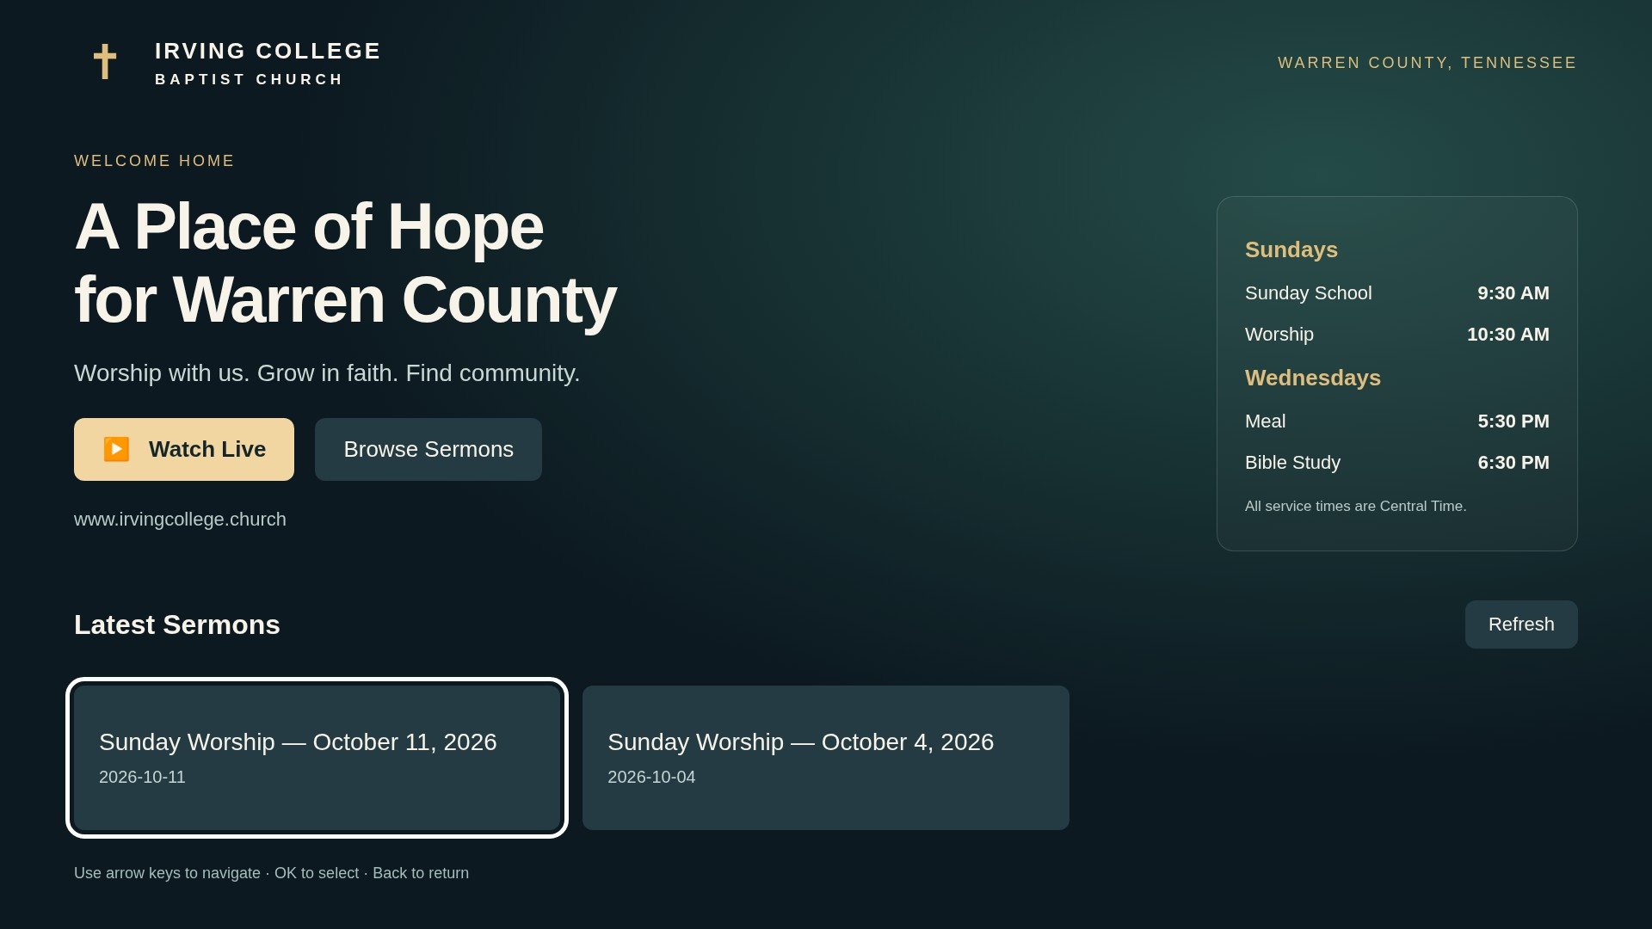
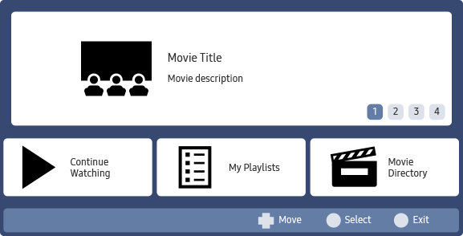
Menus and Functions
App preview images — Sermon browsing
UI element | Function
White outline | Current focus
Title / date | Catalog metadata
Sermon card | OK starts video
Arrows | Move focus
Refresh | Retry catalog
Genuine app screenshot: archive focus state. No fabricated sermon records or video imagery. Browser capture used unmodified app files and unchanged real catalog bytes through the capture harness.

Slide 13
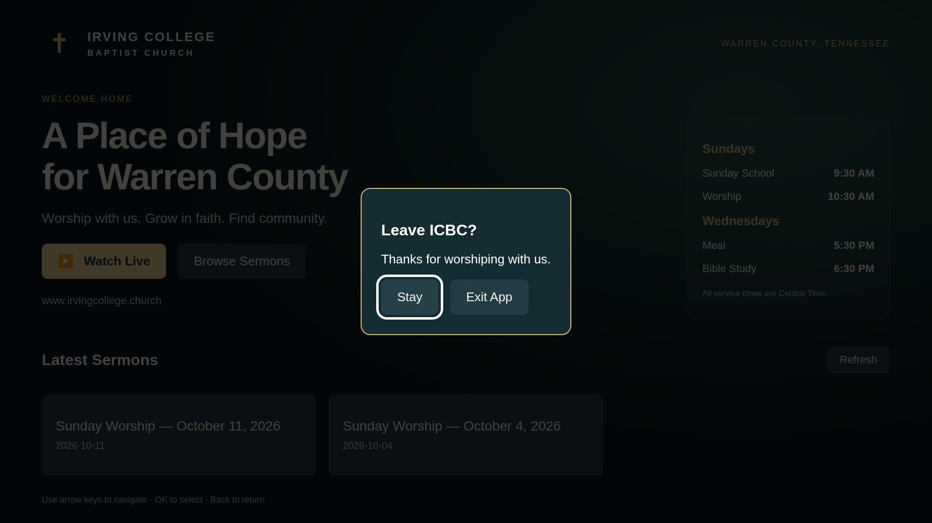
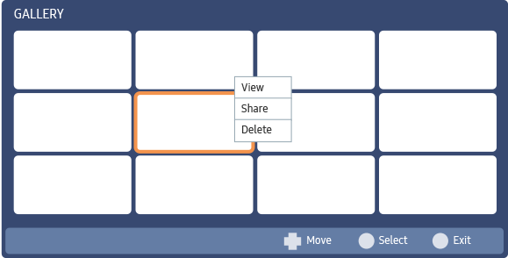
Menus and Functions
App preview images — Exit confirmation
UI element | Function
Stay | Return to Home
Exit App | Close app
RETURN | Dismiss dialog
Arrows / OK | Choose / activate
Genuine browser-rendered exit dialog from the app. No login or payment is required. This screen is reached with RETURN from Home.

Slide 14
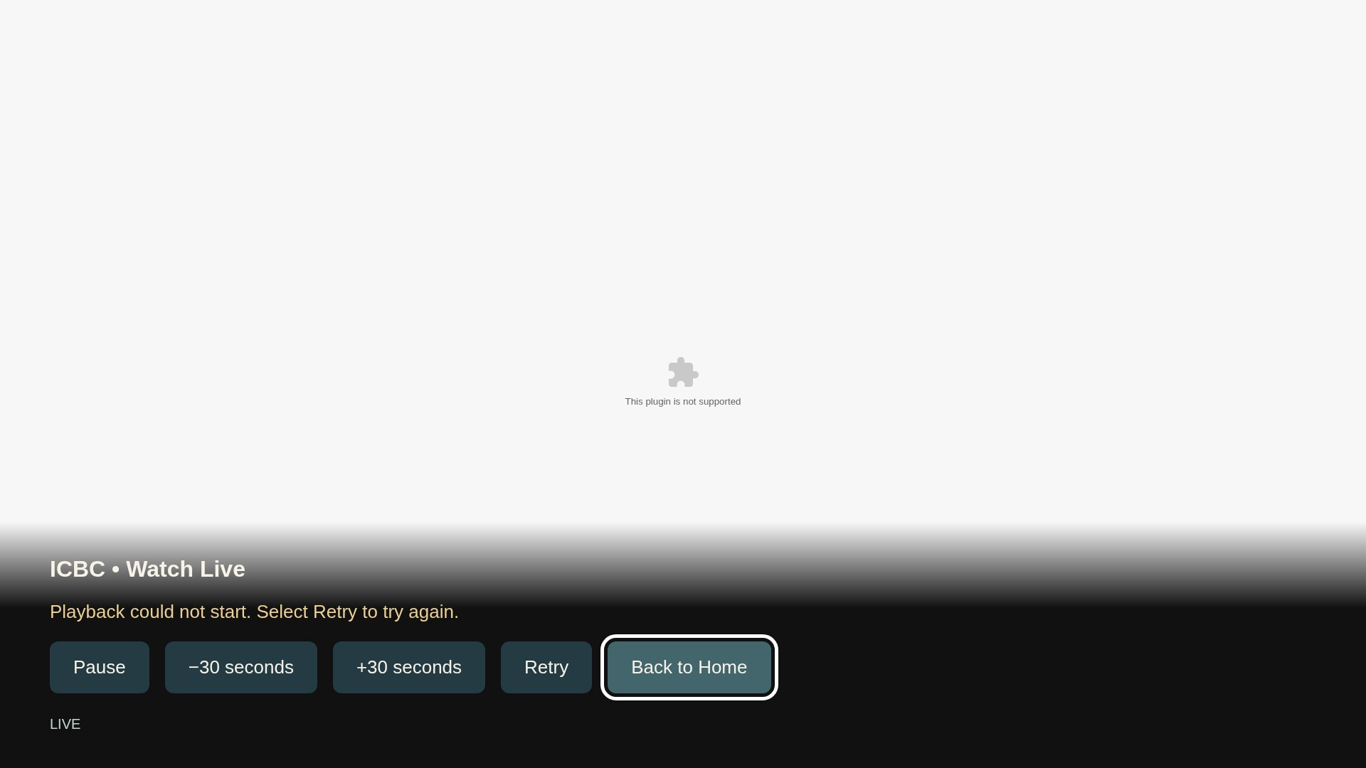
Menus and Functions
App preview images — Player and network recovery
UI element | Function
Pause / Play | Toggle playback
−30 / +30 sec | Archive seek only
Retry | Reconnect video
Back to Home | Stop / return
Status text | Connection/error
Genuine browser capture of the player’s playback-error state on 2026-10-18. No successful playback or video frame is fabricated. Samsung AVPlay, live broadcast availability and physical-TV playback remain unverified.

Slide 15
Contents
UI Structure
Use Cases
Menus and Functions — App preview images
Remote Control Keys
Language Options

Slide 16
Remote Control Keys
RETURN: closes player/restores focus; on Home, opens exit confirmation.
EXIT: platform-defined behavior; the app does not register or override this key.
Key | Action | Remarks
RETURN | Move to previous page. Game applications must show a confirmation popup. | Mandatory. Do not modify.
EXIT | Close the application and show the TV broadcast channel. Game applications must show a confirmation popup. | Mandatory. Do not modify.
ENTER / OK | Activate the focused button or sermon | No full-screen toggle mapping
UP/DOWN/LEFT/RIGHT | Move focus between visible controls | Scroll selected archive item into view
PLAY / PAUSE / PLAY-PAUSE | Control active video | Registered optional media keys
STOP | Close player and return Home | While playing
REWIND / FAST FORWARD | Seek −30 / +30 seconds | Archived content only
CHANNEL / VOLUME / COLORS | No custom app mapping | System behavior retained

Slide 17
Contents
UI Structure
Use Cases
Menus and Functions — App preview images
Remote Control Keys
Language Options

Slide 18
Language Options
The application does not support multiple languages.
The application interface is English. There is no in-app language selector. Sermon titles, speaker fields and date strings are displayed as supplied by the public catalog.
Church service times are Central Time:
Sunday School 9:30 AM; Sunday Worship 10:30 AM.
Wednesday Meal 5:30 PM; Bible Study 6:30 PM.

